Slide 1
Indwelling Urinary Catheter Removal
AHRQ Safety Program for Intensive Care Units:
Preventing CLABSI and CAUTI
Maintaining Catheter Awareness and Prompting Removal
AHRQ Pub. No. 17(22)-0019
April 2022
AHRQ Pub. No. 17-0019-5-EF
March 2018

Slide 2
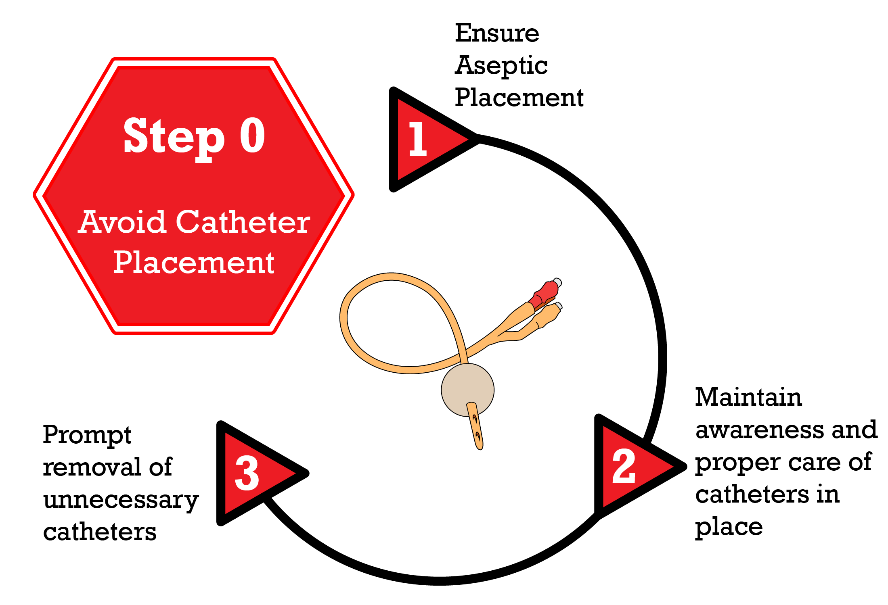
Disrupting the Lifecycle of a Urinary Catheter^{1,2}
Patel PK, Gupta A, Vaughn VM, et al. Review of strategies to reduce central line-associated bloodstream infection (CLABSI) and catheter-associated urinary tract infection (CAUTI) in adult ICUs. J Hosp Med. 8 Nov 2017 [online ahead of print]. Used with permission of Journal of Hospital Medicine.

Slide 3
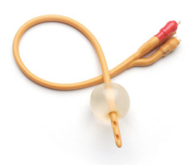
The Problem: Unnecessary Catheter Use³⁻⁵
Urinary catheters are often placed unnecessarily, are in place without physician awareness, and are not removed promptly when no longer needed
10.4% to 32% of inappropriate use of indwelling catheters is in surgical and medical patients
Prolonged catheterization is the number one risk factor for CAUTI
Traditional Steps to Catheter Removal
Provider recognizes catheter is present
Provider recognizes catheter is no longer needed
Provider writes order to remove catheter
Nurse sees order and plans to remove the catheter, or a nurse-driven protocol is present but not being used
Urinary catheter is removed

Slide 4
Socio-Adaptive Challenges To Removal⁶⁻⁸
Communication patterns and catheter use based on unit culture
Nurses’ comfort level and feelings of empowerment with removal protocols
Multi-professional rounding structures and processes that limit inclusion of discussion of catheter
Overlapping responsibility for catheter removal

Slide 5
Strategies To Prompt Catheter Removal⁹⁻¹²
Strategy | Low Tech | High Tech
Reminder: Reminds that a urinary catheter is still in use; may also remind of appropriate indication to continue catheterization | Daily checklist for evaluating urinary catheters Sticker reminder on patient chart or catheter bag Face to face in rounds | Electronic medical record (EMR) reminder Electronic tag for the urinary catheter bag
Stop Order: Prompts removal of urinary catheter based upon specified time after placement (e.g., 24 hours), based upon clinical criteria | Remove in operating room (OR) before leaving Nurse empowered to remove urinary catheters not meeting criteria by default, as part of initial catheter order Preoperative written order to remove urinary catheter on postoperative day 1 or 2, depending on surgery Routine postoperative order | Computerized order for urinary catheter with indications and timed default stop date

Slide 6
Nurse- and Physician-Driven Strategies^{4,12-13}
 | Example Strategy
Physicians | Daily physician assessment of catheter need. Computerized order entry system to prompt physicians to remove/reorder catheter if placed in emergency department (ED) or in place >24 hours. Orders in place for removal in the OR and/or length of time for catheter to remain in place.
Nurses | Nurse-led protocol to remove all urinary catheters that do not meet criteria (nurse empowered). Daily review by nurses for catheter indication to make recommendations for removal (nurse empowered). Nurse-generated daily bedside reminders to encourage physicians to remove unnecessary urinary catheters. Nurse-to-nurse communication during transitions (ED, ICU): “Does this patient have a urinary catheter? Why?” If not indicated, ask for catheter to be removed before transfer.

Slide 7
Team-Driven Strategies: Socio-Adaptive^{5,7-8,14-15}
Multi-professional rounds
Access EMR data during rounds for discussion on indication and duration
Use voice communication technology to assist in making the nurse aware that rounds are occurring on their patient to facilitate participation
Structure communication about devices to include current indication and duration
Culture of Safety and empowerment
Creating a CUSP team or unit multi-professional quality committee to address communication challenges and help build respect among professional
Incorporating Learn From Defects to understand challenges with removal of catheters
Clarifying roles and authority for components of the life cycle of the catheter
Visible nursing leadership supporting nurse-driven protocols and removing obstacles to full implementation

Slide 8
Reminder Example–Low Tech¹⁶
**URINARY CATHETER REMINDER**
Date: ___ ___ / ___ ___ / ___ ___
This patient has had an indwelling urinary catheter since ___ ___ / ___ ___ / ___ ___ .
Please indicate below EITHER (1) that the catheter should be removed, OR (2) that the catheter should be retained. If the catheter should be retained, please state ALL of the reasons that apply.
Please discontinue indwelling urinary catheter; or
Please continue indwelling urinary catheter because patient requires indwelling catheterization for the following reasons (please check all that apply):
Urine volume measurement need:
Hourly urine volume measurement being used to inform and provide treatment AND/OR
Daily urine volume measurement being used to provide treatment AND volume status CANNOT be adequately or reliable assessed without an indwelling urinary catheter
Patient has urologic problem that is being treated with an indwelling urinary catheter
Urine sample that CANNOT be collected by non-catheter method such as urinal, external catheter, ISC
Indwelling urinary catheter is providing comfort from severe distress related to urinary management that cannot be addressed by non-catheter option, ISC, or external catheter
ISC = intermittent straight catheter

Slide 9
Surgical Stop Order Example–High Tech
Electronic Urinary Catheter Protocol
Continue Urinary Catheter Only If:
Patients with urinary catheter inserted by urologist
Urology physician consult (includes pending consults)
Day of surgery if required for procedure (not to exceed 24 hours)
Bladder outlet obstruction
Urologic/perineal procedures if required by surgeon
Continuous bladder irrigation
Movement intolerance due to severe impairment (e.g., severe contractures, pelvic or hip fractures)
Open stage III/IV pressure ulcer to sacrum/perineum AND incontinent and cannot protect wound otherwise
Critically ill patient with titrating vasopressors or receiving massive transfusion of blood products
that require hourly intake and output
Mechanically ventilated patients receiving deep sedation and/or paralytics
Remove Urinary Catheter:
Patient does not meet criteria

Slide 10
Are Catheter Reminders and Stop Orders Effective?¹⁷
In a systematic literature review of 30 studies, including 5 studies of only ICU patients, these interventions reduced CAUTI significantly—by 53%
How many CAUTIs could your unit avoid?
Baseline rate of CAUTI episodes per 1,000 catheter days | Number of avoided CAUTI episodes per 1,000 catheter days anticipated
5 | 2.7 (95% CI 1.8 to 3.5)
10 | 5.3 (95% CI 3.6 to 7.0)
20 | 10.6 (95% CI 7.3 to 13.9)
CI = confidence interval
However, catheter reminders or stop orders were only used in about 50% of hospitals

Slide 11
ICU and Peri-Procedural Protocols^{10,18-22}
Setting | Strategy
ICU | Daily checklists used in multi-professional rounds Daily urinary catheter rounds in ICU by nurses Nurse-empowered stop orders Daily nurse review for indications and removal if appropriate via nurse-driven protocol Daily assessment required by physicians of catheter need
Peri-Procedure | Procedure-specific protocols for catheter placement and post-op stop orders.

Slide 12
Clinical Case for Discussion: Mr. Jones
Mr. Jones, a 57-year-old male, has been in the surgical ICU for 24 hours status post an esophagectomy with esophagogastrostomy for adenocarcinoma of mid-esophagus. His BP is 130/80, pulse is 82, and he is on pressure support ventilation. Urine output averages 80 cc/hr. Can the urinary catheter be removed?
No, because the indwelling urinary catheter is needed to measure hourly urine output
No, because the patient had a major thoracic procedure
No, because he is still on a mechanical ventilator
Yes, because hourly urine output is no longer needed to guide his care
Disclaimer: All case studies are hypothetical and not based on any actual patient or hospital information. Any similarity between a case study and actual patient or hospital experience is purely coincidental.

Slide 13
Removing Urinary Catheter in Surgical Patients²³⁻²⁸
Consider using the Michigan Appropriate Perioperative criteria (MAP) criteria for general and orthopedic procedures to determine appropriateness. OR procedures are placed into 3 groups: placement should be avoided, consider removing in the OR, use in the OR and post-op day 1 removal
Standardizing postoperative catheter removal is critical to reducing catheter use
Catheters for OR procedures (such as laparoscopic with suprapubic port) can be removed before leaving the OR. Discuss OR catheter removal during the third surgical timeout/debrief before that patient leaves the OR
Patients with thoracic epidural catheters can have urinary catheters removed, often within 48 hours after surgery
Use mobilization and sedation vacation to prevent urinary retention while epidurals are in place and once epidurals are removed

Slide 14
Safe Surgical Checklist Example^{25,28}
Consider incorporating the question, “Do we need a catheter for this procedure based on the MAP criteria?”
Surgical checklists include a “Procedure Time Out” of tasks to perform before the patient leaves the OR
This “Procedure Time-Out” can include this question:
Can invasive lines or catheters (including urinary) be removed?
 Yes  No
If No, when?
PACU (post-anesthesia care unit)
Postoperative Day 1
Other: ___________
WHO Surgical Safety Checklist⁴⁶

Slide 15
Clinical Case for Discussion: Mr. Grant
Mr. Grant is a 66-year-old man admitted to the ICU with fluid overload from congestive heart failure and renal insufficiency. He initially required a diuretic drip but is now clinically much improved with intermittent diuretic dosing. He is getting transferred to the floor today. Does he need an indwelling urinary catheter?
Yes, because all patients on diuretics need a urinary catheter
Yes, because the floor physician will use hourly urine output to guide diuretic dosing
No, as long as Mr. Grant is able to urinate by other means (urinal, external catheter, or bladder scanning and intermittent catheterization), the staff can measure urine output/volume status without a catheter (such as by daily standing weights)
Yes, because the urinary catheter will decrease Mr. Grant’s risk of falling when getting up to urinate frequently
Disclaimer: All case studies are hypothetical and not based on any actual patient or hospital information. Any similarity between a case study and actual patient or hospital experience is purely coincidental.

Slide 16
Pearls and Pitfalls of Reminders and Stop Orders⁵
Pearls
Tailor reminder type to care setting (stickers, electronic, etc.) and develop automated, timed reminders/stop order
Embed appropriate indications to guide catheter use in the EMR
Remember to include catheter alternatives
Empower nurses to remove without obtaining additional order from physician team
Use periodic audits, such as “catheter rounds” by nurse leadership, to verify appropriateness and improve implementation of catheter removal strategies
Display at the bedside catheter data to help prompt removal or easily located in the EMR for discussion at handoff and multi-professional rounds
Engage the patient and family in understanding importance of removal and engaging in the process
Pitfalls
Reminders may be ignored, particularly ill-timed EMR alerts
EMRs may make ordering catheter alternative difficult
Employ strategies that combine the use of electronic reminders and socio-adaptive strategies to improve buy-in and implementation

Slide 17
Factors That Affect Success of Reminders and Stop Orders^{4-5,7-8}
Communication patterns and unit culture relative to urinary catheter use
Nurse comfort with urinary catheter removal protocols
Staff knowledge and skills
Respect among nurses and physicians
Ownership by frontline staff, local leadership, and quality staff to review, remind, and reinforce using Root Cause Analysis or Learn From Defects
Information technology support for data collection
Feedback using data on catheter use
ICU team’s recognition of the hazard of urinary catheters

Slide 18
Take-Home Points
Reminders and stop orders can improve awareness of urinary catheters and prompt removal of unnecessary urinary catheters
There are many low-tech and high-tech strategies to implement removal prompts and stop orders
Nurse and physician “buy-in” is extremely important in overcoming barriers to removing unnecessary urinary catheters
Sustaining improvements requires monitoring and feedback on urinary catheter use and rates
Including catheter removal in routine clinical nurse-to-physician discussions can improve and sustain implementation

Slide 19
References
Meddings J, Saint S. Disrupting the life cycle of the urinary catheter. Clin Infect Dis. 2011 Jun;52(11):1291-3. PMID: 21596672.
Patel PK, Gupta A, Vaughn VM, et al. Review of strategies to reduce central line-associated bloodstream infection (CLABSI) and catheter-associated urinary tract infection (CAUTI) in adult ICUs. J Hosp Med. 2018;13(2):105-16. PMID: 29154382.
Laan BJ, Vos MC, Maaskant JM, et al. Prevalence and risk factors of inappropriate use of intravenous and urinary catheters in surgical and medical patients. Journal of Hospital Infection. 2020;105(4):698-704. PMID: 32422310.
Meddings J, Rogers MA, Krein SL, et al. Reducing unnecessary urinary catheter use and other strategies to prevent catheter-associated urinary tract infection: an integrative review. BMJ Qual Saf. 2014;23(4):277-89. doi:10.1136/bmjqs-2012-001774. PMID: 24077850.
Quinn M, Ameling JM, Forman J, et al. Persistent barriers to timely catheter removal identified from clinical observations and interviews. Jt Comm J Qual Patient Saf. 2020;46(2):99-108. PMID: 31879072.
Lo E, Nicolle L, Coffin S, et al. Strategies to prevent catheter-associated urinary tract infections in acute care hospitals: 2014 update. Infect Control Hosp Epidemiol. 2014;35(5):464-79. doi:10.1086/675718. PMID: 24709715.
Niederhauser A, Zullig S, Marschall J, et al. Change in staff perspectives on indwelling urinary catheter use after implementation of an intervention bundle in seven Swiss acute care hospitals: results of a before/after survey study. BMJ. 2019;9(10):e028740. PMID: 31662357.
Schiessler MM, Darwin LM, Phipps AR, et al. Don’t have a doubt, get the catheter out: a nurse-driven CAUTI prevention protocol. Pediatr Qual Saf. 2019:4(4):e183. PMID: 31572885.
Adams D, Bucior H, Day G, et al. HOUDINI: make that urinary catheter disappear – nurse-led protocol. J Infect Prev. 2012;13:44-6.
Knoll BM, Wright D, Ellingson L, et al. Reduction of inappropriate urinary catheter use at a Veterans Affairs hospital through a multifaceted quality improvement program. Clin Infect Dis. 2011; 52(11):1283-90. PMID: 21596671.

Slide 20
References
Agency for Healthcare Research and Quality. Appendix M. Example of a Nurse-Driven Protocol for Catheter Removal. http://www.ahrq.gov/professionals/quality-patient-safety/hais/cauti-tools/impl-guide/implementation-guide-appendix-m.html. Accessed November 2, 2021.
Blodgett TJ. Reminder systems to reduce the duration of indwelling urinary catheters: a narrative review. Urol Nurs. 2009;29(5):369-79. PMID: 19863044.
Giles M, Graham L, Ball J, et al. Implementation of a multifaceted nurse-led intervention to reduce indwelling urinary catheter use in four Australian hospitals: a pre- and post intervention study. J Clin Nurs. 2020;29(5-6):872-86. PMID: 31856344.
Agency for Healthcare Research and Quality. Resident Physicians as Champions in Preventing Device-Associated Infections. Content last reviewed October 2015. https://www.ahrq.gov/hai/cauti-tools/phys-championsgd/index.html. Accessed November 2, 2021.
Agency for Healthcare Research and Quality. Oversee Unit-Based Operations. http://www.ahrq.gov/professionals/education/curriculum-tools/cusptoolkit/videos/09b_overseeubops/index.html. Accessed November 2, 2021.
Meddings J, Saint S, Fowler KE, et al. The Ann Arbor criteria for appropriate urinary catheter use in hospitalized medical patients: Results obtained by using the RAND/UCLA appropriateness method. Ann Intern Med. 2015 May 5;162(9 Suppl):S1-34. doi: 10.7326/M14-1304. PMID: 25938928.
Meddings J, Rogers MA, Macy M, et al. Systematic review and meta-analysis: reminder systems to reduce catheter-associated urinary tract infections and urinary catheter use in hospitalized patients. Clin Infect Dis. 2010;51:550–60. PMID: 20673003.
Kranz J, Schmidt S, Wagenlehner F, Schneidewind L. Catheter-associated urinary tract infections in adult patients. Dtsch Arztebl Int. 2020;117(6):83-8. PMID: 32102727.
Roser L, Altpeter T, Anderson D, et al. A nurse driven Foley catheter removal protocol proves clinically effective to reduce the incidents of catheter related urinary tract infections. Am J Infect Control. 2012;40:e92-3 (Abstract).
Titsworth WL, Hester J, Correia T, et al. Reduction of catheter-associated urinary tract infections among patients in a neurological intensive care unit: a single institution's success. J Neurosurg. 2012 Apr;116:911-20. PMID: 22224785.

Slide 21
References
Robertson N, Gallacher P, Peel N, et al. Implementation of an enhanced recovery programme following pancreaticoduodenectomy. HPB (Oxford). 2012 Oct;14(10):700-8. PMID: 22954007.
Prasad SM, Large MC, Patel AR, et al. Early removal of urethral catheter with suprapubic tube drainage versus urethral catheter drainage alone after robot-assisted laparoscopic radical prostatectomy. J Urol. 2014 Jul;192(1):89-95. PMID: 24440236.
Minig L, Chuang L, Patrono M, et al. Clinical outcomes after fast-track care in women undergoing laparoscopic hysterectomy. Int J Gynaecol Obstet. 2015 Dec;131(3):301-4. PMID: 26386495.
Khoury W, Dakwar, A, Sivkovits K, et al. Fast-track rehabilitation accelerates recovery after laparoscopic colorectal surgery. SLS. 2014 Oct-Dec;18(4). PMID: 25489207.
Zaouter C, Quattara A. How long is a transurethral catheter necessary in patients undergoing thoracotomy and receiving thoracic epidural analgesia? Literature review. J Cardiothorac Vasc Anesth. 2015 Apr;29(2):496-501. PMID: 25287748.
WHO Surgical Safety Checklist. World Health Organization. 2009. http://www.who.int/patientsafety/safesurgery/checklist/en/index.html. Accessed on November 2, 2021.
The best catheter is one that's out. Protocol sets first call for removal in OR. Hosp Peer Rev. 2015;40(9):91-2. http://www.ahcmedia.com/articles/136091-the-best-catheter-is-one-thats-out. Accessed November 2, 2021.
Meddings J, Skolarus TA, Fowler KE, et al. Michigan Appropriate Perioperative (MAP) criteria for urinary catheter use in common general and orthopaedic surgeries: results obtained using the RAND/UCLA Appropriateness Method. BMJ Quality & Safety 2019;28:56-66. PMID: 30100564.

