Slide 1
Urine Culturing Stewardship in the ICU Setting
AHRQ Safety Program for Intensive Care Units: Preventing CLABSI and CAUTI
AHRQ Pub. No. 17(22)-0019
April 2022

Slide 2
Case Study: To Culture or Not To Culture…
Ms. Allen, a 65-year-old woman, has atrial fibrillation on warfarin, and multiple sclerosis complicated by urine retention with a chronic indwelling urinary catheter. She was admitted to telemetry 4 days ago due to elevated INR and to adjust her cardiac meds for better HR control. Ms. Allen was well until 3 hours ago when she had an upper GI bleed, while her INR is 5.3.
She is admitted to the ICU; her temp is 100.8°F during blood transfusion, HR 130, RR 22, BP 97/42. WBC is 11/mcL and her Hgb is now 7.6 g/dL.
Exam shows cloudy urine in her catheter tubing.
Should she have a urinalysis and urine culture?
Abbreviations: BP = blood pressure; GI = gastrointestinal; Hgb = hemoglobin; HR = heart rate; ICU = intensive care unit; INR = international normalized ratio; RR = respiration rate; WBC = white blood cell.
Disclaimer: All case studies are hypothetical and not based on any actual patient or hospital information. Any similarity between a case study and actual patient or hospital experience is purely coincidental.

Slide 3
What Is Urine Culture Stewardship?¹⁻⁵
Ordering urine cultures thoughtfully, so they inform (not misinform) the care of individual patients
Ordering
Indication for urine based on patient evaluation?
Collecting
Standardization of specimen collection
Intervening
Treatment decision: Provide providers with guidance around test interpretation and treatment?

Slide 4
Why Is Appropriate Urine Testing Important?^{2,6-10}
Urinalysis and culture are only meaningful in the presence of signs or symptoms of infection
WBCs can be found in the urine for many reasons besides infection
Bacteriuria in catheterized patients increases 3 to 8% daily
Asymptomatic bacteriuria (ASB) is the bacterial colonization of the urine, which does not typically lead to infection or require treatment
ASB occurs as much as 50% of the time in patients with an indwelling urinary catheter.
Practitioners may unnecessarily treat a positive urinalysis or urine culture
Urinalysis can rule out CAUTI but cannot rule in CAUTI
Note: There are some exceptions to rules about treating ASB, such as pregnancy and urologic procedures, but they are rare in the ICU.

Slide 5
CAUTI Signs and Symptoms^{6,11-12}
Presence of symptoms suggestive of a urinary tract infection (UTI). For example:
Flank pain or costovertebral angle tenderness
acute hematuria
new pelvic discomfort
Fever/rigors
New-onset or worsening sepsis without evidence of another source on history, physical examination, or laboratory testing
Fever or altered mental status without evidence of another source on history, physical examination, or laboratory testing
In spinal cord injury patients: increased spasticity, autonomic dysreflexia, sense of unease

Slide 6
Inappropriate Triggers for Culturing Urine in Catheterized Patients Without Other Symptoms^{3,6}
Urine characteristics
Foul odor
Cloudy urine
Dark urine
Urine sediment
Pyuria (pus in the urine)
Urinary catheter present on admission
During catheter insertion

Slide 7
Survey of Doctors and Nurses for Indications to Urine Culture¹³
Order Indication | Physicians | Nurses
Appearance | 23% | 61%
Odor | 42% | 74%
Dysuria | 54% | 35%
Pan culture | 38% | 45%
UA > 100 WBCs/hpf | 58% | 43%

Slide 8
Patient Evaluation Before Urine Culturing in the Presence of a New Fever in an ICU Patient¹
Questions to ask before culturing urine | Yes | No
Are there clear signs/symptoms of a UTI?
Is sepsis suspected and without a clear source?
Is there a current urinary obstruction?
Has the patient had recent urologic manipulation such as trauma to the GU tract or surgery?
Is the patient granulocytopenic?
Abbreviations: GU = genitourinary; UTI = urinary tract infection.
If “YES” to any of these and the patient is without another reasonable cause for fever, a urine culture is appropriate¹

Slide 9
Technical & Socio-Adaptive Strategies for Diagnostic Stewardship^{4,14-16}
Intervention Type | Diagnostic Stewardship Interventions for Urine Culturing
Treatment guidelines coupled with provider education | Develop institution-specific guidelines based on evidence for correct urine culturing technique and treatment of CAUTI’s Provide education to providers & nurses Actively review urine culture orders and peer feedback
Require clinical indication when placing order | Build hard stops in EHR that require entering indications before ordering culture
Correct specimen collection technique | Nurse training on correct technique Urine culture specimens with preservative
Provide providers with guidance around test interpretation | EHR comment that with positive culture advise providers about management of ASB
Restrict reporting of urine culture results | Report urine culture as mixed if > 3 organisms with no further information Release details of urine culture results only upon request Selectively suppress antimicrobial results or use cascade reporting
Adapted from Claeys KC, Blanco N, Morgan DJ, et al. Advances and challenges in the diagnosis and treatment of urinary tract infections: the need for diagnostic stewardship. Curr Infect Dis Rep. 2019;21(4):11.

Slide 10
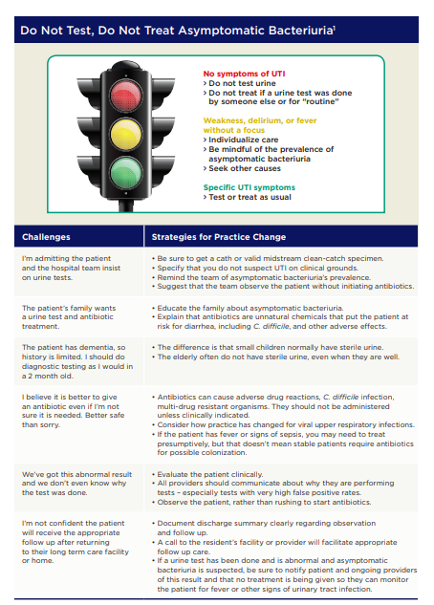
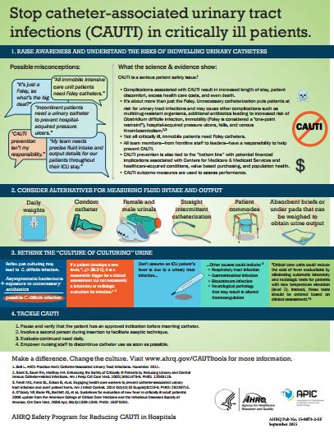
The Educational Campaign^{4-5,14,17-18}
Educate physicians
Educate nurses
Create unitwide tools
Target new staff
Create periodic reminders
Massachusetts Infection Prevention Partnership. Treating asymptomatic bacteriuria: all harm, no benefit. 2013. Used with permission.

Slide 11
Technical & Socio-Adaptive Strategies for Diagnostic Stewardship^{4,14-16}
Intervention Type | Diagnostic Stewardship Interventions for Urine Culturing
Treatment guidelines coupled with provider education | Develop institution-specific guidelines based on evidence for correct urine culturing technique and treatment of CAUTIs Provide education to providers & nurses Actively review urine culture orders and peer feedback
Require clinical indication when placing order | Build hard stops in EHR that require entering indications before ordering culture
Correct specimen collection technique | Nurse training on correct technique Urine culture specimens with preservative
Provide providers with guidance around test interpretation | EHR comment that with positive culture advise providers about management of ASB
Restrict reporting of urine culture results | Report urine culture as mixed if > 3 organisms with no further information Release details of urine culture results only upon request Selectively suppress antimicrobial results or use cascade reporting
Adapted from Claeys KC, Blanco N, Morgan DJ, et al. Advances and challenges in the diagnosis and treatment of urinary tract infections: the need for diagnostic stewardship. Curr Infect Dis Rep. 2019;21(4):11.

Slide 12
Making the EHR Work for You^{3,15,19-24}
Establish a preculture strategy that directs efforts at how cultures are ordered rather than solely addressing issues after a UA or urine culture test is finalized:
Modify the electronic medical record to include appropriate indications for urine cultures in catheterized patients that address patient symptomology
Suprapubic pain/tenderness
Acute gross hematuria
Costovertebral angle tenderness
New fever/rigors with clinical assessment negative for more likely etiology
Acute alteration of mental status with clinical assessment negative for more likely etiology
Alteration in medical condition with clinical assessment negative for more likely etiology in patient in whom fever may not be a reliable sign
Increased spasticity or autonomic dysreflexia in patients with altered neurologic sensation
Eliminate automatic orders in care plans where appropriate
Three-day hard stop on reordering a culture
Reflex urine testing should be considered only if used in conjunction with careful clinical evaluation for signs and symptoms of UTI

Slide 13
Technical & Socio-Adaptive Strategies for Diagnostic Stewardship^{4,14-16}
Intervention Type | Diagnostic Stewardship Interventions for Urine Culturing
Treatment guidelines coupled with provider education | Develop institution specific guidelines based on evidence for correct urine culturing technique and treatment of CAUTIs Provide education to providers and nurses Actively review urine culture orders and peer feedback
Require clinical indication when placing order | Build hard stops in EHR that require entering indications before ordering culture
Correct specimen collection technique | Nurse training on correct technique Urine culture specimens with preservative
Provide providers with guidance around test interpretation | EHR comment that with positive culture advise providers about management of ASB
Restrict reporting of urine culture results | Report urine culture as mixed if > 3 organisms with no further information Release details of urine culture results only upon request Selectively suppress antimicrobial results or use cascade reporting
Adapted from Claeys KC, Blanco N, Morgan DJ, et al. Advances and challenges in the diagnosis and treatment of urinary tract infections: the need for diagnostic stewardship. Curr Infect Dis Rep. 2019;21(4):11.

Slide 14
Collection & Transport To Reduce Contamination^{3,24-27}
If a catheter placed > 2 weeks, change the catheter before collecting a specimen.
Kink tubing 12 inches below sample port, allowing urine to fill the tube. Scrub the hub with antiseptic aspiration from the sampling port. Follow by unkinking the tube.
If specimen can’t be transported and plated on culture medium within 2 hours of collection, specimen should be refrigerated, or consider not using.
Consider using preservative in the tube!
To overcome logistic barriers: use urine collection tubes with preservatives.
Contaminated urine cultures lead to additional diagnostic evaluation and inappropriate antibiotic administration > 40%²⁴
AHRQ Safety Program for ICUs: Preventing CLABSI and CAUTI

Slide 15
Technical & Socio-Adaptive Strategies for Diagnostic Stewardship^{4,14-16}
Intervention Type | Diagnostic Stewardship Interventions for Urine Culturing
Treatment guidelines coupled with provider education | Develop institution specific guidelines based on evidence for correct urine culturing technique and treatment of CAUTIs Provide education to providers and nurses Actively review urine culture orders and peer feedback
Require clinical indication when placing order | Build hard stops in EHR that require entering indications before ordering culture
Correct specimen collection technique | Nurse training on correct technique Urine culture specimens with preservative
Provide providers with guidance around test interpretation | EHR comment that with positive culture advise providers about management of ASB
Restrict reporting of urine culture results | Report urine culture as mixed if > 3 organisms with no further information Release details of urine culture results only upon request Selectively suppress antimicrobial results or use cascade reporting
Adapted from Claeys KC, Blanco N, Morgan DJ, et al. Advances and challenges in the diagnosis and treatment of urinary tract infections: the need for diagnostic stewardship. Curr Infect Dis Rep. 2019;21(4):11.

Slide 16
Current Status of Urine Stewardship²⁰
Survey: 122 acute care facilities in the United States
Urine culture diagnostic stewardship practices
Intervention | % Present
Published indications for ordering urine cultures | 44%
Indications entered into EHR | 17%
Labs offered reflex cultures at the top of the order or prechecked | 66%
Ordered urine culture without your analysis | 96%
Labs proceed with culture even with the delay in transport | 39%
Use preservatives in urine collection tubes | 35%
Report mixture urine culture with no organism workup with three or more pathogens | 90%

Slide 17
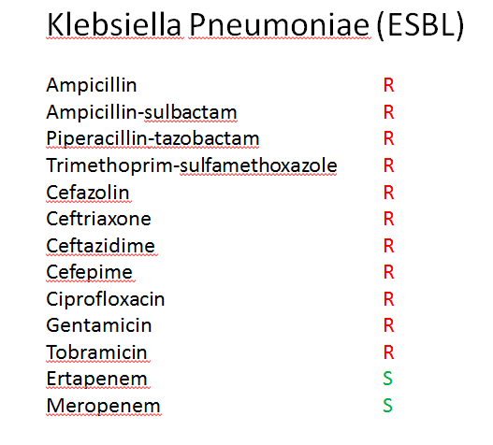
“It’s a Harmless Urine Culture”
Abbreviations: R = resistant; S = susceptible

Slide 18
Why Is Inappropriate Culturing of Urine a Problem?
Harm
Overinflated CAUTI rates
Lower CMS* reimbursement
Inappropriate treatment
Exposes patient to drug allergies, renal failure
Increased cost
of care
Antibiotic overuse/CDI
More resistant organisms
Correct diagnosis missed
*CMS = Centers for Medicare & Medicaid Services

Slide 19
Implementing Culturing Stewardship²⁸
Beliefs and Habits
Pyuria or bacteriuria = UTI
Pre-emptive culturing
Pan culturing
Target with education, use of peer-to-peer feedback audits
Relationships
Nurse input
Attending approval
Involve nurse in decisions
Promote “speak up” culture and collaboration
Require attending approval of urine cultures
Include infection preventionist on team rounds
Connect with lab on how cultures are reported
Ordering Process
Fever order sets
Indication-based ordering
UA first approach
Improve CPOE order sets to require indication
“Guidance at point of care”
Harms of Misdiagnosis
Unnecessary treatment: Antibiotic resistance, allergies, C. diff
Increased cost, non-reimbursement
Publicize adverse events to increase engagement; keep personal
Abbreviations: C. diff = Clostridium difficile; CPOE = computerized physician order entry

Slide 20
Additional Solutions
Periodically audit urine culturing practices
Follow up with ordering provider if culture was inappropriate
Avoid reflexive screening
Urine cultures upon admission
Automatic urine tests when catheters are inserted
Pan culture fever workups
Reflex culture performed without patient symptoms
Write a proper fever protocol

Slide 21
Communication Pearls
Encourage a real patient evaluation for fever and thoughtful culturing
If a provider wants orders followed without discussion—
“[provider name], the CAUTI committee, chaired by your partner, met and developed this new practice pathway around the culture of culturing and shows the best evidence for culturing to protect our ICU patients from drug-resistant bacteria."
If skeptical staff think it is just about avoiding penalties—
“Yes, this does help us avoid penalties, but more importantly, it’s what is best to prevent harm to the patient.”

Slide 22
Back to the Case²
What about Ms. Allen, who was admitted for an upper GI bleed from warfarin with a chronic indwelling urinary catheter and cloudy urine?
She should NOT have had a culture, because her findings were due to bleeding, and screening urine tests on admission are inappropriate, even with an indwelling urinary catheter.² Cloudy urine does not predict CAUTI.
However, a urinalysis was sent, and this hospital performs reflex cultures.
Disclaimer: All case studies are hypothetical and not based on any actual patient or hospital information. Any similarity between a case study and actual patient or hospital experience is purely coincidental.

Slide 23
Take-Home Points
Do not order a urine culture if the patient is asymptomatic
Educate staff on potential harms of inappropriate culturing and how to assess urine culture need
Incorporate cues for culturing practices into the EHR
Assess urine culturing practices in your unit through audits and evaluation
If the catheter is in place less than 2 weeks, change out prior to obtaining a culture
Ensure all staff feel free to speak up and share accountability for responsible urine culturing

Slide 24
References
O’Grady NP, Barie PS, Bartlett JG, et al. Guidelines for evaluation of new fever in critically ill adult patients: 2008 update from the American College of Critical Care Medicine and the Infectious Diseases Society of America. Crit Care Med. 2008;36(4):1330-49. PMID: 18379262.
Agency for Healthcare Research and Quality. Urine Culture Practices in the ICU; Antibiotic Stewardship; Practical ICU Tools; Using Results from the Safety Culture Surveys. https://www.ahrq.gov/hai/cauti-tools/archived-webinars/urine-culture-practices-icu-video.html. Accessed November 6, 2021.
Garcia R, Spitzer E. Promoting appropriate urine culture management to improve health care outcomes and the accuracy of catheter-associated urinary tract infections. Am J Infect Control. 2017;45(10):1143-53. PMID: 28476493.
Claeys KC, Blanco N, Morgan DJ, et al. Advances and challenges in the diagnosis and treatment of urinary tract infections: the need for diagnostic stewardship. Curr Infect Dis Rep. 2019;21(4):11. PMID: 30834993.
Meddings J, Manojlovich M, Ameling J, et al. Quantitative results of a national intervention to prevent hospital-acquired catheter-associated urinary tract infection: a pre-post observational study. Ann Intern Med. 2019;171(7_Suppl):S38-S44. PMID: 31569231.
Nicolle LE, Gupta K, Bradley SF, et al. Clinical Practice Guideline for the Management of Asymptomatic Bacteriuria: 2019 Update by the Infectious Diseases Society of America. Clin Infect Dis. 2019;68(10):e83-e110. PMID: 30895288.
Hartstein AI, Garber SB, Ward TT, et al. Nosocomial urinary tract infection: a prospective evaluation of 108 catheterized patients. Infect Control. 1981;(5):380-6. PMID: 6795141.
Classen DC, Larsen RA, Burke JP, et al. Prevention of catheter-associated bacteriuria: clinical trial of methods to block three known pathways of infection. Am J Infect Control. 1991;19(3):136-42. PMID: 1863002.
Warren JW, Damron D, Tenney JH, et al. Fever, bacteremia, and death as complications of bacteriuria in women with long-term urethral catheters. J Infect Dis. 1987;155(6):1151-8. PMID: 3572035.
Magill SS, Edwards JR, Beldavs ZG, et al. Prevalence of antimicrobial use in US acute care hospitals, May-September 2011. JAMA. 2014;312(14):1438-46. PMID: 25291579.
Hooton TM, Bradley SF, Cardenas DD, et al. Diagnosis, prevention, and treatment of catheter-associated urinary tract infection in adults: 2009 International Clinical Practice Guidelines from the Infectious Diseases Society of America. Clin Infect Dis. 2010;50(5):625-63. PMID: 20175247.
Watson KJ, Trautner B, Russo H, et al. Using clinical decision support to improve urine culture diagnostic stewardship, antimicrobial stewardship, and financial cost: a multicenter experience. Infect Control Hosp Epidemiol. 2020;41(5):564-570. PMID: 32131910.
Advani SD, Fakih MG. The evolution of catheter-associated urinary tract infection (CAUTI): Is it time for more inclusive metrics? Infect Control Hosp Epidemiol. 2019;40(6):681-685. PMID: 30915925.
Petty LA, Vaughn VM, Flanders SA, et al. Risk factors and outcomes associated with treatment of asymptomatic bacteriuria in hospitalized patients. JAMA Intern Med. 2019;179(11):1519-27. PMID: 31449295.
Lin G, Knowlson S, Nguyen H, et al. Urine test stewardship for catheterized patients in the critical care setting: provider perceptions and impact of electronic order set interventions. Am J Infect Control. 2019;47(10):1277-79. PMID: 31128982.

Slide 25
References
Daniel GW, Schneider M, McClellan MB. Addressing antimicrobial resistance and stewardship: the priority antimicrobial value and entry (PAVE) award. JAMA. 2017;318(12):1103-4. PMID: 28772301.
Massachusetts Infection Prevention Partnership. Treating Asymptomatic Bacteriuria: All Harm, No Benefit. http://macoalition.org/Initiatives/infections/uti_2013/tools/ED_Detailing%20Sheet.pdf. Accessed November 6, 2021.
Agency for Healthcare Research and Quality. Intensive Care Unit Infographic Poster. http://www.ahrq.gov/professionals/quality-patient-safety/hais/cauti-tools/impl-guide/implementation-guide-appendix-l.html. Accessed November 6, 2021.
Shirley D, Scholtz H, Osterby K, et al. Optimizing inpatient urine culture ordering practices using the electronic medical record: a pilot study. Am J Infect Control. 2017;38(4):486-8. PMID: 28025951.
Sullivan KV, Morgan DJ, Leekha S. Use of diagnostic stewardship practices to improve urine culturing among SHEA research network hospitals. Infect Control Hosp Epidemiol. 2019;40(2):228-31. PMID: 30522544.
Coughlin RF, Peaper D, Rothenberg C, et al. Electronic health record-assisted reflex urine culture testing improves emergency department diagnostic efficiency. Am J Med Qual. 2020;35(3):252-7. PMID: 31296024.
Howard-Anderson, JR, Ashraf S, Overton EC, et al. Sustained decrease in urine culture utilization after implementing a reflex urine culture intervention: a multicenter quasi-experimental study. Infect Control Hosp Epidemiol. 2020;41(3):369-71. PMID: 31996274.
Mullin KM, Kovacs CS, Fatica C, et al. A multifaceted approach to reduction of catheter-associated urinary tract infections in the intensive care unit with an emphasis on “stewardship of culturing.” Infect Control Hosp Epidemiol. 2017;38(2):186-8. PMID: 27852357.
Association for Professionals in Infection Control and Epidemiology. APIC Implementation Guide: Guide to Preventing Catheter-Associated Urinary Tract Infections. https://apic.org/wp-content/uploads/2019/02/APIC_CAUTI_IG_FIN_REVD0815.pdf. Accessed November 6, 2021.
Klausing BT, Tillman SD, Wright PW, et al. The influence of contaminated urine cultures in inpatient and emergency department settings. Am J Infect Control. 2016;44(10):1166-7. PMID: 27311512.
Davies PE, Daley MJ, Hecht J, et al. Effectiveness of a bundled approach to reduce urinary catheters and infection rates in trauma patients. Am J Infect Control. 2018;46(7):758-63. PMID: 29397230.
Drekonja DM, Grigorya L, Lichtenberger P, et al. Teamwork and safety climate affect antimicrobial stewardship for asymptomatic bacteriuria. Infect Control Hosp Epidemiol. 2019;40(9):963-7. PMID: 31339085.
National Healthcare Safety Network (NHSN). Patient Safety Component Manual: Chapters 2 and 7. https://www.cdc.gov/nhsn/pdfs/pscmanual/pcsmanual_current.pdf. Accessed November 6, 2021.

