Slide 1
AHRQ Safety Program for MRSA Prevention
Optimizing Environmental Cleaning
ICU & Non-ICU
AHRQ Pub. No. 25-0007
October 2024

Slide 2
Educational Objectives
Discuss why environmental cleaning is critical.
Understand the current state of knowledge regarding environmental cleaning.
Explore interacting facets of environmental cleaning.

Slide 3
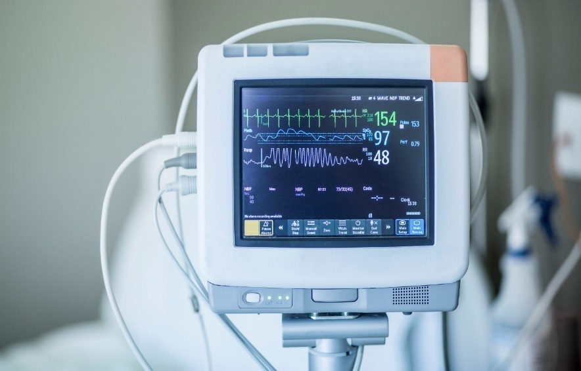
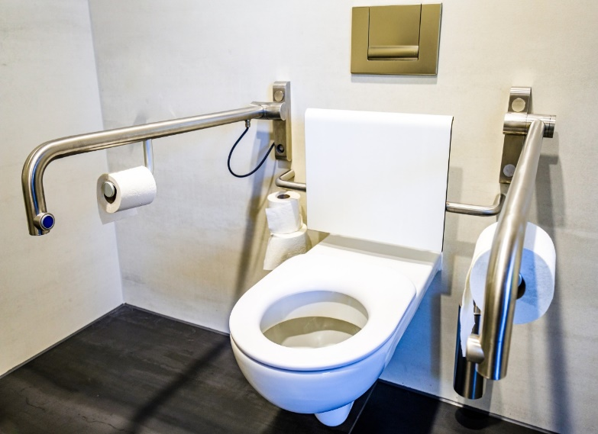
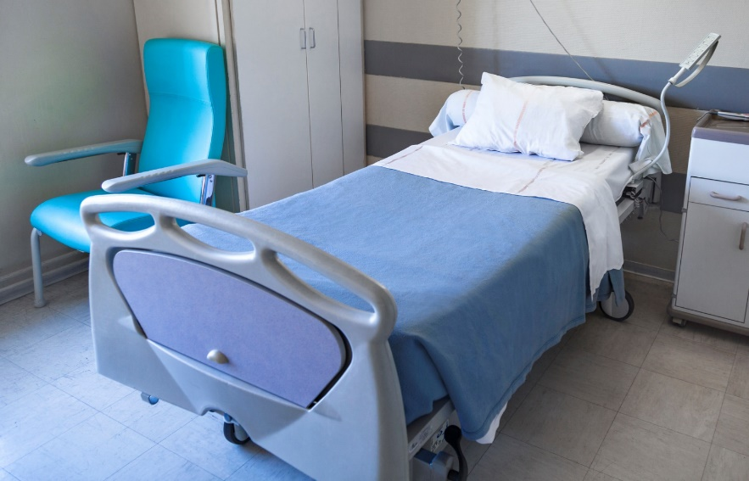
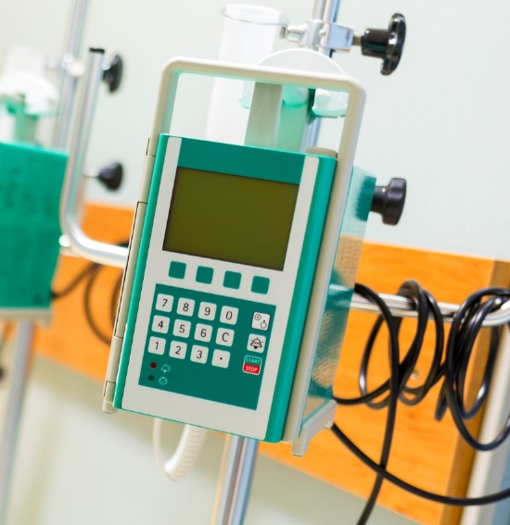
MRSA And Other Pathogens on Hospital Surfaces
The hospital environment is commonly contaminated with pathogens such as the following:
  Methicillin-resistant Staphylococcus aureus (MRSA)¹
  Clostridioides difficile^{2,3}
Examples of high-touch surfaces:⁴
  Intravenous poles
  Bedrails
  Over-bed tables

Slide 4
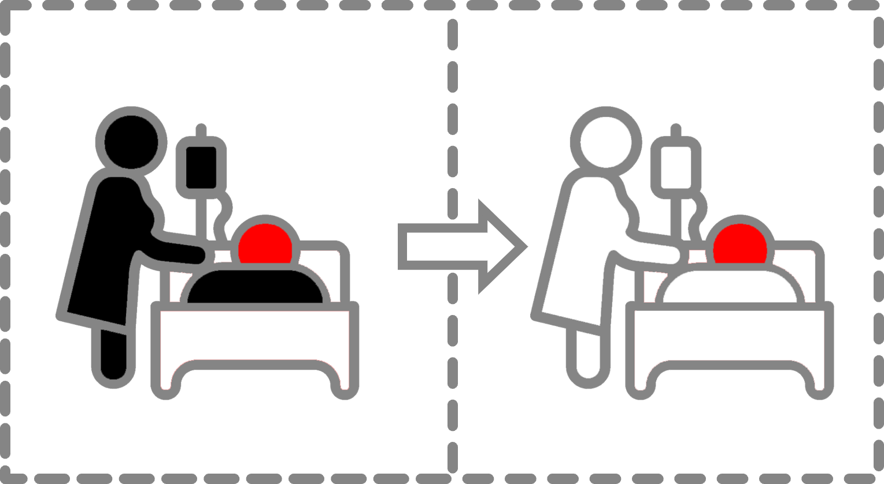
Transmission From Environment to Patient⁵
A 2023 meta-analysis by Gu et al. examined the risk of acquisition of multidrug-resistant organisms (MDRO) from prior bed occupants in the ICU.
Results found that prior bed occupancy by someone infected or colonized with an MDRO increases the odds of MDRO acquisition in subsequent bed occupants by 1.8 in the ICU.

Slide 5
Additional Studies on Transmission From Environment to Patient
Study | Organism | Location | Results
Cohen et al.⁶ | Staphylococcus aureus Acinetobacter baumannii Streptococcus pneumoniae Pseudomonas aeruginosa Klebsiella pneumoniae Enterococcus faecalis Enterococcus faecium | 4 hospitals | Previous bed occupant with the same organism: Odds, 5.83 (95 percent CI, 3.62 to 9.39) Roommate with the same organism: Odds, 4.82 (95 percent CI, 3.67 to 6.34)
Huang et al.⁷ | MRSA Vancomycin-resistant Enterococcus (VRE) | 8 intensive care units (ICUs) | MRSA: adjusted odds ratio [OR], 1.4 (95 percent CI, 1.0 to 1.8) VRE: adjusted OR, 1.4 (95 percent CI, 1.0 to 1.9)
Datta et al.⁸ | MRSA VRE | 10 ICUs | MRSA: Baseline OR, 1.4; Intervention OR, 1.1 VRE: Baseline, OR 1.4; Intervention OR, 1.4
Shaughnessy et al.⁹ | C. difficile | 1 ICU | Hazard ratio [HR], 2.4 (95 percent CI, 1.2 to 4.5)
Nseir et al.¹⁰ | Multidrug-resistant (MDR) P. aeruginosa MDR A. baumannii Extended-spectrum beta-lactamase (ESBL)-producing Gram-negative bacilli (GNB) | 1 ICU | MDR P. aeruginosa: OR, 2.3 (95 percent CI, 1.2 to 4.3) MDR A. baumannii: OR, 4.2 (95 percent CI, 2.0 to 8.8) ESBL-producing GNB: OR, 1.5 (95 percent CI, 0.6 to 3.5)

Slide 6
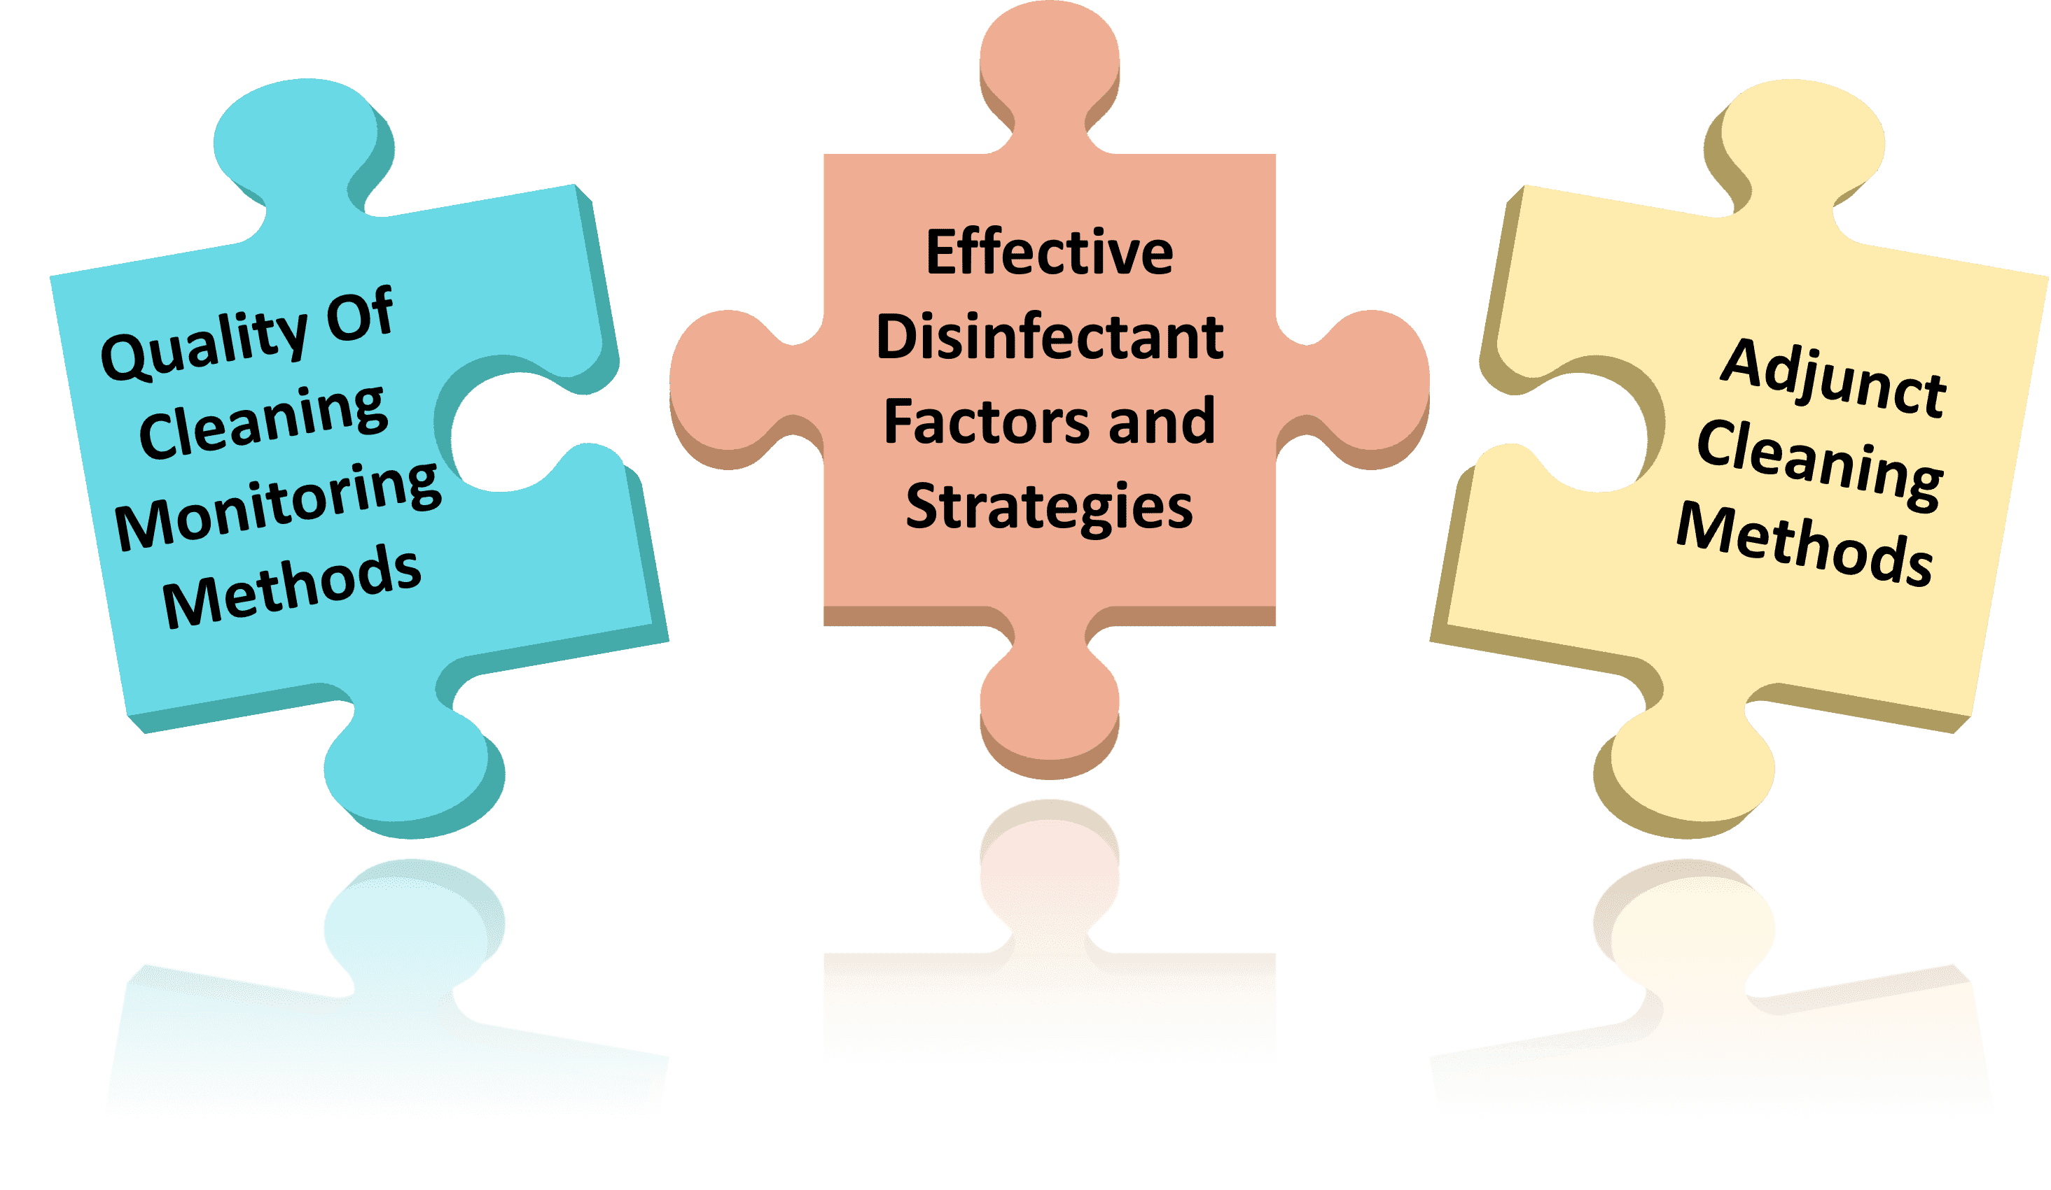
Three Key Facets of Environmental Cleaning

Slide 7
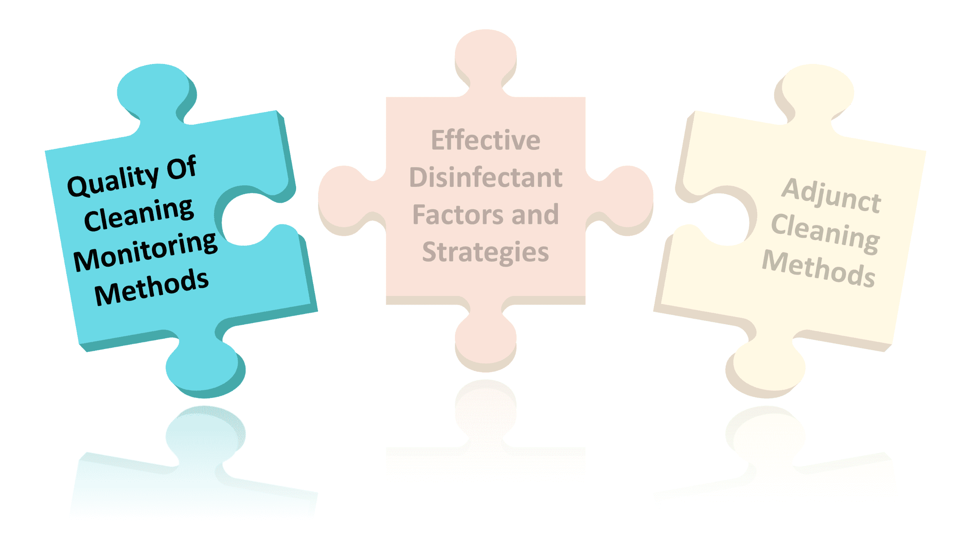
Quality of Cleaning Monitoring Methods
Assessment of current status and quality control

Slide 8
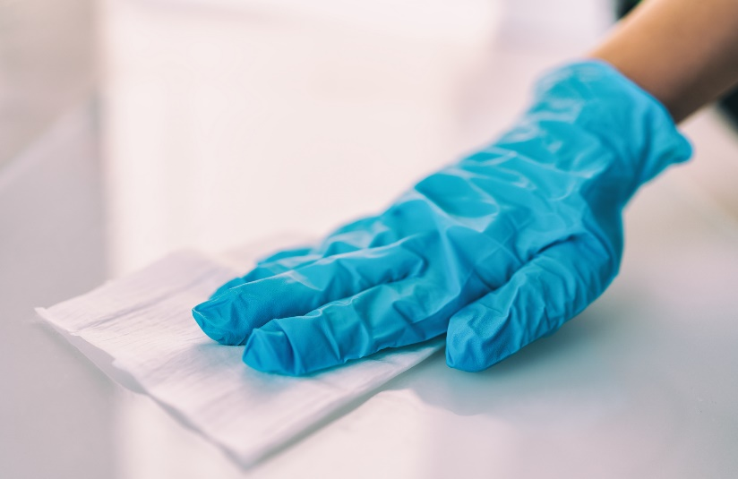


Assessing The Current Quality of Cleaning
What percentage of high-touch surfaces in the unit are adequately cleaned?
Is feedback given in the unit?
To whom?
Who gives the feedback?
Is the feedback appreciated?
Is it acted upon?

Slide 9
Observation And Culturing¹¹⁻¹³
Observation
Definition: Visual check of the room
Use: Easy to do, no special skill required
Disadvantages: Lack of visible soiling does not indicate adequate disinfection
Culturing
Definition: Sampling the surface and sending specimen to lab for tests
Use: Generally targeted towards one specific organism of concern
Disadvantages: Not part of usual hospital programs, not immediately actionable, labor-intensive

Slide 10
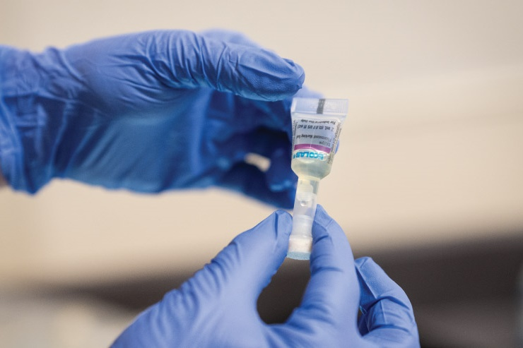
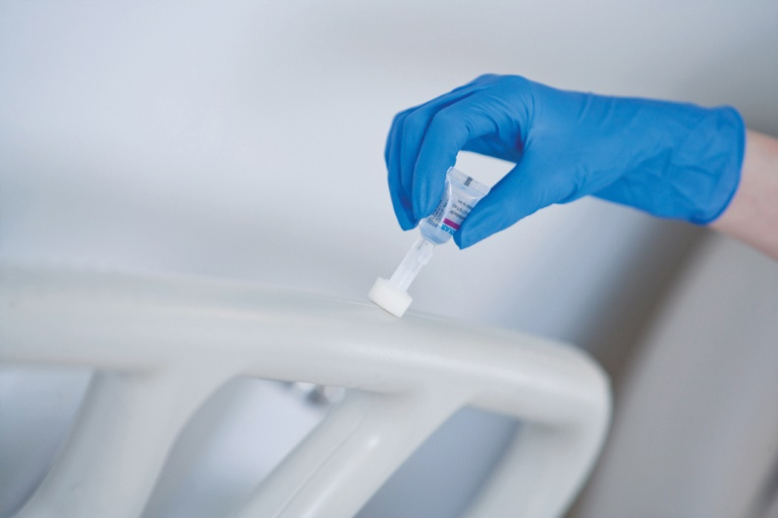
Fluorescent Gel Monitoring¹¹⁻¹⁴
Fluorescent Gel
Fluorescent gel is invisible except under an ultraviolet (UV) light.
High-touch surfaces in the patient environment are marked with the gel.
After a set interval, the surfaces are re-checked with a UV flashlight.
If the surface glows, then it indicates that cleaning was not done effectively.
Source: Ecolab USA Inc. Images used with permission.

Slide 11
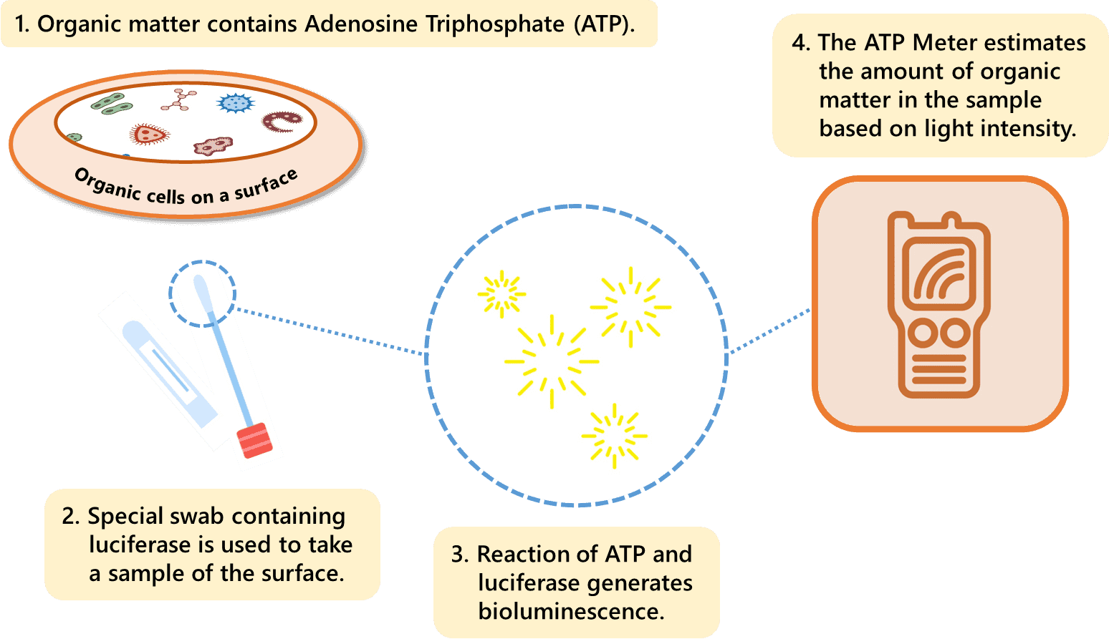
Adenosine Triphosphate (ATP) System^{11-13,15}
ATP System

Slide 12
Fluorescent Gel Versus ATP¹¹⁻¹⁶
Categories | Fluorescent Gel | ATP System
Supported by evidence | Yes¹⁴ | Yes¹⁶
Ease of use | More intuitive | Less intuitive
Ease of understanding | More intuitive | Less intuitive
Identifies pathogens | No | No
Objective | Less objective | More objective
Quantitative results | Not quantitative | Quantitative
Immediate feedback | Yes | Yes
Potential for Hawthorne effect | More likely | Less likely
Cost | Depends on product | Costly

Slide 13
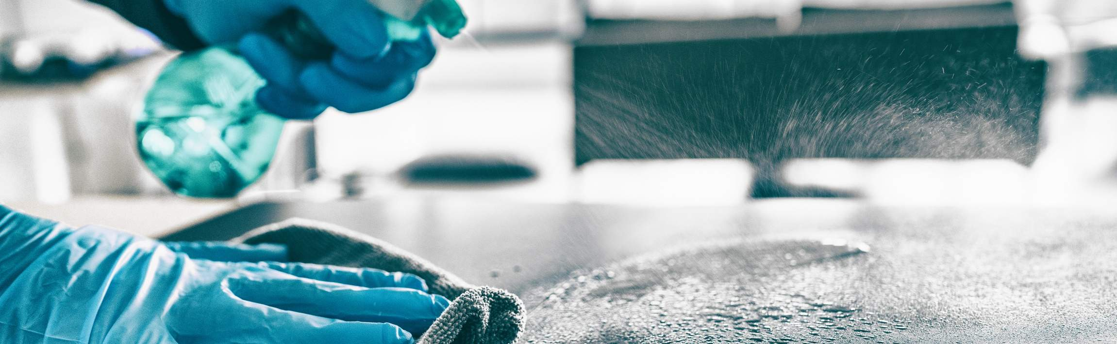
Effective Quality Control of Cleaning Programs
Establish clear purpose, expectations, and goals in a supportive environment.
  Involve stakeholders from individual to unit and departmental levels.
  Optimize tools, education, and supervisory support
Promote data feedback.
  Specify action plans including rewards and retraining.

Slide 14
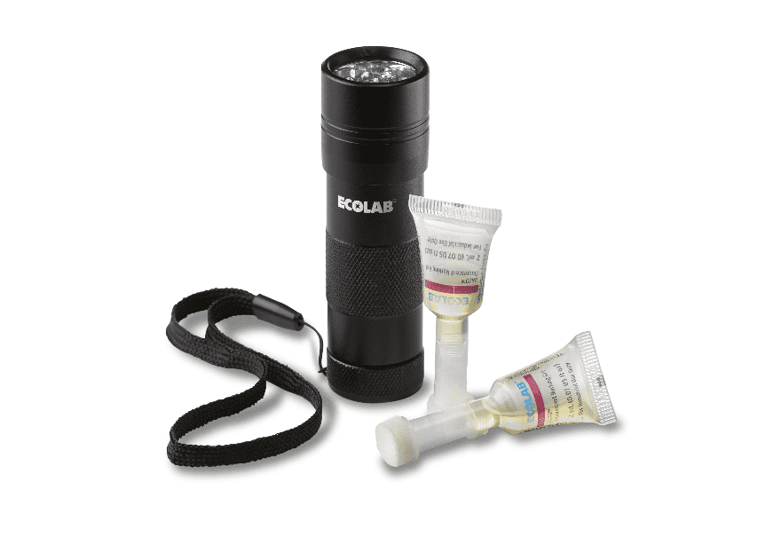
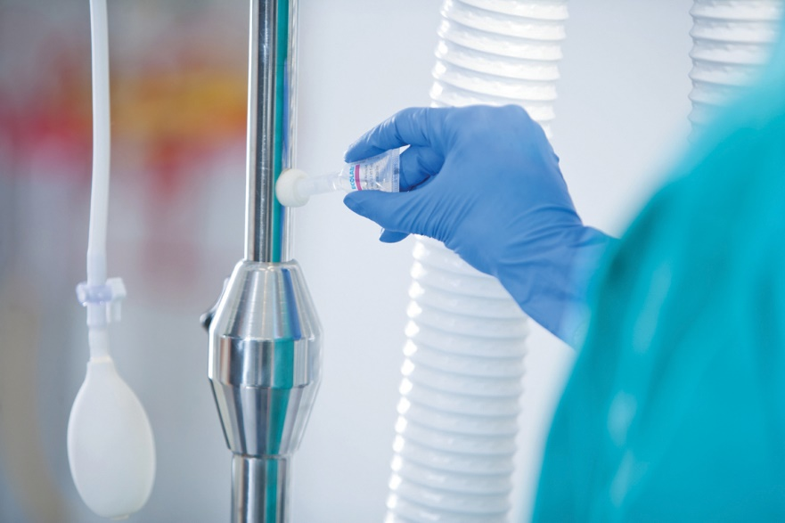
Implementing Quality Control
Some questions to ask when implementing quality control:
  What system and product will be used?
  How many surfaces?
  How many rooms?
  Which rooms?
  Who takes on this task?
More information is available in the presentation:
Assessing Environmental Cleaning Effectiveness
Source: Ecolab USA Inc. Images used with permission.

Slide 15
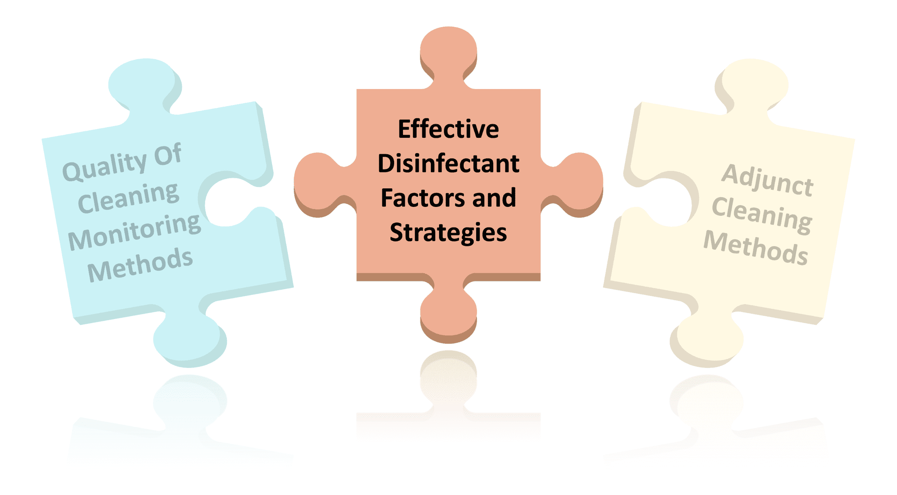
Effective Disinfectant Factors and Strategies
Selecting Disinfection Products and Strategies

Slide 16

Effective Disinfectants¹⁷
The Environmental Protection Agency (EPA) maintains list of disinfectants and the organisms they can disinfect.¹⁸
Selection of disinfection product includes many factors:
  Targeted organisms
    Non-spore forming pathogens: Consider quaternary ammonium-based products.
    Spore forming pathogens: Consider sporicidal type products (e.g., EPA List K for products effective against C. difficile).^{19,20}
  Ease of use
  Cost
  Surface type

Slide 17
Sporicidal Disinfectants
Disinfectant | Advantages | Disadvantages
Traditional bleach (sodium hypochlorite)¹⁷ | Inexpensive | Requires pre-cleaning of surfaces May damage surfaces Leaves residue, requiring rinsing Strong odor and irritant Short shelf life
Newer bleach-neutralizer combinations (Clorox Healthcare® Fuzion® Cleaner Disinfectant)²¹ | One-step cleaner and disinfectant Better smell Less damaging to surfaces | More expensive Limited application, such as spray form
NaDCC (chlorine-based sodium dichloroisocyanurate)²² | One-step cleaner and disinfectant Inexpensive Stable half-life | Leaves some residue Mild odor Complex mixing and dilution, requiring personal protective equipment
Hydrogen peroxide/peracetic acid^{12,23} | One-step cleaner and disinfectant No residue Less damaging to surfaces | Requires installation of dispensing unit Mild odor More expensive
Novel sporicidal hydrogen peroxide (PDI Sani-HyPerCide®)²⁴ | One-step cleaner and disinfectant Wipe and spray | Limited availability

Slide 18

Use Of Sporicidal Agents²⁵
Many hospitals do not use a sporicidal agent for environmental cleaning and disinfection for all rooms and areas.
  Instead, they often use a non-sporicidal and less expensive disinfectant such as quaternary ammonium for regular, non-contact isolation rooms.
A 2019 survey of 47 environmental services personnel from hospitals across 26 U.S. states found the following:
  Bleach was the most frequently used sporicidal disinfectant.
  Regarding the use of sporicidal disinfectants for regular rooms:
  Five hospitals (10.6 percent) routinely used them during daily disinfection.
  Eight hospitals (17 percent) routinely used them during terminal disinfection.

Slide 19
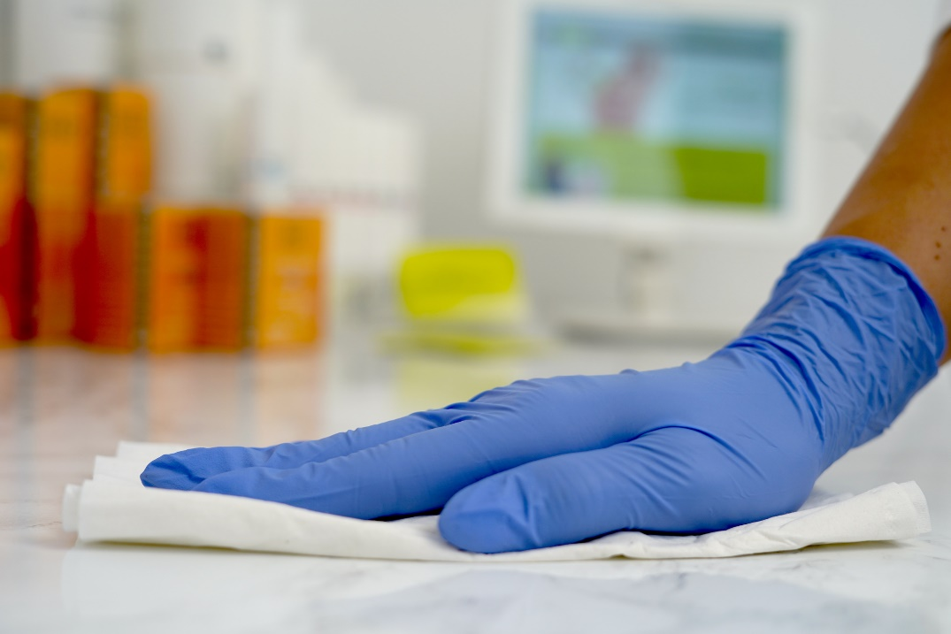
Universal Sporicidal: Advantages and Disadvantages²⁶
Universal sporicidal strategy: a sporicidal disinfectant used in all patient care areas.
Advantages:
  May reduce C. difficile on a unit with high infection rates.
  May simplify cleaning processes for environmental care associates.
Disadvantages:
  May not reduce C. difficile on a unit with endemic infection rates.
  May damage surfaces.
  Strong odor and irritant.
  Tends to be more costly.

Slide 20
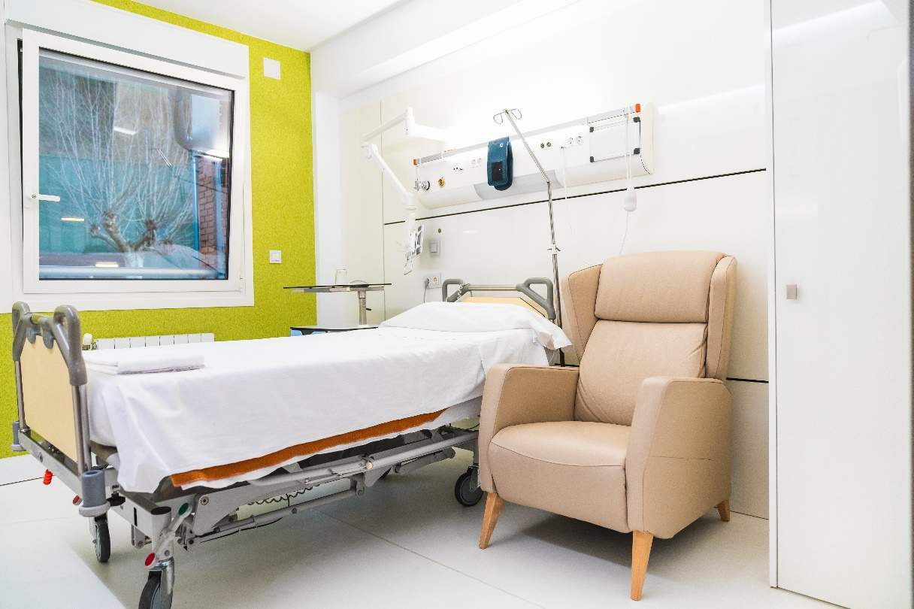
Universal Sporicidal: Strategy Based on Infection Rates^{25,26}
Implement during daily and terminal cleaning when C. difficile or multidrug-resistant organism (MDRO) infection rates are above a certain threshold.
  Even if suboptimal cleaning did not cause the increase in C. difficile, “colonization pressure” may lead to environmentally-related transmissions.
Return to standard processes when rates normalize or after a standard period of time.

Slide 21
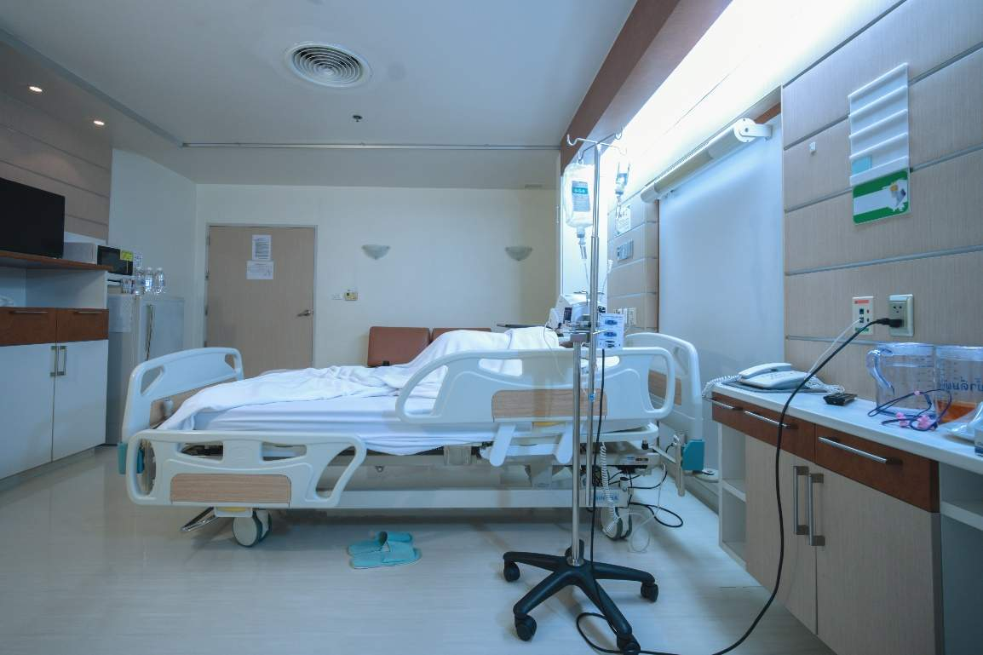
Universal Sporicidal: Terminal Cleaning Strategy^{25,26}
Implement during terminal cleaning regardless of C. difficile or MDRO rates.
Using cleaning agents only at discharge causes less damages to surfaces and less potential irritation for patients as they are not in the room during the process.
However, having different products for daily and terminal cleaning may cause confusion.

Slide 22
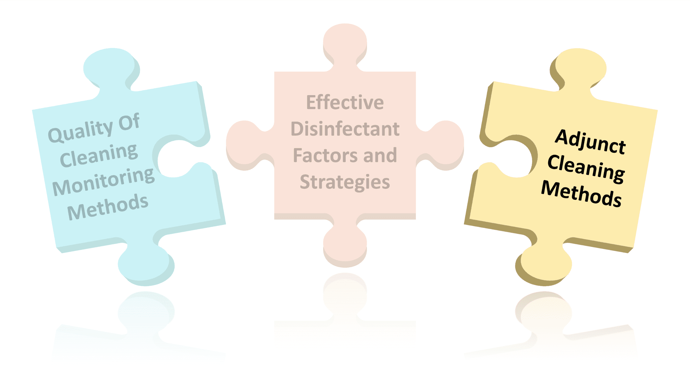
Adjunct Cleaning Methods
Available “no-touch” technologies

Slide 23
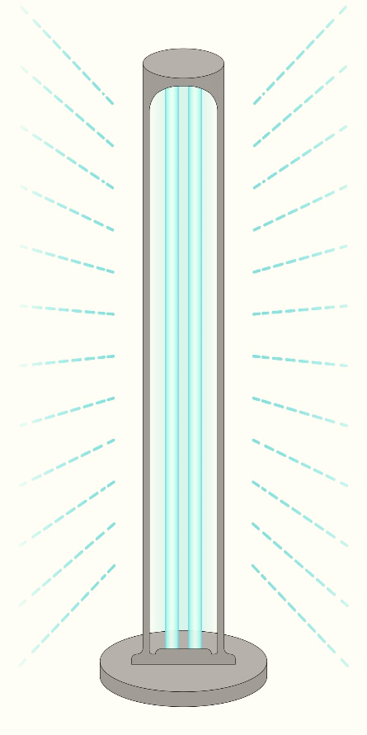
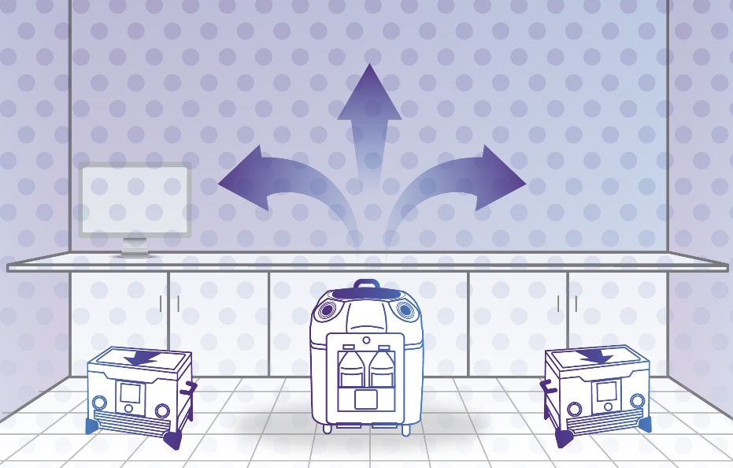
No-Touch Technologies
Two main types in use:
  Ultraviolet-C (UV-C) Disinfection
  Hydrogen Peroxide Vapor (HPV)
Source: Ecolab USA Inc. Used with permission.

Slide 24
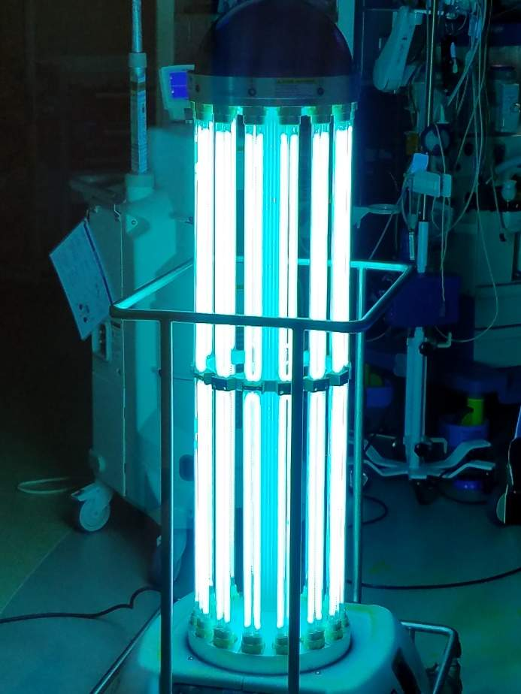
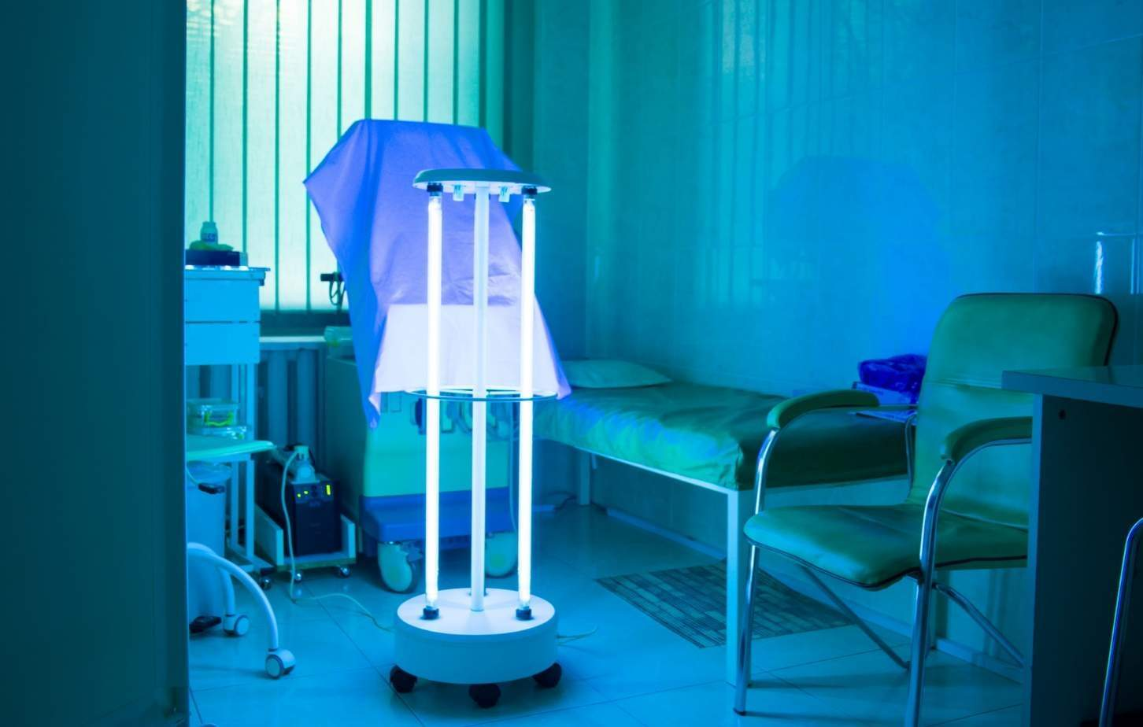
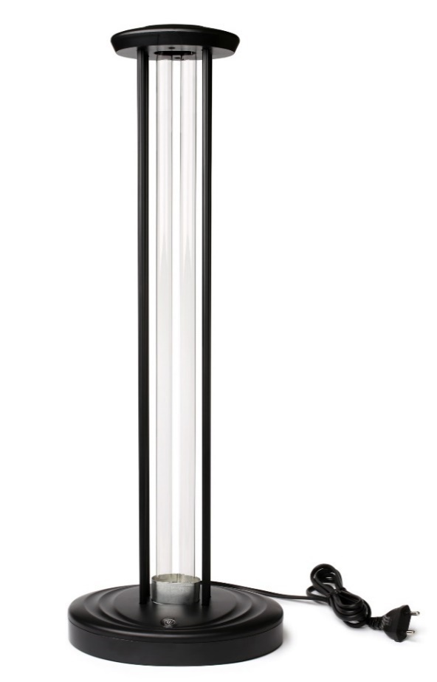
Examples Of UV-C Machines

Slide 25
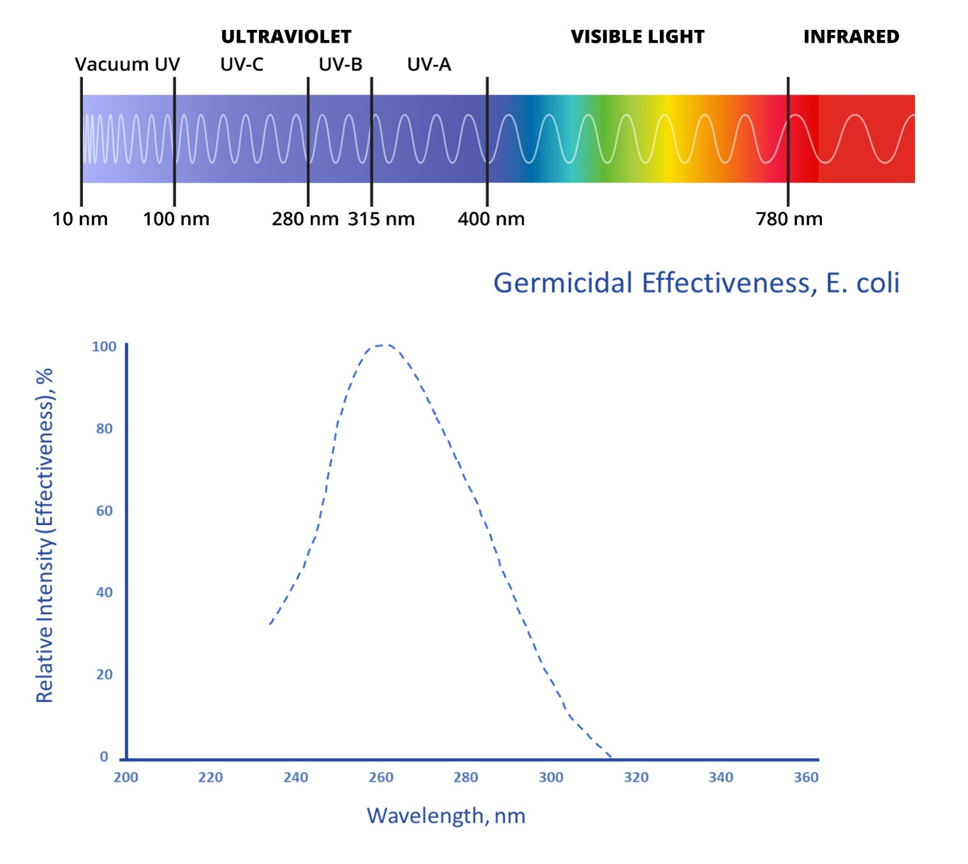
UV-C Disinfection²⁷
Light in the ultraviolet-C (UV-C) spectrum, at wavelengths between 200 and 280 nm, has a germicidal effect.
Absorbed UV-C
light inactivates
the ability of microbes to replicate.

Slide 26
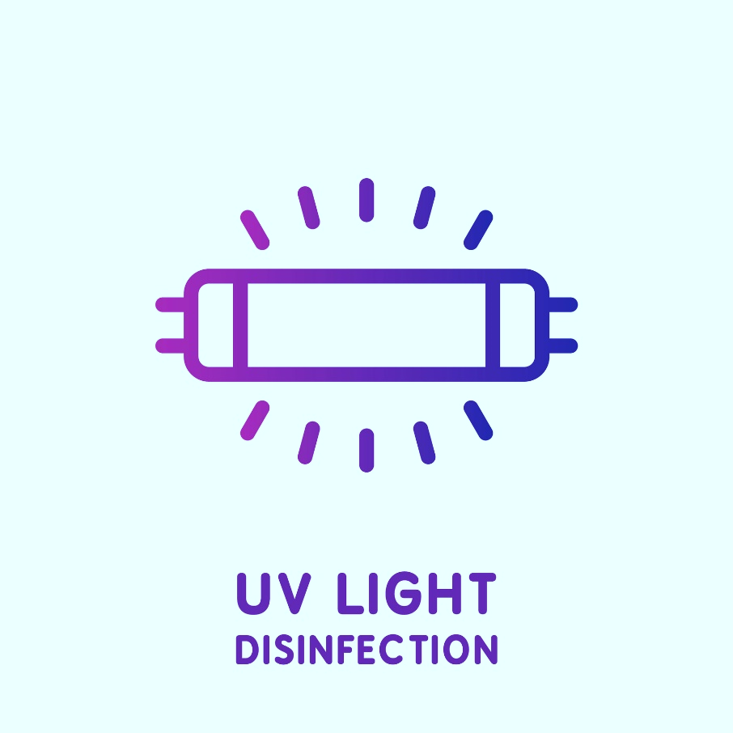
UV-C Disinfection: The Evidence²⁸
Many studies on UV-C with patient outcomes are before-after studies.
  A hospital or unit implements UV-C with an infection prevention bundle to tackle high C. difficile or MDRO rates, and then the rate decreases.
These studies are challenging to interpret.
  Difficult to attribute improvement to UV-C alone
  May have publication bias
  May have “regression to the mean”
  Very few studies in endemic times

Slide 27
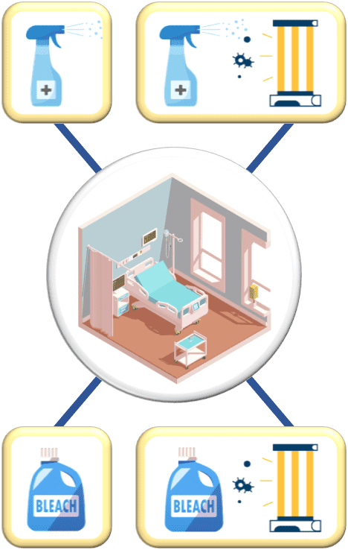
The Benefits of Enhanced Terminal Room Disinfection Study²⁹
First major study to examine UV-C technology in a systematic way
Multicenter, cluster randomized trial
  Nine participating hospitals
Assessed the risk of pathogen acquisition of the subsequent room occupant
  MRSA, VRE, MDR Acinetobacter, C. difficile
Four different strategies for disinfection upon discharge
  Reference/Control: Quaternary ammonium except in rooms with C. difficile that used bleach
  Quaternary ammonium and UV-C except in rooms with C. difficile that used bleach and UV-C
  Bleach for all rooms
  Bleach and UV-C

Slide 28
The Benefits of Enhanced Terminal Room Disinfection Study: Results²⁹
For all organisms, there was significant improvement when adding UV-C to quaternary ammonium disinfectant, relative to the reference group.
  This decrease was comparable to when using bleach.
  No significant changes were observed for bleach and UV-C.
For MRSA, there was significant improvement when UV-C was added to quaternary ammonium disinfectant, relative to the reference group.
  No significant changes were observed for bleach or bleach and UV-C.
Organism | Quaternary Ammonium | UV-C And Quaternary Ammonium | Bleach | Bleach And UV-C
All Target Organisms Relative risk [RR] (95 percent CI) p-value [below 0.05 for significance] | Reference | 0.69 (0.50 to 0.95) 0.025 | 0.74 (0.61 to 0.91) 0.004 | 1.0 (0.81 to 1.23) 1.00
MRSA RR (95 percent CI) | Reference | 0.67 (0.48 to 0.94) 0.019 | 0.89 (0.72 to 1.09) 0.260 | 1.09 (0.85 to 1.39) 0.503

Slide 29





Advantages Of UV-C Disinfection^{28,30-32}
Relatively quick.
Proven effective against bacteria and viruses on surfaces.
Safe to use.
Positive opinions of technology held by patients.³¹
Easy to teach, easy to use, can be performed by hospital staff.

Slide 30

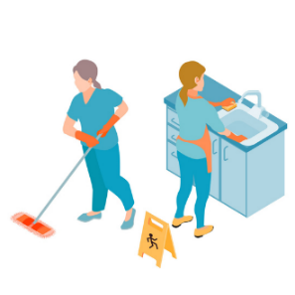

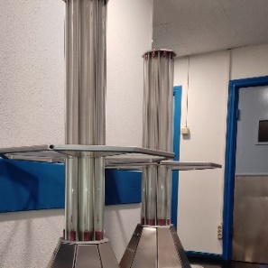



Disadvantages Of UV-C Disinfection^{28,30-32}
Inability to penetrate through shaded areas or solid surfaces
Requires a designated person or role
Relies on coordination between patient admissions
Storage considerations
Maintenance issues
Upfront and ongoing associated costs
Difficulty in evaluating impact

Slide 31
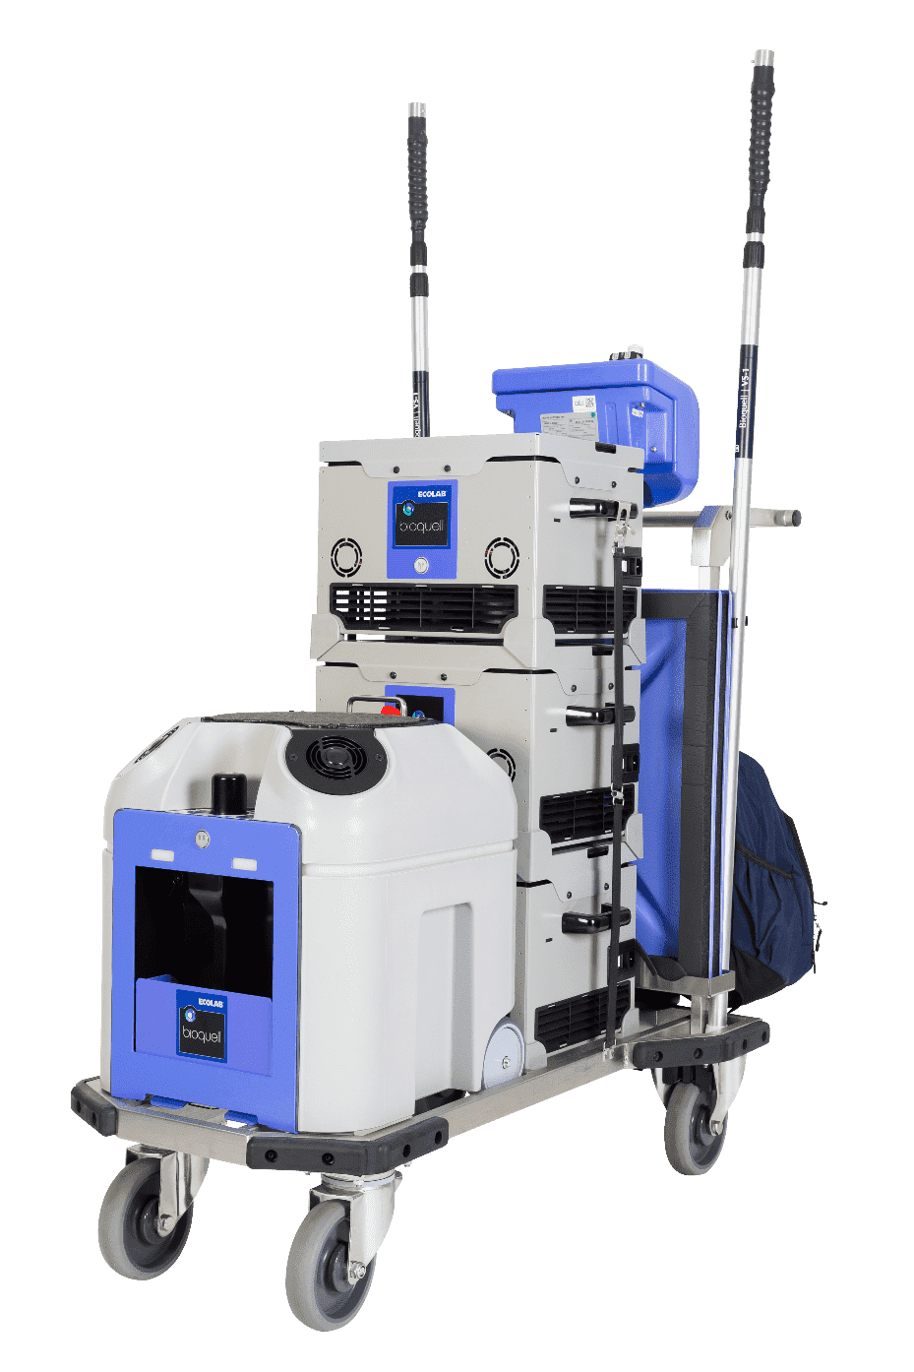
Hydrogen Peroxide Vapor (HPV)^{30,31,33}
Liquid hydrogen peroxide (30 to 35 percent) is vaporized and emitted.
  Patient room must be sealed, including doors, windows, and vents.
Hydrogen peroxide condenses onto all exposed surfaces and kills pathogens.
After a pre-set interval, remaining hydrogen peroxide in the air is converted into water vapor and oxygen.
  The room cannot be opened before the process is finished, due to the danger of the high hydrogen peroxide concentration.
Source: Ecolab USA Inc. Used with permission.

Slide 32
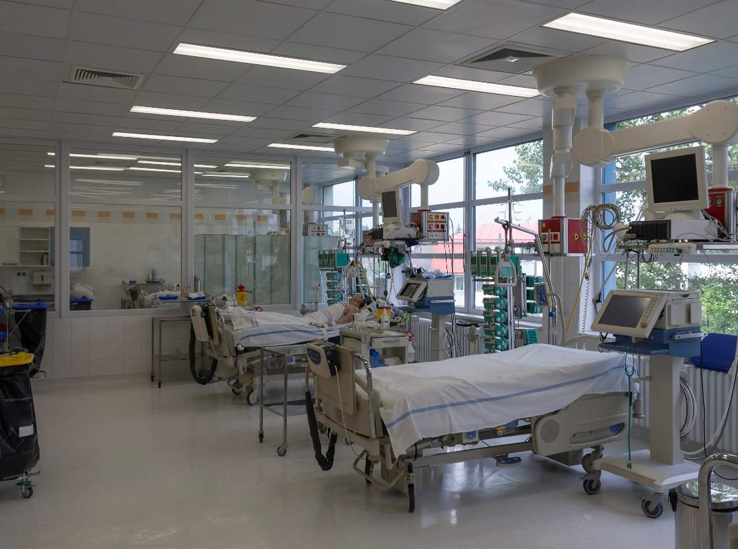
Environmental Decontamination With HPV³³
Study by Passaretti et al. (2013):
30-month prospective cohort intervention study that evaluated the
impact of HPV room disinfection with prior occupants known to be infected or colonized with MDROs.
VRE, MRSA, C. difficile, multidrug-resistant Gram-negative rods (MDR-GNR).
Evaluated six high-risk units in a tertiary care hospital.
For patients subsequently admitted to rooms decontaminated with HPV, when compared to those admitted to standard cleaning rooms and after adjusting for other factors:
  64 percent were less likely to acquire any MDRO.
  80 percent were less likely to acquire VRE.

Slide 33


Advantages Of HPV Disinfection^{30,31,34,35}
Proven effective against bacteria and viruses on surfaces.
Safe to use when protocols are followed.
Leaves no residue or irritants.
Provides uniform coverage and is evenly dispersed throughout the room, including corners and hard to reach areas.

Slide 34



Disadvantages Of HPV Disinfection^{30,31,34,35}
Requires specialized training for setup and use.
Requires vacated and fully sealed room (e.g., doors sealed with tape and ventilation shut off).
Requires two to five hours without interruption.
Relies on coordination between patient admissions.
Maintenance issues and storage considerations.
Upfront and ongoing associated costs.
Difficulty in evaluating impact.

Slide 35
Comparison Of No-Touch Technologies³⁰⁻³⁵
UV-C | HPV
Reduces microbial burden | Reduces microbial burden
High capital cost | High capital cost
Requires pre-cleaning | Requires pre-cleaning
Requires room to be empty | Requires room to be empty
Rapid | Two to five hours
Can work in any space | Requires enclosed and sealed room
Limited by sight-view | Does not require line of sight

Slide 36
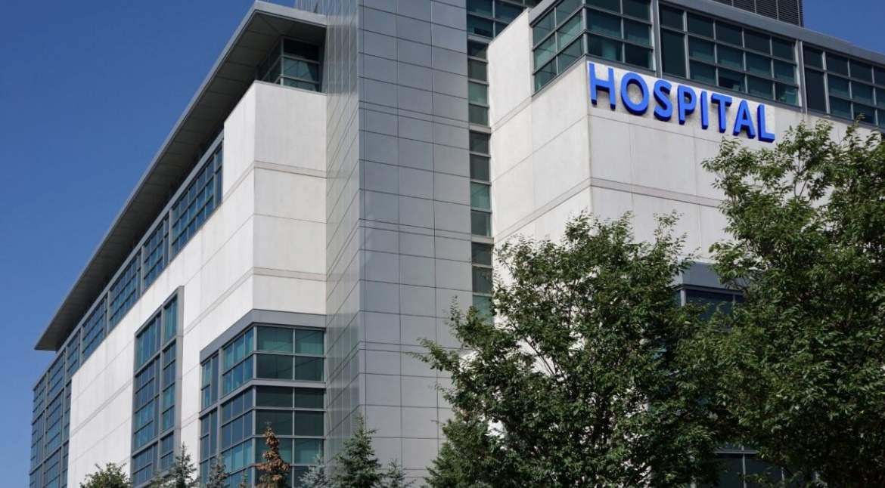
Case Example
An Uptick in C. difficile Rates in the Department of Medicine

Slide 37
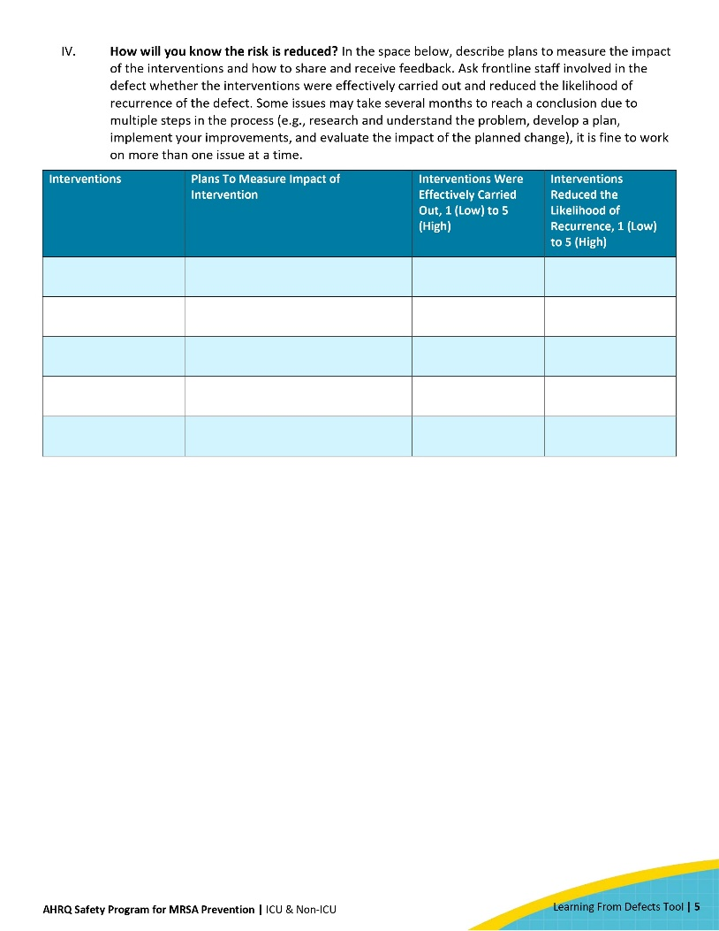
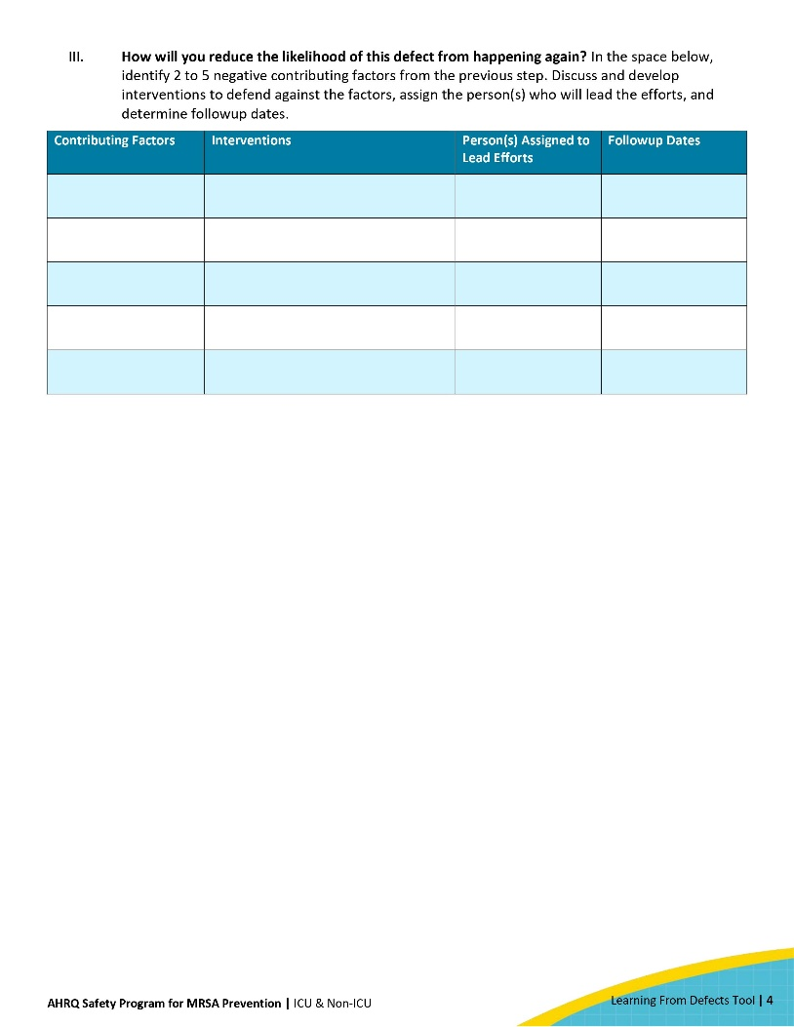
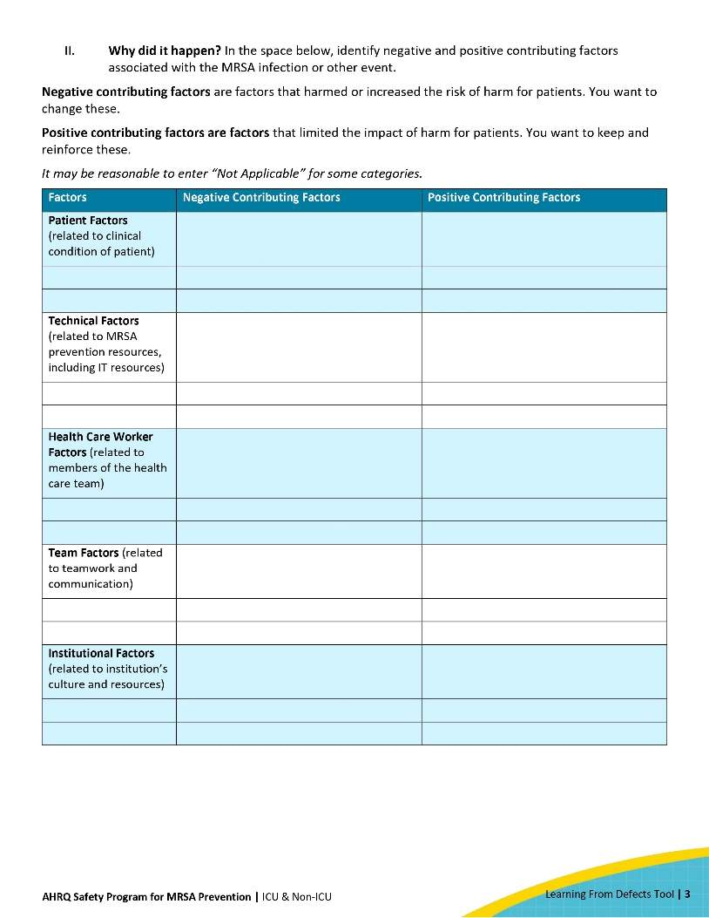
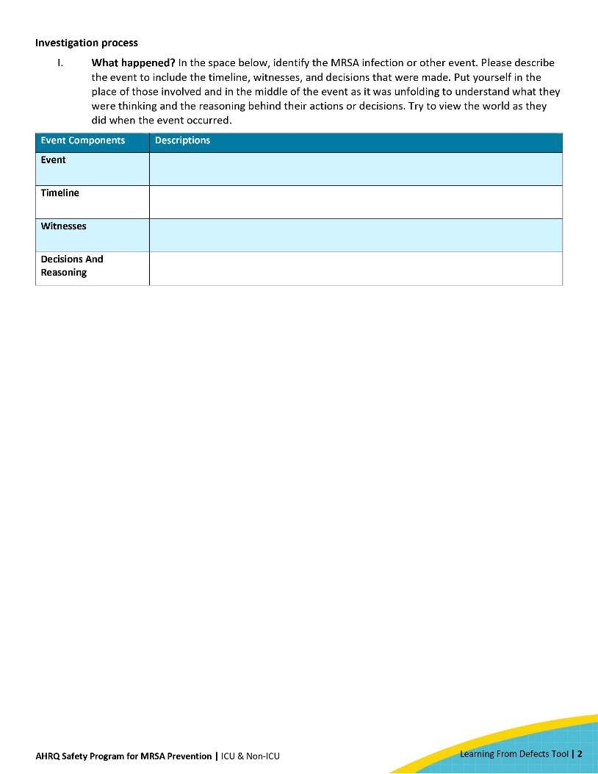
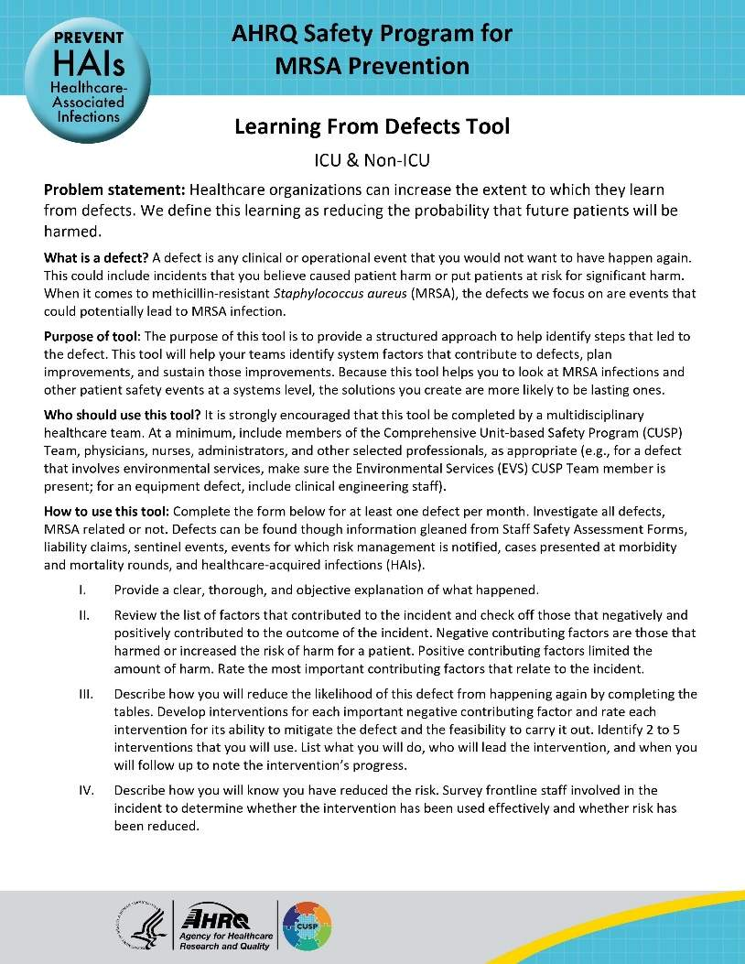
Using The Learning From Defects Tool
The following are four questions to help guide the CUSP (Comprehensive Unit-based Safety Program) team in problem-solving and defect identification:
  What happened?
  Why did it happen?
  How do we reduce the likelihood of this defect from happening again?
  How do we know the risk is reduced?
Access the AHRQ Learning From Defects Tool.

Slide 38
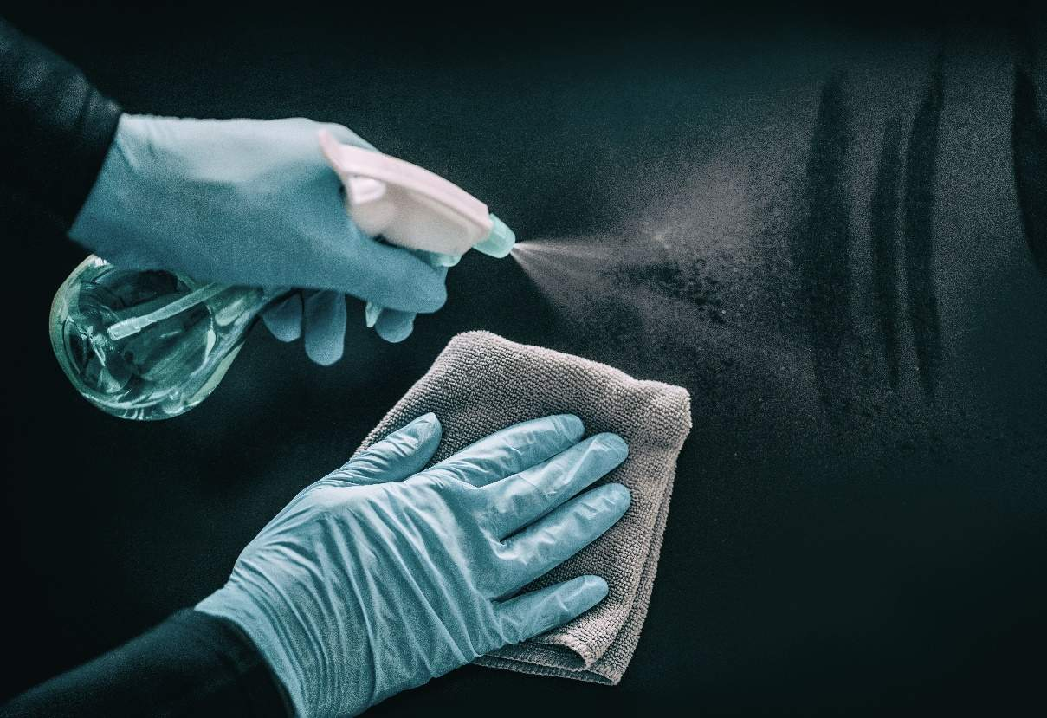
Case Example: What Happened?
There was an uptick in C. difficile rates.
Most cases occurred in rooms where the previous patient had C. difficile infection.
Further investigation revealed a recent change in cleaning agents.
Environmental Services (EVS) and hospital staff complained of the smell, difficulty breathing, and eye irritation after the change and did not use the product as intended.

Slide 39

Case Example: Why Did It Happen?
  Over a year ago, the hospital transitioned from quaternary ammonia products to sporicidal agents.
  In the last few months, there was a change in sporicidal agent, due to an availability issue with the supplier.
Staff were not informed of the change and were not provided instructions for the proper use of the new agent.

Slide 40


Case Example: Identify Contributing Factors
Negative Contributing Factors
Definition: Factors that increased the risk of harm.
There was a lack of training about the new cleaning agents.
There was a lack of knowledge about the strong odor and potential irritations.
Positive Contributing Factors
Definition: Factors that limited the impact of harm.
There was an established CUSP team.
There was an established partnership between the Infection Prevention Control (IPC) and EVS teams.

Slide 41

Case Example: How Do We Reduce the Likelihood of This Defect From Happening Again?
Implemented a training initiative for the proper use of the new cleaning agents
  Discussed the changes in CUSP meetings and engaged IPC and EVS collaboration
  Created talking points for the staff
  Included information on the odor and potential irritants
  Encouraged the use of masks
  Provided information for all units impacted by the change

Slide 42

Case Example: How Do We Know the Risk Is Reduced?
Obtained staff feedback.
  Rate the effectiveness of the intervention.
  How has it changed the workflow?
  What impact did it have on the identified problems?
  What impact did it have on the infection rates?

Slide 43

Analyze And Disseminate Data
Remember to analyze the data collected and share the results widely with all levels of the organization.
Inform and engage stakeholders about environmental cleaning program performance to drive improvement efforts and accountability.

Slide 44

Celebrate Successes
Establishing an effective environmental cleaning program is hard work and
requires effort and feedback from all leadership levels.
Remember to acknowledge and celebrate successes!

Slide 45
Key Takeaways
There is no quick fix when it comes to reducing healthcare environmental contamination and mitigating MRSA and other MDRO transmissions.
Methods to monitor quality of cleaning include observation, culturing, fluorescent gel monitoring, and ATP systems.
Many factors influence the selection of disinfection products.
  Organisms to be targeted, such as sporicidal vs. non-sporicidal pathogens
  Ease of use
  Cost
  Surface type
While no-touch technologies such as UV-C and HPV effectively eliminate pathogens on surfaces, more large-scale studies are needed to determine their precise impact on HAI and MDRO prevention.
Data collection, analysis, and feedback are essential in driving improvement efforts and accountability.
Environmental cleaning programs require hard work and effort from all levels of healthcare personnel. Remember to celebrate successes!

Slide 46
Disclaimer
The findings and recommendations in this presentation are those of the authors, who are responsible for its content, and do not necessarily represent the views of AHRQ. No statement in this presentation should be construed as an official position of AHRQ or of the U.S. Department of Health and Human Services.
Any practice described in this presentation must be applied by healthcare practitioners in accordance with professional judgment and standards of care in regard to the unique circumstances that may apply in each situation they encounter. These practices are offered as helpful options for consideration by healthcare practitioners, not as guidelines.

Slide 47
Reference List—1
Watson PA, Watson LR, Torress-Cook A. Efficacy of a hospital-wide environmental cleaning protocol on hospital-acquired methicillin-resistant Staphylococcus aureus rates. J Infect Prev. 2016 Jul;17(4):171-6. PMID: 28989476.
Verity P, Wilcox MH, Fawley W, et al. Prospective evaluation of environmental contamination by Clostridium difficile in isolation side rooms. J Hosp Infect. 2001 Nov;49(3):204-9. PMID: 11716638.
McFarland LV, Mulligan ME, Kwok RY, et al. Nosocomial acquisition of Clostridium difficile infection. N Engl J Med. 1989 Jan;320(4):204-10. PMID: 2911306.
Cobrado L, Silva-Dias A, Azevedo MM, et al. High-touch surfaces: microbial neighbours at hand. Eur J Clin Microbiol Infect Dis. 2017 Nov;36:2053-62. PMID: 28647859.
Gu GY, Chen M, Pan JC, et al. Risk of multi-drug-resistant organism acquisition from prior bed occupants in the intensive care unit: a meta-analysis. J Hosp Infect. 2023 Sep;139:44-55. PMID: 37406860.
Cohen B, Liu J, Cohen AR, et al. Association between healthcare-associated infection and exposure to hospital roommates and previous bed occupants with the same organism. Infect Control Hosp Epidemiol. 2018 May;39(5):541-546. PMID: 29486805.
Huang SS, Datta R, Platt R. Risk of acquiring antibiotic-resistant bacteria from prior room occupants. Arch Intern Med. 2006 Oct 9;166(18):1945-51. PMID: 17030826.

Slide 48
Reference List—2
Datta R, Platt R, Yokoe DS, Huang SS. Environmental cleaning intervention and risk of acquiring multidrug-resistant organisms from prior room occupants. Arch Intern Med. 2011 Mar 28;171(6):491-4. PMID: 21444840.
Shaughnessy MK, Micielli RL, DePestel DD, et al. Evaluation of hospital room assignment and acquisition of Clostridium difficile infection. Infect Control Hosp Epidemiol. 2011 Mar;32(3):201-6. doi: 10.1086/658669. PMID: 21460503.
Nseir S, Blazejewski C, Lubret R, et al. Risk of acquiring multidrug-resistant Gram-negative bacilli from prior room occupants in the intensive care unit. Clin Microbiol Infect. 2011 Aug;17(8):1201-8. PMID: 21054665.
Carling PC, Bartley JM. Evaluating hygienic cleaning in health care settings: what you do not know can harm your patients. Am J Infect Control. 2010 Jun 1;38(5):S41-50. PMID: 20569855.
Boyce JM. Modern technologies for improving cleaning and disinfection of environmental surfaces in hospitals. Antimicrob Resist Infect Control. 2016 Apr;5:10. PMID: 27069623.
Mitchell BG, Wilson F, Dancer SJ, et al. Methods to evaluate environmental cleanliness in healthcare facilities. Healthcare Infect. 2013 Feb;18(1):23-30.
Hung IC, Chang HY, Cheng A, et al. Application of a fluorescent marker with quantitative bioburden methods to assess cleanliness. Infect Control Hosp Epidemiol. 2018 Nov;39(11):1296-1300. PMID: 30221609.

Slide 49
Reference List—3
Nante N, Ceriale E, Messina G, et al. Effectiveness of ATP bioluminescence to assess hospital cleaning: a review. J Prev Med Hyg. 2017 Jun;58(2):E177-E183. PMID: 28900359.
Ziegler MJ, Babcock HH, Welbel SF, et al. Stopping hospital infections with environmental services (SHINE): a cluster-randomized trial of intensive monitoring methods for terminal room cleaning on rates of multidrug-resistant organisms in the intensive care unit. Clin Infect Dis. 2022 Feb 1:ciac070. PMID: 35100614.
Rutala WA, Weber DJ. Selection of the ideal disinfectant. Infect Control Hosp Epidemiol. 2014 Jul;35(7):855-65. PMID: 24915214.
US Environmental Protection Agency. Selected EPA-Registered Disinfectants. https://www.epa.gov/pesticide-registration/selected-epa-registered-disinfectants. Accessed June 12, 2024.
Fawley WN, Underwood S, Freeman J, et al. Efficacy of hospital cleaning agents and germicides against epidemic Clostridium difficile strains. Infect Control Hosp Epidemiol. 2007 Aug;28(8):920-5. PMID: 17620238.
U.S. Environmental Protection Agency (EPA). EPA’s Registered Antimicrobial Products Effective Against Clostridioides difficile (C. diff) Spores [List K]. https://www.epa.gov/pesticide-registration/epas-registered-antimicrobial-products-effective-against-clostridioides. Accessed June 12, 2024.

Slide 50
Reference List—4
Wong YK, Alhmidi H, Mana TS, et al. Impact of routine use of a spray formulation of bleach on Clostridium difficile spore contamination in non-C difficile infection rooms. Am J Infect Control. 2019 Jul 1;47(7):843-5. PMID: 30711351.
Skive B, Lawaetz AC, Hammerum AM, et al. Survival of hospital-and community-associated Enterococcus faecium following exposure to in-use concentrations of the biocide sodium dichloroisocyanurate (NaDCC). J Glob Antimicrob Resist. 2022 Jun;29:281-8. PMID: 35358701.
Rybka A, Gavel A, Kroupa T, et al. Peracetic acid‐based disinfectant is the most appropriate solution for a biological decontamination procedure of responders and healthcare workers in the field environment. J Appl Microbiol. 2021 Sep;131(3):1240-8. PMID: 33590580.
Cadnum JL, Pearlmutter BS, Haq MF, et al. Effectiveness and real-world materials compatibility of a novel hydrogen peroxide disinfectant cleaner. Am J Infect Control. 2021 Dec 1;49(12):1572-4. PMID: 34416312.
Han Z, Pappas E, Simmons A, et al. Environmental cleaning and disinfection of hospital rooms: a nationwide survey. Am J Infect Control. 2021 Jan;49(1):34-39. PMID: 32798634.
Balsells E, Filipescu T, Kyaw MH, et al. Infection prevention and control of Clostridium difficile: a global review of guidelines, strategies, and recommendations. J Glob Health. 2016 Dec;6(2). PMID: 28028434.

Slide 51
Reference List—5
Kowalski W. Ultraviolet Germicidal Irradiation Handbook: UVGI for Air and Surface Disinfection. Berlin: Springer-Verlag Berlin Heidelberg; 2009.
Haas JP, Menz J, Dusza S, et al. Implementation and impact of ultraviolet environmental disinfection in an acute care setting. Am J Infect Control. 2014 Jun;42(6):586-90. PMID: 24837107.
Anderson DJ, Chen LF, Weber DJ, et al. Enhanced terminal room disinfection and acquisition and infection caused by multidrug-resistant organisms and Clostridium difficile (the Benefits of Enhanced Terminal Room Disinfection study): a cluster-randomised, multicentre, crossover study. Lancet. 2017 Feb 25;389(10071):805-814. PMID: 28104287.
Weber DJ, Kanamori H, Rutala WA. ‘No touch’ technologies for environmental decontamination: focus on ultraviolet devices and hydrogen peroxide systems. Curr Opin Infect Dis. 2016 Aug;29(4):424-31. PMID: 27257798.
Doll M, Morgan DJ, Anderson D, et al. Touchless technologies for decontamination in the hospital: a review of hydrogen peroxide and UV devices. Curr Infect Dis Rep. 2015 Sep;17:1-1. PMID: 26252970.
Rock C, Curless MS, Carson KA, et al. Patient and health care worker perceptions of daily use of ultraviolet-C technology as an adjunct to daily cleaning in an academic hospital: secondary study of ultraviolet-C light evaluation as an adjunct to removing multi-drug resistant organisms. Am J Infect Control. 2018 Mar;46(3):348-9. PMID: 29056329.

Slide 52
Reference List—6
Passaretti CL, Otter JA, Reich NG, et al. An evaluation of environmental decontamination with hydrogen peroxide vapor for reducing the risk of patient acquisition of multidrug-resistant organisms. Clin Infect Dis. 2013 Jan;56(1):27-35. PMID: 23042972.
Rutala WA, Weber DJ. Disinfection and sterilization in health care facilities: an overview and current issues. Infect Dis Clin North Am. 2016 Sep;30(3):609-37. PMID: 27515140.
Otter JA, Yezli S, Perl TM, et al. The role of 'no-touch' automated room disinfection systems in infection prevention and control. J Hosp Infect. 2013 Jan;83(1):1-13. PMID: 23195691.

