Slide 1
Low Tidal Volume Ventilation:
Introduction, Evidence, and Implementation
AHRQ Safety Program for Mechanically Ventilated Patients
AHRQ Pub. No. 16(17)-0018-54-EF
January 2017

Slide 2
Learning Objectives
After this session, you will be able to—
Explain why we should use low tidal volume ventilation (LTVV)
Outline the historical background and scientific evidence supporting the use of LTVV
Implement recommended standards for LTVV

Slide 3
What Is Low Tidal Volume Ventilation?
Low tidal volume ventilation is a lung protective strategy that seeks to prevent ventilator-associated lung injury
LTVV is an approach that targets much lower tidal volume than what has been traditionally used
LTVV also focuses on the avoidance of zero positive end-expiratory pressure (ZEEP)

Slide 4
What Are the Goals of LTVV?
Target tidal volume of 6–8 mL/kg of predicted body weight (PBW) for patients without ARDS and 4–6 mL/kg PBW for patients with ARDS
  Predicted body weight based on height/sex
  Not ideal body weight
  Not actual body weight
Avoid the use of ZEEP
  Use positive end-expiratory pressure (PEEP) settings ≥ 5 cm H₂0

Slide 5
Why Should We Use LTVV?
Significant benefit when outcomes are compared using lower volumes (6 cc/kg) versus traditional tidal volumes (12 cc/kg)¹
Additional studies and meta-analysis showed large tidal ventilation and the resulting high pressures were harmful
1. Ventilation with lower tidal volumes as compared with traditional tidal volumes for acute lung injury and the acute respiratory distress syndrome. The Acute Respiratory Distress Syndrome Network. N Engl J Med. 2000;342(18):1301-8. PMID: 10793162.

Slide 6
Why Should We Use LTVV?
Low tidal volume ventilation protects lungs by—
Preventing “volutrauma” (overdistension of some alveoli areas and underdistension in other areas)
Preventing barotrauma
Preventing development of acute respiratory distress syndrome (ARDS)
Suppressing activation of chemical inflammatory mediators
Improving outcomes

Slide 7
History Review
AHRQ Safety Program for Mechanically Ventilated Patients

Slide 8
Early History
1776: Dr. John Hunter developed a double bellows system that pushed and pulled air in and out of lung; used on dogs with tubes going into trachea
1837: Efforts like Hunter’s lost favor as chest compressions became preferred method for moving air (not same as CPR)
Both positive and negative pressure systems continued to be developed
1850: French Academy of Sciences reported that positive pressure caused what we now know as barotrauma, which may result in pneumothorax, rupture of alveoli, and emphysema

Slide 9
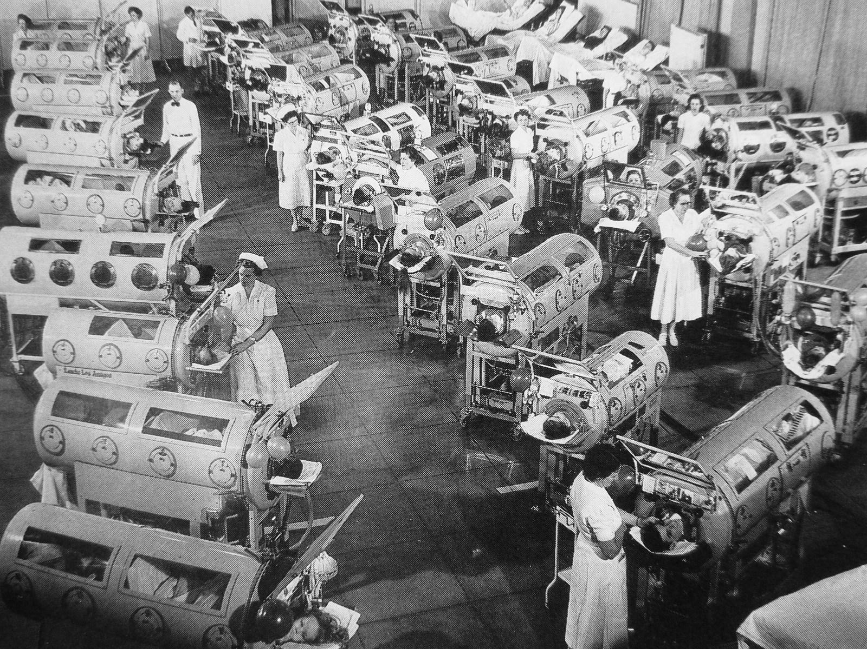
The Iron Lung
Negative pressure ventilation became the most common approach, ultimately resulting in the iron lung.

Slide 10
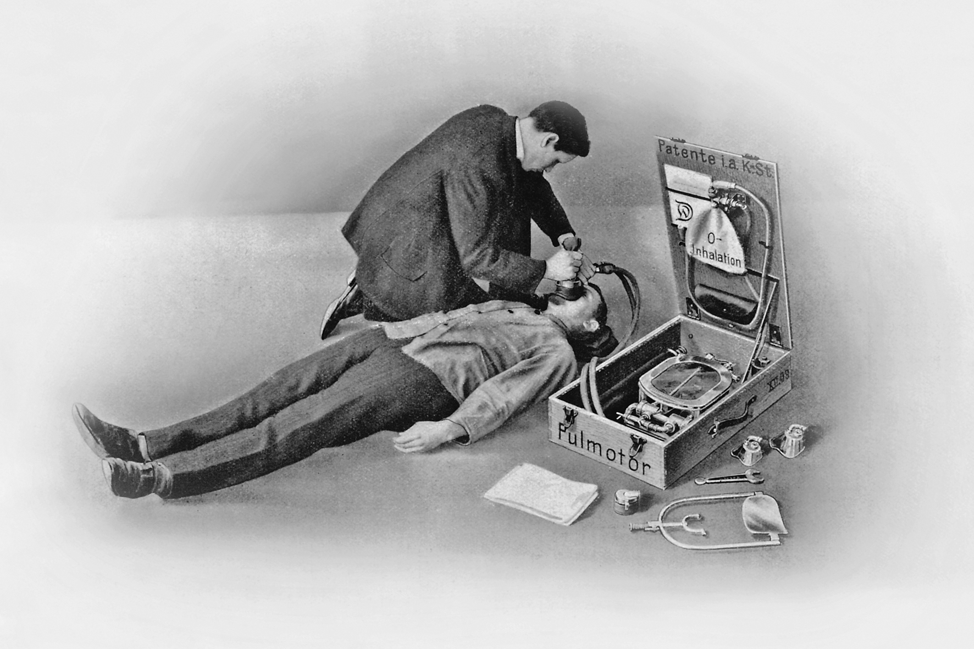
Positive Pressure Vents Still Progressed
Johann Dräger developed the portable Pulmotor in 1907.
By 1909, the Pulmotor was a top seller for his company.
Notes:
However, the Pulmomotor was primarily used by fire departments and other “first responders” as opposed to hospitals

Slide 11
Endotracheal Intubation
Uncommon and considered inappropriate outside of the operating room (OR)
Polio epidemics in the 1950s outstripped the supply of iron lungs, returning attention to the use of positive-pressure ventilation (PPV) in other settings
Soon the transition to endotracheal tubes in conjunction with PPV outside the OR accelerated

Slide 12
1950s
Despite progress, ventilators were still crude
Difficult to precisely control volume and pressure
Two primary modes were used
  Volume regulated
  Pressure limited

Slide 13
Ventilator Progress
1960s though 1970s
  Ventilation was primarily volume controlled
  Ventilation was completely independent of patient’s pulmonary mechanics
1970s through 1980s
  Development of patient-triggered modes such as synchronized intermittent mandatory ventilation (SIMV)
  A great variety of modes became available

Slide 14
Supporting research
AHRQ Safety Program for Mechanically Ventilated Patients

Slide 15
Common Ventilator Modes
Volume Cycled Modes | Pressure Cycled Modes | Other Modes
Continuous mandatory ventilation (CMV) assist control (AC) Synchronized intermittent mandatory ventilation (SIMV) Volume support (VS) Pressure regulated volume controlled (PRVC) | Pressure support (PS) Continuous positive airway pressure (CPAP) Pressure control (PC) Airway pressure release ventilation (APRV) Bilevel ventilation | Proportional assist ventilation (PAV) Adaptive support ventilation (ASV) Inverse ratio ventilation (IRV) High-frequency oscillatory ventilation (HFOV) Extracorporeal membrane oxygenation (ECMO) Other

Slide 16
The Basis for Traditional Ventilation Strategies
1963 study in NEJM showed development of hypoxia in surgical patients when lower ventilation was provided.
“
Perhaps the best course of action during controlled ventilation is to imitate nature quite closely in providing reasonably large tidal volumes at a respiratory rate not exceeding 14 to 16 per minute, and also in providing periodic passive hyperinflation of the lungs, thus replacing the lacking spontaneous deep breaths, or sighs. It might even be desirable if mechanical respirators were able to “sigh” automatically.
––Bendixen, NEJM, 1963²
”
2. Bendixen HH, Hedley Whyte J, Laver MB. Impaired oxygenation in surgical patients during general anesthesia with controlled ventilation. N Engl J Med. 1963 269:991-6. PMID: 14059732.

Slide 17
Traditional Ventilation Strategies
Since atelectasis is undesirable (shunt, hypoxia), a large tidal volume approach became the norm
  10–15 cc/kg
  Disseminated by most textbooks
Evidence of oxygen toxicity also made physicians reluctant to use high fraction of inspired oxygen (FIO₂) to overcome shunt and hypoxia

Slide 18
The Problem With Large Tidal Volumes (V_{t})
Acute lung injury (ALI)
Involves a breakdown in lung architecture and capillary leak
Leads to stiff lungs with areas of over- and underinflation
Large V_{t}
Results in overdistension of some areas resulting in “volutrauma,” which is considered a major cause of ventilator-associated lung injury
Leads to inflammatory responses that further damage the lung(s)

Slide 19
The Problem With Large Tidal Volumes (V_{t})
It’s clear that commonly used tidal volumes were injurious to the lung.
Can also lead to barotrauma
  Rupture of alveoli
  Pneumothorax
Some airspaces collapse, then reopen cyclically
  Shear stresses as alveoli close and “pop” open
Researchers proposed using lower tidal volumes and allowing mild to moderate respiratory acidosis to improve outcomes.

Slide 20
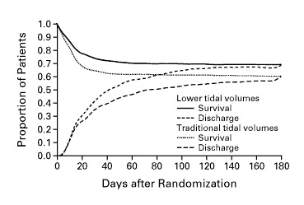
ARDSNet: Probability of Survival and Discharged Home¹
Based on animal studies and some small clinical studies, the ARDSNet Trial (2000, NEJM) compared outcomes using traditional tidal volumes (>10 cc/kg) to lower volumes (4–6 cc/kg) in patients with ARDS and ALI and found significant benefit.
1. Ventilation with lower tidal volumes as compared with traditional tidal volumes for acute lung injury and the acute respiratory distress syndrome. The Acute Respiratory Distress Syndrome Network. N Engl J Med. 2000 342(18):1301-8. PMID: 10793162.

Slide 21
Primary Findings¹
VARIABLE | GROUP RECEIVING LOWER TIDAL VOLUMES | GROUP RECEIVING TRADITIONAL TIDAL VOLUMES | P VALUE
Death before discharge home and breathing without assistance (%) | 31.0 | 39.8 | 0.007
Breathing without assistance by day 28 (%) | 65.7 | 55.0 | <0.001
Number of ventilator-free days, days 1 to 28 | 12±11 | 10±11 | 0.007
Barotrauma, days 1 to 28 | 10 | 11 | 0.430
Number of days without failure of nonpulmonary organs or systems, days 1 to 28 | 15±11 | 12±11 | 0.006
Plus–minus values are means ±SD. The number of ventilator-free days is the mean number of days from day 1 to day 28 on which the patient had been breathing without assistance for at least 48 consecutive hours. Barotrauma was defined as any new pneumothorax, pneumomediastinum, or subcutaneous emphysema, or a pneumatocele that was more than 2 cm in diameter. Organ and system failures were defined as described in the Methods section.
1. Ventilation with lower tidal volumes as compared with traditional tidal volumes for acute lung injury and the acute respiratory distress syndrome. The Acute Respiratory Distress Syndrome Network. N Engl J Med. 2000 342(18):1301-8. PMID: 10793162.

Slide 22
LTVV in ARDS
Large V_{t} and the high pressures it generates were harmful^{3,4}
LTVV became the mainstay of ARDS management
  Ventilate with V_{t} of 4–6 cc/kg PBW
  Plateau pressures should be measured, documented, and targeted to be no more then 30 cm H₂0 (too difficult to measure transpulmonary pressures clinically)
  PEEP/FIO₂ escalation and de-escalation algorithm
PBW = predicted body weight
It is based on weight and sex.
3. Putensen C, Theuerkauf N, Zinserling J, et al. Meta-analysis: ventilation strategies and outcomes of the acute respiratory distress syndrome and acute lung injury. Ann Intern Med. 2009 151(8):566-76. PMID: 19841457.
4. Girard TD, Bernard GR. Mechanical ventilation in ARDS: a state-of-the-art review. Chest. 2007 131(3):921-9. PMID: 17356115.

Slide 23
Beyond ARDS? Emerging Evidence⁵
Multi-hit theory
  Priming: initial insult → at risk for ARDS
  Pneumonia
  Sepsis
  Trauma
  Noncardiogenic shock
  Multiple transfusions
  Cardiopulmonary bypass
Large V_{t} and large transpulmonary pressures leads to amplification of inflammation and ventilator induced lung injury (iatrogenic ARDS)
Lellouche F, Lipes J. Prophylactic protective ventilation: lower tidal volumes for all critically ill patients? Intensive Care Med. 2013 39(1):6-15. PMID: 23108608.

Slide 24
Beyond ARDS? Emerging Evidence⁵
Direct lung insult*
Ventilator-
Induced
Lung Injury
OR
ARDS
Indirect lung insult**
*Direct lung insults
**Indirect lung insults
Pneumonia
Aspiration
Toxic inhalation
Pulmonary contusion
Pulmonary vasculitis
Sepsis
Systemic inflammatory response syndrome
Trauma
Pancreatitis
Post-circulatory arrest
Multiple transfusions
Severe burns
Cardiopulmonary bypass
Lellouche F, Lipes J. Prophylactic protective ventilation: lower tidal volumes for all critically ill patients? Intensive Care Med. 2013 39(1):6-15. PMID: 23108608.

Slide 25
ICU Patient Results⁵ (Qualitative Systematic Review)
 |  |  |  | Control Ventilatory Settings |  | Experimental Ventilatory Settings
Study | Study Design | ICU | No. of Patients | Tidal Volume (ml/kg) | PEEP (cmH20) | Tidal Volume (ml/kg) | PEEP (cmH20) | Main findings with protective ventilation
Lee, et al. | RCT | Surgical | 103 | 12 | 5 | 6 | 5 | Trend for decreased pulmonary infections and decrease in MG duration
Gajic, et al. (2004) | COH | Med/surg | 332 | – | – | – | – | OR for ALI = 1.3 with VT >6 ml/kg
Gajic, et al. (2005) | COH | Med/surg | 3,261 | – | – | – | – | OR for ARDS = 2.6 with VT >700 ml
Mascia, et al. (2007) | OBS | Neurocritical | 86 | 9.5^{b} | 3.7^{b} | 10.4^{b} | 4.2^{b} | RR for ALI = 5.1 with high VT. Decreased inflammatory cytokines with low VT
Determann, et al. | RCT | Med/surg | 150 | 10 | –ª | 6 | –ª | RR for ALI = 5.1 with high VT. Decreased inflammatory cytokines with low VT
Pinheiro de Oliveira, et al. | RCT | Med/surg | 20 | 10–12 | 5 | 5–7 | 5 | Decreased BAL cytokines with low VT
Mascia, et al. (2010) | RCT | Med/surg | 118 | 10–12 | 3–5 | 6–8 | 8–10 | Increase in eligible and harvested lungs with low VT
ªPEEP titrated based on a PEEP/FIO₂ ladder
^{b}Mean results
Lellouche F, Lipes J. Prophylactic protective ventilation: lower tidal volumes for all critically ill patients? Intensive Care Med. 2013 39(1):6-15. PMID: 23108608.

Slide 26
Meta-analysis of LTVV in Patients Without Lung Injury⁶
________________________________________________________________________________________________ Mean (SD)
Protective Ventilation Conventional Ventilation P
(n=1,416) (n=1,406) Value
________________________________________________________________________________________________
Age, y 59.97 (7.92) 60.22 (7.36) .93
Weight, kg 72.71 (12.34) 72.13 (12.16) .93
Tidal volume, mL/kg IBW 6.45 (1.09) 10.60 (1.14) ˂.001
PEEP, cm H₂O 6.40 (2.39) 3.41 (2.79) .01
Plateau pressure, cm H₂O 16.63 (2.58) 21.35 (3.61) .006
Respiratory rate, breaths/min 18.02 (4.14) 13.20 (4.43) .01
Minute-volume, L/min 8.46 (2.90) 9.13 (2.70) .72
PaO₂/FIO₂ 304.41 (65.74) 312.97 (68.13) .51
PaCO₂/ mm Hg 41.05 (3.79) 37.90 (4.19) .003
pH 7.37 (0.03) 7.40 (0.03) .11
6. Serpa Neto A, Cardoso SO, Manetta JA, et al. Association between use of lung-protective ventilation with lower tidal volumes and clinical outcomes among patients without acute respiratory distress syndrome: a meta-analysis. JAMA. 2012 308(16):1651-9. PMID: 23093163.

Slide 27
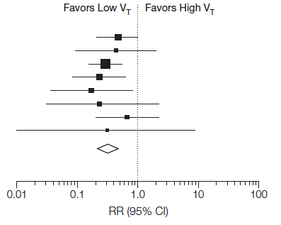
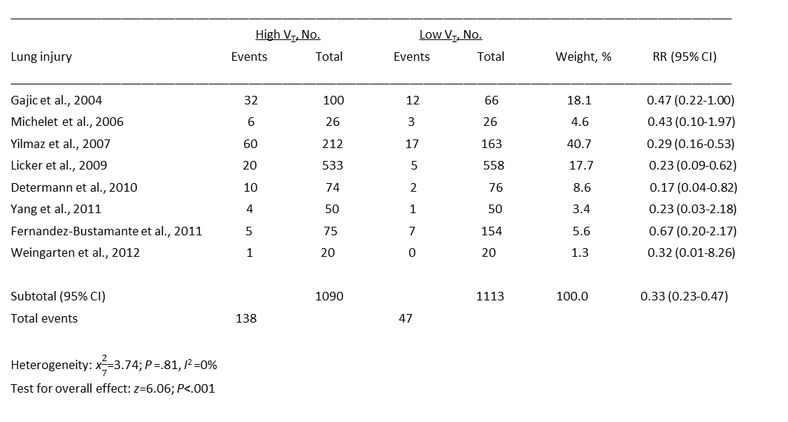
LTVV in Patients Without Lung Injury⁶
____________________________________________________________________________________________________________
High V_{T}, No. Low V_{T}, No.
Lung injury Events Total Events Total Weight, % RR (95% CI)
____________________________________________________________________________________________________________
Gajic et al., 2004 32 100 12 66 18.1 0.47 (0.22-1.00)
Michelet et al., 2006 6 26 3 26 4.6 0.43 (0.10-1.97)
Yilmaz et al., 2007 60 212 17 163 40.7 0.29 (0.16-0.53)
Licker et al., 2009 20 533 5 558 17.7 0.23 (0.09-0.62)
Determann et al., 2010 10 74 2 76 8.6 0.17 (0.04-0.82)
Yang et al., 2011 4 50 1 50 3.4 0.23 (0.03-2.18)
Fernandez-Bustamante et al., 2011 5 75 7 154 5.6 0.67 (0.20-2.17)
Weingarten et al., 2012 1 20 0 20 1.3 0.32 (0.01-8.26)
Subtotal (95% CI) 1090 1113 100.0 0.33 (0.23-0.47)
Total events 138 47
Heterogeneity: x$\frac{2}{7}$=3.74; P =.81, I² =0%
Test for overall effect: z=6.06; P˂.001
FAVORS LOW V_{T}
FAVORS HIGH V_{T}
LTVV significantly reduced development of lung injury
For every 11 patients who received LTVV, 1 case of lung injury was prevented
6. Serpa Neto A, Cardoso SO, Manetta JA, et al. Association between use of lung-protective ventilation with lower tidal volumes and clinical outcomes among patients without acute respiratory distress syndrome: a meta-analysis. JAMA. 2012 308(16):1651-9. PMID: 23093163.

Slide 28
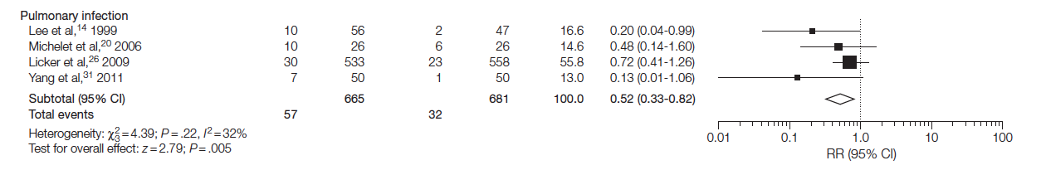
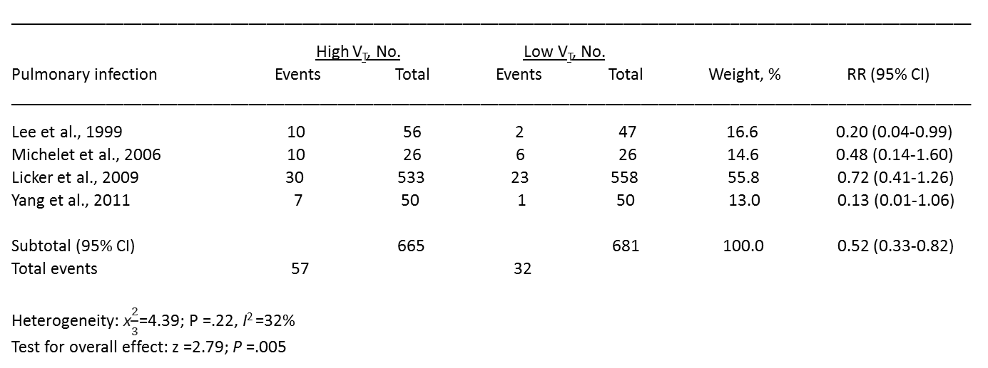
LTVV in Patients Without Lung Injury⁶
____________________________________________________________________________________________________________
High V_{T}, No. Low V_{T}, No.
Pulmonary infection Events Total Events Total Weight, % RR (95% CI)
____________________________________________________________________________________________________________
Lee et al., 1999 10 56 2 47 16.6 0.20 (0.04-0.99)
Michelet et al., 2006 10 26 6 26 14.6 0.48 (0.14-1.60)
Licker et al., 2009 30 533 23 558 55.8 0.72 (0.41-1.26)
Yang et al., 2011 7 50 1 50 13.0 0.13 (0.01-1.06)
Subtotal (95% CI) 665 681 100.0 0.52 (0.33-0.82)
Total events 57 32
Heterogeneity: x$\frac{2}{3}$=4.39; P =.22, I² =32%
Test for overall effect: z =2.79; P =.005
LTVV significantly reduces the incidence of pulmonary infection
For every 26 patients who received LTVV, 1 pulmonary infection was prevented
FAVORS LOW V_{T}
FAVORS HIGH V_{T}
6. Serpa Neto A, Cardoso SO, Manetta JA, et al. Association between use of lung-protective ventilation with lower tidal volumes and clinical outcomes among patients without acute respiratory distress syndrome: a meta-analysis. JAMA. 2012 308(16):1651-9. PMID: 23093163.

Slide 29
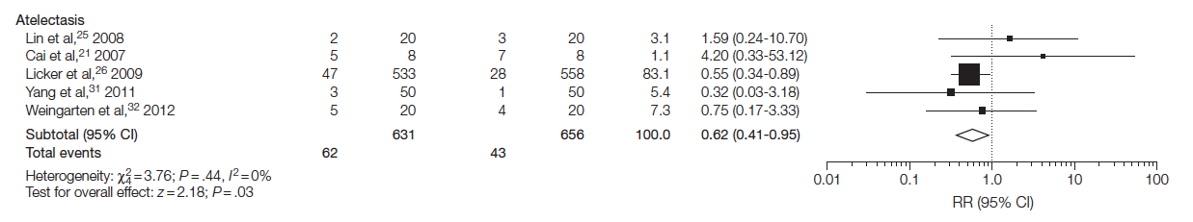
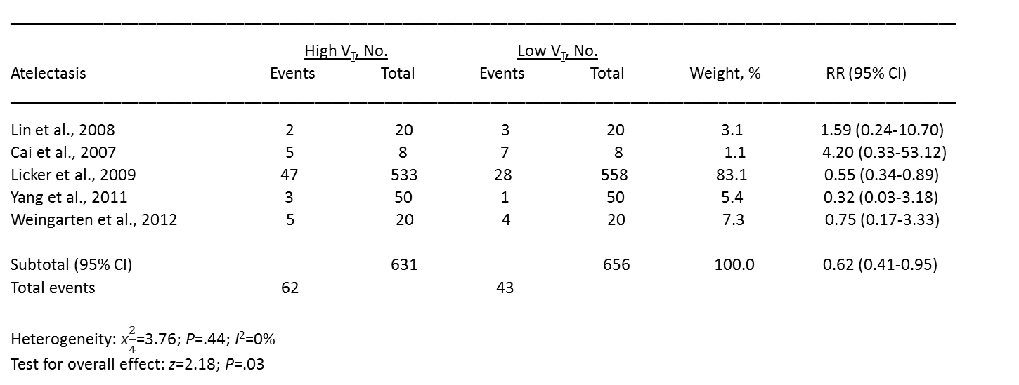
LTVV in Patients Without Lung Injury⁶
____________________________________________________________________________________________________________
High V_{T}, No. Low V_{T}, No.
Atelectasis Events Total Events Total Weight, % RR (95% CI)
____________________________________________________________________________________________________________
Lin et al., 2008 2 20 3 20 3.1 1.59 (0.24-10.70)
Cai et al., 2007 5 8 7 8 1.1 4.20 (0.33-53.12)
Licker et al., 2009 47 533 28 558 83.1 0.55 (0.34-0.89)
Yang et al., 2011 3 50 1 50 5.4 0.32 (0.03-3.18)
Weingarten et al., 2012 5 20 4 20 7.3 0.75 (0.17-3.33)
Subtotal (95% CI) 631 656 100.0 0.62 (0.41-0.95)
Total events 62 43
Heterogeneity: x$\frac{2}{4}$=3.76; P=.44; I²=0%
Test for overall effect: z=2.18; P=.03
LTVV significantly reduced the incidence of atelectasis
FAVORS LOW V_{T}
FAVORS HIGH V_{T}
6. Serpa Neto A, Cardoso SO, Manetta JA, et al. Association between use of lung-protective ventilation with lower tidal volumes and clinical outcomes among patients without acute respiratory distress syndrome: a meta-analysis. JAMA. 2012 308(16):1651-9. PMID: 23093163.

Slide 30
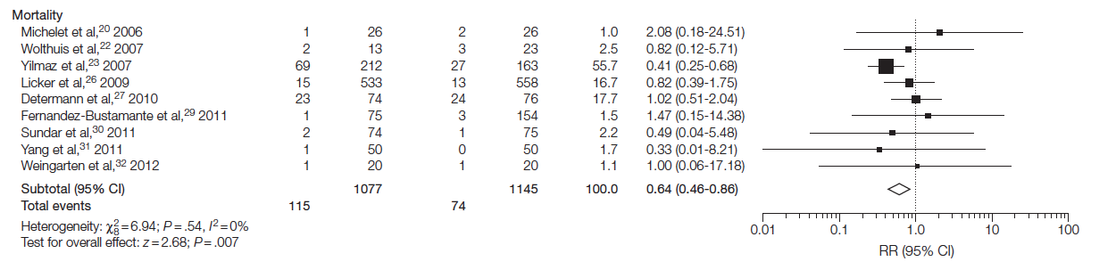
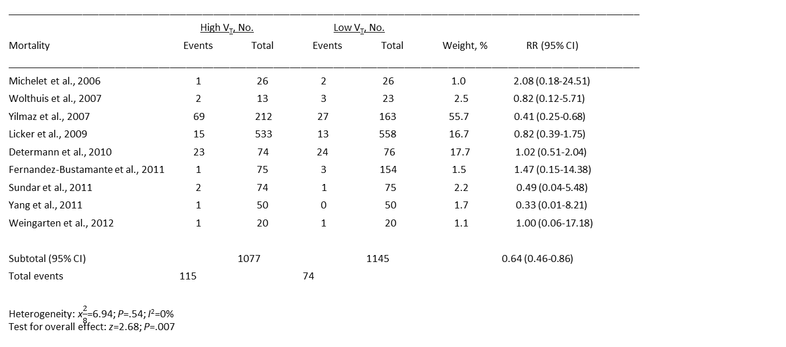
LTVV in Patients Without Lung Injury⁶
____________________________________________________________________________________________________________________
High V_{T}, No. Low V_{T}, No.
Mortality Events Total Events Total Weight, % RR (95% CI)
____________________________________________________________________________________________________________________
Michelet et al., 2006 1 26 2 26 1.0 2.08 (0.18-24.51)
Wolthuis et al., 2007 2 13 3 23 2.5 0.82 (0.12-5.71)
Yilmaz et al., 2007 69 212 27 163 55.7 0.41 (0.25-0.68)
Licker et al., 2009 15 533 13 558 16.7 0.82 (0.39-1.75)
Determann et al., 2010 23 74 24 76 17.7 1.02 (0.51-2.04)
Fernandez-Bustamante et al., 2011 1 75 3 154 1.5 1.47 (0.15-14.38)
Sundar et al., 2011 2 74 1 75 2.2 0.49 (0.04-5.48)
Yang et al., 2011 1 50 0 50 1.7 0.33 (0.01-8.21)
Weingarten et al., 2012 1 20 1 20 1.1 1.00 (0.06-17.18)
Subtotal (95% CI) 1077 1145 0.64 (0.46-0.86)
Total events 115 74
Heterogeneity: x$\frac{2}{8}$=6.94; P=.54; I²=0%
Test for overall effect: z=2.68; P=.007
LTVV significantly reduced mortality
For every 23 patients who received LTVV, a life was saved
Hospital length of stay was also significantly reduced (6.91 days vs. 8.87 days)
FAVORS LOW V_{T}
FAVORS HIGH V_{T}
6. Serpa Neto A, Cardoso SO, Manetta JA, et al. Association between use of lung-protective ventilation with lower tidal volumes and clinical outcomes among patients without acute respiratory distress syndrome: a meta-analysis. JAMA. 2012 308(16):1651-9. PMID: 23093163.

Slide 31
Focusing on ICU Patients Only
Acute lung injury
  Three trials with 691 patients
  RR=0.33; 95% CI 0.21 to 0.51
  p=0.001
Mortality
  Three trials with 561 patients
  RR=0.57; 95% CI 0.38 to 0.84
  p=0.005
Pulmonary infection
  One trial with 103 patients
  RR=0.20; 95% CI 0.04 to 0.99
  p=0.05
RR = Relative risk
CI = Confidence interval

Slide 32
Quality Gap
Large V_{t} still commonly used in ICUs⁵
  Up to 18 cc/kg PBW
Pulmonary damage shown to occur within a few hours of mechanical ventilation⁷
Clinicians often miss early or mild ARDS or fail to appreciate the at-risk patient quality gap⁸
Lellouche F, Lipes J. Prophylactic protective ventilation: lower tidal volumes for all critically ill patients? Intensive Care Med. 2013 39(1):6-15. PMID: 23108608.
Zupancich E, Paparella D, Turani F, et al. Mechanical ventilation affects inflammatory mediators in patients undergoing cardiopulmonary bypass for cardiac surgery: a randomized clinical trial. J Thorac Cardiovasc Surg. 2005 130(2):378-83. PMID: 16077402.
Herasevich V, Tsapenko M, Kojicic M, et al. Limiting ventilator-induced lung injury through individual electronic medical record surveillance. Crit Care Med. 2011 39(1):34-9. PMID: 20959788.

Slide 33
Low Tidal Volume Implementation
AHRQ Safety Program for Mechanically Ventilated Patients

Slide 34

Preemption
Why wait?
Why not initiate LTVV on all patients to minimize risk?
Too late once ARDS/ALI criteria are met
A few hours of mechanical ventilation with large V_{t} may start the cascade

Slide 35
Low Tidal Volume Implementation⁹
A 2013 study reviewed patients undergoing relatively major abdominal surgery and receiving mechanical ventilation for between 4 and 5 hours
Patients who received a low tidal volume strategy using PEEP settings had statistically significant improvements in a variety of parameters when compared to standard tidal ventilations
  Postoperative complications
  Pulmonary complications
  Length of stay
9. Furtier E, Constantin JM, Paugam-Burtz C, et al. A trial of intraoperative low-tidal-volume ventilation in abdominal surgery. N Eng J Med. 2013 Aug 1;369(5):428-37. PMID: 23902482.

Slide 36
Low Tidal Volume Implementation
Patients at risk of ARDS should be ventilated with a V_{t} of 6–8 ml/kg PBW
Tidal volumes of this size eliminate most hypercarbia

Slide 37
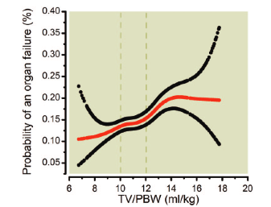
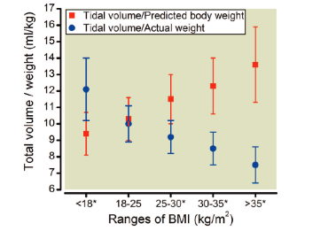
Use PBW Rather Than ABW
Predicted body weight (PBW) is based on sex and height
For BMI > 25, actual body weight (ABW) will lead to incorrect V_{t} and is associated with increased organ failure⁵
Lellouche F, Lipes J. Prophylactic protective ventilation: lower tidal volumes for all critically ill patients? Intensive Care Med. 2013 39(1):6-15. PMID: 23108608.

Slide 38
What About Positive End-Expiratory Pressure?
Low V_{t} does cause atelectasis, as correctly suggested by Bendixen’s research in 1963
  But only when it is used in isolation—without PEEP
  PEEP counteracts this tendency, especially in obesity
Prevents one form of “atelectrauma” (alveoli snapping open and closed)
8–12 cm H₂O PEEP is used in many studies of pre-emptive low V_{t}, but many also use 5–8 cm H₂O
Use ARDSNet protocol if ARDS is diagnosed

Slide 39
What About PEEP?
Unclear optimal level in nonacute lung injury (non-ALI) patients
Clear that we should not use zero end-expiratory pressure
  ZEEP is considered any PEEP < 5
  Associated with negative outcomes^{10,11}
    Hypoxia
    Ventilator-associated pneumonia
    Increased mortality
10. Metnitz PG, Metnitz B, Moreno RP, et al. SAPS 3 Investigators. Epidemiology of mechanical ventilation: analysis of the SAPS 3 database. Intensive Care Med. 2009 35(5):816-25. PMID: 19288079.
11. Manzano F, Fernández-Mondéjar E, Colmenero M, et al. Positive-end expiratory pressure reduces incidence of ventilator-associated pneumonia in nonhypoxemic patients. Crit Care Med. 2008 36(8):2225–31. PMID: 18664777.

Slide 40
Respiratory Rate
Using Low V_{t} may require increased respiratory rates to prevent excessive hypercarbia
Permissive hypercapnia (partial pressure of carbon dioxide [pCO₂] in the 50s) may be needed
  Usually tolerated well unless there is also a severe metabolic acidosis
  Maintain minute ventilation as best as possible
  May need to increase to 30 breaths per minute or more
  Potential downsides with these high rates include breath-stacking and high auto-PEEP

Slide 41
Plateau Pressure
Need to keep <30 cm H₂O
To achieve this, V_{t} may need to be dropped further depending on compliance
Bronchodilators, sedation, or very rarely paralysis may be necessary
Sedation and paralysis should be used very sparingly, especially paralytics, unless severe ARDS is present

Slide 42
Barriers to Low V_{t} Implementation
Translation of evidence into practice is difficult
Only 46% of eligible ARDS patients received LTVV 8 years after ARDSNet trial¹²
Application to non-ALI patients is not well known, but likely much lower nationally
12. Umoh NJ, Fan E, Mendez-Tellez PA, et al. Patient and intensive care unit organizational factors associated with low tidal volume ventilation in acute lung injury. Crit Care Med. 2008 36(5):1463-8. PMID: 18434907.

Slide 43
Address Variability in Practice
Do you have a standardized protocol?
If a provider orders settings outside of LTVV strategy parameters, is a change to the order required?
  How is the order modified?
Do your providers comply with protocols?

Slide 44
Steps to Implementing a LTVV Strategy
Educate staff on LTVV strategy
Identify inconsistencies in prescriber engagement or agreement
Garner buy-in from all providers
  Address and work with dissenters
Develop standard protocol
Employ default strategy that encourages LTVV

Slide 45
Protocol
Standardize protocol
  Electronic health record
  Paper
Assign custodian of process
  Respiratory therapist
  Physician
Include tools to support or reinforce expectation
Add system redundancies

Slide 46
Closing Gaps in Quality
Audit your intervention practices
Review LTVV data
  LTVV Data Collection tool
Tip: The LTVV Data Collection tool can be found at https://www.ahrq.gov/professionals/quality-patient-safety/hais/tools/mvp/modules/technical/daily-ltvv-tool.html .

Slide 47
Summary
Low tidal volume ventilation
  Beneficial for patients with ALI/ARDS
  Data also suggest it is beneficial in non-ALI/ARDS ICU patients
Current recommendations
  Target Vt 6–8 mL/Kg (or less if ARDS)
  PEEP ≥ 5 cm H₂O

Slide 48
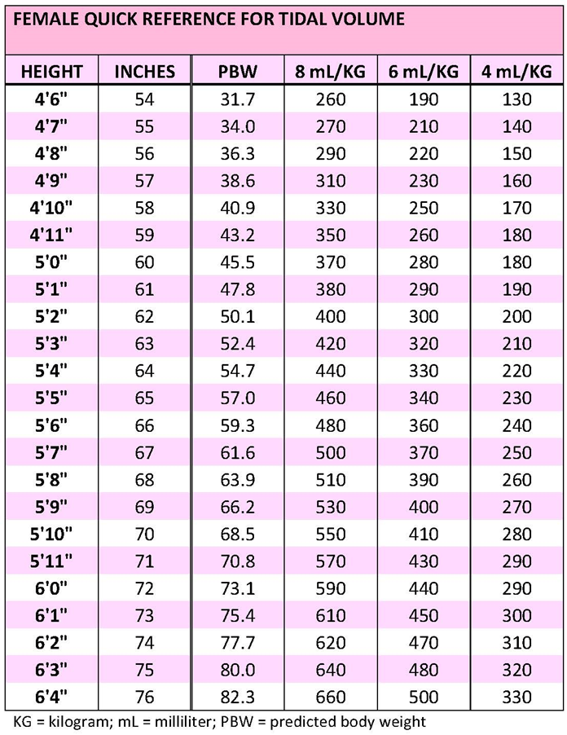
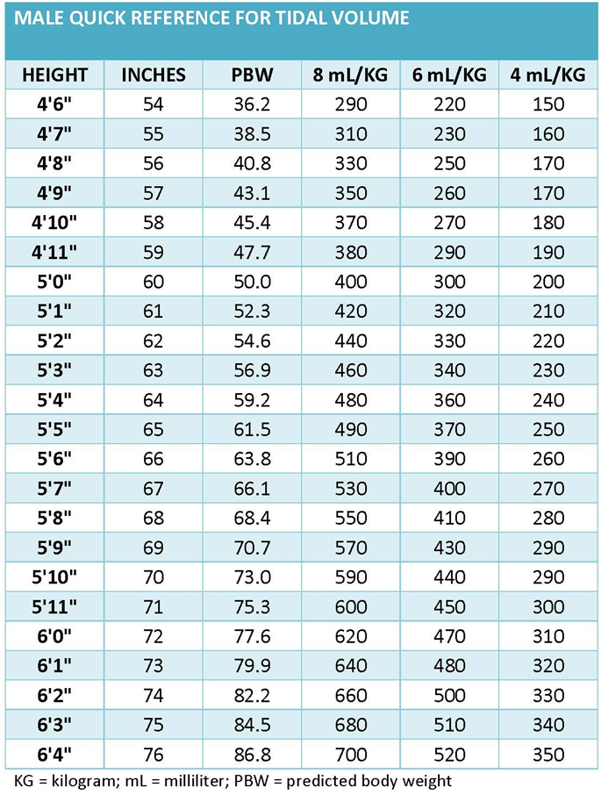
LTVV Quick Reference for Tidal Volume

Slide 49

Questions?

Slide 50
References
Ventilation with lower tidal volumes as compared with traditional tidal volumes for acute lung injury and the acute respiratory distress syndrome. The Acute Respiratory Distress Syndrome Network. N Engl J Med. 2000;342(18):1301-8. PMID: 10793162.
Bendixen HH, Hedley Whyte J, Laver MB. Impaired oxygenation in surgical patients during general anesthesia with controlled ventilation. N Engl J Med. 1963;269:991-6. PMID: 14059732.
Putensen C, Theuerkauf N, Zinserling J, et al. Meta-analysis: ventilation strategies and outcomes of the acute respiratory distress syndrome and acute lung injury. Ann Intern Med. 2009;151(8):566-76. PMID: 19841457.
Girard TD, Bernard GR. Mechanical ventilation in ARDS: a state-of-the-art review. Chest. 2007;131(3):921-9. PMID: 17356115.

Slide 51
References
Lellouche F, Lipes J. Prophylactic protective ventilation: lower tidal volumes for all critically ill patients? Intensive Care Med. 2013;39(1):6-15. PMID: 23108608.
Serpa Neto A, Cardoso SO, Manetta JA, et al. Association between use of lung-protective ventilation with lower tidal volumes and clinical outcomes among patients without acute respiratory distress syndrome: a meta-analysis. JAMA. 2012;308(16):1651-9. PMID: 23093163.
Zupancich E, Paparella D, Turani F, et al. Mechanical ventilation affects inflammatory mediators in patients undergoing cardiopulmonary bypass for cardiac surgery: a randomized clinical trial. J Thorac Cardiovasc Surg. 2005;130(2):378-83. PMID: 16077402.
Herasevich V, Tsapenko M, Kojicic M, et al. Limiting ventilator-induced lung injury through individual electronic medical record surveillance. Crit Care Med. 2011;39(1):34-9. PMID: 20959788.

Slide 52
References
Furtier E, Constantin JM, Paugam-Burtz C, et al. A trial of intraoperative low-tidal-volume ventilation in abdominal surgery. N Eng J Med. 2013 Aug 1;369(5):428-37. PMID: 23902482.
Metnitz PG, Metnitz B, Moreno RP, et al. SAPS 3 Investigators. Epidemiology of mechanical ventilation: analysis of the SAPS 3 database. Intensive Care Med. 2009;35(5):816-25. PMID: 19288079.
Manzano F, Fernández-Mondéjar E, Colmenero M, et al. Positive-end expiratory pressure reduces incidence of ventilator-associated pneumonia in nonhypoxemic patients. Crit Care Med. 2008;36(8):2225–31. PMID: 18664777.
Umoh NJ, Fan E, Mendez-Tellez PA, et al. Patient and intensive care unit organizational factors associated with low tidal volume ventilation in acute lung injury. Crit Care Med. 2008;36(5):1463-8. PMID: 18434907.

