Slide 1
National Center for Excellence in Primary Care Research
Presents
Research on Person-Centered Care
June 27, 2024
Presented by:
Ian Hargraves, PhD
Alex Krist, MD, MPH
Zsolt Nagykáldi, PhD
Moderated by:
Maya Gerstein, DrPH

Slide 2
NCEPCR Webinar Series
The views expressed in this webinar do not represent official views of the U.S. Department of Health and Human Services or the Agency for Healthcare Research and Quality.
Notes:
AHRQ is hosting a webinar series, Strengthening Primary Care Research. Today’s webinar is the fifth in the series. Stay tuned to the AHRQ channels for future webinar dates and registration.

Slide 3
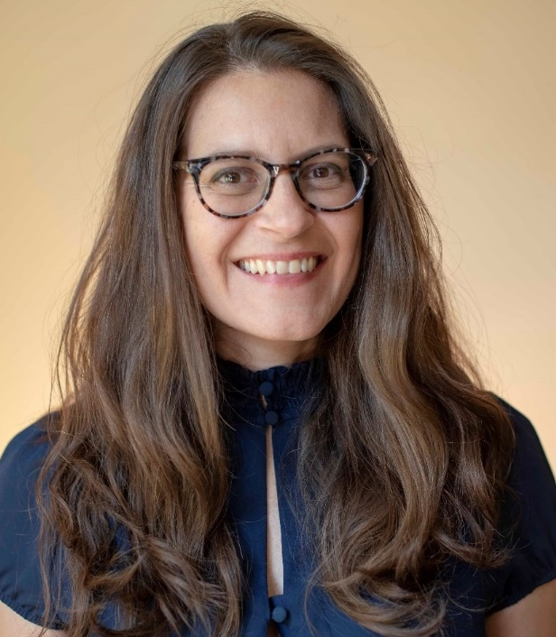
Welcome
Aimee R. Eden, PhD, MPH
Acting Director,
National Center for Excellence in Primary Care Research (NCEPCR),
AHRQ
Notes:
Good day, everyone. My name is Aimee Eden. I am the acting Director for AHRQ’s National Center for Excellence in Primary Care Research. It is my pleasure to welcome you to today’s webinar.

Slide 4

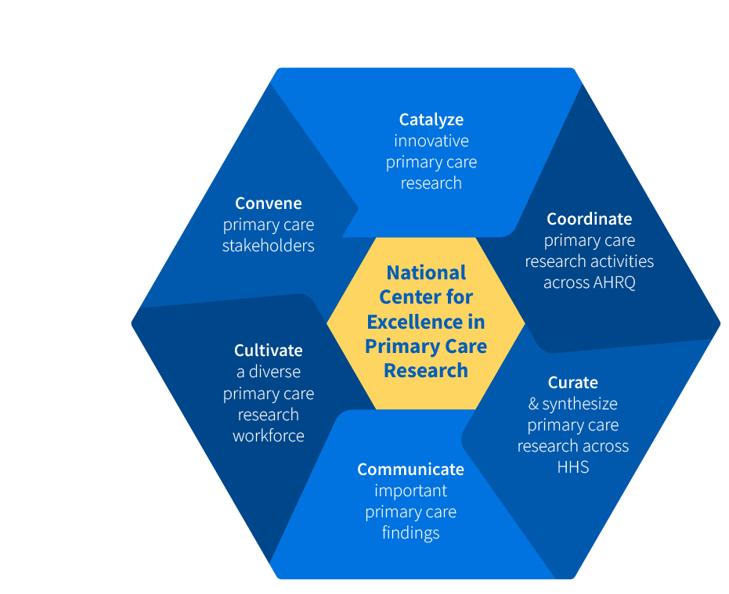
NCEPCR Vision & Mission
VISION:
NCEPCR envisions a future where all patients receive high quality, whole person, evidence-based, affordable primary health care from a healthy primary care workforce.
MISSION:
NCEPCR’s mission is to support transformative primary care research, tools and methods for implementation, and the next generation of primary care researchers to improve the delivery of primary care.

Slide 5

NCEPCR 2021-2022 Report

Slide 6
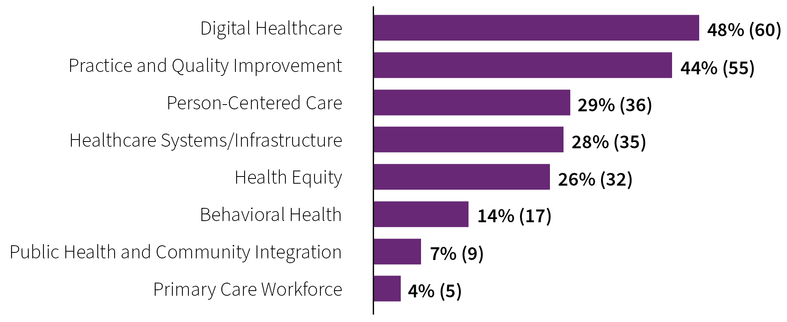
2021-2022 Primary Care Grants by Topic Areas (N=124)

Slide 7
Primary Care Funding Opportunities
Research to Advance the Science of Primary Care (R01)
  To build evidence about the characteristics and value of primary care that influence patient outcomes and advance health equity, such as care coordination, continuity of care, and comprehensiveness of care, person-centered, whole healthcare, and trust, and how these can be improved and effectively delivered to strengthen primary healthcare.
Small Research Projects to Advance the Science of Primary Care (R03)
  To support small research projects that advance the understanding of the role and capacity of primary care to increase the value and quality of care and improve patient outcomes and population health by delivering person-centered care.

Slide 8
Today’s Webinar Objectives
Research Methods on Person-Centered Care
Highlight research involving person-centered tools and processes that support primary care practice.
Notes:
The goal of today’s webinar is to 1. Highlight examples of primary care research on integration of behavioral health and
2. Introduce AHRQ resources that support behavioral health integration.

Slide 9

Moderator
Maya Gerstein, DrPH
Health Science Administrator,
AHRQ
Notes:
Now I’d like to introduce the moderator for today’s webinar, Dr. Yalda Jabbarpour, from The Robert Graham Center.
Dr. Jabbarpour will facilitate the Q&A and discussion, which will take place after all of the presentations are finished. Welcome, Yalda!

Slide 10
Today’s Webinar Presenters
Ian Hargraves, PhD, Mayo Rochester, SDMo – a Measure of the Occurrence of SDM in the Care of Patients with Chronic Conditions
Alex Krist, MD, MPH, Virginia Commonwealth University School of Medicine, Patient Preferences in Addressing Health Behaviors, Mental Health, and Social Needs
Zsolt Nagykáldi, PhD, University of Oklahoma College of Medicine, Reducing Opioid Use Incidence in Seniors in Oklahoma (RISE-OK)
Notes:
Hello everyone. We have three primary care researchers here today. Join me in welcoming:
Hannah Neprash, PhD (University of Minnesota; School of Public Health; Division of Health Policy & Management), The Role of Nurse Practitioners in Improving Access to Primary Care
Lawrence P. Casalino, MD, PhD (Weill Cornell Medical College, Department of Population Health Sciences), Primary Care Physician-Staff Dyads (“Teamlets”): A Simple, Efficient Means to Improve Healthcare Quality and Decrease Cost
Sylvia Hysong, PhD (Baylor College of Medicine), Impact of Team Configuration and Team Stability on Primary Care Quality
.
Be sure to save your questions – we’ll have the Q&A session after all the presentations are over. You can also pop your questions into the chat for later.

Slide 11
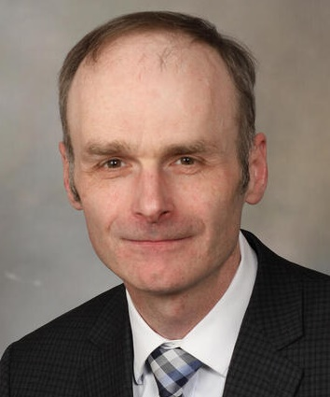
Presentation 1
Shared Decision Making Occurrence (SDMo) – a Measure of the Occurrence of SDM in the Care of Patients with Chronic Conditions
Ian Hargraves, MD Mayo Rochester
Notes:
Now I’d like to introduce our first presenter, Hannah Neprash, PhD, University of Minnesota; School of Public Health; Division of Health Policy & Management. Welcome Dr. Neprash.

Slide 12
Shared Decision Making (SDM)
Traditionally focuses on involving patients in decision making
  Declaring that a decision needs to be made and choices exist
  Inviting patient participation
  Providing information about options
  Weighing pros and cons against patient preferences

Slide 13
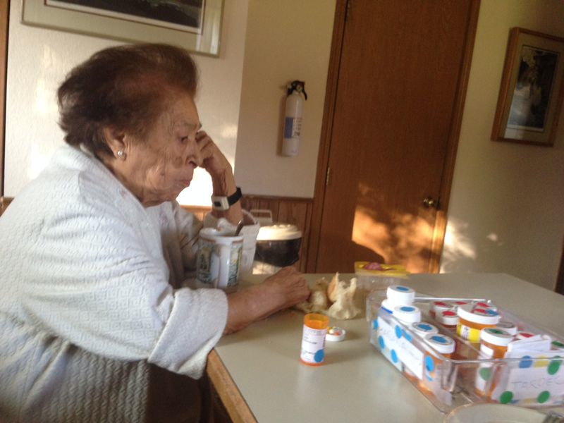
SDM and Chronic Care
Shared decision making
Better decisions
Better outcomes¹
Images: Ana Castañeda Guarderas. Permission to use image from the patient’s family on file

Slide 14
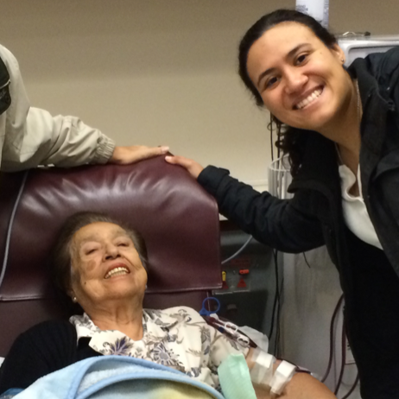

SDM Different in Different Situations
SDM didn’t happen by
involving the patient in weighing the pre-determined options for a pre-specified problem
SDM happened through
together, creatively problem-solving a problematic situation^{2,3}
Image: Ana Castañeda Guarderas

Slide 15
Multiple Modes of SDM in Chronic Care
Existing observer measures do not detect problem solving SDM or other modes of SDM⁵
Problem solving SDM as prevalent as weighing pros and cons in diabetes encounters⁴

Slide 16
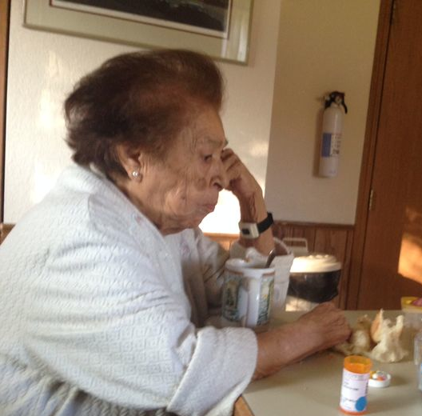
SDM in Chronic Care
Patients and clinicians working together
to change a
problematic
situation
(SDM)⁶
Image created with Microsoft Designer

Slide 17
Improving SDM in Chronic Care
Patients and clinicians working together
to change a
problematic
situation
(SDM)
Is it happening?
Better outcomes

Slide 18
SDMo – A Measure of the Occurrence of SDM in the Care of Patients with Chronic Conditions
To develop a theory
based observer measure of
SDM
In this encounter, are patient and clinician working together
to improve a
problematic
situation?
that can answer the fundamental question

Slide 19
Basis in Theory
Theoretical base
John Dewey’s
Method of Inquiry⁷
Problematic situations are troubling
no emotion = no problematic situation
Conversational inquiry
changes problematic situations
noticing
formulating
trying on
integrating

Slide 20



SDMo – A Measure of the Occurrence of SDM in the Care of Patients with Chronic Conditions
Observed encounter
Sensitizing items
(observable actions)
Informed global assessment
The patient and clinician are curious
The patient and clinician notice a potential problem
draft
The conversation generates possibilities
20

Slide 21
Methods
User centered design approach
  Aim 1: To develop an initial set of theory-based observable actions (items) that indicate SDM
  Aim 2: To field test and iteratively refine the SDMo items and training materials against video recordings of chronic care encounters
  Aim 3: To estimate the reliability and validity of SDM against video recordings of chronic care encounters

Slide 22

Aim 1: Produce Initial Instrument
Theoretical base
a
Observing working together in encounters
Creating and trying out items
Literature description of SDM process
Facilitated brain
storming
Existing observer items
Cross disciplinary literature survey
Theory refinement
Delphi review
Patient and clinician experience
Create an initial set of theory-based items
The patient and clinician are curious
The patient and clinician notice a potential problem
draft
The conversation generates possibilities
22

Slide 23


Aim 2: User Test, Refine >> Final Instrument
Theoretical base
SDMo ready to use
novice users
23

Slide 24
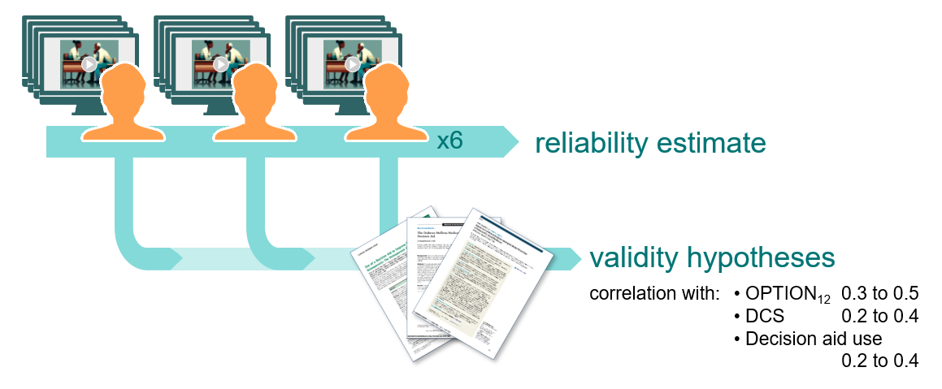
Aim 3: Estimate Reliability and Validity
24

Slide 25
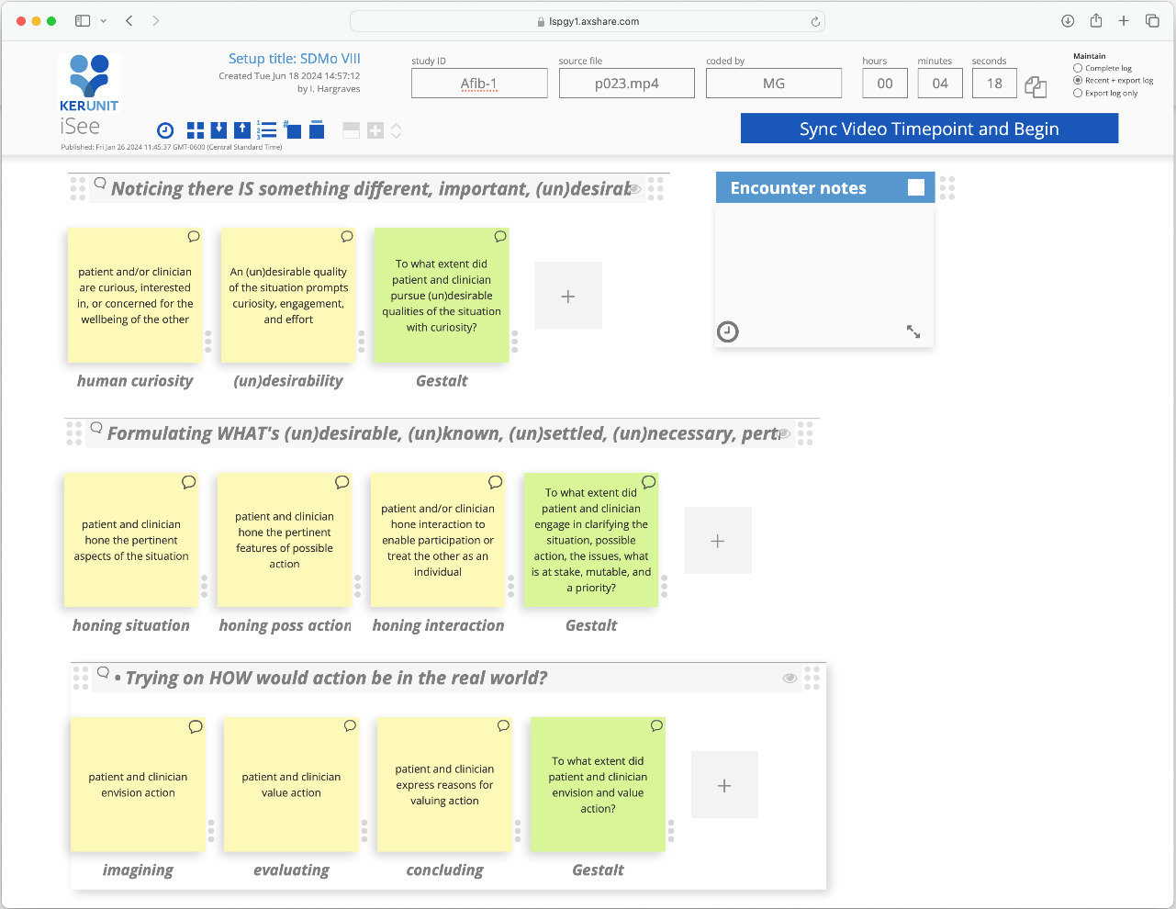
Findings
Aim 1
1,300 items generated. Reduced to
40 to Delphi
Theory used in several non-medical disciplines, occasionally arises in medical literature, but not in its collaborative form⁸
Novel in SDM literature
Possible to shift focus away from individual behaviors to the purposeful use of method
Aim 2
Custom web-based interface created for prototyping
draft

Slide 26
Lesson Learned
Novel models are time intensive to realize
Importance of language for novel approaches
Balancing theory depth with usability
Team balance

Slide 27
References
1. Shay LA, Lafata JE. Where is the evidence? A systematic review of shared decision making and patient outcomes. Med Decis Making. 2015
2. Hargraves IG, Montori VM, Brito JP, Kunneman M, Shaw K, LaVecchia C, et al. Purposeful SDM: A problem-based approach to caring for patients with shared decision making. Patient Education and Counseling. 2019
3. Hargraves IG, Fournier AK, Montori VM, Bierman AS. Generalized shared decision making approaches and patient problems. Adapting AHRQ’s SHARE Approach for Purposeful SDM. Patient Education and Counseling. 2020
4. Ruissen MM, Montori VM, Hargraves IG, Branda ME, Leon Garcia M, de Koning EJ, et al. Problem-based shared decision-making in diabetes care: a secondary analysis of video-recorded encounters. BMJ Evid Based Med. 2023
5. Hartasanchez SA, Grande SW, Montori VM, Kunneman M, Brito JP, McCarthy S, et al. Shared decision making process measures and patient problems. Patient Educ Couns. 2022
6. Montori VM, Ruissen MM, Hargraves IG, Brito JP, Kunneman M. Shared decision-making as a method of care. BMJ Evid Based Med. 2023
7. Dewey J. Logic : the theory of inquiry. New York: H. Holt and company; 1938
8. Wright HG. Means, ends and medical care. Dordrecht: Springer; 2007

Slide 28
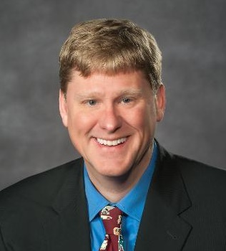

Presentation 2
Patient Preferences in Addressing Health Behaviors, Mental Health, and Social Needs
Alex Krist, MD, MPH
Virginia Commonwealth University School of Medicine
Notes:
Now I’d like to introduce our second presenter, Lawrence P. Casalino, MD, PhD, Weill Cornell Medical College, Department of Population Health Sciences, who is presenting on primary care physician staff dyads or “teamlets” – a simple, efficient means to improve healthcare quality and decrease cost. Welcome Dr. Casalino.

Slide 29

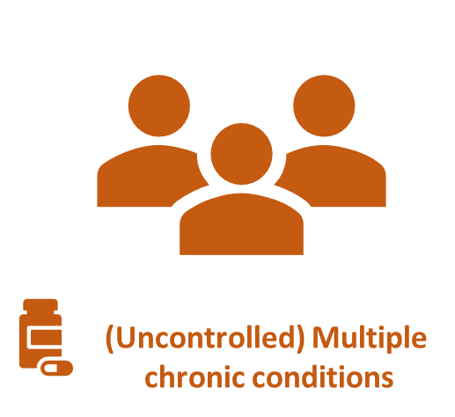


Root Causes of Poor Health
Unhealthy behaviors
Mental health risks
Unmet social needs

Slide 30
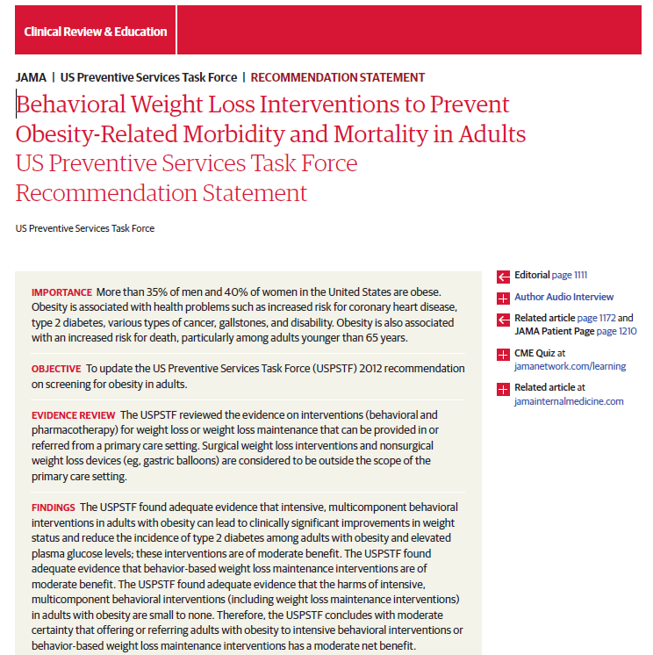
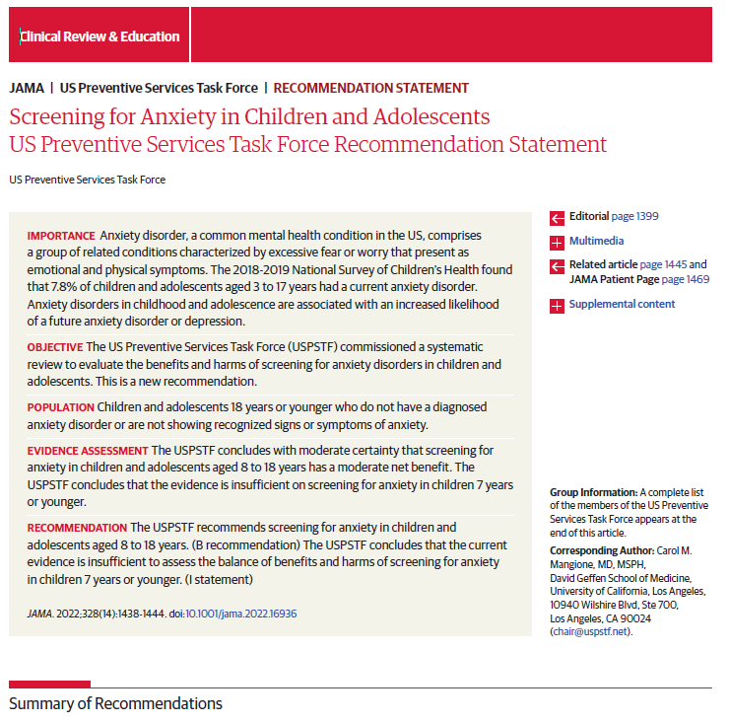
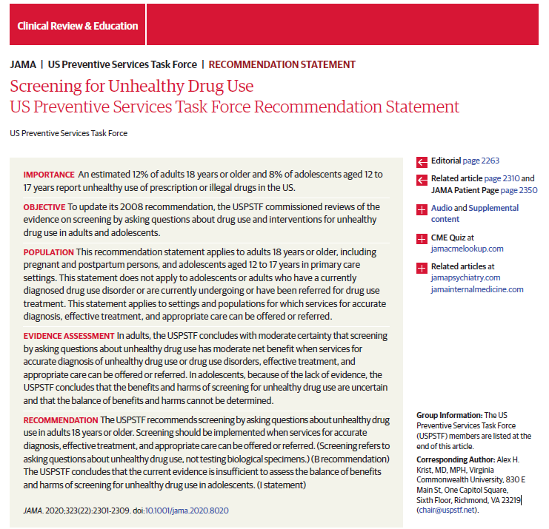
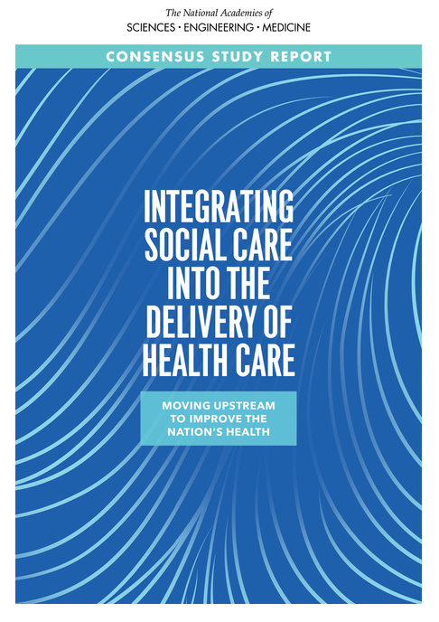
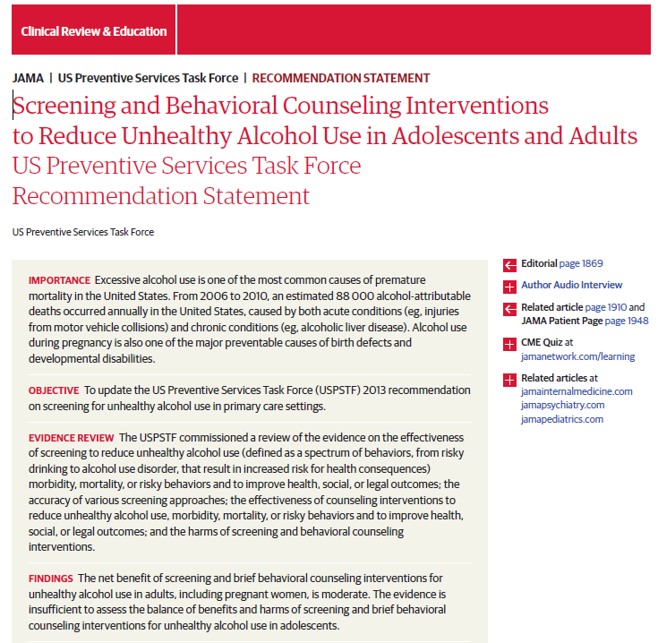
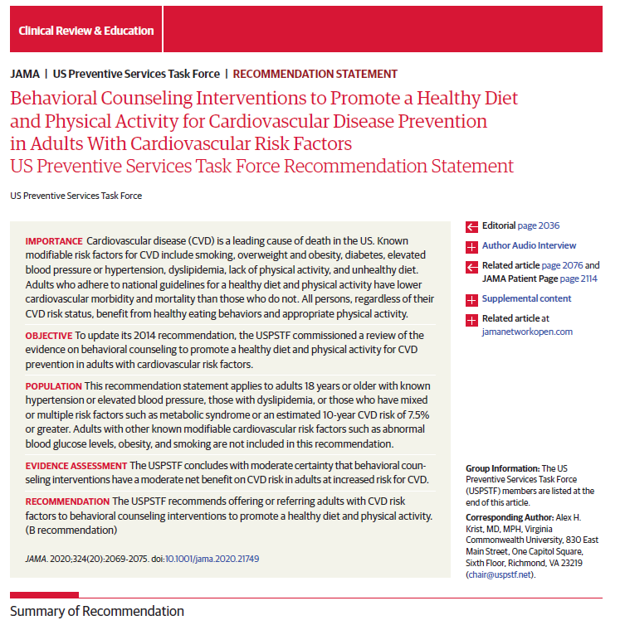
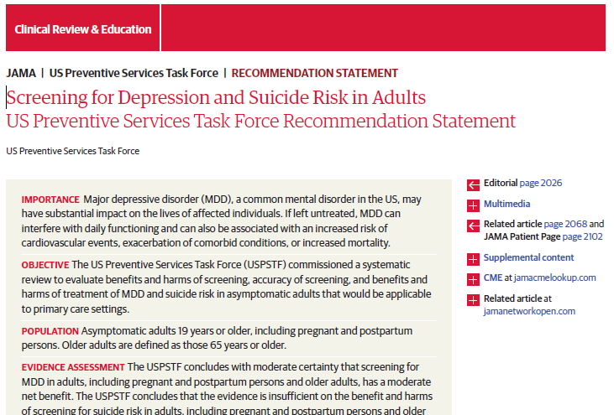
Many Recommendations to Screen and Counsel for These Root Causes

Slide 31
Specific Research Aims
To test a feasible, patient-centered, enhanced care planning approach to addressing root causes of poor health as a more effective strategy to improve control of chronic disease for people with multiple chronic conditions than conventional biomedical care
  Asses the Reach and Implementation of the care planning approach
  Compare the effectiveness of the care planning approach to conventional biomedical care
  Understand the patient, practice, and community contextual factors that influence outcomes

Slide 32
Methods – Overview
Five-year R01 funded by the Agency for Healthcare Research and Quality (AHRQ), award # 1R01HS02622-01A1 (in year 5 of 6)
Clinician-level randomized controlled trial in the Richmond, Fredericksburg, Charlottesville, and Fairfax regions of the ACORN practice-based research network
All patients with multiple chronic conditions and one uncontrolled were invited to participate
Goal of recruiting 10 patients per clinician

Slide 33






Methods – 4 Intervention Components
Patient Navigator and Community Health Worker support patient
Patient completes Health Risk Assessment and is presented with identified risk areas
Patient decides what they want to work on and creates personal care goal
Patients connected to Community Programs
Weekly updates confidence and progress with achieving goal

Slide 34
Health Risk Assessment (19 Topics)
Unhealthy Behaviors
Fruits and vegetables per day
Fast food per week
Soda per day
Weekly minutes of exercise
Tobacco use
Risky drinking
Illegal drug use
Mental Health
Depression
Anxiety
Loneliness
Poor sleep
Social Needs
Financial needs
Employment status
Food security
Transportation
Housing stability
Dental care
Intimate partner violence
Neighborhood safety

Slide 35
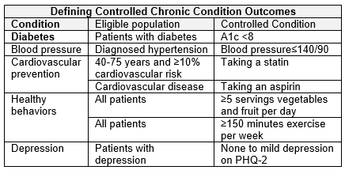
Methods
Participants
  Age 18 years and older
  ≥2 chronic conditions (cardiovascular disease, hypertension, hyperlipidemia, diabetes, obesity, depression)
  One condition uncontrolled
Four data sources
  Electronic health record
  MyOwnHealthReport database
  Patient survey
    Baseline, 6 and 12 months

Slide 36
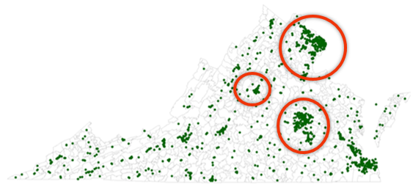
Participants
Recruited participants between Nov 2019 and Dec 2023
81 clinicians from 30 practices
Recruited 457 patients
  187 intervention patients
  270 control patients

Slide 37
Findings – Everyone Had a Risk!
580 unhealthy behaviors, 240 mental health risks, and 205 social needs
Created 236 health behavior, 29 mental health, and 12 social care plans

Slide 38



Findings – Patient Interests in Care Plans
Unhealthy behaviors
100% 1 or more
Health behavior care plans
92.5%
Mental health risks
66.8% 1 or more
Mental health care plans
23.2%
Social needs
51.3% 1 or more
Social care plans
12.5%
*Health Behavior vs. Mental Health p <0.001
*Health Behavior vs. Social Need p <0.001
*Mental health vs Social Needs p=0.048

Slide 39
Findings – Most Common Risks and Care Plans
Unhealthy behaviors
98.9% nutrition
81.7% exercise
64.7% obesity
Unhealthy behavior care plans
92.8% nutrition
36.2% exercise
Mental health risks
44.9% anxiety/depression
43.9% loneliness
39.6% sleep
Mental health care plans
11.9% anxiety/depression
9.8% loneliness
14.9% sleep
Social needs
33.7% financial
23.0% transportation
18.2% food insecurity
Social care plans
7.9% financial
0.5% transportation
0% food insecurity

Slide 40
Lesson Learned
It is hard to do research during a pandemic (even if topic addressed is needed even more!)
Interest in addressing needs may not reflect impact of the need on health and wellbeing
We need a cultural change to integrate mental health and social needs into primary care
Care plans are very fluid
Improvement in health behaviors, mental health, and social needs may matter more than change control of chronic disease

Slide 41
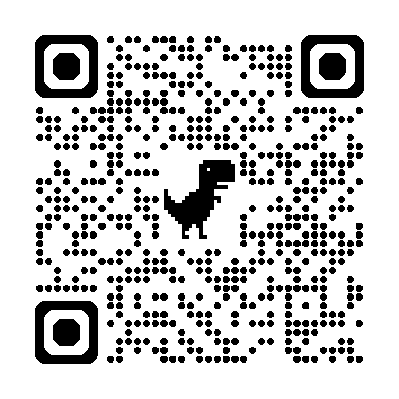
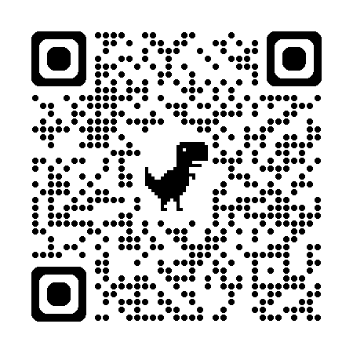
Thank You!
If you have questions or want to talk more email me at alexander.krist@vcuhealth.org
Study website
ACORN website
https://ecpvirginia.squarespace.com/
https://www.acornvirginia.org/

Slide 42
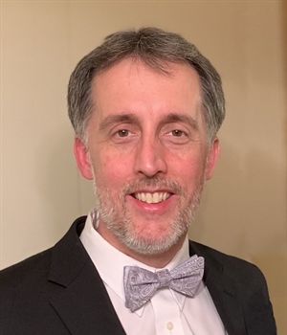
Presentation 3
Reducing Opioid Use Incidence in Seniors in Oklahoma (RISE-OK)
Zsolt Nagykáldi, PhD
University of Oklahoma
College of Medicine
Notes:
Now I’d like to introduce our third presenter, Sylvia Hysong, PhD Baylor College of Medicine, who is presenting on the impact of team configuration and team stability on primary care quality. Welcome Dr. Hysong.

Slide 43

Reducing Opioid Use Incidence in Seniors in Oklahoma (RISE-OK) Study
Reducing Opioid Use Incidence in Seniors in Oklahoma (RISE-OK) Study
Zsolt Nagykaldi, PhD¹; Lee Jennings, MD²; Steven Crawford, MD¹; Juell Homco, PhD, MPH³;
Lourdes Planas, PhD⁴; Chuck Tryon, MA³; Tim VanWagoner, PhD⁵
Department of Family and Preventive Medicine¹, Reynolds Section of Geriatric Medicine²,
Department of Medical Informatics³, College of Pharmacy, Clinical & Administration Sciences⁴,
Oklahoma Shared Clinical & Translational Resource⁵;
The University of Oklahoma Health Sciences Center & The OU-TU School of Community Medicine
Notes:
Good afternoon, my name is Zsolt Nagykaldi and I represent a large study team from the University of Oklahoma Health Sciences Center, which is currently conducting a state‐wide implementation study called: Reducing Opioid Use Incidence in Seniors in Oklahoma or RISE‐ OK. In this talk, I would like to build upon the points made by my colleagues today and showcase an example of implementing patient‐centered research in primary care practice. [Next slide]

Slide 44

Background
Non-cancer chronic pain (NCCP) management and opioid use in NCCP have been studied more often in younger individuals, but older (60+) patients suffer from more chronic conditions that cause pain which hinders meaningful life activities and achieving personal life goals. Opioid mis/use in NCCP has very different characteristics in older populations, which is also less well-studied.
We initiated an AHRQ-funded R18 implementation study in 2020 to improve the management of NCCP in older adults, both those who are on opioids and those who are not.
Notes:
A substantial body of research has been published on how to address non‐cancer chronic pain or NCCP with or without opioid medications in the general population, however much less is known about how to do the same in older populations that typically have more comorbid conditions that may interfere with and extend the effects of chronic pain and in which there is a much greater focus on how pain affects one’s quality of life and functioning. We also know that the use of opioids and other medications show a quite different pattern in older populations.
So, for these reasons, we established a multi‐disciplinary team to initiate a large, AHRQ‐ funded implementation/dissemination study in 2020 to develop and test a more sophisticated care delivery model for older NCCP patients. [Next slide]

Slide 45
Overarching Study Aims
Aim 1: In the first year of the project, develop a set of chronic pain management resources and new healthcare approaches that are tailored to older adults (role of community advisors) assembled into a RISE-OK Practice Toolkit and Academic Detailing guide
Aim 2: Over a 2-year period, help about 30 Oklahoma primary care practices implement tailored chronic pain management approaches and resources in a multi-level implementation
Aim 3: Through a multi-level evaluation approach, measure the effectiveness of the RISE-OK program to improve patient health, quality of care, and healthcare experience outcomes
Aim 4: Disseminate findings through academic venues and to community partners (e.g., resources, toolkits, lessons learned)
Notes:
The RISE‐OK study had 4 overreaching aims. In the first year, we convened a series of expert and community advisory groups to help us put the study on a firm, patient‐ and community‐centered foundation and to develop critical resources that can help our practices implement patient‐focused interventions. In particular, we co‐created a RISE‐OK Practice Toolkit and an Academic Detailing guide for our peer‐clinician educators and study practices.
In the second and third years, we conducted a comprehensive and multi‐level hybrid implementation‐effectiveness study that aimed at improving care delivery systems for patient‐centered and goal‐oriented NCCP care. I will say more about these levels later.
We also created a rigorous measurement structure to assess both the quality of our implementation and the effectiveness of the RISE‐OK program at the patient‐, practice‐, and health system or community levels.
And finally, we are currently working on data analyses and the dissemination of lessons learned and our resources through academic and community venues. [Next slide]

Slide 46
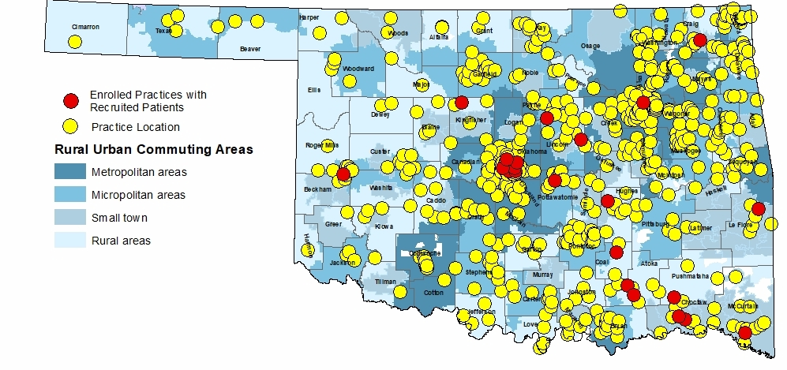
Setting and Participants
Practice Eligibility (n=31)
Sees adults (18+) in Oklahoma and uses EHR for care
At least 20 patients 60+ with NCCP
OR
At least 20 patients 60+ on opioids
Exclude: single PCP retiring soon
Patient Eligibility (n=270)
60+ with non-cancer chronic pain
OR
Receives chronic opioid therapy for non-cancer chronic pain
Notes:
This slide shows the distribution of our RISE‐OK practices in Oklahoma. The yellow dots indicate practice sites in our larger primary care network that we approached, and the red dots show those practices that actually participated. The striking difference between these underscore the difficulty of finding willing and able sites for a study that addresses a difficult challenge and which requires significant involvement.
On the left side you can see our practice and patient eligibility requirements that were set to cast the widest possible net across the primary care population. Practices that used EHRs and saw at least 20 NCCP patients, 60 or older, were eligible, whether these patients received opioid therapy or not. Patient eligibility followed our practice criteria: any established NCCP patient, 60 or older, could participate regardless of opioid therapy. [Next slide]

Slide 47
Setting and Participants
Notes:
Just a little bit about our patient population. We managed to retain 270 patients out of the planned 310 across 31 practices. These participants followed expected population statistics in terms of age, sex and race/ethnicity that were closely aligned with the mixture of patients who are established in primary care in our state, including over half of our practices that were located in rural populations. [Next slide]

Slide 48
Implementation Design
Multi-level intervention (patients IN practices IN health systems)
Patient level:
  Age- and person-tailored NCCP management plan
  Patient goal-oriented NCCP management approach (goal setting and attainment)
  Personalized opioid and benzo tapering plan
Practice level:
  Benchmarking & Feedback-Academic Detailing-Practice Facilitation-Tech Support-Learning Community
  NCCP patient registry, PEG score tracking, Prescription Monitoring Program (PMP) use
  Safe opioid prescribing practices
  Improved documentation, coding and billing
  Improved mental health screening and follow-up services
Health system/community level:
  Community-level referral system and service linkages
  Community resource deployment and use diversification
Notes:
As I mentioned before, our team deployed a carefully designed, multi‐level implementation and evaluation approach. We had numerous patient‐centered implementation components and outcomes at all three levels of our intervention. For example, we deployed resources for person‐tailored pain management plans, patient goal‐oriented intervention approaches, pain‐function interference measures, and personalized diversification of pharmacological and non‐pharmacological therapy. [Next slide]

Slide 49
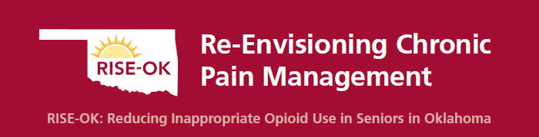


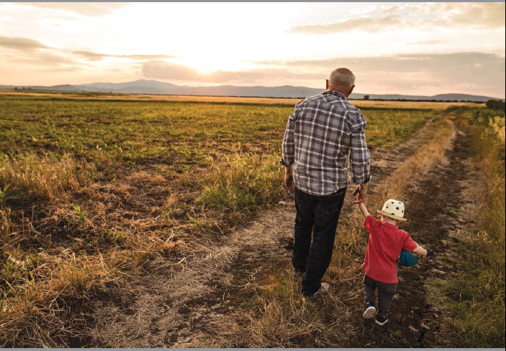
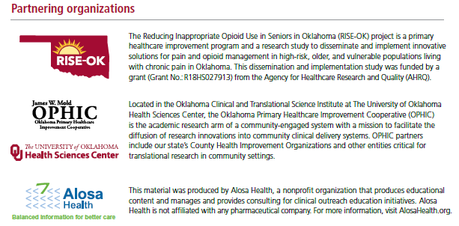
Collecting PCOR Data Example 1:
Academic Detailing and Practice Facilitation
Notes:
On this slide you can see screenshots of our professional peer‐clinician educator / Academic Detailer or AD Guide that we developed collaborating with Alosa Health. This well‐designed guide served as a conversation aid that was used in each practice at the project kickoff meeting. The AD session aimed at introducing the topic and to have a respectful conversation with the clinicians and staff about how to contextualize and apply evidence and resources we offered, in the particular setting, in order to develop a tailored program implementation plan. [Next slide]

Slide 50
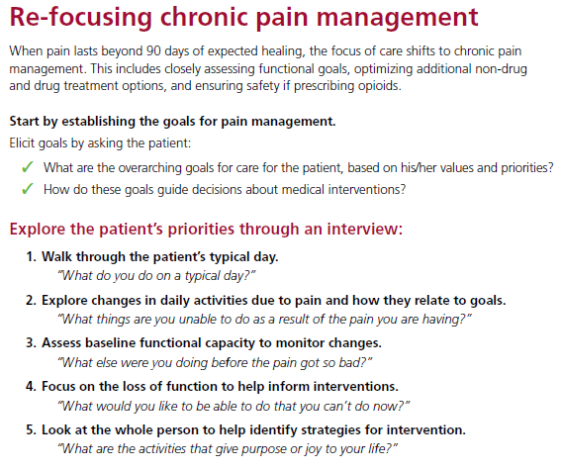
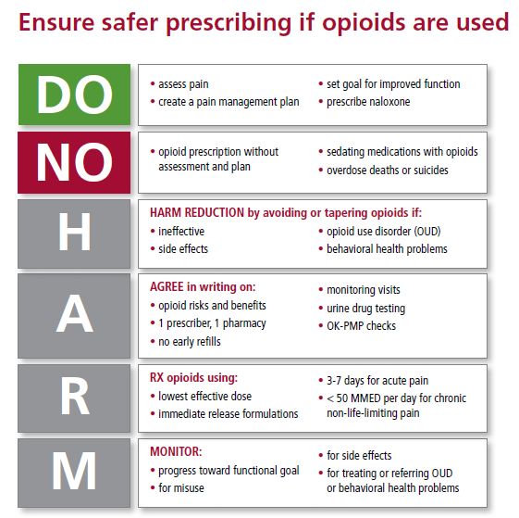
Collecting PCOR Data Example 1:
Academic Detailing and Practice Facilitation
Notes:
These are two pages from the AD Guide. On the left side I wanted to show the 5 key patient goal‐oriented questions that clinicians could ask to refocus pain management conversations from the pain itself to how pain is a barrier to a more enjoyable life and achieving one’s health goals. One of the questions was: “What do you do on a typical day?” which elicits a richer understating of what matters to someone and what their environment looks like. Clinicians could also ask: “What would you like to be able to do that you can’t do now?” which touches specifically on pain‐related barriers to achieving personal goals.
On the right side I show an example of how we attempted to distill the many variable interventions related to safe prescribing into a visually appealing and effective mental checklist for clinicians using the DO‐NO‐HARM acronym as mnemonic. [Next slide]

Slide 51
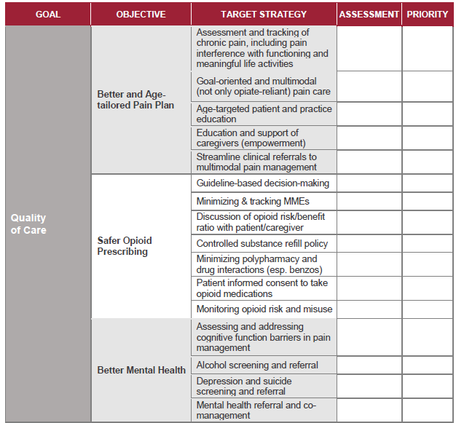
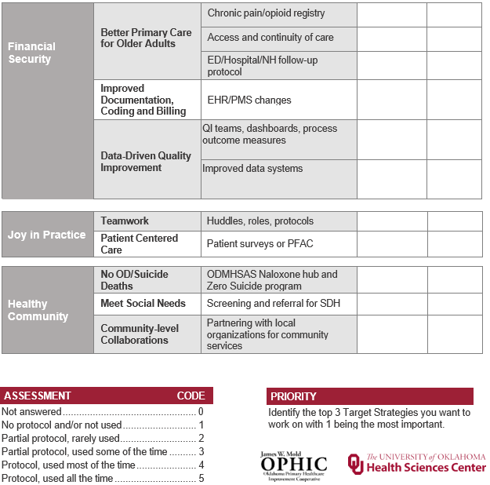
Collecting PCOR Data Example 1:
Academic Detailing and Practice Facilitation
Notes:
In the course of the RISE‐OK project we realized that the best way to make research patient centered is to design a patient‐centered implementation approach at the practice‐, health system‐, and community levels. Since we envisioned our entire program in a strongly patient goal‐oriented paradigm, we thought that we should also work with our practices in a goal‐oriented framework and so we adapted a formerly developed practice assessment tool, which you can see here, that aligned 4 high‐level practice goal domains with NCCP‐specific objectives, strategies, techniques, and even resources that practices could use to create their own priorities for a tailored implementation plan. [Next slide]

Slide 52
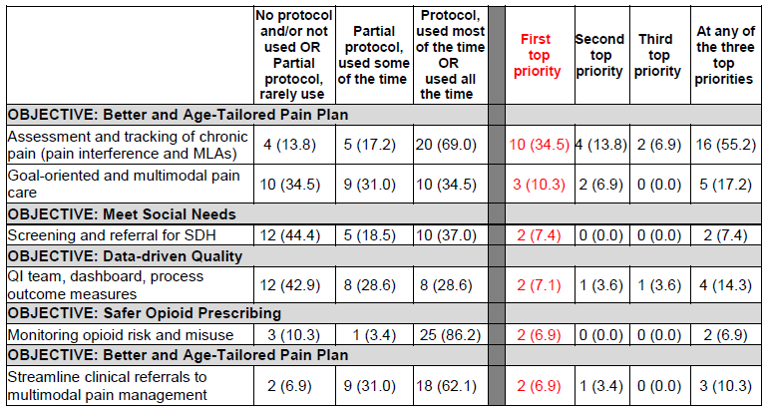
Collecting PCOR Data Example 1:
Practice Improvement Strategy Priorities
Top care improvement objectives selected from 27 total
Notes:
And look what happened when we based our implementation design on the practices’ self‐ prioritized goals. Instead of focusing on the usual NCCP care process targets, such as medication monitoring or refill policies, most practices turned their attention to learning how to capture and address pain‐function interference and how to operationalize goal‐oriented multimodal pain care. I think we can agree that these represent a more sophisticated, more appropriate, and based on what we learned, perhaps even more effective approach. [Next slide]

Slide 53
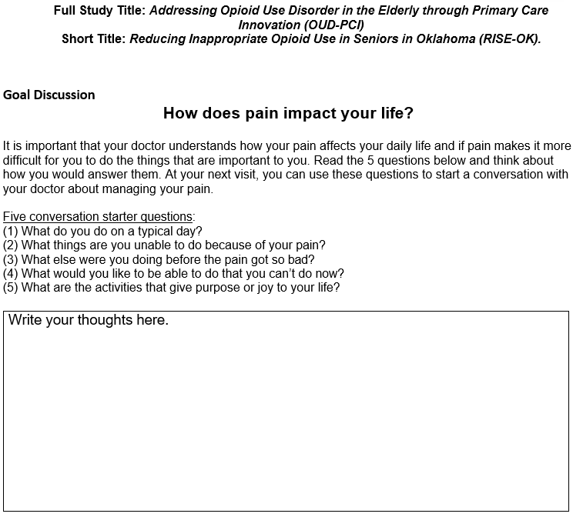
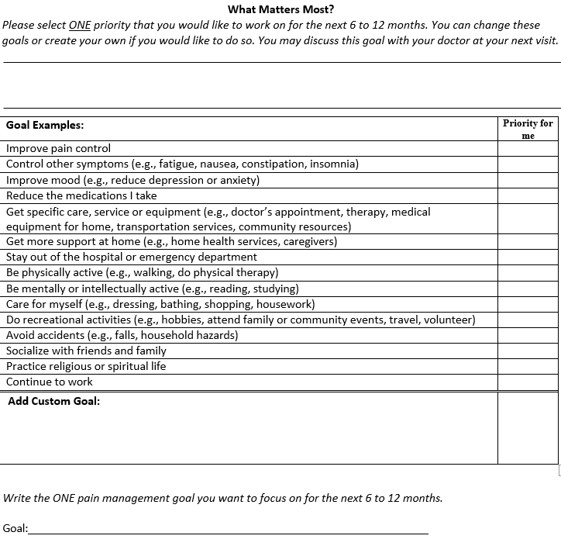
Collecting PCOR Data Example 2:
Pain Management Goal Setting and Attainment
Notes:
Another example from our project for leveraging patient‐centered data is a pain management goal‐setting and goal‐attainment conversation guide that we initially planned to use in regular care, but due to study limitations, our team used in separate phone conversations with patients. Starting with the five pain goal questions, which you can see in the red box, patients were led through a standard exercise to select or craft a custom priority goal for themselves. [Next slide]

Slide 54
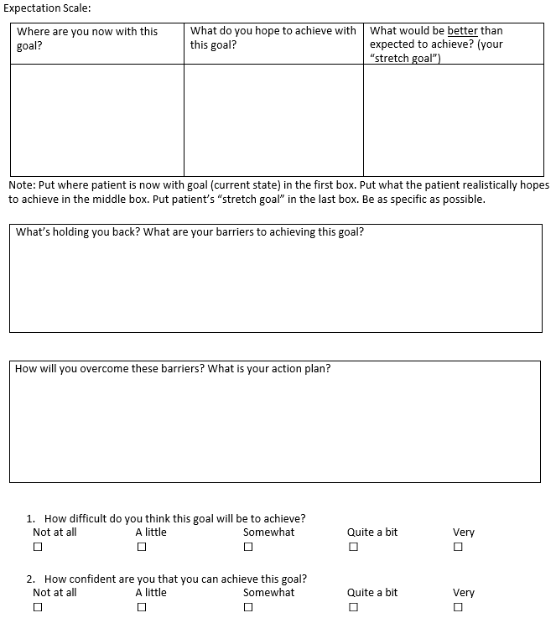
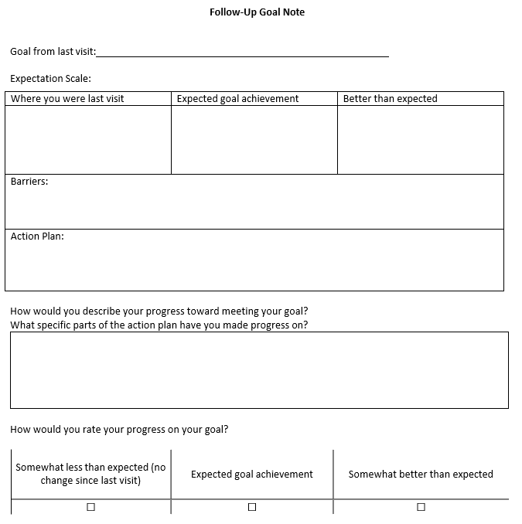
Collecting PCOR Data Example 2:
Pain Management Goal Setting and Attainment
Notes:
This exercise also included goal scaling (including “where you are now; what you hope to achieve; and how far you can possibly go”) and the usual scaling of perceived difficulty and confidence in achieving their goal. On the right, I show the attainment scaling part of the guide where barriers are reviewed and an action plan for overcoming them is created along with self‐rating of one’s progress. [Next slide]

Slide 55
Collecting PCOR Data Example 2:
Pain Management Goal Priorities
Notes:
What’s really interesting, as an early outcome of this particular approach, is that, again, instead of the expected focus on improving pain control (which you can see listed at the red arrow), we find functioning and quality of life goals as the highest priorities. Even when patients told us that their priority was to receive services, most of the time, they aimed at addressing functional capacity and life quality. [Next slide]

Slide 56
Collecting PCOR Data Example 3:
Evaluating Patient and Practice Interviews
30-60 minute semi-structured interviews with 10 patients, 10 clinicians, 5 staff
Patient Interview Domains:
  Initiating pain care conversations and receiving education or resources
  Receiving NCCP care recommendations
  Setting pain care goals with PCP
  Challenges faced over the course of achieving pain goals
  Changes or improvements in pain care over time
  Level of achieving more optimal pain care and pain-life interference
  How PCPs can best to talk to patients about managing chronic pain
  How well team-based approach to pain care worked (facilitators / barriers)
  Patterns of opioid medication use for NCCP
  Other issues and feedback
Major Emerging Themes:
  Pain interference with functioning and QoL issues are top concerns
  NCCP is pervasive and complex, it affects multiple life domains in synergy/interaction
  Variable success in achieving balance between minimizing pharmacotherapy risk and pain relief
  Healthcare processes are often inadequate (sometimes even fail) to provide QoL-focused solutions
  RISE-OK seems to have a moderate effect in at least some patients on meeting their pain care needs
"What I really liked was that [PCP] wanted to use the minimum amount of pain medication that gave the maximum effect."
"...ever since the breakdown on taking the narcotics, I think it's gotten a lot of physicians scared to prescribe any narcotics. And honestly, for some patients, it just comes down to, 'This is the only solution'."
“I have a mower (...) and I will cut my front yard for 10 or 15 minutes until I can’t do it anymore. I will stress and try the pain. I don't want to (…) become handicapped.”
Notes:
In this third and final example from RISE‐OK, I would like to provide some very early results from 10 patient, 10 clinician, and 5 clinic staff interviews that are being analyzed currently. Patient interviews explored many domains, including the quality and content of pain care conversations; goal setting and changes in pain‐function interference; care experience; and changes in the patterns of therapy. What we can say at this point is that emerging themes include functioning and quality of life as the main concern for patients; that NCCP in older adults is even more complex and multi‐faceted than we thought; and that current health care is spotty in terms of balancing patient and clinical needs or to respond to patient needs to improve their quality of life.
Some of these themes were substantiated by patient quotes on the right side reflecting both success stories and some of the shortcomings from the patient’s perspective. [Next slide]

Slide 57
Collecting PCOR Data Example 3:
Evaluating Patient and Practice Interviews
Clinician Interview Domains:
  Chronic pain management and care delivery process
    Identifying, contacting and scheduling NCCP care candidates
    Structure of chronic pain management visits
    Patient education and shared decision-making visit components
    Setting pain care goals and goal attainment review (skills, resources)
    Care processes to act upon shared pain management plan
    Access to / linking to outside services and community referrals
    Protocol of opioid prescribing
    High-risk meds review and management process
    Follow-up care for NCCP patients
    Patient access and utilization of referred services
    Systems in place to prevent patients falling through the cracks
  Experience with RISE-OK participation
    General observations and personal experience
    Facilitators and barriers of program implementation
    Success and failure stories
    Workarounds and solutions applied
    What could we improve in a next program iteration?
    What improvements and gains will you sustain after RISE-OK?
    Any other feedback to share?
“…we also provide Narcan® and medication safety boxes. Gun safety boxes and stuff. I believe all those came with my RISE-OK project.”
"We just ran our reports to get those [NCCP] patients. It provided a list and contact information on who we thought would be good for the program. But I met with the [practice] facilitator several times for us to initially get that going.”
“I like handouts and different tools that we can use in the rooms. I mean anything like that can help us because we can be told things all day long but if you don't have that [resource] at your fingertips to look back on and things like that... you know, it's hard.”
Notes:
And finally, I would like to say a few words about our practice interviews that we just started analyzing. These interviews were very detailed and they covered all major steps of the chronic pain management care cycle, in addition to the experience of clinicians and staff participating in RISE‐OK and lots of barriers and facilitators to implementing and sustaining the program.
In order to underscore the importance of addressing practice resource gaps, I would like to highlight the third quote. This clinician said: “…we can be told things all day long but if you don't have that [resource] at your fingertips to look back on and things like that... you know, it's hard.” One of the strengths of our program was to help resource practices through practice facilitation and by co‐designing and deploying a large library of resources linked to their own care improvement priorities. [Last slide please]

Slide 58
Lesson Learned
Management of NCCP in older adults is challenging and complex and it requires significantly more robust practice support systems
Building capacity to manage NCCP in a patient goal-oriented approach may help focus care on key patient needs (Fx & QoL)
More data stream and system integration is needed to collect health data that “matters to patients” for NCCP care (e.g., PMP)
Much needed non-pharmacological therapy options are often lacking esp. in rural and underserved areas (innovations?)
It takes a concerted & multi-disciplinary effort to move the needle on NCCP management in older adults
Notes:
In summary: we have learned about the utmost importance of robust primary care practice and patient support, and building capacity for a patient‐goal oriented care approach which, we believe, has great potential to make chronic pain care person‐centered. We also learned that substantially more work is needed to provide those integrated data and care systems that can effectively respond to complex needs of older adults with NCCP; and that there are large gaps in services, especially in rural and underserved areas, to diversify chronic pain therapy.
And finally, RISE‐OK exemplifies how a multi‐disciplinary and comprehensive approach to NCCP management can move the needle for older adults toward better patient‐centered outcomes and care experience.
Thank you for your attention!

Slide 59
Questions
Please post your questions in the chat!

Slide 60
Thank you
    Check the AHRQ Channels for announcements about the next webinar in the series
We value your feedback.
Please complete the short evaluation poll after this webinar!
Notes:
Check the AHRQ channels for announcements about the next webinar in the NCECPR webinar series.
Please take the short evaluation poll that will pop up after this webinar. Thank you to our excellent presenters and to all of you for joining us today!

