Slide 1
AHRQ Safety Program for Ambulatory Surgery
Implementation Guide
Appendix K. Quality Improvement Study Framework
Debrief Example
Quality Improvement Study
<name> Ambulatory Surgery Center
<insert date>

Slide 2
Problem Statement
The surgical safety checklist has been shown to reduce surgical mortality and complication rates in a variety of surgical settings
A critical component of the checklist is the completion of a debrief after each case
The debrief provides an opportunity to address—
  Equipment problems
  Key concerns for patient recovery and management
  Ideas for making the next case safer and/or more efficient
When any elements of the debrief are omitted, teams miss opportunities to discuss continuous quality improvement, resulting in negative safety implications for patients
QI Study Debrief Example

Slide 3
Improvement Team
Project Leader(s)
  <insert name>
Team Members
  <insert name> - Administrator/Manager
  <insert name> - Anesthesiologist/Certified Registered Nurse Anesthetist
  <insert name> - Circulating Nurse
  <insert name> - Scrub Technician
  <insert name> - Surgeon
  <insert name> - Data collector
  <insert name> - Anesthesia Technician
  <insert name> - Pre-op/Post-Anesthesia Care Unit Nurse (PACU)
  <insert name> - Physician Assistant
  <insert name> - Infection Preventionist
QI Study Debrief Example

Slide 4
Data Description
What: Debrief completion rate
Where: Observed cases in the ambulatory surgery center (ASC)
What you’re using to collect data: Checklist observation tool
Who: All surgical admissions to the ASC
Exclusions: <insert any exclusions> or <none>
Who will collect data: Designated observer for each case
<insert specific role identified>
Collection period: 1 week to establish baseline completion rate
QI Study Debrief Example

Slide 5
Data Collection
Baseline data collection period: 3/2/2015 – 3/6/2015
Number of cases observed: 23
Data collected
  Tally sheet of debriefs completed
  Observation log data
QI Study Debrief Example

Slide 6
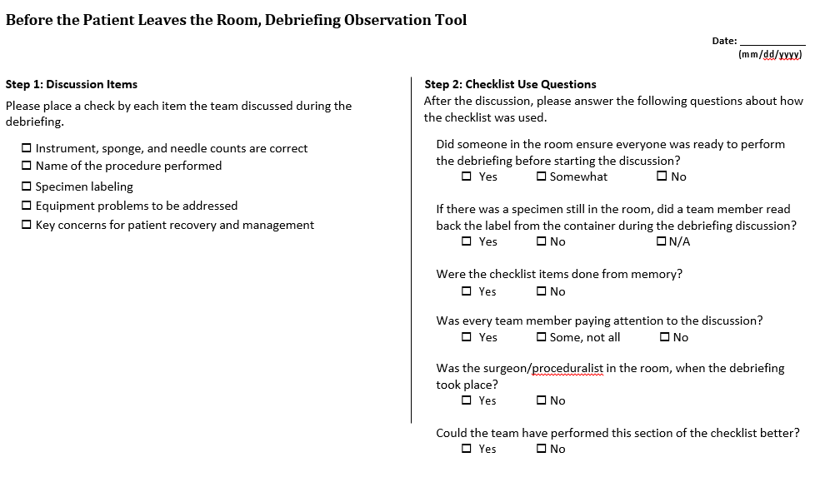
Data Collection
Observation tool – debrief elements
QI Study Debrief Example

Slide 7
Baseline Data
Data collection period: 3/2/2015 – 3/6/2015
Exclusions: <insert exclusions>
Observation Date | Cases Observed | Debriefs Completed | Debrief Completion Rate
3/2/2015 | 6 | 3 | 50%
3/3/2015 | 4 | 3 | 75%
3/4/2015 | 4 | 1 | 25%
3/5/2015 | 3 | 2 | 67%
3/6/2015 | 6 | 3 | 50%
Totals | 23 | 12 | 52%
QI Study Debrief Example

Slide 8
The Goal
To achieve a 100% completion rate for all elements of the debrief for all surgical cases by June 1, 2015.
QI Study Debrief Example

Slide 9
Data Comparison
Goal = 100%
Average = 52%
QI Study Debrief Example

Slide 10
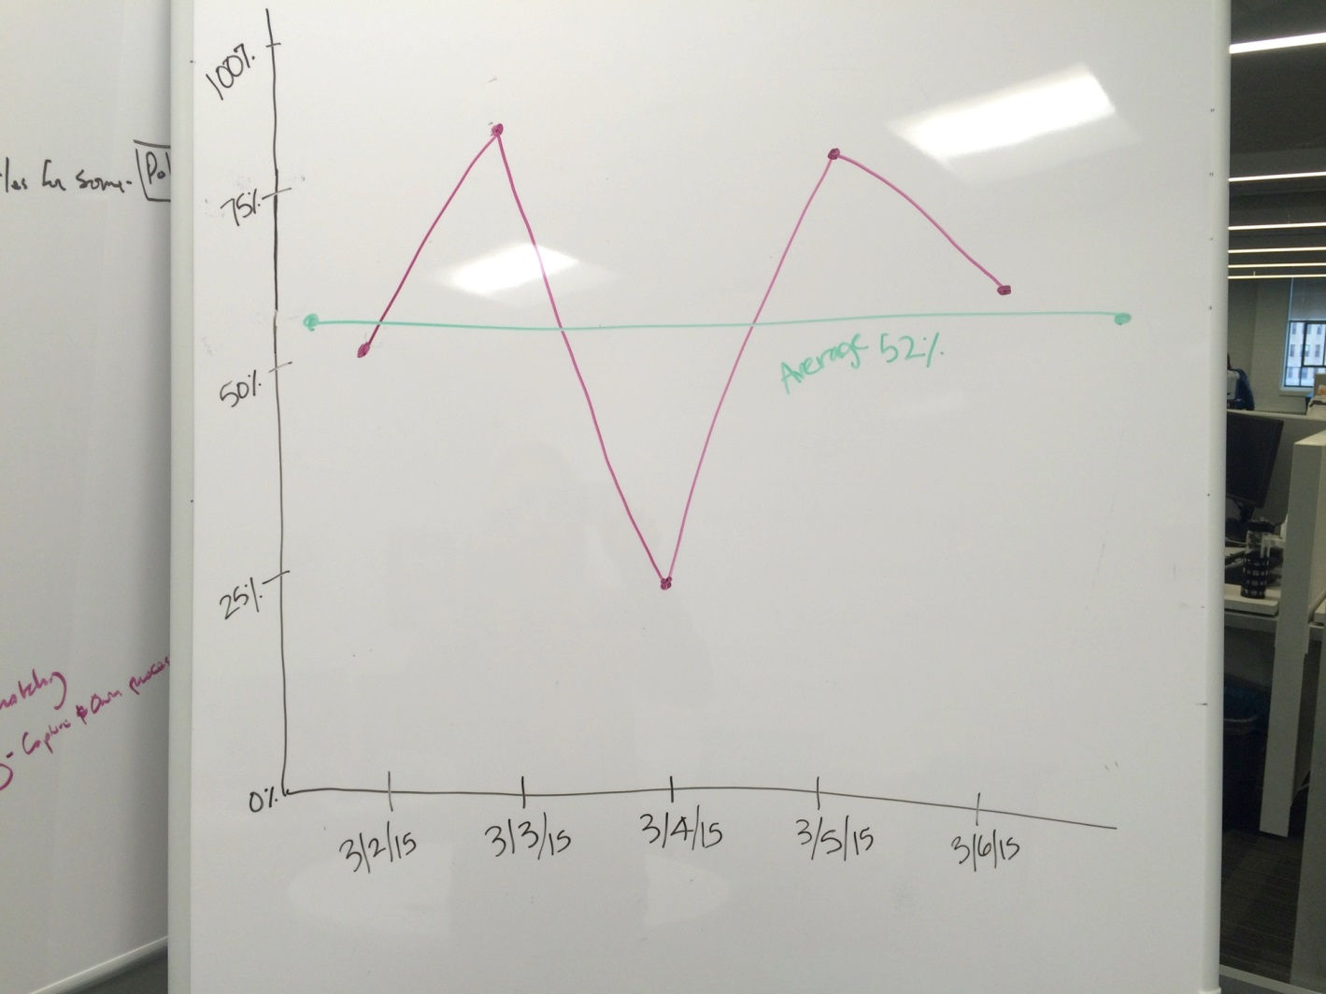
Data Comparison
QI Study Debrief Example

Slide 11
Data Comparison
Debrief completion rate goal: 100%
Observed debrief completion rate: 52%
Current performance: Below goal by 48%
QI Study Debrief Example

Slide 12
Cause of the Problem
Reasons for not completing the debrief
  Team is in a hurry to get to the next case
  Case volume doesn’t allow sufficient time for a debrief between cases
  No one takes the lead on initiating the discussion
  Lack of a specific trigger to initiate the discussion
QI Study Debrief Example

Slide 13
Corrective Actions/Interventions
Intervention: <insert proposed intervention to increase debrief completion rate>
Example: The circulator will initiate the debrief at the end of each case
Target: <insert target of intervention>
Example: All of Dr. Smith’s cases
Timeframe: <insert timeframe>
Example: The week of 3/9/2015 – 3/13/2015
QI Study Debrief Example

Slide 14
Materials Developed (optional)
QI Study Debrief Example

Slide 15
Change Data
Pre-Intervention
Cases Observed | Debriefs Completed | Debrief Completion Rate
23 | 12 | 52%
Post-Intervention
Data collection period: 3/9/2015 – 3/13/2015
Exclusions: <insert exclusions>
Observation Date | Cases Observed | Debriefs Completed | Debrief Completion Rate
3/9/2015 | 4 | 3 | 75%
3/10/2015 | 5 | 3 | 60%
3/11/2015 | 6 | 5 | 83%
3/12/2015 | 2 | 1 | 50%
3/13/2015 | 5 | 4 | 80%
Totals | 22 | 16 | 73%
Some improvement - below goal by 27%
QI Study Debrief Example

Slide 16
Data Comparison
Goal = 100%
Average = 52%
QI Study Debrief Example

Slide 17
Data Comparison
Debrief completion rate goal: 100%
Observed debrief completion rate: 73%
Current performance: Below goal by 27%
QI Study Debrief Example

Slide 18
Additional Corrective Actions or
Remeasurements
Intervention: <insert proposed intervention to increase debrief completion rate>
Example: The surgeon removing his/her gloves will serve as the trigger for the circulator to initiate the debrief
Target: <insert target of intervention>
Example: All of Dr. Smith’s cases
Timeframe: <insert timeframe>
Example: The week of 3/16/2015 – 3/20/2015
QI Study Debrief Example

Slide 19
Materials Developed (optional)
QI Study Debrief Example

Slide 20
Remeasurement
Post-Intervention #1
Cases Observed | Debriefs Completed | Debrief Completion Rate
22 | 16 | 73%
Post-Intervention #2
Data collection period: 3/16/2015 – 3/20/2015
Exclusions: <insert exclusions>
Post-Intervention #2
Observation Date | Cases Observed | Debriefs Completed | Debrief Completion Rate
3/16/2015 | 3 | 3 | 100%
3/17/2015 | 5 | 5 | 100%
3/18/2015 | 5 | 5 | 100%
3/19/2015 | 2 | 2 | 100%
3/20/2015 | 5 | 5 | 100%
Totals | 20 | 20 | 100%
Goal reached – 100%
QI Study Debrief Example

Slide 21
Data Comparison
Goal = 100%
Average = 73%
Average = 52%
Initiator Role Intervention
Trigger Intervention
QI Study Debrief Example

Slide 22
Data Comparison
Debrief completion rate goal: 100%
Observed debrief completion rate: 100%
Current performance: Goal achieved 100%
QI Study Debrief Example

Slide 23
Conclusions
The goal of 100% debrief completion rate for all surgical cases was achieved prior to the target date of June 1, 2015
The identification of a role to initiate the debrief (circulator) as well as a specific trigger to prompt debrief initiation (surgeon glove removal) were both necessary to achieve success
Team members found this to be challenging at first, but over time they began to adjust to the new process
Team members report a better sense of teamwork in the operating room
PACU staff report care transitions from the operating room are smoother as a result of consistent performance of the debrief
QI Study Debrief Example

Slide 24
Communication/Reporting of Findings
The results of this study were shared with the board on XX/XX/2015
<insert excerpt from board meeting minutes>
QI Study Debrief Example

Slide 25
Sustaining the Gains
Performance was reassessed 3 months after the goal was achieved
Data collection period: 6/22/2015 – 6/26/2015
Exclusions: <insert exclusions>
Observation Date | Cases Observed | Debriefs Completed | Debrief Completion Rate
6/22/2015 | 5 | 5 | 100%
6/23/2015 | 3 | 3 | 100%
6/24/2015 | 4 | 4 | 100%
6/25/2015 | 3 | 3 | 100%
6/26/2015 | 2 | 2 | 100%
Totals | 17 | 17 | 100%
QI Study Debrief Example

Slide 26
Sustaining the Gains
The debrief completion rate remains at the goal of 100%
QI Study Debrief Example

Slide 27
Future Work
Completion rates for other elements of the surgical safety checklist will be explored
  Completion of preop briefing
  Completion of the timeout
    Completion of surgeon sharing any changes to operative plan and possible difficulties
    Completion of team introductions
    Completion of surgeon's statement regarding concerns before starting the procedure
Consistent use of each component on the checklist will help improve the safety culture in our center
QI Study Debrief Example

