Slide 1
AHRQ Safety Program for Ambulatory Surgery Implementation Guide
Appendix N. Part 1: A Clear View of Flexible Endoscope Processing:
Transport, Leak Testing, Cleaning
Susan Klacik B.S., CRCST, CIS, FCS

Slide 2
Objectives
After this viewing this video you will be able to—
List basic endoscope processing steps
Explain infection prevention guidelines for transport, leak testing, and cleaning

Slide 3
Resources
Flexible endoscope manufacturers instructions for use (IFU)
American National Standards Institute/Association for the Advancement of Medical Instrumentation (ANSI/AAMI) ST91:2015 Flexible and semi-rigid endoscope processing in health care facilities

Slide 4
Basic Endoscope Processing Steps
Precleaning at the point of use
Transporting
Leak testing
Cleaning
Rinsing
Inspecting or testing for cleanliness, where applicable
Disinfection/high-level disinfection and monitoring of the process, where applicable
Rinsing
Drying and alcohol flush
Storage

Slide 5
Point of Use Precleaning IFU
Importance of precleaning
Equipment needed
Process to use
Specific measurements
Specific times to suction fluids

Slide 6
Point of Use Precleaning ST91
To prevent buildup of bioburden, development of biofilms, and drying of secretions, precleaning should take place at the point of use immediately following the procedure.

Slide 7
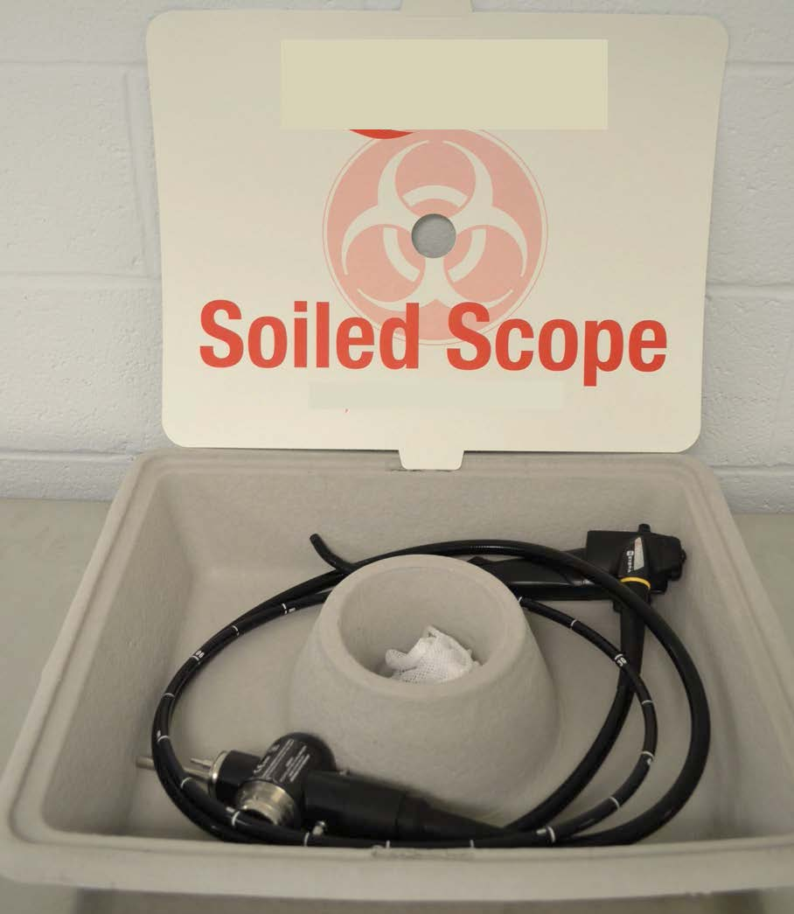
Transport of Used Flexible Endoscopes
Transport one scope per container
Coil in large loops
Do not transport with sharps
Keep attachments with scope
Mark with biohazard label
Personnel must wear appropriate personal protective equipment (PPE)
Susan Klacik (author), 2015

Slide 8
Transport of Used Scopes - Continued
Personnel must wear PPE
The attachments stay with the scope
Susan Klacik (author), 2015
Susan Klacik (author), 2015

Slide 9
Leak Testing IFU
Specify equipment needed
Provide instructions on how to connect and disconnect
Identify leaks
Provide instructions on what to do if a leak is detected
Susan Klacik (author), 2015

Slide 10
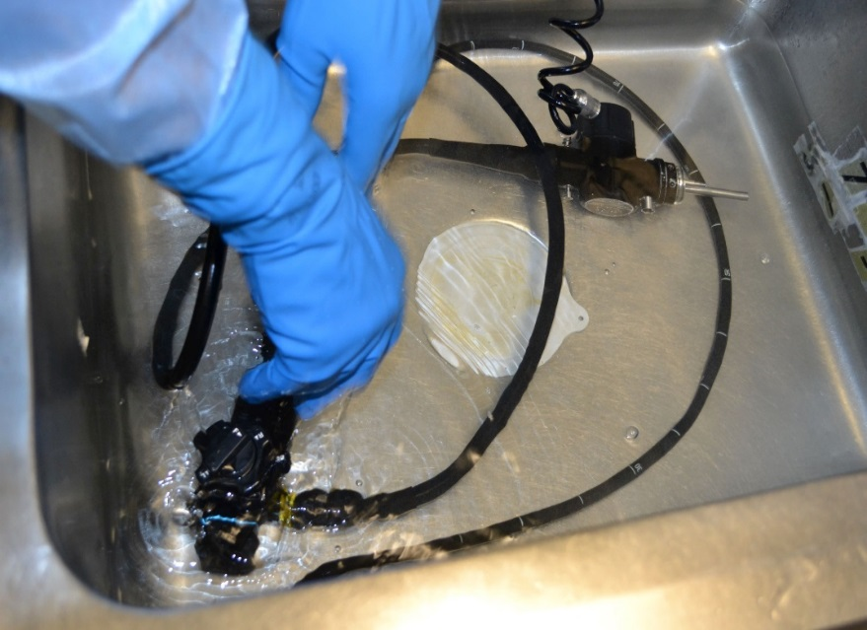
Leak Testing ST91
Perform as soon as possible
Scope minimally coiled
Overcoiling can mask a hole and allow it to go undetected
Work surface should be
well lighted
Allow sufficient time
Susan Klacik (author), 2015

Slide 11
Manual Cleaning IFU
Equipment needed
Type of cleaning solution
Measurement of solution
Time of solution contact
Step-by step process
Delayed processing
Susan Klacik (author), 2015

Slide 12
Manual Cleaning ST91
Clean as soon as possible after use to prevent soil from drying on the device
Use fresh cleaning solution for each endoscope
The temperature of the cleaning solution should be monitored
Use the correct size clean brush
Clean all attachments
If using an automatic flushing system, be sure it is compatible with the endoscope
Susan Klacik (author), 2015

Slide 13
Rinsing IFU
Specific steps
Equipment needed
Specific amount of water to flush through
Specific amount of air needed to flush water from the channel(s)
Susan Klacik (author), 2015

Slide 14
Rinsing ST91
After cleaning, thoroughly rinse scope and accessories with copious amounts of tap water
Rinse all exterior endoscope surfaces with freely flowing potable water
Purge channels with air using a syringe to evacuate residual rinse water
Remove rinse water from the channels by purging channels with air using a syringe

Slide 15
Inspecting for Cleanliness
Visual inspection of the exterior scope
Cleaning verification to verify the effectiveness of the cleaning process
Susan Klacik (author), 2015

Slide 16
References
American National Standards Institute and Association for the Advancement of Medical Instrumentation. ANSI/AAMI ST91:2015 Flexible and semi-rigid endoscope processing in health care facilities. 2015. http://www.aami.org/productspublications/ProductDetail.aspx?ItemNumber=2477.

