Slide 1
AHRQ Safety Program for Ambulatory Surgery Implementation Guide
Appendix O. Part 2: A Clear View of Flexible Endoscope Processing: Disinfection/Sterilization Record Keeping
Susan Klacik B.S., CRCST, CIS, FCS

Slide 2
Objectives
After viewing this video you will be able to—
List basic endoscope processing steps
Explain infection prevention guidelines for scope disinfection/sterilization, record keeping, and scope storage

Slide 3
High-Level Disinfection/Sterilization: Instructions for Use (IFU)
Equipment needed
Type of high-level disinfectant (HLD)/sterilants compatible with scope
Measurement of solution
Specific steps for thorough rinsing
Exact measurements for rinsing
Step-by step process

Slide 4
High-Level Disinfection
Don fresh personal protective equipment (PPE), including gloves and skin and eye protection
Use a closed container labeled with a biohazard symbol
The container should be large enough to completely immerse the endoscope in the liquid chemical sterilant (LCS)/HLD solution
Prepare according to the manufacturer's written IFU
Document:
name of solution
expiration date
date of preparation
date of use
Test the minimum recommended concentration (MRC) before each use with the disinfectant-specific test strip
Follow the label directions for the test strip
Document results

Slide 5
Automatic Endoscope Reprocessor (AER)
Check to ensure the scope can be processed
Validated
Compatible with high-level disinfectant
PPE used for decontamination should not be worn when handling a scope or any of the accessories after they have gone through the disinfection process

Slide 6
Automatic Endoscope Reprocessor (AER)
Incoming water should be filtered using bacterial retentive filters as recommended in the AER manufacturer's written IFU
Quality testing devices are available for many AERs to ensure the solutions are flowing
Testing should be performed at least weekly, after major repairs, or whenever there is a concern about equipment function

Slide 7
Sterilization
Terminal sterilization is the preferred method
Terminal sterilization is recommended for flexible and semi-rigid endoscopes that enter sterile body cavities
Susan Klacik (author), 2015

Slide 8
Storage IFU
Criteria for scope storage cabinet
How to prepare scope for storage
Angulation knobs
Attachments
If the scope should be hung or coiled
Susan Klacik (author), 2015

Slide 9
Storage ST91
Store hanging vertically with the distal tip hanging freely in a clean well-ventilated cabinet
Angulation lock should be in the open position
Leave sufficient space around scopes to prevent them hitting into one another
All removable parts (e.g., valves and caps) should be detached and kept with the scope

Slide 10
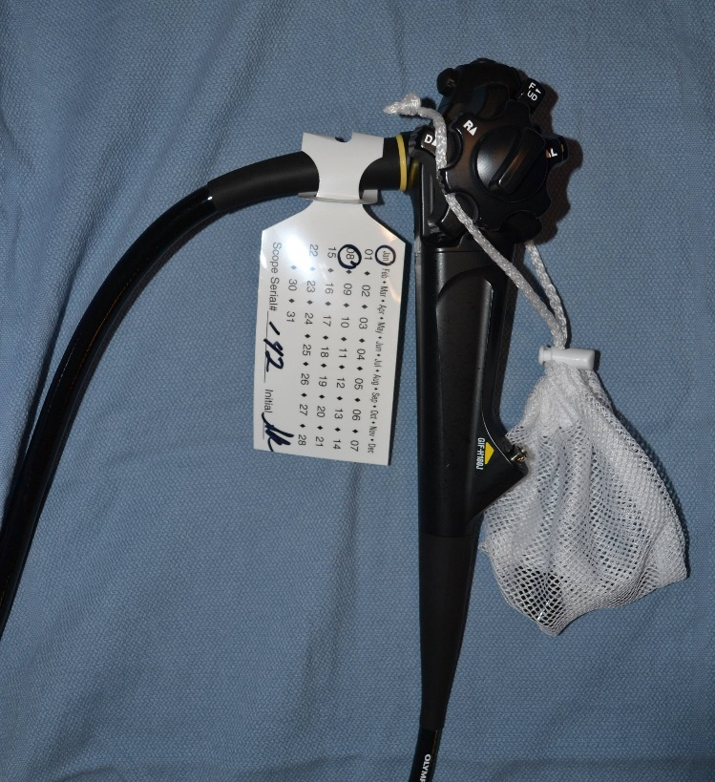
Storage ST91
A tag or label should be attached to the scope to document that the scope has been cleaned or high-level disinfected
The tag should be labeled with the following information:
Date of processing
Name(s) of person(s) who performed the processing
Date of high-level disinfection
Susan Klacik (author), 2015

Slide 11
Storage ST91
Channels should be dry to help prevent bacterial growth and biofilm formation
To help ensure that no moisture is left on or in any part of the endoscope, all channels should be flushed with 70–80 percent alcohol to facilitate drying
All channels should be purged with filtered medical-grade air at the correct pressure
Temperature and humidity in the area where the scopes are stored should be monitored

Slide 12
Hang Time
Existing Guidelines
Organization | Time
Association for the Advancement of Medical Instrumentation (AAMI) | Risk Assessment
Association for PeriOperative Registered Nurses (AORN) | 5 days
Canadian Standards Association | 7 days
Veterans Health Administration (VA) | 12 days

Slide 13
Hang Time Risk Assessment
Type of endoscope (with lumen or without lumen)
Condition of the endoscope after processing (e.g., dry or wet)
Way the endoscope was transported from processing to storage
Use of aseptic technique to remove the endoscope from the AER
Conditions of storage environment

Slide 14
Hang Time Risk Assessment
Excessive handling during storage
Manufacturer’s written IFU for storage
Compliance with professional organization guidelines for storage
Frequency of use
Frequency, type, and results of quality monitoring of processing
Quality of final rinse water (consult AAMI TIR34:2014, Water for the reprocessing of medical devices)

Slide 15
Transport of Disinfected Scopes
Protect from recontamination
Don new exam gloves before removing the endoscope from the storage cabinet
Transport using an impervious barrier method that will prevent recontamination
The endoscope should be loosely coiled to prevent damage
The transport system should not be reused for clean transport

Slide 16
Quality Control Ability To Track Scope Use
Identify—
The sterilizer, AER, or soaking container
The date chemical sterilization or high-level disinfection was performed
The sterilization or high-level disinfection cycle number
Patient identifier

Slide 17
Record Keeping
Lot number
Specific name of the item
Patient identifier
Procedure/physician
LCS/HLD expiration date
Exposure time and temperature
Cycle date & time
Name of LCS/HLD
Name/initials of person performing HLD/sterilization
Results of quality monitoring testing

Slide 18
References
American National Standards Institute and Association for the Advancement of Medical Instrumentation. ANSI/AAMI ST91:2015 Flexible and semi-rigid endoscope processing in health care facilities. 2015. http://www.aami.org/productspublications/ProductDetail.aspx?ItemNumber=2477.

