Slide 1
AHRQ Safety Program for Ambulatory Surgery Implementation Guide
Appendix P. Evaluating and Selecting Hand Hygiene Products
Timothy Landers, Ph.D., R.N., CNP, CIC Assistant Professor, The Ohio State University College of Nursing

Slide 2
Disclosures
Dr. Landers receives salary support and research funding from Robert Wood Johnson Foundation Nurse Faculty Scholars. He received travel support from GOJO Industries as an industry consultant.

Slide 3
Objectives
Identify important considerations when selecting hand hygiene products
Apply a standardized methodology to evaluate hand hygiene products in a specific clinical setting

Slide 4
Multimodal Strategies for Hand Hygiene
Hand hygiene
Effective strategies
Personnel
Patients & families
Organizational & system characteristics
External environment

Slide 5
Understanding Hand Hygiene Product Evaluation
Safety, efficacy, effectiveness
Regulatory framework
Label claims
Tips for evaluating claims

Slide 6
Efficacy Versus Effectiveness
Efficacy
Effectiveness
Benefit under ideal use
In vitro testing
Reduction of bacteria on the hands
Real-world conditions
In vivo testing
Clinical trials and observation
Adoption, usage, tolerability

Slide 7
Regulatory Framework
Testing protocols
Bacteria (ASTM E2783, EN 1040, EN 13727)
Fungicidal (N1275, EN 13624)
Virucidal (ASTM E1052, EN 14476)
Sporicidal (EN 14347)

Slide 8
FDA-Approved Labels
“Handwash to help reduce bacteria that potentially can cause disease”
“Hand sanitizer to help reduce bacteria on the skin”
“Surgical hand scrub product”

Slide 9
Evaluating Manufacturer Claims
Inactive ingredients
Other components
Understand test methodology
Clinical relevance
Third-party evaluation
Dispenser technology
Local needs

Slide 10
Action Step: Review the Labels for Products in Current Use
What is the labeled indication?
What are the active and inactive ingredients?
What data is given about in vitro testing?

Slide 11
Product Selection: Key Recommendations
Test products locally (setting, environment, users)
Include health care workers in product selection
Consider tolerability/acceptability

Slide 12
Important Characteristics
Appearance
Usability
Tolerability
Dispensing system
Integration with monitoring system
Cost

Slide 13
Product Evaluation World Health Organization (WHO) Method One
Single new product evaluation
Completion of baseline assessment
Implement new product, assess at 3–5 days and 1 month
Full protocol specifies number users, measurement of use
Source: World Health Organization. Tools for Evaluation and Feedback. 2009. http://www.who.int/gpsc/5may/tools/evaluation_feedback/en/.

Slide 14
Product Evaluation WHO Method One
Part 1 – Demographics
Part 2 – Product assessment
Part 3 – Skin health assessment
Source: World Health Organization. Tools for Evaluation and Feedback. 2009. http://www.who.int/gpsc/5may/tools/evaluation_feedback/en/.

Slide 15
Sample Questions for Local Evaluation of Hand Hygiene Products
©World Health Organization 2009. All rights reserved.

Slide 16
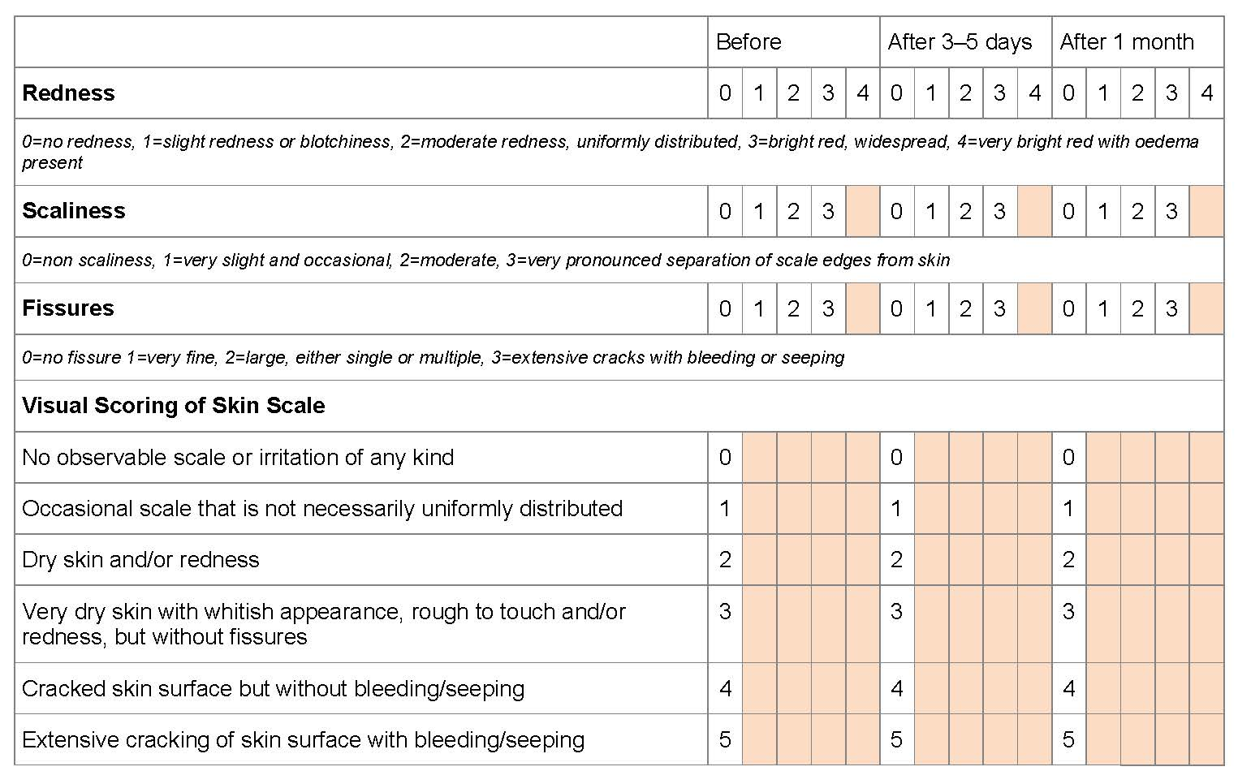
Scales To Evaluate Skin Condition by the Observer
©World Health Organization 2009. All rights reserved.

Slide 17
Product Evaluation WHO Method Two
Two-product comparison
Completion of baseline assessment
Implement product A, assess at 3–5 days
Two-day “wash-out”
Implement product B, assess at 3–5 days
Full protocol specifies number of participants, measurement of use
Source: World Health Organization. Tools for Evaluation and Feedback. 2009. http://www.who.int/gpsc/5may/tools/evaluation_feedback/en/.

Slide 18
Product Evaluation WHO Method Two
Part 1 – Demographics
Part 2 – Product assessment
Part 3 – Skin health assessment
Source: World Health Organization. Tools for Evaluation and Feedback. 2009. http://www.who.int/gpsc/5may/tools/evaluation_feedback/en/.

Slide 19
Action Step
Evaluate new product
Intentionally pick participants
Use WHO Method One
Evaluate current product and new product
Use formal WHO Method 2 methodology

Slide 20
Resources
Association for Professionals in Infection Control and Epidemiology. Guide to Hand Hygiene Programs for Infection Prevention. 2015. http://apic.org/Professional-Practice/Implementation-guides.
World Health Organization. Tools for Evaluation and Feedback. 2009. http://www.who.int/gpsc/5may/tools/evaluation_feedback/en/.

