Slide 1
Action Plan for Translating Research Into Practice:
Gap Analysis and Tests of Change
AHRQ Safety Program for Mechanically Ventilated Patients
AHRQ Pub. No. 16(17)-0018-31-EF
January 2017

Slide 2
Learning Objectives
After this session, you will be able to—
List steps of Translating Research Into Practice (TRIP) framework
Define gap analysis
List principles of test of change
Pilot test of change and collect data to evaluate potential intervention
Notes:
SAY:
From a high level, this presentation will cover the following topics.
You will be able to distinguish the AHRQ Safety Program for Surgery from that of other national improvement projects.
The connection between surgical safety teamwork and safety culture work as structured in the Comprehensive Unit-based Safety Program (CUSP) will be clear.
You will also be familiar and hopefully able to list the steps for developing a local surgical site infection (SSI) prevention bundle.

Slide 3
Model for Improving Care¹⁻²
LOCAL PROBLEMS
COMMON PROBLEMS
Comprehensive Unit-based Safety Program (CUSP)
Translating Evidence Into Practice (TRIP)
Improving Care of Mechanical Ventilation
Prework: Measure clinician and staff perceptions of safety culture with Hospital Survey on Patient Safety Culture
Summarize the evidence in a checklist
Identify local barriers to implementation
Measure performance
Ensure all patients get the evidence
  Engage
  Educate
  Execute
  Evaluate
Elevate head of bed 30°
Use subglottic endotracheal tubes
Minimize sedation level
Assess then address delirium
Perform awakening and breathing trials
Tailor goals to maximize mobility
Educate staff on science of safety
Identify defects
Partner with a senior executive
Learn from defects
Improve teamwork and communication
ADAPTIVE WORK
TECHNICAL WORK
  1. Pronovost PJ, Berenholtz SM, Needham DM. Translating evidence into practice: a model for large scale knowledge translation. BMJ. 2008 Oct 6;337:a1714. PMID: 18838424.
  2. Pronovost PJ, Berenholtz SM, Goeschel C, et al. Improving patient safety in intensive care units in Michigan. J Crit Care. 2008 Jun;23(2):207-21. PMID: 18538214.

Slide 4
Translating Research Into Practice¹
Summarize the evidence
1
Envision
the problem within the larger system
Engage collaborative multidisciplinary teams centrally and locally
Identify local barriers
to implementation
2
Measure performance
3
Ensure that all patients
receive the interventions
4
  1. Pronovost PJ, Berenholtz SM, Needham DM. Translating evidence into practice: a model for large scale knowledge translation. BMJ. 2008 Oct 6;337:a1714. PMID: 18838424.

Slide 5
Summarize the Evidence¹
Identify interventions
Summarize the Evidence
Prioritize interventions with the largest benefits and lowest barriers
1
Implement interventions to foster new behaviors
  1. Pronovost PJ, Berenholtz SM, Needham DM. Translating evidence into practice: a model for large scale knowledge translation. BMJ. 2008 Oct 6;337:a1714. PMID: 18838424.
Notes:
Review the evidence supporting all of the components of the PAD guidelines, mobility and reducing VAE

Slide 6
Identify Local Barriers¹
Observe staff performing care delivery tasks
Identify local barriers to implementation
Walk the process to identify defects at each step
2
Solicit feedback from all stakeholders
Identify potential gains or losses
  1. Pronovost PJ, Berenholtz SM, Needham DM. Translating evidence into practice: a model for large scale knowledge translation. BMJ. 2008 Oct 6;337:a1714. PMID: 18838424.
Notes:
When walking your current process and talking with staff, identify barriers to the different components of the ABCDEF bundle—for example: don’t have a pain scale beyond self reporting—so we could be inadequately identifying and/or managing pain; our order set for continuous sedation has a RASS target of -2 or no target at all, staff believe the increase in workload to mobilize patients is going to prevent us from getting patients up.

Slide 7
Identify Local Barriers
Walk your process
Perform a gap analysis between current performance and the ideal state
Use several sources of information
  Capture baseline data for daily care processes and early mobility measures
  Speak with multiple providers with varying levels of expertise both in the field and in the unit
  Seek multidisciplinary representation
Notes:
When walking your current process and talking with staff, identify barriers to the different components of the ABCDEF bundle—for example: don’t have a pain scale beyond self reporting—so we could be inadequately identifying and/or managing pain; our order set for continuous sedation has a RASS target of -2 or no target at all, staff believe the increase in workload to mobilize patients is going to prevent us from getting patients up

Slide 8
Measure Performance¹
Select process and/or outcome measures
Measure performance
3
Develop and pilot test measures
Measure baseline performance
  1. Pronovost PJ, Berenholtz SM, Needham DM. Translating evidence into practice: a model for large scale knowledge translation. BMJ. 2008 Oct 6;337:a1714. PMID: 18838424.
Notes:
The measures have been selected and already pilot tested. So you will just need to define a data collection process at your organization and begin to collect baseline data

Slide 9
Measure Performance
Identify metrics to define the current practice and to track progress over time
Collect data on current practice
Create a vision for desired state and share it with entire unit
Modify that vision through an iterative process until it reflects the unit’s shared vision

Slide 10
GAP ANALYSIS
Find the differences between evidence-based care and current practice

Slide 11
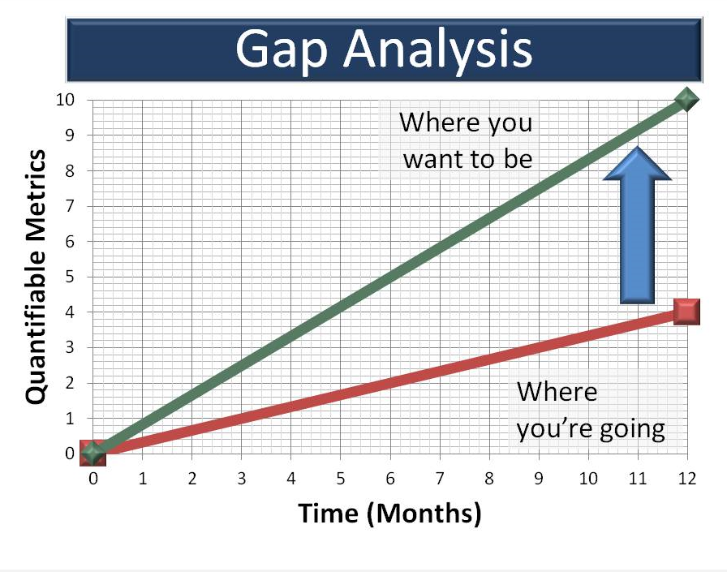
Gap Analysis

Slide 12

Unit-Based Gap Analysis³
The unit-based gap analysis tool was developed by the American Association of Critical Care Nurses (AACN)
Originally designed to be used in conjunction with one of the AACN’s bedside technical intervention bundles but can be effectively applied to any process within your specific unit
Respondent uses a Likert scale to record the frequency in which an activity or procedure is performed
  3. Unit Gap Analysis. Implementing the ABCDE Bundle at the Bedside: American Association of Critical-Care Nurses. http://www.aacn.org/wd/practice/content/actionpak/withlinks-ABCDE-ToolKit.content?menu=practice. Accessed March 8, 2016.

Slide 13
Unit-Based Gap Analysis³
Sedation, SAT, and SBT Protocols
Our unit uses a sedation and analgesia protocol consistent with the Pain, Agitation, and Delirium guidelines
We routinely perform both pain and sedation assessment on patients using a validated tool
We currently perform spontaneous awakening trails (SATs) daily on all patients receiving sedation
We use a standardized protocol for performing SATs
We use a standardized protocol for performing spontaneous breathing trials (SBT)
Yes
Always
Occasionally
Sometimes
No
Never
  3. Unit Gap Analysis. Implementing the ABCDE Bundle at the Bedside: American Association of Critical-Care Nurses. http://www.aacn.org/wd/practice/content/actionpak/withlinks-ABCDE-ToolKit.content?menu=practice. Accessed March 8, 2016.

Slide 14
Unit-Based Gap Analysis³
Delirium Assessment and Management
All patients are assessed daily for the presence of delirium
We use a validated tool to assess for the presence of delirium (Confusion Assessment Method for the Intensive Care Unit or Intensive Care Delirium Screening Checklist)
Our unit has a standardized delirium management protocol
Delirium monitoring is included in our daily rounds for ALL patients
Yes
Always
Occasionally
Sometimes
No
Never
  3. Unit Gap Analysis. Implementing the ABCDE Bundle at the Bedside: American Association of Critical-Care Nurses. http://www.aacn.org/wd/practice/content/actionpak/withlinks-ABCDE-ToolKit.content?menu=practice. Accessed March 8, 2016.

Slide 15
Unit-Based Gap Analysis³
Early Exercise and Progressive Mobility
Our unit has a protocol for early exercise and progressive mobility for ALL patients
Immobile patients on our unit receive passive range of motion regularly, if tolerated
Our unit has the necessary support equipment to safely assist with patients’ increased mobility
Respiratory therapists and physical therapists are available to assist with implementing early exercise and progressive mobility protocols
Mobility is addressed during daily rounds
Yes
Always
Occasionally
Sometimes
No
Never
  3. Unit Gap Analysis. Implementing the ABCDE Bundle at the Bedside: American Association of Critical-Care Nurses. http://www.aacn.org/wd/practice/content/actionpak/withlinks-ABCDE-ToolKit.content?menu=practice. Accessed March 8, 2016.

Slide 16
Bridge the Gap
Use the gap example to sell the project, garner buy-in, and create energy to accelerate change
List and prioritize defects and changes required to achieve your objectives
Explore why the defects exist
  Drill down
  Ask Why, Why, Why?
Create a plan to move from current to target condition
  Assess then address cultural barriers
  Include project management support
  Incorporate change management techniques

Slide 17
Ensure All Patients Receive the Evidence (4 Es)¹
Ensure that all patients receive interventions
4
Engage
How can we engage hearts and minds?
Educate
How can we turn the evidence into behaviors?
Execute
How can we do this?
Evaluate
How do we know if we made a difference?
  1. Pronovost PJ, Berenholtz SM, Needham DM. Translating evidence into practice: a model for large scale knowledge translation. BMJ. 2008 Oct 6;337:a1714. PMID: 18838424.

Slide 18
Translating Research Into Practice¹
Summarize the evidence
1
Envision
the problem within the larger system
Engage collaborative multidisciplinary teams centrally and locally
Identify local barriers
to implementation
2
Measure performance
3
Ensure that all patients
receive the interventions
4
  1. Pronovost PJ, Berenholtz SM, Needham DM. Translating evidence into practice: a model for large scale knowledge translation. BMJ. 2008 Oct 6;337:a1714. PMID: 18838424.

Slide 19
Summary
Gap exists between evidence and practice regarding sedation and mobility
Undertake change at the local level
Perform gap analysis between your current practice and future state (where you want to be—your vision)
Set goals to improve care

Slide 20
Tests of Change
How small-scale tests inform sustainable quality improvement efforts

Slide 21
Basics of Tests of Change^{4–6}
DEFINE | Small-scale tests to evaluate proposed change
GOAL | Test potential improvement to unit’s workflow with potential to transform care
BENEFITS | Provides rapid real-time feedback Allows iterative adjustment Offers action-oriented learning
  4. Science of Improvement: Testing Changes. How to Improve: Institute for Healthcare Improvement. 2015. http://www.ihi.org/resources/Pages/HowtoImprove/ScienceofImprovementTestingChanges.aspx.
  Accessed March 8, 2016.
  5. Principles for Tests of Change. Robert Wood Johnson Foundation. 2008. http://www.rwjf.org/en/research-publications/find-rwjf-research/2008/06/the-transforming-care-at-the-bedside-tcab-toolkit/section-3-testing-ideas/principles-for-tests-of-change.html. Accessed March 8, 2016.
  6. Principles for Rapid Cycle Tests. Robert Wood Johnson Foundation. 2008. http://www.rwjf.org/content/dam/farm/toolkits/toolkits/2008/rwjf26881. Accessed March 8, 2016.
Notes:
Goal Test potential improvement to unit’s workflow with potential to transform care in large and small ways

Slide 22
Reasons To Test Change⁴
Increase belief that change will result in improvement
Decide which of several proposed changes will lead to desired improvement
Evaluate how much improvement can be expected from the change
Decide whether the proposed change will work in the actual environment of interest
  4. Science of Improvement: Testing Changes. How to Improve: Institute for Healthcare Improvement. 2015. http://www.ihi.org/resources/Pages/HowtoImprove/ScienceofImprovementTestingChanges.aspx.
  Accessed March 8, 2016.

Slide 23
Reasons To Test Change⁴
Decide which combinations of changes will have desired effects on key measures of quality
Evaluate costs, social impact, and side effects of a proposed change
Minimize resistance upon implementation
  4. Science of Improvement: Testing Changes. How to Improve: Institute for Healthcare Improvement. 2015. http://www.ihi.org/resources/Pages/HowtoImprove/ScienceofImprovementTestingChanges.aspx.
  Accessed March 8, 2016.

Slide 24
Principles for Tests of Change⁶
Test to evaluate if a new idea or innovation will work
Test small (n=1)
  One nurse
  One shift
  One patient
  One shift change report
Engage an informed tester who is invested in the process
  6. Principles for Rapid Cycle Tests. Robert Wood Johnson Foundation. 2008. http://www.rwjf.org/content/dam/farm/toolkits/toolkits/2008/rwjf26881. Accessed March 8, 2016.

Slide 25
Principles for Tests of Change
Don’t wait for a committee approval
Form a hypothesis and collect data (quantitative and qualitative)
Go to the committee after test with data to support proposed changes
Revise–it takes many iterations to build innovations

Slide 26
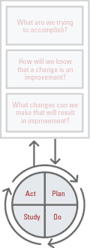
Plan-Do-Study-Act (PDSA) Cycle⁴
What are we trying to accomplish?
PDSA is the core of the Institute for Healthcare Improvement’s
Model for Improvement
How will we know that a change is an improvement?
What changes can we make that will result in improvement?
  4. Science of Improvement: Testing Changes. How to Improve: Institute for Healthcare Improvement. 2015. http://www.ihi.org/resources/Pages/HowtoImprove/ScienceofImprovementTestingChanges.aspx. Accessed March 8, 2016.

Slide 27
PDSA Cycle for Learning and Improvement⁴
ACT
PLAN
DO
STUDY
What changes are to be made?
Next cycle?
Objective
Questions and predictions (why)
Plan to carry out cycle
(who, what, where, when)
Plan for data collection
Analyze data
Compare data with
predictions
Summarize what was learned
Carry out plan
Document problems and unexpected observations
Collect and begin data analysis
  4. Science of Improvement: Testing Changes. How to Improve: Institute for Healthcare Improvement. 2015. http://www.ihi.org/resources/Pages/HowtoImprove/ScienceofImprovementTestingChanges.aspx. Accessed March 8, 2016.

Slide 28
PDSA Step 1: PLAN
Plan test, including data collection plan
State test objectives
Make predictions about what will happen and why
Develop a plan to test the change
  Who?
  What?
  When?
  Where?
  What data need to be collected?

Slide 29
PDSA Step 2: Do
Try out the test on a small scale
Carry out the test
Document problems and unexpected observations
Collect and begin data analysis
Keep data collection as simple as possible

Slide 30
PDSA Step 3: Study
Set aside time to analyze data and study results
Analyze data
Compare the data with predictions
Summarize and reflect on what was learned

Slide 31
PDSA Step 4: Act
Refine change, based on what was learned from test
Determine what modifications are needed
Adapt test to reflect new information
Prepare a plan for the next test
Abandon test if necessary

Slide 32
Test of Change Examples^{6–7}
Implement weekly updates of data sharing with unit to show progress
Elicit daily goals with new script
Give incentive to document new care procedure
  Appreciate good work
  Remind nurses to continue documentation
Include reminder of 10 a.m. spontaneous awakening trial target at both daily nurse huddles
  6. Principles for Rapid Cycle Tests. Robert Wood Johnson Foundation. 2008. http://www.rwjf.org/content/dam/farm/toolkits/toolkits/2008/rwjf26881. Accessed March 8, 2016.
  7. Klompas M, Anderson D, Trick W, et al. The preventability of ventilator-associated Events: The CDC Prevention Epicenters' Wake Up and Breathe Collaborative. Am J Respir Crit Care Med. 2014 Nov 4. PMID: 25369558.

Slide 33
Sample Test of Change⁷
Spontaneous Awakening Trials (SATs)
PLAN | Raise SAT compliance rate by reminding nursing staff of 10 a.m. SAT target time
DO | On Monday, add daily reminder at 7 a.m. nurse huddle of 10 a.m. SAT target
STUDY | Analyze current data Did more patients receive SAT at 10 a.m.?
ACT | Add reminder of 10 a.m. SAT target to both 7 a.m. and 7 p.m. daily nurse huddles
  7. Klompas M, Anderson D, Trick W, et al. The preventability of ventilator-associated Events: The CDC Prevention Epicenters' Wake Up and Breathe Collaborative. Am J Respir Crit Care Med. 2014 Nov 4. PMID: 25369558.

Slide 34
Planning Questions
What do you need to test the idea?
Who will be involved in the test?
How will you educate participants?
Where will test occur?
When will test occur?
What is the expected outcome?
How will you know it is successful?

Slide 35
Share Your Test of Change
What did you predict would happen?
What happened?
What did you learn?
What are your next steps?

Slide 36
Next Steps
Identify measurable goal of proposed change
Test under multiple conditions
Test with a variety of staff
Review all feedback
Be forward thinking and flexible
Revise proposal until concerns are addressed

Slide 37
Questions?

Slide 38
References
  Pronovost PJ, Berenholtz SM, Needham DM. Translating evidence into practice: a model for large scale knowledge translation. BMJ. 2008 Oct 6;337:a1714. PMID: 18838424.
  Pronovost PJ, Berenholtz SM, Goeschel C, et al. Improving patient safety in intensive care units in Michigan. J Crit Care. 2008 Jun;23(2):207-21. PMID: 18538214.
  Unit Gap Analysis. Implementing the ABCDE Bundle at the Bedside: American Association of Critical-Care Nurses. http://www.aacn.org/wd/practice/content/actionpak/withlinks-ABCDE-ToolKit.content?menu=practice. Accessed March 8, 2016.
  Science of Improvement: Testing Changes. How to Improve: Institute for Healthcare Improvement. 2015. http://www.ihi.org/resources/Pages/HowtoImprove/ScienceofImprovementTestingChanges.aspx. Accessed March 8, 2016.

Slide 39
References
  Principles for Tests of Change. Robert Wood Johnson Foundation. 2008. http://www.rwjf.org/en/research-publications/find-rwjf-research/2008/06/the-transforming-care-at-the-bedside-tcab-toolkit/section-3-testing-ideas/principles-for-tests-of-change.html. Accessed March 8, 2016.
  Principles for Rapid Cycle Tests. Robert Wood Johnson Foundation. 2008. http://www.rwjf.org/content/dam/farm/toolkits/toolkits/2008/rwjf26881. Accessed March 8, 2016.
  Klompas M, Anderson D, Trick W, et al. The preventability of ventilator-associated Events: The CDC Prevention Epicenters' Wake Up and Breathe Collaborative. Am J Respir Crit Care Med. 2014 Nov 4. PMID: 25369558.

