Slide 1
The Four Es of Early Mobility
AHRQ Safety Program for Mechanically Ventilated Patients
AHRQ Pub. No. 16(17)-0018-50-EF
January 2017

Slide 2
Learning Objectives
After this session, you will be able to—
List the four Es from TRIP framework (engage, educate, execute, and evaluate)
Apply each “E” intervention to early mobility (EM)

Slide 3
Translating Research Into Practice¹
Summarize the evidence
1
Envision
the problem within the larger system
Engage collaborative multidisciplinary teams centrally and locally
Identify local barriers
to implementation
2
Measure performance
3
Ensure that all patients
receive the interventions
4
1. Pronovost PJ, Berenholtz SM, Needham DM. Translating evidence into practice: a model for large scale knowledge translation. BMJ. 2008 Oct 6;337:a1714. PMID: 18838424.

Slide 4
Summarize the Evidence¹
Identify interventions
Summarize the Evidence
Prioritize interventions with the largest benefits and lowest barriers
1
Implement interventions to foster new behaviors
1. Pronovost PJ, Berenholtz SM, Needham DM. Translating evidence into practice: a model for large scale knowledge translation. BMJ. 2008 Oct 6;337:a1714. PMID: 18838424.

Slide 5
Identify Local Barriers¹
Observe staff performing care delivery tasks
Identify local barriers to implementation
Walk the process to identify defects at each step
2
Solicit feedback from all stakeholders
Identify potential gains or losses
1. Pronovost PJ, Berenholtz SM, Needham DM. Translating evidence into practice: a model for large scale knowledge translation. BMJ. 2008 Oct 6;337:a1714. PMID: 18838424.

Slide 6
What Are Your Barriers?²
BARRIER | STRATEGY TO OVERCOME BARRIER
Lack of leadership | Designate an overall leader who is involved and committed to quality improvement Involve a champion from every discipline
Lack of staffing and equipment | Identify equipment rental process Obtain grants and review capital budget for purchase of equipment Apply for nursing grants to fund dedicated physical and occupational therapists (PT/OT) and PT technicians
Lack of knowledge and training | Educate multidisciplinary team on evidence for early mobility interventions Create simple guidelines for PT/OT consultants Crosstrain staff
Lack of referrals and standardized documentation | Establish screening criteria Educate about appropriate referrals Clarify bed rest orders versus PT consultations Chart board guidelines for mobility
2. Needham DM, Korupolu R. Rehabilitation quality improvement in an intensive care unit setting: implementation of a quality improvement model. Top Stroke Rehabil. 2010 Jul-Aug;17(4):271-81. PMID: 20826415.

Slide 7
What Are Your Barriers?²
BARRIER | STRATEGY TO OVERCOME BARRIER
Oversedation | Educate interdisciplinary staff about continuous versus bolus sedation Standardize approach to sedation management
Delirium | Screen with validated assessment tool Minimize use of benzodiazepines Consider use of antipsychotics to treat delirium
Pain and discomfort | Indicate a pain protocol to titrate pain medications
Physiological instability | Create guidelines for screening physiological stability
Safety | Screen daily for PT/OT safety before initiating therapy Initiate any therapy beyond feet dangling with respiratory therapist at bedside Untangle lines prior to therapy to avoid accidental dislodgement
2. Needham DM, Korupolu R. Rehabilitation quality improvement in an intensive care unit setting: implementation of a quality improvement model. Top Stroke Rehabil. 2010 Jul-Aug;17(4):271-81. PMID: 20826415.

Slide 8
Measure Performance¹
Select process and/or outcome measures
Measure performance
3
Develop and pilot test measures
Measure baseline performance
1. Pronovost PJ, Berenholtz SM, Needham DM. Translating evidence into practice: a model for large scale knowledge translation. BMJ. 2008 Oct 6;337:a1714. PMID: 18838424.

Slide 9
Ensure All Patients Receive the Evidence (Four Es)¹
Ensure that all patients receive interventions
4
Engage
How can we engage hearts and minds?
Educate
How can we turn the evidence into behaviors?
Execute
How can we do this?
Evaluate
How do we know if we made a difference?
1. Pronovost PJ, Berenholtz SM, Needham DM. Translating evidence into practice: a model for large scale knowledge translation. BMJ. 2008 Oct 6;337:a1714. PMID: 18838424.

Slide 10
Four Es of Early Mobility
 |  | FRONTLINE STAFF | EARLY MOBILITY
Engage | ADAPTIVE | Ask, how will early mobility make the world a better place? Explain preventable harm to staff Share stories about patients Develop a business case Include executive and physician leadership | Define evidence related to preventing ventilator-associated events (short- and long-term cognitive effects, and physical and psychological disabilities) Share success stories and videos Visit a site with experienced units or facilities Create business case related to the impact of early mobility including decreased time on ventilator, in intensive care unit, and in hospital Share business case with executive and provider champions

Slide 11
Four Es of Early Mobility
 |  | FRONTLINE STAFF | EARLY MOBILITY
Educate | TECHNICAL | What do we need to mobilize critically ill patients? Convert evidence into behaviors Evaluate awareness and agreement | Discuss post-intensive care syndrome Review the literature Develop mobility criteria and progressive mobility protocols Develop education plan including hands-on workshops, presentations, conferences, and interactive discussions Identify support through outreach to the leadership team

Slide 12
Four Es of Early Mobility
 |  | FRONTLINE STAFF | EARLY MOBILITY
Execute | ADAPTIVE | How will we implement early mobility at our hospital give local culture and resources? Listen to resisters Standardize care and create independent checks Make it easy to do the right thing Learn from mistakes | Update process for mobilizing patient Review policies and protocols Identify key stakeholders Gather appropriate equipment Discuss as part of interdisciplinary rounds/daily goals Learn from defects
Evaluate | TECHNICAL | How will we know that our efforts to mobilize our patients made a difference? Define measures Assess measures regularly Provide feedback to staff and celebrate success | Collect data and review with staff Use your data to trend performance

Slide 13
Engage and Educate Frequently
Share at multidisciplinary safety program meetings
Discuss at staff meetings every 6 weeks
Present at board meetings
Clarify expectations at daily huddles
Reinforce with email
Publish newsletter
Post on bulletin boards
Talk with staff while collecting data

Slide 14
Engage All Staff
Sitters/Observers
Clinical Technicians/ Nursing Assistants
Ambulate
Turn
Range of motion
Document
Ancillary Personnel

Slide 15
Engage – Family Resources
Consider a Family Involvement Menu:
Invites family members to assist in EM exercises
Encourages family members to partner with nurses
Facilitates connection with the sick relative

Slide 16
Educate: Turn Evidence Into Behaviors
Define and approve mobilization readiness criteria
Develop early/progressive mobility protocols and guidelines
Review the literature
Develop education plan including hands-on workshops, presentations, conferences, and interactive discussions
Identify support through outreach to the leadership team

Slide 17
Readiness Assessment: Other Considerations
Patient factors
Sedation level
Breathing support for EM interventions
Femoral lines
Presence of lines, drains, catheters
Other factors
The right equipment
Sufficient staffing/multidisciplinary focus

Slide 18
Execute: Make It Easy To Do the Right Thing
What is the process for mobilizing a patient?
Is there a policy on the unit?
Who should be involved?
Do we have all the equipment?
Discuss as part of interdisciplinary rounds/daily goals
Add mobility level to report sheet and nursing handoff

Slide 19
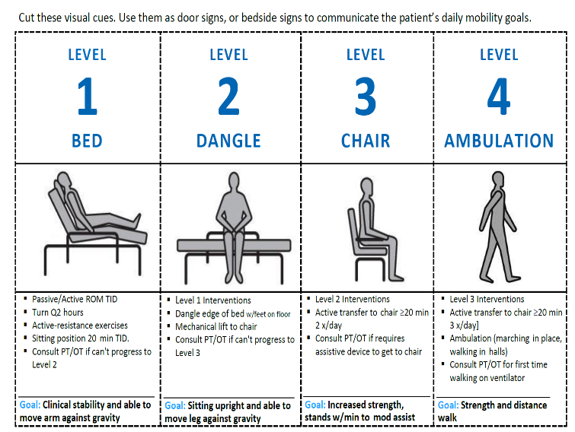
Early Progressive Mobility Protocol
Use visual cues to communicate daily mobility goals
Place near patient on white board, door, or bedside
Laminate cues and write custom goals when appropriate
Used with permission. Adapted at St. Joseph Mercy Hospital from the American Association of Critical-Care Nurses early progressive mobility protocol.³ Learn more at www.aacn.org.

Slide 20
Sample Early Mobility Protocol⁴
4. Bassett RD, Vollman KM, Brandwene L, et al. Integrating a multidisciplinary mobility programme into intensive care practice (IMMPTP): a multicentre collaborative. Intensive Crit Care Nurs. 2012 Apr;28(2):88-97. PMID: 22227355.

Slide 21
Evaluate: Measure Your Success
Collect process measures data
Review at monthly safety program meetings
Post prominently for frontline staff
Use your data to trend performance

Slide 22
Daily Early Mobility Measures Form

Slide 23
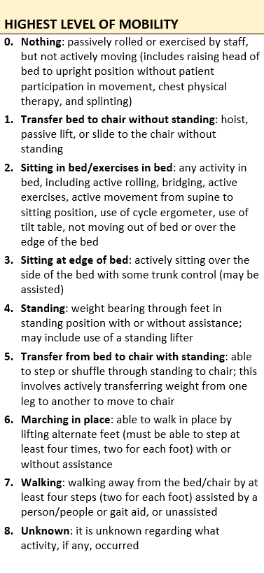
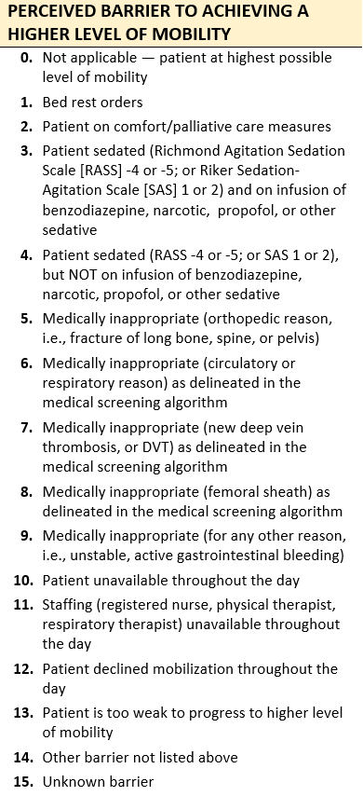
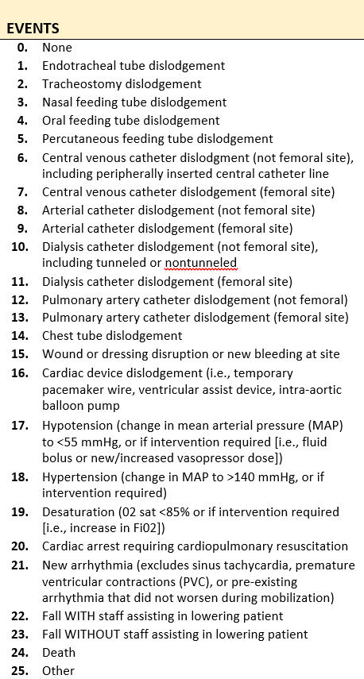
Daily Early Mobility Measures Guide

Slide 24
Highest Level of Mobility
0. Nothing – passively rolled or exercised by staff but not actively moving
Transfer from bed to chair without standing – hoist, passive lift, or slide to the chair without standing
Sitting in bed/exercises in bed – any activity in bed, including active rolling, bridging, active exercises, use of tilt table
Sitting at edge of bed – actively sitting over the side of the bed with some trunk control
Standing – weight bearing through feet in standing position with or without assistance
Transfer from bed to chair with standing – able to step or shuffle through standing to chair
Marching in place – able to walk in place by lifting alternate feet (at least four times, two for each foot)
Walking – walking away from the bed/chair by at least four steps
Unknown

Slide 25
Perceived Barriers
0. Not applicable – patient at highest possible level of mobility
Bed rest orders
Patient on comfort/palliative care measures
Patient sedated (Richmond Agitation-Sedation Score [RASS] -4 or -5; or Riker Sedation-Agitation Scale [SAS] 1 or 2) and on infusion of benzodiazepine, narcotic, or propofol
Patient sedated (RASS -4 or -5; or SAS 1 or 2), but NOT on infusion of benzodiazepine, narcotic, or propofol
Medically inappropriate (orthopedic reason, e.g., fracture of long bone, spine, or pelvis)
Medically inappropriate (circulatory or respiratory reason) as delineated in the medical screening algorithm

Slide 26
Perceived Barriers
Medically inappropriate (new deep vein thrombosis) as delineated in the medical screening algorithm
Medically inappropriate (femoral sheath) as delineated in the medical screening algorithm
Medically inappropriate (for any other reason; e.g., unstable, active gastrointestinal bleeding)
Patient unavailable throughout the day
Staffing (registered nurse, PT, and OT) unavailable throughout the day
Patient declined mobilization throughout the day
Patient is too weak to progress to higher level of mobility
Other barrier not listed above
Unknown barrier

Slide 27
Adverse Events During Mobilization
0. None
Endotracheal tube dislodgement
Tracheostomy dislodgement
Nasal feeding tube dislodgement
Oral feeding tube dislodgement
Percutaneous feeding tube dislodgement
Central venous catheter dislodgement (not femoral site), including peripherally inserted central catheter line
Central venous catheter dislodgement (femoral site)
Arterial catheter dislodgement (not femoral site)
Arterial catheter dislodgement (femoral site)
Dialysis catheter dislodgement (not femoral site), including tunneled or non-tunneled
Dialysis catheter dislodgement (femoral site)

Slide 28
Summary
The TRIP framework assists in making sure all patients receive the appropriate interventions by using the Four Es (engage, educate, execute, evaluate)
The Four Es can be specifically applied to the practice of early mobility
Engage your frontline staff by appealing to intrinsic motivators
Educate your care team through the use of progressive mobility protocols and by reviewing current literature
Execute by reviewing policy and procedures, implementing multidisciplinary rounds, and learning from defects
Evaluate your progress by assessing measures regularly and using data to follow performance trends
To apply the Four Es, use a daily early mobility data collection form to easily record information on a patient’s highest level of mobility, barriers to higher levels of mobility, and any adverse events that occurred as a result of early mobility efforts

Slide 29
References
Pronovost PJ, Berenholtz SM, Needham DM. Translating evidence into practice: a model for large scale knowledge translation. BMJ. 2008 Oct 6;337:a1714. PMID: 18838424.
Needham DM, Korupolu R. Rehabilitation quality improvement in an intensive care unit setting: implementation of a quality improvement model. Top Stroke Rehabil. 2010 Jul-Aug;17(4):271-81. PMID: 20826415.
Early Progressive Mobility Protocol. Aliso Viejo, CA: American Association of Critical-Care Nurses. April 2013. http://www.aacn.org/wd/practice/docs/tool%20kits/early-progressive-mobility-protocol.pdf. Accessed June 14, 2016.
Bassett RD, Vollman KM, Brandwene L, et al. Integrating a multidisciplinary mobility programme into intensive care practice (IMMPTP): a multicentre collaborative. Intensive Crit Care Nurs. 2012 Apr;28(2):88-97. PMID: 22227355.

