Slide 1
Measure Descriptions for Daily Care Processes
AHRQ Safety Program for Mechanically Ventilated Patients
AHRQ Pub. No. 16(17)-0018-44-EF
January 2017

Slide 2
Learning Objectives
After this session, you will be able to—
Collect and enter Daily Care Process (DCP) data using the DCP data collection tool
Understand the definitions of the data elements
Locate the necessary data elements

Slide 3
Daily Care Processes: Key Interventions
Use a subglottic secretion drainage endotracheal tube (SSD-ETT) for patients intubated for more than 72 hours
Elevate the head of bed (HOB) to at least 30 degrees
Interrupt sedation daily and minimize sedative use
Assess sedation and delirium with structured scales
Perform spontaneous awakening trials (SAT) and spontaneous breathing trials (SBT)

Slide 4
Data Collection
Drives quality improvement efforts
Can be used for quality improvement processes or for research
Provides quantifiable measures of care practices
Guides patient safety conversations
Justifies resource allocations
Human resources (time)
Financial resources (money)
Supplies and equipment (stuff)

Slide 5
Daily Care Processes Data Collection Tool
Intubation
SSD-ETT
HOB
Sedation scale
Delirium assessment
SAT and SBT

Slide 6
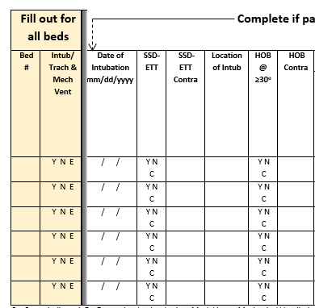
Data Collection: Intubation, SSD-ETT, and HOB

Slide 7
Let’s Begin…
Fill out for all beds
Track by bed, not by patient
Include
Bed number
Was the patient in that bed intubated or trached AND on mechanical ventilation at the time of observation?
Y = Yes
N = No
E = Empty bed

Slide 8
Date of Intubation
Enter the date the patient was intubated
If the date is not available*, enter admission date (either to the unit or to the hospital, as appropriate)
If the patient is extubated and re-intubated within 24 hours, use the original date
*i.e., when from an outside institution

Slide 9
SSD-ETT
Evaluate daily for patients receiving mechanical ventilation
Does the patient have a subglottic secretion drainage endotracheal tube?

Slide 10
SSD-ETT
Y = Patient has a SSD-ETT or a subglottic suctioning tracheostomy tube
N = Patient does not have a SSD-ETT
C = Use of a SSD-ETT is contraindicated

Slide 11
SSD-ETT Contraindications
Evaluate daily for patients receiving mechanical ventilation AND with C entered in the previous column
Enter the number associated with the reason for contraindication
Enter 1 if the contraindication is a tracheostomy (without subglottic suctioning)
Enter 0 if the contraindication is “other”

Slide 12
Location of Intubation
Evaluate daily for patients receiving full vent support
Codes:
0. Your intensive care unit (ICU) or unit
Another ICU/unit in your hospital
Outside hospital
Operating room
Rapid response team
Emergency department
Cardiovascular and interventional laboratory
During a code on the floor
Another location not listed above

Slide 13
HOB ≥ 30 Degrees
Evaluate daily for patients receiving mechanical ventilation
Y = HOB is ≥30 degrees at the time of observation
N = HOB is NOT ≥30 degrees at the time of observation
C = HOB ≥30 degrees is contraindicated

Slide 14
HOB Elevation Contraindications
Evaluate daily for patients receiving mechanical ventilation AND with C entered in the previous column
What is the reason elevating the HOB to ≥30 degrees, when compared to a horizontal surface, is contraindicated?
Enter the number associated with the reason for contraindication:
0. Other
Hypotension
Unstable psychological status
Low cardiac index
Cervical, thoracic, or lumbar surgery or instability
Left ventricular assist device
Right ventricular assist device
Intra-aortic balloon pump
Open abdomen
Patient refusal

Slide 15
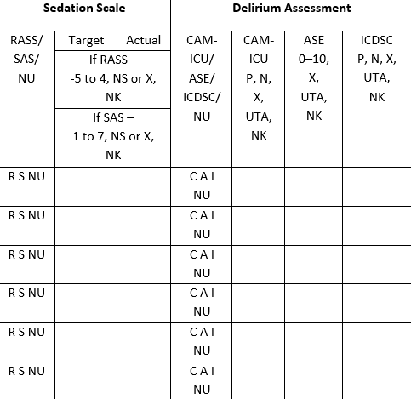
Data Collection: Sedation and Delirium

Slide 16
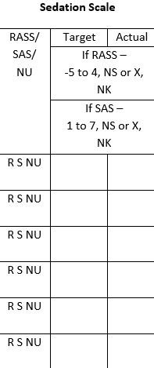
Sedation Scale
What sedation scale do you use on your unit?
This question refers to your unit, not to this specific patient

Slide 17
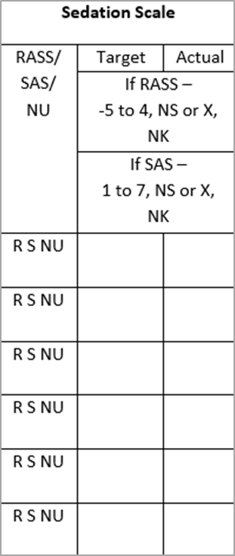
Sedation Scale
Use Richmond Agitation Sedation Scale (RASS) or Riker Sedation-Agitation Scale (SAS) but not both
R = RASS
S = SAS
NU = Unit uses neither RASS or SAS
If NU, skip to Delirium Assessment

Slide 18
Sedation Scale: Target RASS
If you use RASS…
Target: What is the target RASS score for this patient?
Enter RASS sedation scale value (-5 to 4)
“NS” means not set
“NK” means target RASS was set, but is not known
Enter “NK” if you don’t know whether a target RASS was actually set

Slide 19
Sedation Scale: Actual RASS
If you use RASS…
Actual: What is the actual RASS score for this patient?
Enter RASS sedation scale value (-5 to 4)
Enter “X” if an actual RASS sedation level was not scored
Enter “NK” if target RASS was scored, but is not known
Enter “NK” if you don’t know whether a target RASS was actually scored

Slide 20
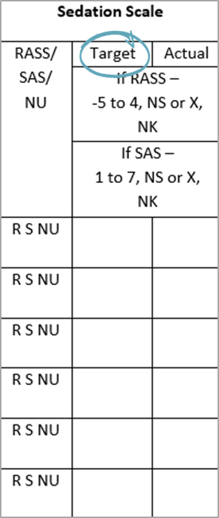
Sedation Scale: Target SAS
If you use SAS…
Target: What is the target SAS score for this patient?
Enter SAS sedation scale value (1 to 7)
Enter “NS” if not set
Enter “NK” if target SAS was set but is not known
Enter “NK” if you don’t know whether a target SAS was actually set

Slide 21
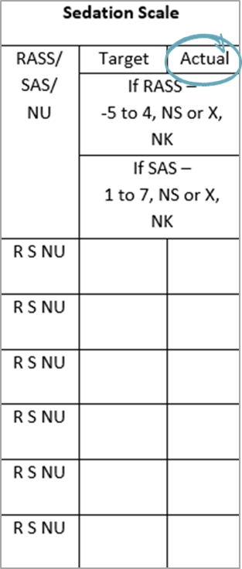
Sedation Scale: Actual SAS
If you use SAS…
Actual: What is the actual SAS score for this patient?
Enter SAS sedation scale value (1 to 7)
Enter “X” if an actual SAS sedation level was not scored
Enter “NK” if target SAS was scored, but is not known
Enter “NK” if you don’t know whether a target SAS was actually scored

Slide 22
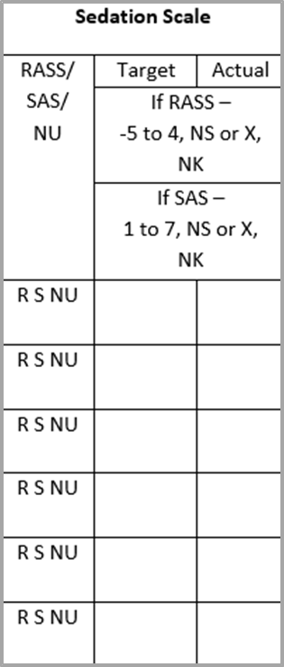
Sedation Scale: NU
If you entered “NU”
NU = Unit uses neither RASS or SAS
If NU, skip Target and Actual sections and go to Delirium Assessment

Slide 23
Delirium Assessment
Society of Critical Care Medicine’s 2013 Pain, Agitation, and Delirium (PAD) clinical practice guidelines
Recommends theses valid and reliable delirium screening tools
Confusion Assessment Method for the ICU (CAM-ICU)
Intensive Care Delirium Screening Checklist (ICDSC)
Screen moderate to high-risk patients at least once per nursing shift

Slide 24
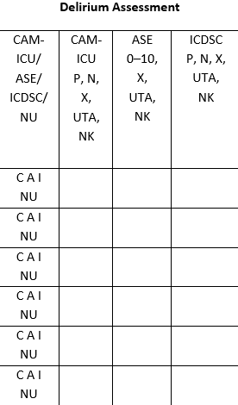
Delirium Assessment
Choose either CAM-ICU, ICDSC, or ASE, but not more than one
C = CAM-ICU
A = Attention Screening Exam (ASE)
I - ICDSC
NU = Unit uses neither CAM-ICU, ICDSC, or ASE
If NU, skip to the sedation section

Slide 25
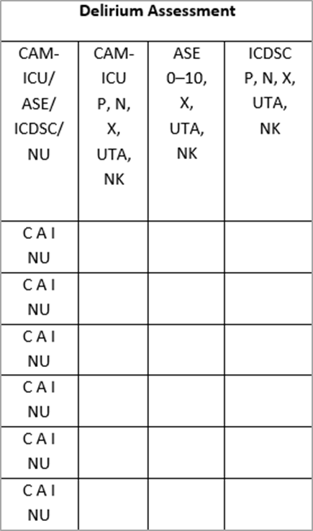
Delirium Assessment: CAM-ICU
Is the patient positive or negative for delirium?
Enter “P” if the patient is positive for delirium
Enter “N” if the patient is negative for delirium
Enter “X” if CAM-ICU assessment was not completed
Enter “UTA” if unable to assess
Such as RASS = -4 or -5 OR SAS = 1 or 2
Enter “NK” if CAM-ICU was completed, but results aren’t known
Enter “NK” if you don’t know whether the exam was performed

Slide 26
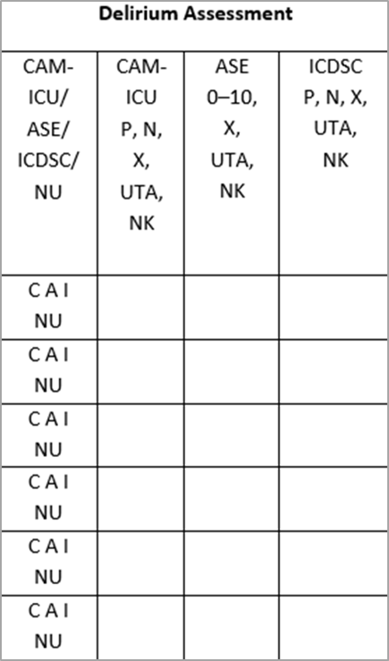
Delirium Assessment: ICDSC
Is the patient positive or negative for delirium?
Enter “P” if the patient is positive for delirium
Enter “N” if the patient is negative for delirium
Enter “X” if ICDSC was not completed
Enter “UTA” if unable to assess
Such as RASS = -4 or -5 OR SAS = 1 or 2
Enter “NK” if ICDSC was completed, but results aren’t known
Enter “NK” if you don’t know whether the exam was performed

Slide 27
Delirium Assessment: Attention Screening Exam
If the CAM-ICU or ICDSC are not yet feasible in your unit
Second feature of the CAM-ICU
10- to 20-second test
Goal to determine if patient can follow a simple command for that period of time
Inattention must be present to diagnose delirium
Recommend patients at least undergo the ASE once per nursing shift
Recognize that ASE may be abnormal due to disease, drugs, or other causes

Slide 28
Attention Screening Exam
Provider reads one of the following sequences:
S A V E A H A A R T
C A S A B L A N C A
A B A D B A D D A Y
Patient squeezes the provider’s hand when he hears the letter “A”
Error defined as—
No squeeze with letter “A”
A squeeze on a letter other than “A”

Slide 29
Attention Screening Exam
Count the number of errors
Inattention is present if the patient commits more than two errors
If the patient squeezes on every letter, assign an error count of 10
If the patient doesn’t squeeze on any letter, assign an error count of 10

Slide 30
Attention Screening Exam
What is the patient’s ability to pay attention?
Use only if CAM-ICU or ICDSC are not performed
Enter the number of errors, 0 to 10
Enter “X” if the exam was not performed
Enter “UTA” if unable to assess
RASS = -4 or -5
SAS = 1 or 2
Enter “NK” if the exam was performed, but number of errors is not known
Enter “NK” if you don’t know whether the exam was performed

Slide 31
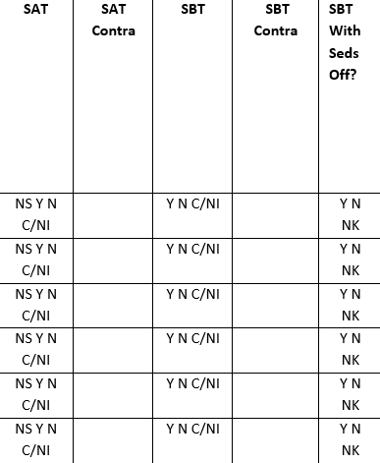
Data Collection: SAT and SBT

Slide 32
Spontaneous Awaking Trial
Evaluate every day for patients receiving mechanical ventilation
Have medications for sedation been held today?
NS = Not sedated
Y = Medications for sedation have been held
N = Medications for sedation have NOT been held
C/NI = Holding medications for sedation is either contraindicated or not indicated today

Slide 33
SAT – Contraindications
Evaluate daily for patients receiving mechanical ventilation AND with C/NI entered in the SAT column
Why is an SAT inappropriate for this patient?
0. Other
Sedatives for active seizures or objective evidence of active alcohol withdrawal
Escalating sedative doses due to ongoing agitation
Neuromuscular blockers
Active myocardial ischemia in the previous 24 hours
Increased intracranial pressure in the previous 24 hours
High-frequency oscillation ventilation

Slide 34
Spontaneous Breathing Trial
Evaluate every day for patients receiving mechanical ventilation
Has the patient had an SBT today?
Y = Patient had an SBT
N = Patient did not have an SBT
C/NI = If use of an SBT is contraindicated or not indicated

Slide 35
SBT – Contraindications
Evaluate daily for patients receiving mechanical ventilation AND with C/NI entered in the SBT column
Why is an SBT inappropriate for this patient?
0. Other
No adequate oxygenation
No spontaneous inspiratory effort in a 5-minute period
Acute agitation requiring escalating sedative doses
Significant vasopressors or inotropes
Increased intracranial pressure in the previous 24 hours

Slide 36
SBT – With Sedatives Off
Evaluate every day for patients receiving mechanical ventilation AND with a Y entered in the previous column
Was the SBT performed with sedatives off?
Y = SBT performed with sedatives off
N = SBT was performed with sedatives on
NK = Unknown if sedatives were off when the SBT was performed

Slide 37
Data Measures Guide
The Data Measures Guide can help you determine more than 10 different metrics, including—
SSD-ETT compliance and contraindication rates
HOB compliance and contraindication rates
Percentage of achieving RASS/SAS target
Percentage of RASS/SAS actual being {-1, 0, 1} or {4, 5}
Distribution of RASS/SAS Actual Scores
Delirium assessment participation rate
Percentage of CAM-ICU negative, ICDSC negative, or ASE ≤2 (no delirium)
Percentage of incorrectly reporting CAM-ICU/ICDSC/ASE UTA (Unable To Assess)
SAT and SBT compliance and contraindication rates

Slide 38
Data Measures Guide
Data should drive all quality improvement efforts…
The Data Measures Guide provides detailed instructions on how to calculate and evaluate process and outcome measures in your unit using data gathered from the data collection tools provided for this safety program. The guide can be found on the AHRQ Web site at www.ahrq.gov/HAImvp.

Slide 39
Questions?

