Slide 1
Introduction to Daily Care Processes: Evidence Behind Spontaneous Awakening Trials, Spontaneous Breathing Trials, and Head of Bed Elevation
AHRQ Safety Program for Mechanically Ventilated Patients
AHRQ Pub. No. 16(17)-0018-42-EF
January 2017

Slide 2
Learning Objectives
After this session, you will be able to—
Identify how the use of spontaneous awakening trials (SATs) and spontaneous breathing trials (SBTs) can reduce the length of mechanical ventilation and the risk of ventilator-associated pneumonia (VAP)
Follow and perform the recommended SAT and SBT protocols when clinically indicated
Understand the benefits of utilizing head of bed (HOB) elevation techniques
Access the supporting resources for these daily care process measures

Slide 3
SATs and SBTS

Slide 4
Complications of Sedation
Suppresses respiratory drive, prolonging ventilator dependence
Increases risk for delirium
Impairs mobility
Prolonged ventilator dependence can increase the risk of pneumonia, atelectasis, and acute respiratory distress syndrome (ARDS), among others

Slide 5
Daily Interruption of Sedatives
Fewer than half of practitioners worldwide reported implementing daily interruption of sedatives^{1,2}
Germany 34%
Canada 40%
USA 40%
1. Tanios MA, de Wit M, Epstein SK, et al. Perceived barriers to the use of sedation protocols and daily sedation interruption: a multidisciplinary survey. J Crit Care. 2009 24(1):66-73. PMID: 19272541.
2. Devlin JW, Tanios MA, Epstein SK. Intensive care unit sedation: waking up clinicians to the gap between research and practice. Crit Care Med. 2006 34(2):556-7. PMID: 16424748.

Slide 6
SAT & SBT Specific VAP Prevention Guidelines
Centers for Disease Control and Prevention³
Does not specifically address SAT and SBT, but supports weaning
American Thoracic Society⁴
Recommends use of daily interruption or lightening of sedation to avoid constant heavy sedation and to facilitate and accelerate weaning
Does not specifically address SBT
3. Tablan OC, Anderson LJ, Besser R, et al. Guidelines for preventing healthcare-associated pneumonia, 2003: recommendations of CDC and the Healthcare Infection Control Practices Advisory Committee. MMWR Recomm Rep. 2004 Mar 26;53(RR-3):1-36. PMID: 15048056.
4. American Thoracic Society, Infectious Diseases Society of America. Guidelines for the management of adults with hospital-acquired, ventilator-associated, and healthcare-associated pneumonia. Am J Respir Crit Care Med. 2005 171(4):388-416. PMID: 15699079.

Slide 7
SAT & SBT Specific VAP Prevention Guidelines
Society for Healthcare Epidemiology of America (SHEA)⁵
Recommends simultaneous use of daily SATs and the daily assessment of readiness wean through SBTs
Recommends management of ventilated patients with minimal sedation whenever possible and avoidance of benzodiazepines
5. Klompas M, Branson R, Eichenwald EC, et al. Strategies to prevent ventilator-associated pneumonia in acute care hospitals: 2014 update. Infect Control Hosp Epidemiol. 2014 35(8):915-36. PMID: 25026607.

Slide 8
2014 SHEA Compendium Update⁵
Manage ventilated patients without sedatives whenever possible
Interrupt sedation once a day with SATs
Assess readiness to extubate once a day with SBTs
Pair spontaneous breathing trials with spontaneous awakening trials
Employ early exercise and mobilization
Use noninvasive positive pressure ventilation whenever feasible
5. Klompas M, Branson R, Eichenwald EC, et al. Strategies to prevent ventilator-associated pneumonia in acute care hospitals: 2014 update. Infect Control Hosp Epidemiol. 2014 35(8):915-36. PMID: 25026607.

Slide 9
SAT & SBT Protocol^{6,7}
6. Kress J, Pohlman A, O'Connor M, et al. Daily interruption of sedative infusion in critically ill undergoing mechanical ventilation. N Engl J Med. 2000 342(20):1471-7. PMID: 10816184.
7. Girard TD, Kress JP, Fuchs BD, et al. Efficacy and safety of a paired sedation and ventilator weaning protocol for mechanically ventilated patients in intensive care (awakening and breathing controlled trial): A randomised controlled trial. Lancet. 2008 371(9607):126-134. PMID: 18191684.

Slide 10
SAT Summary
SAT Safety Screen
No oscillator
No active seizures
No benzodiazepines for alcohol withdrawal
No agitation
No paralytics
No active myocardial infarction
Normal intracranial pressure
No planned surgery within 24 hours
pass
Fail SAT
Perform SAT
Persistent anxiety, agitation, or pain
Respiratory rate >35/min
SpO₂ <88%
Respiratory distress
Acute cardiac dysrhythmia
Diaphoresis
Heart rates >130
pass
Screen for SBT
Restart sedatives at ½ prior dose

Slide 11
SAT Protocol^{6,7}
SAT consists of two parts: safety screen and trial
SAT safety screen checks for contraindications to performing SAT trial
For patients who are not responsive to verbal stimuli, the SAT trial checks for contraindications to performing the SBT safety screen and SBT trial
6. Kress J, Pohlman A, O'Connor M, et al. Daily interruption of sedative infusion in critically ill undergoing mechanical ventilation. N Engl J Med. 2000 342(20):1471-7. PMID: 10816184.
7. Girard TD, Kress JP, Fuchs BD, et al. Efficacy and safety of a paired sedation and ventilator weaning protocol for mechanically ventilated patients in intensive care (awakening and breathing controlled trial): A randomised controlled trial. Lancet. 2008 371(9607):126-134. PMID: 18191684.

Slide 12
SAT Safety Screen Eligibility^{6,7}
The patient must meet the following criteria to be eligible for the SAT safety screen:
No high-frequency oscillatory ventilation
No active seizures
No benzodiazepines for alcohol withdrawal
No objective evidence of active alcohol withdrawal
No agitation
No paralytics
No active myocardial ischemia in the previous 24 hours
No increased intracranial pressure in the previous 24 hours
No planned surgery within 24 hours
6. Kress J, Pohlman A, O'Connor M, et al. Daily interruption of sedative infusion in critically ill undergoing mechanical ventilation. N Engl J Med. 2000 342(20):1471-7. PMID: 10816184.
7. Girard TD, Kress JP, Fuchs BD, et al. Efficacy and safety of a paired sedation and ventilator weaning protocol for mechanically ventilated patients in intensive care (awakening and breathing controlled trial): A randomised controlled trial. Lancet. 2008 371(9607):126-134. PMID: 18191684.

Slide 13
Passing the SAT Safety Screen
The patient must meet the following criteria to PASS the SAT safety screen:
No persistent anxiety, agitation, or pain
Respiratory rate <35/min
SpO₂ >88%
Heart rate >130
Does not experience respiratory distress
Does not experience acute cardiac dysrhythmia
Does not experience diaphoresis
If the patient PASSES the safety screen, proceed to the SAT trial
If the patient FAILS the SAT safety screen, they should be rescreened the following day

Slide 14
Passing the SAT Trial
There are two different ways a patient can pass the SAT trial:
The patient passes the SAT trial if they can perform three out of the four following tasks on request:
Open their eyes
Look at their caregiver
Squeeze the hand
Put out their tongue
The patient passes the SAT trial if they can go without sedation for 4 hours without new symptoms or complications such as—
Sustained anxiety, agitation or pain
Respiratory rate of 35 breaths/minute for ≥ 5 minutes
SpO₂ of less than 88% for ≥ 5 minutes
Acute cardiac dysrhythmia
Two or more signs of respiratory distress
Tachycardia
Bradycardia
Use of accessory muscles
Marked dyspnea
Abdominal paradox
Diaphoresis

Slide 15
Passing the SAT Trial
If patient tolerates the SAT trial:
Proceed to the SBT safety screen
If patient fails the SAT trial:
Sedatives are started at half the prior dosage
Then titrated up as needed
Perform the SAT screen again the following day

Slide 16
SBT Safety Screen
SBT Safety Screen
Inspiratory efforts
Oxygen saturation ≥88%
FiO₂ ≤50%
Positive end-expository pressure (PEEP) ≤8-10cm H₂O
No active myocardial infarction
No paralytics
No agitation (Richmond Agitation Sedation Scale [RASS] ≤ +2)
Low or no vasopressors
pass
Perform SBT
Fail SBT
Agitation or diaphoresis
Respiratory rate >35/min
Respiratory rate <8/min
SpO₂ <88%
Mental status change
Acute cardiac dysrhythmia
pass
Extubate
Resume
Vent Support

Slide 17
SBT Protocol
SBT consists of two parts: safety screen and trial
SBT safety screen checks for contraindications to performing SBT trial
SBT trial checks for contraindications to considering extubation

Slide 18
Passing the SBT Safety Screen
The patient must have the following to pass the safety screen:
Inspiratory efforts
Oxygen saturation ≥88%
FiO₂ ≤50%
PEEP ≤8 cm H₂O
No active myocardial infarction
No paralytics
No agitation (RASS ≤ +2)
Low or no vasopressors

Slide 19
Passing the SBT Trial
The patient must meet the following to pass the SBT trial:
No evidence of sustained anxiety or agitation
Respiratory rate of ≤35 breaths/minute and ≥8 breaths per minute
SpO₂ greater than 88%
No change in mental status
No acute cardiac dysrhythmia
Fewer than two signs of respiratory distress
Tachycardia
Bradycardia
Use of accessory muscles
Marked dyspnea
Abdominal paradox
Diaphoresis

Slide 20
Failing the SBT Trial
If the patient fails the SBT trial
Reventilate immediately
Reassess the following day
If the patient passes the SBT trial
Notify physician to consider performing extubation

Slide 21
Perceived Barriers to Sedation Protocols and SATs¹
Multidisciplinary Web-based survey (n=904)
Reasons for lack of protocol use
No physician order, 35%
Lack of nursing support, 11%
Fear of oversedation, 7%
Barriers for daily sedation interruption
Nursing acceptance, 22%
Risk of device removal, 19%
Respiratory compromise, 26%
Patient discomfort, 13%
1. Tanios MA, de Wit M, Epstein SK, et al. Perceived barriers to the use of sedation protocols and daily sedation interruption: a multidisciplinary survey. J Crit Care. 2009 24(1):66-73. PMID: 19272541.

Slide 22
Intensive Care Unit (ICU) Barriers to SATs
View SATs as unnecessary, and light sedation as more appropriate and safer
Claim no physician orders
Maintain inadequate staff to undertake protocols
Unconvinced lowering sedation will benefit patients

Slide 23
ICU Barriers to SATs⁸
Nursing attitudes account for one-third of variance in number of patients who received sedatives
Only 17.7% of respondents thought it was easier to care for an awake and alert patient receiving mechanical ventilation than to care for a similar patient more sedated
8. Guttormson JL, Chlan L, Weinert C, et al. Factors influencing nurse sedation practices with mechanically ventilated patients: a U.S. national survey. Intensive Crit Care Nurs. 2010 26(1):44-50. PMID: 19945879.

Slide 24
Evidence for SATs and SBTs

Slide 25
Strøm et al.⁹
A protocol of no sedation for critically ill patients receiving mechanical ventilation: a randomised trial
140 patients randomized to routine sedation versus no sedation
70 prescribed routine sedation (propofol then midazolam)
70 prescribed no sedation (morphine boluses as needed)
Patients with no sedation
Mean 4.2 (95% confidence interval [CI] 0.3 to 8.1) fewer days on ventilation
Shorter ICU stay (hazard ratio [HR] 1.86, 95% CI 1.1 to 3.2)
Shorter hospital stay (HR 3.6, 95% CI 1.5 to 9.1)
More agitated delirium (20% vs. 7%) but no difference in self-extubations
1:1 nursing
9. Strøm T, Martinussen T, Toft P. A protocol of no sedation for critically ill patients receiving mechanical ventilation: a randomised trial. Lancet. 2010 Feb 6;375(9713):475-80. PMID: 20116842.

Slide 26
Kress et al.⁶
Daily interruption of sedative infusions in critically ill patients undergoing mechanical ventilation
Intervention group:
2.4 more days alive and off the ventilator (p=.004)
1.9 times more likely to be extubated (p<0.001, 95% CI 1.3 to 2.7)
ICU length of stay shorter by 3.5 days (p=0.02)
6. Kress J, Pohlman A, O'Connor M, et al. Daily interruption of sedative infusion in critically ill undergoing mechanical ventilation. N Engl J Med. 2000 342(20):1471-7. PMID: 10816184.

Slide 27
Girard et al.⁷
Efficacy and safety of paired sedation and ventilator weaning protocol for mechanically ventilated patients in intensive care (awakening and breathing controlled trial): a randomised controlled trial
7. Girard TD, Kress JP, Fuchs BD, et al. Efficacy and safety of a paired sedation and ventilator weaning protocol for mechanically ventilated patients in intensive care (awakening and breathing controlled trial): A randomised controlled trial. Lancet. 2008 371(9607):126-34. PMID: 18191684.

Slide 28
Wake Up and Breathe

Slide 29
CDC Prevention Epicenters’ Wake Up and Breathe Collaborative¹⁰
What: First prospective study of the preventability of ventilator-associated events (VAEs)
Who: 12 ICUs affiliated with 7 hospitals
Why: Prevent VAEs through less sedation and earlier liberation from mechanical ventilation
How: Increase performance of paired daily SATs and SBTs
10. Klompas M, Anderson D, Trick W, et al. The Preventability of Ventilator-Associated Events: The CDC Prevention Epicenters' Wake Up and Breathe Collaborative. Am J Respir Crit Care Med. 2015 Feb 1;191(3):292-301. PMID: 25369558.

Slide 30
CDC Prevention Epicenters’ Wake Up and Breathe Collaborative¹⁰
Included opt-out protocol for paired daily SATs and SBTs
Registered nurses and respiratory therapists initiate SATs/SBTs rather than doctors
Automatic for all patients unless doctor actively “opts out”
Protocol developed by national experts
Narrow set of well-defined contraindications
Multicenter learning collaborative to aid implementation
10. Klompas M, Anderson D, Trick W, et al. The Preventability of Ventilator-Associated Events: The CDC Prevention Epicenters' Wake Up and Breathe Collaborative. Am J Respir Crit Care Med. 2015 Feb 1;191(3):292-301. PMID: 25369558

Slide 31
CDC Prevention Epicenters’ Wake Up and Breathe Collaborative¹⁰
Ventilator Days and Length of Stay (LOS) Reductions
-2.4 vent days
-3.0 ICU days
-6.3 LOS days
VAE Reductions
-37% in VACs
-65% in IVACs
SATs and SBTs Increases
+63% in SATs
+16% in SBTs
+81% in SBTs done with sedatives off
IVAC = infection-related ventilator-associated complication; VAC = ventilator-associated condition
10. Klompas M, Anderson D, Trick W, et al. The Preventability of Ventilator-Associated Events: The CDC Prevention Epicenters' Wake Up and Breathe Collaborative. Am J Respir Crit Care Med. 2015 Feb 1;191(3):292-301. PMID: 25369558

Slide 32
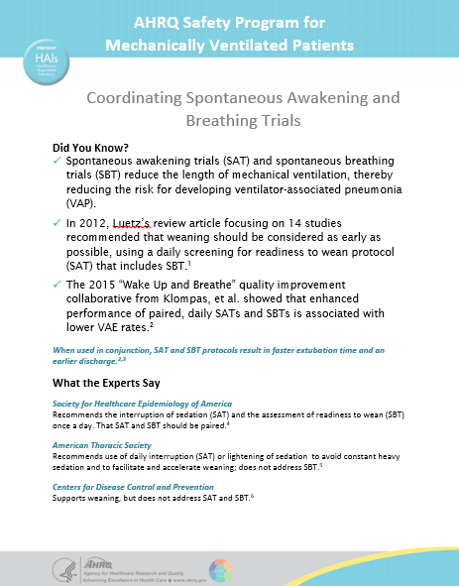
Resources: SAT and SBT Fast Facts
Ready to post in the unit
Provides quick reference to latest evidence-based protocols
Summarizes position of four leaders in the VAP field
Can be found on the AHRQ Web site at https://www.ahrq.gov/sites/default/files/wysiwyg/professionals/quality-patient-safety/hais/tools/mvp/modules/technical/sat-sbt-factsheet.docx

Slide 33
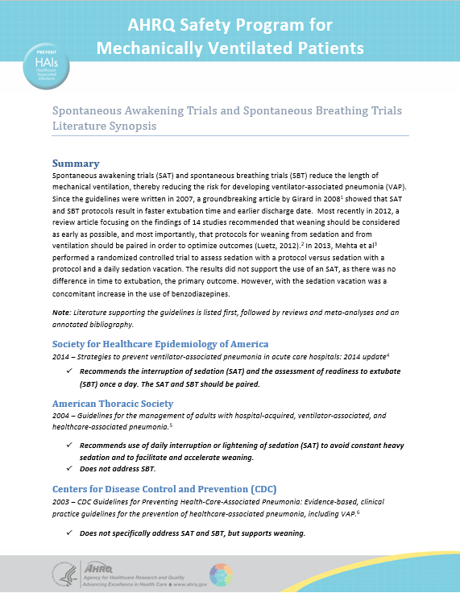
Resources: SAT and SBT Literature Review
Ready to post in the unit
Provides quick reference to latest evidence-based protocols
Summarizes position of four leaders in the VAP field
Can be found on the AHRQ Web site at https://www.ahrq.gov/sites/default/files/wysiwyg/professionals/quality-patient-safety/hais/tools/mvp/modules/technical/sat-sbt-litreview.docx

Slide 34
HOB Elevation

Slide 35
HOB Elevation¹¹
The elevation of the HOB to a semi-recumbent position (>30 degrees) is associated with a decreased incidence of aspiration and VAP
Study showed that both the supine position and length of time the patient is kept in this position are potential risk factors for aspiration of gastric contents
11. Torres A, Serr-Battles J, Ros E, et al. Pulmonary aspiration of gastric contents in patients receiving mechanical ventilation: the effect of body position.. Ann Intern Med. 1992 Apr 1;116(7):540-3. PMID 1543307.

Slide 36
HOB Elevation
Several successful strategies have been used to improve compliance with HOB elevation of at least 30 degrees. These include:
the use of a bed with a specific attachment that will show the angle at a glance
use of a handheld protractor
a determination of what mark on which bed can signify the correct angle for recline
HOB elevation should be fed back to unit staff on a regular basis.
Involve everyone who cares for the patient, including family members, to ensure the HOB is maintained at the correct angle
The intervention is supported unanimously by all four leading guidelines, and newer publications in the field accept HOB elevation as an effective, low-cost, and low-risk intervention.

Slide 37
HOB Specific VAP Prevention Guidelines
Society for Healthcare Epidemiology of America⁵
Recommends the use semi-recumbent position (30–45 degrees) as a strategy to prevent aspiration.
ZAP the VAP: Ventilator Associated Pneumonia¹²
Recommends the head of bed elevation to be 45 degrees, as long as not contraindicated.
5. Klompas M, Branson R, Eichenwald EC, et al. Strategies to prevent ventilator-associated pneumonia in acute care hospitals: 2014 update. Infect Control Hosp Epidemiol. 2014 35(8):915-36. PMID: 25026607.
12. Dodek P, Keenan S, Cook D, et al. Evidence-based clinical practice guideline for the prevention of ventilator-associated pneumonia. Ann Intern Med. 2004 Aug 17;141(4):305-13. PMID: 15313747.

Slide 38
HOB Specific VAP Prevention Guidelines
Centers for Disease Control and Prevention³
In the absence of medical contraindication(s), elevate the HOB at an angle of 30–45 degrees for patients with a high risk for aspiration (e.g., a person receiving mechanically assisted ventilation)
American Thoracic Society⁴
Recommends that patients should be kept in a semi-recumbent position (30–45 degrees) rather than supine to prevent aspiration.
3. Tablan OC, Anderson LJ, Besser R, et al. Guidelines for preventing healthcare-associated pneumonia, 2003: recommendations of CDC and the Healthcare Infection Control Practices Advisory Committee. MMWR Recomm Rep. 2004 Mar 26;53(RR-3):1-36. PMID: 15048056.
4. American Thoracic Society, Infectious Diseases Society of America. Guidelines for the management of adults with hospital-acquired, ventilator-associated, and healthcare-associated pneumonia. Am J Respir Crit Care Med. 2005 171(4):388-416. PMID: 15699079.

Slide 39
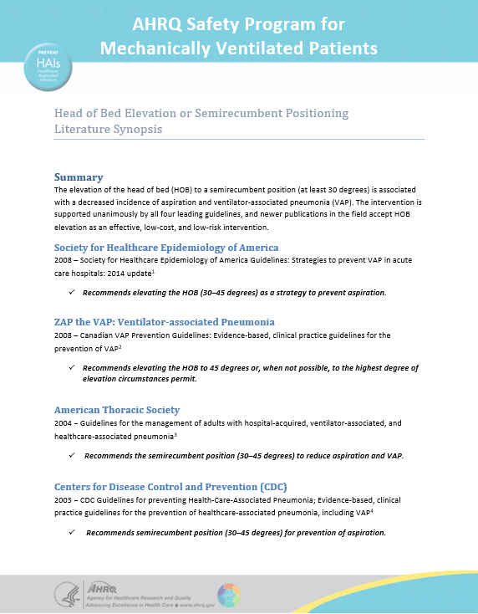
Resources: HOB Literature Review
Ready to post in the unit
Provides quick reference to latest evidence-based protocols
Summarizes position of four leaders in the VAP field
Can be found on the AHRQ Web site at https://www.ahrq.gov/sites/default/files/wysiwyg/professionals/quality-patient-safety/hais/tools/mvp/modules/technical/head-bed-elevation-litreview.docx

Slide 40
Questions?

Slide 41
References
Tanios MA, de Wit M, Epstein SK, et al. Perceived barriers to the use of sedation protocols and daily sedation interruption: a multidisciplinary survey. J Crit Care. 2009 24(1):66-73. PMID: 19272541.
Devlin JW, Tanios MA, Epstein SK. Intensive care unit sedation: waking up clinicians to the gap between research and practice. Crit Care Med. 2006 34(2):556-7. PMID: 16424748.
Tablan OC, Anderson LJ, Besser R, et al. Guidelines for preventing healthcare-associated pneumonia, 2003: recommendations of CDC and the Healthcare Infection Control Practices Advisory Committee. MMWR Recomm Rep. 2004 Mar 26;53(RR-3):1-36. PMID: 15048056.
American Thoracic Society, Infectious Diseases Society of America. Guidelines for the management of adults with hospital-acquired, ventilator-associated, and healthcare-associated pneumonia. Am J Respir Crit Care Med. 2005 171(4):388-416. PMID: 15699079.
Klompas M, Branson R, Eichenwald EC, et al. Strategies to prevent ventilator-associated pneumonia in acute care hospitals: 2014 update. Infect Control Hosp Epidemiol. 2014 35(8):915-36. PMID: 25026607.
Kress J, Pohlman A, O'Connor M, et al. Daily interruption of sedative infusion in critically ill undergoing mechanical ventilation. N Engl J Med. 2000 342(20):1471-7. PMID: 10816184.

Slide 42
References
Girard TD, Kress JP, Fuchs BD, et al. Efficacy and safety of a paired sedation and ventilator weaning protocol for mechanically ventilated patients in intensive care (awakening and breathing controlled trial): A randomised controlled trial. Lancet. 2008 371(9607):126-34. PMID: 18191684.
Guttormson JL, Chlan L, Weinert C, et al. Factors influencing nurse sedation practices with mechanically ventilated patients: a U.S. national survey. Intensive Crit Care Nurs. 2010 26(1):44-50. PMID: 19945879.
Strøm T, Martinussen T, Toft P. A protocol of no sedation for critically ill patients receiving mechanical ventilation: a randomised trial. Lancet. 2010 Feb 6;375(9713):475-80. PMID: 20116842.
Klompas M, Anderson D, Trick W, et al. The Preventability of Ventilator-Associated Events: The CDC Prevention Epicenters' Wake Up and Breathe Collaborative. Am J Respir Crit Care Med. 2015 Feb 1;191(3):292-301. PMID: 25369558.
Torres A, Serr-Battles J, Ros E, et al. Pulmonary aspiration of gastric contents in patients receiving mechanical ventilation: the effect of body position. Ann Intern Med. 1992 Apr 1;116(7):540-3. PMID 1543307.
Dodek P, Keenan S, Cook D, et al. Evidence-based clinical practice guideline for the prevention of ventilator-associated pneumonia. Ann Intern Med. 2004 Aug 17;141(4):305-13. PMID: 15313747.

