Slide 1
Introduction and Evidence for Early Mobility:
A Protocol To Get Patients Out of Bed Faster
AHRQ Safety Program for Mechanically Ventilated Patients
AHRQ Pub. No. 16(17)-0018-48-EF
January 2017

Slide 2
Learning Objectives
After this session, you will be able to—
Recognize the importance of implementing an early mobility (EM) protocol
Identify the key interventions of an EM program
Apply evidence from current literature to support the use of an EM protocol

Slide 3
Importance of Early Mobility
There is strong evidence that mobilizing critically ill patients—
  Is safe and feasible¹
  Is cost effective¹
  Decreases duration of mechanical ventilation²
  Decreases hospital and intensive care unit (ICU) length of stay^{1,2}
  Mitigates the short-term complications of critical illness: delirium and muscular weakness³
  Mitigates the long-term disabilities of critical illness: physical, cognitive, and psychological⁴
1. Morris PE, Goad A, Thompson C, et al. Early intensive care unit mobility therapy in the treatment of acute respiratory failure. Crit Care Med. 2008 Aug;36(8):2238-43. PMID: 18596631.
2. Schweickert WD, Pohlman MC, Pohlman AS, et al. Early physical and occupational therapy in mechanically ventilated, critically ill patients: a randomized controlled trial. Lancet. 2009 May 30;373(9678):1874-82. PMID: 19446324.
3. Ferrante L, Pisani M, Murphy T, et al. Functional trajectories among older persons before and after critical illness. JAMA Intern Med. 2015 Apr;175(4):523-9. PMID: 25665067.
4. Hodgson C, Bellomo R, Berney S, et al. Early mobilization and recovery in mechanically ventilated patients in the ICU: a bi-national, multi-centre, prospective cohort study. Crit Care. 2015 Feb 26;19:81. PMID: 25715872.

Slide 4
Daily EM: Summary of Key Interventions
Use a multidisciplinary and coordinated approach
  Include nurses; physical, occupational, and respiratory therapists; physicians; and administrators
Interrupt daily sedation and minimize sedative use
  Daily sedative interruptions and targeting light sedation will help patients remain alert and cooperative
Assess sedation and delirium with structured scales
  Routinely assessing the patient’s cognitive function helps target lighter sedation levels and treat delirium
  Screen for highest level of mobilization
    Use a standard screening algorithm to determine which patients may safely participate in a mobilization program
Employ a nurse-driven protocol to achieve highest level of mobility
  Shifting the focus of nurse-driven mobilization to the time of acute illness promotes recovery

Slide 5
Evidence From Two Studies
Ferrante L et al.³
  Functional trajectories among older persons before and after critical illness
Hodgson C et al.⁴
  Early mobilization and recovery in mechanically ventilated patients in the ICU
3. Ferrante L, Pisani M, Murphy T, et al. Functional trajectories among older persons before and after critical illness. JAMA Intern Med. 2015 Apr;175(4):523-9. PMID: 25665067.
4. Hodgson C, Bellomo R, Berney S, et al. Early mobilization and recovery in mechanically ventilated patients in the ICU: a bi-national, multi-centre, prospective cohort study. Crit Care. 2015 Feb 26;19:81. PMID: 25715872.

Slide 6
Functional Trajectories Among Older Persons Before and After Critical Illness³
Data from longitudinal prospective study, pre-baseline information collected by self-report and confirmed by medical record review
  291 patients ≥ 70 years old
  Participants were drawn from a separate ongoing longitudinal study on restricted activity among community-living older persons
Number of disabilities in 13 activities collected
  Basic Activities of Daily Living (ADL) (score: 0–4)
  Instrumental ADLs (score: 0–5)
  Mobility (score: 0–4)
Functional trajectories analyzed before and after ICU
3. Ferrante L, Pisani M, Murphy T, et al. Functional trajectories among older persons before and after critical illness. JAMA Intern Med. 2015 Apr;175(4):523-9. PMID: 25665067.

Slide 7
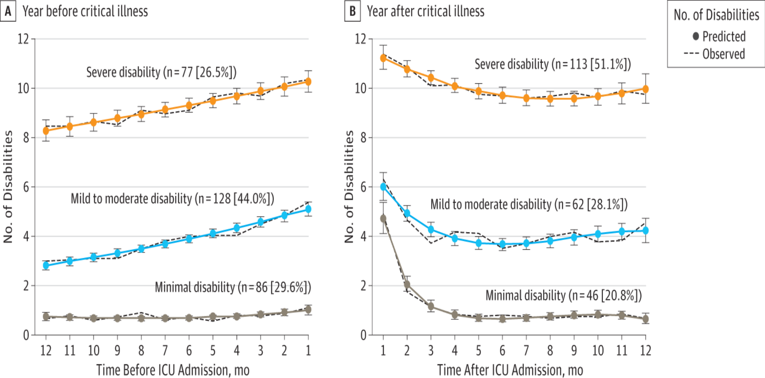
Functional Trajectories Pre and Post ICU³
Functional Trajectories Pre & Post ICU¹
54% of patients with critical illness had significant functional decline post ICU
45% experienced early death (within 30 days of admission)
3. Ferrante L, Pisani M, Murphy T, et al. Functional trajectories among older persons before and after critical illness. JAMA Intern Med. 2015 Apr;175(4):523-9. PMID: 25665067.

Slide 8
Functional Trajectories Pre and Post ICU³
25% of minimally disabled patients became severely disabled or experienced early death
40% of mild to moderately disabled patients became severely disabled; 25% experienced early death
3. Ferrante L, Pisani M, Murphy T, et al. Functional trajectories among older persons before and after critical illness. JAMA Intern Med. 2015 Apr;175(4):523-9. PMID: 25665067.

Slide 9
Mortality Associated With Worsening Pre-ICU Functional Trajectory³
Within 1 year, risk of death more than doubled for patients considered mild to moderately disabled upon admission
Adjusted hazard ratio (95% confidence interval [CI]) = 2.41 (1.29 to 4.50)
% Increase in Mortality (95% CI) | Pre-ICU Functional Trajectory
 | Minimal | Mild to Moderate | Severe
30-day | 8.1 (2.4 to 13.9) | 22.7 (15.4 to 29.9) | 32.5 (22.0 to 42.9)
1-year | 18.6 (10.4 to 26.8) | 44.5 (35.9 to 53.1) | 67.5 (57.1 to 78.0)
3. Ferrante L, Pisani M, Murphy T, et al. Functional trajectories among older persons before and after critical illness. JAMA Intern Med. 2015 Apr;175(4):523-9. PMID: 25665067.

Slide 10
Mortality Associated With Worsening Pre-ICU Functional Trajectory³
Within 1 year, risk of death more than tripled for those patients considered severely disabled upon admission
Adjusted hazard ratio (95% CI) = 3.84 (1.84 to 8.03)
% Increase in Mortality (95% CI) | Pre-ICU Functional Trajectory
 | Minimal | Mild to Moderate | Severe
30-day | 8.1 (2.4 to 13.9) | 22.7 (15.4 to 29.9) | 32.5 (22.0 to 42.9)
1-year | 18.6 (10.4 to 26.8) | 44.5 (35.9 to 53.1) | 67.5 (57.1 to 78.0)
3. Ferrante L, Pisani M, Murphy T, et al. Functional trajectories among older persons before and after critical illness. JAMA Intern Med. 2015 Apr;175(4):523-9. PMID: 25665067.

Slide 11
Summary³
In this study of older patients—
  Decline from pre-ICU functional status was noted in 53% of patients
  Early death occurred in 25% of patients
  Functional decline prior to ICU showed higher post-ICU risks for—
    Death
    Further functional declines
3. Ferrante L, Pisani M, Murphy T, et al. Functional trajectories among older persons before and after critical illness. JAMA Intern Med. 2015 Apr;175(4):523-9. PMID: 25665067.

Slide 12
Early Mobilization and Recovery of Mechanically Ventilated Patients in the ICU⁴
Prospective cohort study of 192 mechanically ventilated patients in Australia and New Zealand
  12 ICUs participating:
    Median ratio of physical therapists (PT) to patient = 1 to 9
    PT provides respiratory therapy (including mechanical ventilation)
  All patients were capable of independent mobilization prior to hospital
  Data collection for up to 14 days in ICU
4. Hodgson C, Bellomo R, Berney S, et al. Early mobilization and recovery in mechanically ventilated patients in the ICU: a bi-national, multi-centre, prospective cohort study. Crit Care. 2015 Feb 26;19:81. PMID: 25715872.

Slide 13
Objectives⁴
Observe practices related to active early mobilization exercises during mechanical ventilation
Assess relationship of early mobilization to ICU-acquired weakness
4. Hodgson C, Bellomo R, Berney S, et al. Early mobilization and recovery in mechanically ventilated patients in the ICU: a bi-national, multi-centre, prospective cohort study. Crit Care. 2015 Feb 26;19:81. PMID: 25715872.

Slide 14
Findings⁴
122 (64%) of patients did not receive any EM
In ventilated patients who received EM:
  Median (interquartile range [IQR]) time to EM: 5 (3–8) days
  Median (IQR) number of EM sessions: 2 (1–4)
For 209 PT sessions:
  45 percent involved exercises in bed
  25 percent involved passive transfer to sitting
  11 percent involved sitting over the edge of the bed
  11 percent involved standing at the bedside
  4 percent of all sessions involved transfer from bed to chair through standing
  12 percent involved walking (no patients walked before day 7)
4. Hodgson C, Bellomo R, Berney S, et al. Early mobilization and recovery in mechanically ventilated patients in the ICU: a bi-national, multi-centre, prospective cohort study. Crit Care. 2015 Feb 26;19:81. PMID: 25715872.

Slide 15
PT Reported Barriers to Early Mobilization⁴
Intubation and sedation were main barriers
 | Endotracheal tube | Sedation | Inotropes | Femoral Line | Respiratory Rate | Pulmonary Artery Catheter | Agitated | Weakness
Day 1 (n=192) | 94 | 92 | 14 | 22 | 9 | 14 | 0 | 0
Day 2 (n=181) | 87 | 85 | 14 | 22 | 9 | 14 | 0 | 0
Day 3 (n=161) | 65 | 69 | 9 | 18 | 9 | 7 | 5 | 0
Day 4 (n=147) | 57 | 58 | 9 | 11 | 7 | 5 | 7 | 2
Day 5 (n=131) | 46 | 47 | 9 | 14 | 9 | 2 | 14 | 6
Day 6 (n=108) | 41 | 42 | 5 | 9 | 12 | 0 | 9 | 10
Day 7 (n=101) | 30 | 36 | 5 | 11 | 16 | 0 | 13 | 11
4. Hodgson C, Bellomo R, Berney S, et al. Early mobilization and recovery in mechanically ventilated patients in the ICU: a bi-national, multi-centre, prospective cohort study. Crit Care. 2015 Feb 26;19:81. PMID: 25715872.

Slide 16
Time to Activity⁴
4. Hodgson C, Bellomo R, Berney S, et al. Early mobilization and recovery in mechanically ventilated patients in the ICU: a bi-national, multi-centre, prospective cohort study. Crit Care. 2015 Feb 26;19:81. PMID: 25715872.

Slide 17
Other Outcomes⁴
Strength assessed for 94/156 survivors at ICU discharge
  Mean (± SD) Medical Research Council Dyspnea Scale (MRC) score (range 0–60) = 43 ± 12.5
49 (52%) had ICU-acquired weakness
  (MRC < 48) at ICU discharge
Higher MRC score at ICU discharge associated with—
  Early mobilization (p=0.003)
  Discharge to home versus facility (p<0.0001)
  Increased survival at day 90 (p<0.0001)
4. Hodgson C, Bellomo R, Berney S, et al. Early mobilization and recovery in mechanically ventilated patients in the ICU: a bi-national, multi-centre, prospective cohort study. Crit Care. 2015 Feb 26;19:81. PMID: 25715872.

Slide 18
Summary⁴
EM was uncommon in mechanically ventilated ICU patients
  Despite long history of dedicated PTs in units
  Sedation is the most common barrier
Over 50% of ICU survivors may develop ICU-acquired weakness
Lower muscle strength associated with—
  Less ICU mobilization
  Institutionalization at hospital discharge
  Worse 90-day survival
  Additional findings specific to EM in the ICU setting can be found in the educational slide set Early Mobility in the Intensive Care Unit
4. Hodgson C, Bellomo R, Berney S, et al. Early mobilization and recovery in mechanically ventilated patients in the ICU: a bi-national, multi-centre, prospective cohort study. Crit Care. 2015 Feb 26;19:81. PMID: 25715872.

Slide 19
Evidence for Early Mobility – Recap
An early mobility protocol for mechanically ventilated patients in the ICU—
  Is safe, feasible, and cost effective¹
  Decreases duration of mechanical ventilation and ICU and hospital length of stay^{1,2}
  Mitigates both short- and long-term complications of critical illness such as delirium, muscular weakness, and physical, cognitive, and psychological disabilities^{3,4}
  Is not contraindicated by the presence of intubation
1. Morris PE, Goad A, Thompson C, et al. Early intensive care unit mobility therapy in the treatment of acute respiratory failure. Crit Care Med. 2008 Aug;36(8):2238-43. PMID: 18596631.
2. Schweickert WD, Pohlman MC, Pohlman AS, et al. Early physical and occupational therapy in mechanically ventilated, critically ill patients: a randomized controlled trial. Lancet. 2009 May 30;373(9678):1874-82. PMID: 19446324.
3. Ferrante L, Pisani M, Murphy T, et al. Functional trajectories among older persons before and after critical illness. JAMA Intern Med. 2015 Apr;175(4):523-9. PMID: 25665067.
4. Hodgson C, Bellomo R, Berney S, et al. Early mobilization and recovery in mechanically ventilated patients in the ICU: a bi-national, multi-centre, prospective cohort study. Crit Care. 2015 Feb 26;19:81. PMID: 25715872.

Slide 20

Questions?

Slide 21
References
Morris PE, Goad A, Thompson C, et al. Early intensive care unit mobility therapy in the treatment of acute respiratory failure. Crit Care Med. 2008 Aug;36(8):2238-43. PMID: 18596631.
Schweickert WD, Pohlman MC, Pohlman AS, et al. Early physical and occupational therapy in mechanically ventilated, critically ill patients: a randomized controlled trial. Lancet. 2009 May 30;373(9678):1874-82. PMID: 19446324.
Ferrante L, Pisani M, Murphy T, et al. Functional trajectories among older persons before and after critical illness. JAMA Intern Med. 2015 Apr;175(4):523-9. PMID: 25665067.
Hodgson C, Bellomo R, Berney S, et al. Early mobilization and recovery in mechanically ventilated patients in the ICU: a bi-national, multi-centre, prospective cohort study. Crit Care. 2015 Feb 26;19:81. PMID: 25715872.

