Slide 1
Measure Descriptions for Daily Early Mobility
AHRQ Safety Program for Mechanically Ventilated Patients
AHRQ Pub. No. 16(17)-0018-49-EF
January 2017

Slide 2
Learning Objectives
After this session, you will be able to—
Collect and enter daily early mobility data using the Daily Early Mobility Data Collection Tool
Understand the definitions of the data elements
Locate the necessary data elements

Slide 3
Daily Early Mobility: Key Interventions
Use multidisciplinary and coordinated approach
Interrupt sedation daily and minimize sedative use
Assess sedation and delirium with structured scales
Screen for highest level of mobilization
Employ a nurse-driven protocol to achieve highest level of mobility

Slide 4
Data Collection
Drives quality improvement efforts
Can be used for quality improvement processes or for research
Provides quantifiable measures of care practices
Guides patient safety conversations
Justifies resource allocations
Human resources (time)
Financial resources (money)
Supplies and equipment (stuff)

Slide 5
Daily Early Mobility Data Collection Tool
Intubation
Sedation
Delirium
Early mobility (EM)
Perceived barriers to EM
Physical/occupational therapy (PT/OT)
Adverse events
Event types

Slide 6
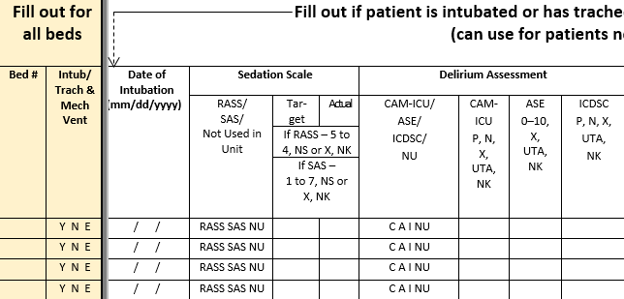
Data Collection: Intubation, Sedation, and Delirium

Slide 7
Let’s Begin…
Fill out for all beds
Track by bed, not by patient
Include
Bed number
Was the patient in that bed intubated or trached AND on mechanical ventilation at the time of observation?
Y = Yes
N = No
E = Empty bed

Slide 8
Date of Intubation
Enter the date the patient was intubated
If the date is not available*, enter admission date (either to the unit or to the hospital, as appropriate)
If the patient is extubated and re-intubated within 24 hours, use the original date
*i.e., when from an outside institution

Slide 9
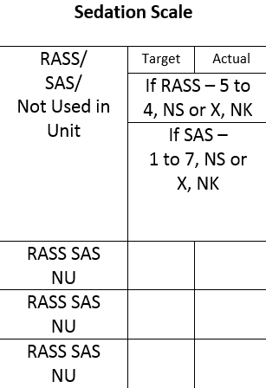
Sedation Scale
What sedation scale do you use on your unit?
This question refers to your unit, not to this specific patient

Slide 10
Sedation Scale
R = Richmond Agitation Sedation Scale (RASS)
S = Riker Sedation-Agitation Scale (SAS)
NU = Unit uses neither RASS or SAS
If NU, skip to Delirium Assessment

Slide 11
Sedation Scale
Choose either RASS or SAS, but not both
Choose the value closest to 10 a.m.
If two values are equidistant, choose the earlier time

Slide 12
Sedation Scale: Target RASS or SAS
Target: What is the target RASS or SAS score for this patient?
Enter RASS sedation scale value (-5 to 4)
OR
Enter SAS sedation scale value (1 to 7)
“NS” means not set
“NK” means target RASS or SAS score was set, but is not known
Enter “NK” if you don’t know whether a target RASS or SAS score was actually set

Slide 13
Sedation Scale: Actual RASS or SAS
Actual: What is the actual RASS or SAS score for this patient?
Enter RASS sedation scale value (-5 to 4)
OR
Enter SAS sedation scale value (1 to 7)
“NS” means not set
“NK” means target RASS or SAS score was set, but is not known
Enter “NK” if you don’t know whether a target RASS or SAS score was actually set

Slide 14
Delirium Assessment
Society of Critical Care Medicine’s 2013 Pain, Agitation, and Delirium (PAD) clinical practice guidelines
Recommends these valid and reliable delirium screening tools
Confusion Assessment Method for the ICU (CAM-ICU)
Intensive Care Delirium Screening Checklist (ICDSC)
Screen moderate- to high-risk patients at least once per nursing shift

Slide 15
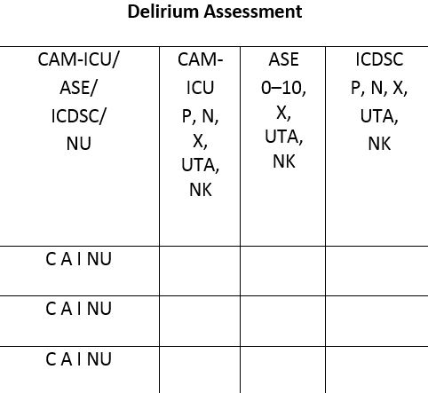
Delirium Assessment
C = CAM-ICU
A = Attention Screening Exam (ASE)
I - ICDSC
NU = Unit uses neither CAM-ICU, ICDSC, nor ASE
If NU, skip to the sedation section

Slide 16
Delirium Assessment
Choose either CAM-ICU, ICDSC, or ASE, but not more than one
CAM-ICU incorporates the ASE
Choose the value closest to 10 a.m.
If equidistant, choose the earlier time

Slide 17
Delirium Assessment: CAM-ICU
Is the patient positive or negative for delirium?
Enter “P” if the patient is positive for delirium
Enter “N” if the patient is negative for delirium
Enter “X” if CAM-ICU assessment was not completed
Enter “UTA” if unable to assess
Such as RASS = -4 or -5 OR SAS = 1 or 2
Enter “NK” if CAM-ICU was completed, but results aren’t known
Enter “NK” if you don’t know whether the exam was performed

Slide 18
Delirium Assessment: ICDSC
Is the patient positive or negative for delirium?
Enter “P” if the patient is positive for delirium
Enter “N” if the patient is negative for delirium
Enter “X” if ICDSC was not completed
Enter “UTA” if unable to assess
Such as RASS = -4 or -5 OR SAS = 1 or 2
Enter “NK” if ICDSC was completed, but results aren’t known
Enter “NK” if you don’t know whether the exam was performed

Slide 19
Delirium Assessment: Attention Screening Exam
If the CAM-ICU or ICDSC is not yet feasible in your unit, use the ASE:
Second feature of the CAM-ICU
10- to 20-second test
Goal to determine if patient can follow a simple command for that period of time
Inattention must be present to diagnose delirium
Recommend patients at least undergo the ASE once per nursing shift
Recognize that ASE may be abnormal due to disease, drugs, or other causes

Slide 20
Attention Screening Exam
Provider reads one of the following sequences:
S A V E A H A A R T
C A S A B L A N C A
A B A D B A D D A Y
Patient squeezes the provider’s hand when he hears the letter “A”
Error defined as—
No squeeze with letter “A”
A squeeze on a letter other than “A”

Slide 21
Attention Screening Exam
Count the number of errors
Inattention is present if the patient commits more than two errors
If the patient squeezes on every letter, assign an error count of 10
If the patient doesn’t squeeze on any letter, assign an error count of 10

Slide 22
Attention Screening Exam
What is the patient’s ability to pay attention?
Use only if CAM-ICU or ICDSC are not performed
Enter the number of errors, 0 to 10
Enter “X” if the exam was not performed
Enter “UTA” if unable to assess
RASS = -4 or -5
SAS = 1 or 2
Enter “NK” if the exam was performed, but number of errors is not known
Enter “NK” if you don’t know whether the exam was performed

Slide 23
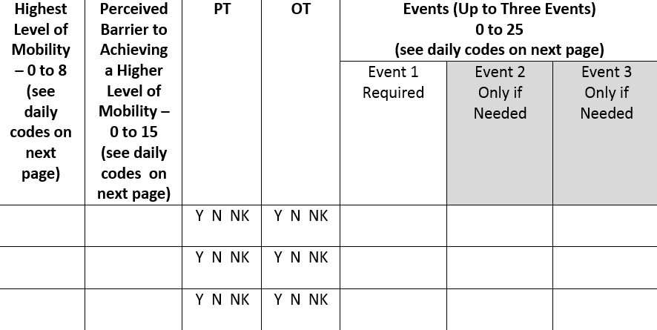
Data Collection: Early Mobility Measures

Slide 24
Highest Level of Mobility
What was the highest level of mobility achieved by the patient in the last 24 hours?
Enter a code 0–8
Code legend can be found on second page of data collection tool

Slide 25
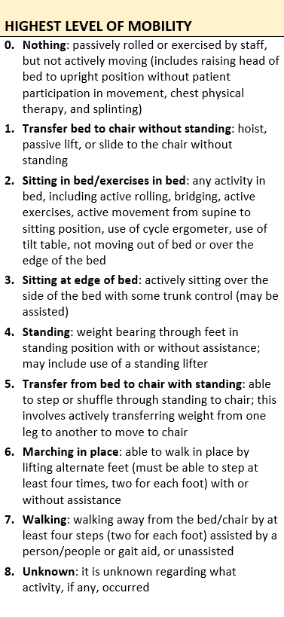
Highest Level of Mobility¹
0. Nothing
1. Transfer bed to chair without standing
2. Sitting in bed/exercises in bed
3. Sitting at edge of bed
4. Standing
5. Transfer from bed to chair with standing
6. Marching in place
7. Walking
8. Unknown
1. Tipping C, Bailey M, Bellomo R, et al. The ICU mobility scale has construct and predictive validity and is responsive. A multicenter observational study. Ann Am Thorac Soc. 2016 Jun;13(6):887-93. PMID: 27015233.

Slide 26
Perceived Barrier to Achieving Higher Mobility
What prevented the patient from being mobilized to a higher level?
Enter a code 0–15 from second page of data collection tool

Slide 27
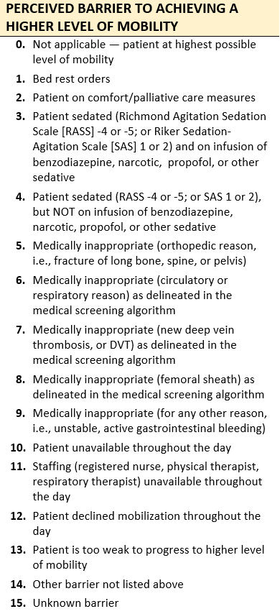
Perceived Barrier Code Examples
Not applicable (0)
Bed rest orders (1)
Patient sedated (3, 4)
Medically inappropriate
Orthopedic (5)
Circulatory or respiratory (6)
Deep vein thrombosis (7)
Femoral sheath (8)
Unstable (9)
Patient unavailable or declined (10, 12)
Patient too weak (13)
If multiple codes apply, select the LOWEST number

Slide 28
Physical and Occupational Therapy
Physical therapy (PT)
Did the physical therapist evaluate or treat the patient within the last 24 hours?
Occupational therapy (OT)
Did the occupational therapist evaluate or treat the patient within the last 24 hours?

Slide 29
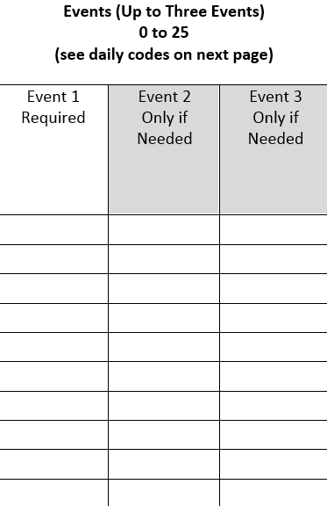
Events
Did the patient have an “event” while being mobilized within the last 24 hours?
Event codes are listed on the back of the data collection sheet
Can include up to three events if necessary

Slide 30
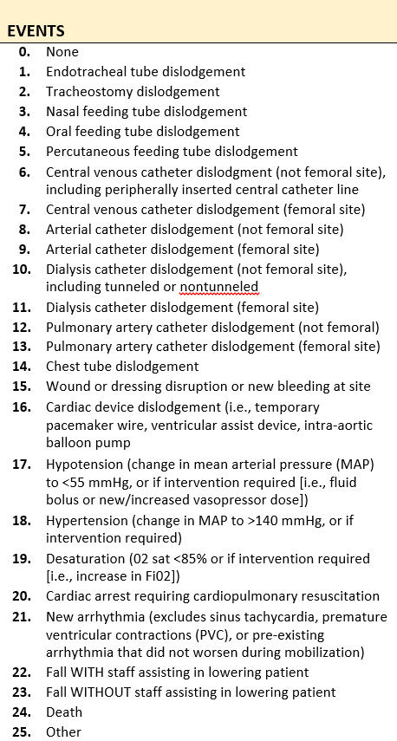
Event Codes
Examples
None (0)
Endotracheal tube dislodgement (1)
Nasal or oral feeding tube dislodgement (3, 4)
Arterial catheter dislodgement (8, 9)
Chest tube dislodgement (14)
Hypotension or hypertension (17, 18)
Cardiac arrest (20)
Fall with or without staff assisting in lowering patient (22, 23)
Other (25)

Slide 31
Data Measures Guide
Data should drive all quality improvement efforts…
The Data Measures Guide provides detailed instructions on how to calculate and evaluate process and outcome measures in your unit using data gathered from the data collection tools provided for this safety program. The guide can be found on the AHRQ Web site at www.ahrq.gov/haimvp.
The Guide can help you determine—
Delirium assessment participation rate
Percentage of CAM-ICU negative, ICDSC negative, or ASE ≤2 (no delirium)
Percentage of incorrectly reporting CAM-ICU/ICDSC/ASE UTA (Unable to Assess)
Adverse event incidence rate (intubated and non-intubated)
Percentage of patient days mobilized out of bed (intubated and non-intubated)
Percentage of achieving RASS/SAS target
Percentage of RASS/SAS actual being {-1, 0, 1} or {4, 5}
Distribution of RASS/SAS Actual Scores
Physical or occupational therapy participation rate
Top 10 adverse events for ventilated and nonventilated patients
Perceived barriers for ventilated patients

Slide 32
Questions?

Slide 33
References
1. Tipping C, Bailey M, Bellomo R, et al. The ICU mobility scale has construct and predictive validity and is responsive. A multicenter observational study. Ann Am Thorac Soc. 2016 Jun;13(6):887-93. PMID: 27015233.

