Slide 1
Measure Descriptions for Low Tidal Volume Ventilation
AHRQ Safety Program for Mechanically Ventilated Patients
AHRQ Pub. No. 16(17)-0018-36-EF
January 2017

Slide 2
Learning Objectives
After this session, you will be able to—
Collect and enter low tidal volume ventilation (LTVV) data using the LTVV Data Collection Tool
Understand the definitions of the data elements
Locate the necessary data elements

Slide 3
LTVV: Key Interventions
Use multidisciplinary and coordinated approach
Prevent acute respiratory distress syndrome (ARDS)
Use positive end-expiratory pressure (PEEP) ≥ 5 cm H₂0, not zero end-expiratory pressure
Maintain plateau pressure at ≤ 30 cm H₂0
Use tidal volume of 6-8 cc/kg predicted body weight (PBW) for patients without ARDS, 4-6 cc/kg PBW for patients with ARDS

Slide 4
Data Collection
Drives quality improvement efforts
Can be used for quality improvement processes or for research
Provides quantifiable measures of care practices
Guides patient safety conversations
Justifies resource allocations
Human resources (time)
Financial resources (money)
Supplies and equipment (stuff)

Slide 5
LTVV Data Collection Tool
Intubation
Ventilator mode
Height/gender
Tidal volume (target and actual)
Plateau pressure
PEEP
ARDS status

Slide 6
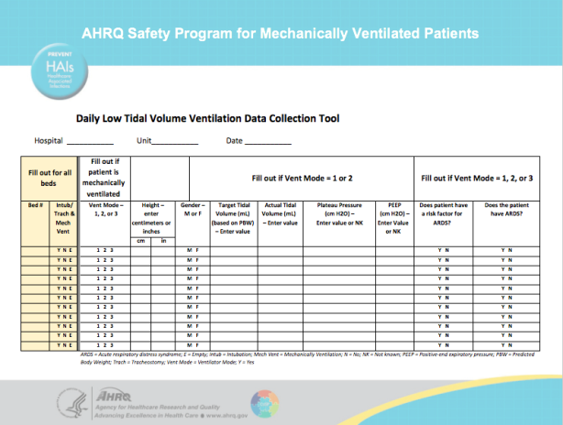
Data Collection: Intubation and Ventilator Mode

Slide 7
Let’s Begin…
Fill out for all beds
Track by bed, not by patient
Include bed number (even if empty)
Is the patient currently receiving mechanical ventilation?
Y = Patient is currently intubated/trached AND mechanically ventilated
N = Patient is treated with noninvasive ventilation OR patient is NOT currently intubated/trached AND mechanically ventilated
E = Empty bed

Slide 8
Ventilator Modes – Volume-Cycled Modes
Circle 1 for volume-cycled modes
Assist control
Synchronized intermittent mandatory ventilation
Volume support
Pressure-regulated volume-controlled
Continuous mandatory ventilation

Slide 9
Ventilator Modes – Pressure-Cycled Modes
Circle 2 for pressure-cycled modes
Pressure support
Continuous positive airway pressure
Airway pressure release ventilation (APRV)
Bilevel ventilation

Slide 10
Ventilator Modes – Other Modes
Circle 3 for other modes
Proportional assist ventilation
Adaptive support ventilation
High-frequency oscillatory ventilation
Extracorporeal membrane oxygenation
Other

Slide 11
For Vent Modes 1 and 2 Only
Enter patient’s height in either centimeters OR inches
Circle patient’s gender
Enter the target tidal ventilation based on predicted body weight (PBW)
PBW can be found on the LTVV Quick Cards included in the LTVV data collection tool
Enter the actual tidal volume at the time of observation in the next column
If the ventilator is in a volume-cycled mode, use the preset/prescribed tidal volume
If the ventilator is in a pressure-cycled mode, enter the approximate expired tidal volume

Slide 12
For Vent Modes 1 and 2 Only
What is the plateau pressure at or nearest to the time of observation?
If plateau pressure is not available or not known, enter NK
For APRV/bilevel modes, this is the P_{high} value
What is the PEEP at or nearest to the time of observation?
If PEEP is not available or not known, enter NK
For APRV/bilevel modes, this is the P_{low} value

Slide 13
Data Collection: ARDS

Slide 14
For ALL Vent Modes (1, 2, or 3)
Does the patient have a risk factor for ARDS?
Circle Y if the patient has one of the following:
Pneumonia
Sepsis, severe sepsis, or septic shock, not secondary to pneumonia
Aspiration
Trauma
Other risk factor
Otherwise, circle N
Does the patient have a diagnosis of ARDS at the time of observation?
Circle Y if the patient has a diagnosis of ARDS at the time of observation
Otherwise, circle N

Slide 15
Data Measures Guide
Data should drive all quality improvement efforts…
The Data Measures Guide provides detailed instructions on how to calculate and evaluate process and outcome measures in your unit using data gathered from the data collection tools provided for this safety program. The guide can be found on the AHRQ Web site here.
LTVV compliance rates (≥4 and ≤8 mL/PBW) for all patients
LTVV compliance rates (≥4 and ≤6 mL/PBW) for patients with ARDS
LTVV compliance rates (≥6 and ≤8 mL/PBW) for patients without ARDS
PEEP compliance rates (≥ 5 cm H₂0)

Slide 16
Questions?

