Slide 1
Nurse-Driven Early Mobility Protocols
AHRQ Safety Program for Mechanically Ventilated Patients
AHRQ Pub. No. 16(17)-0018-52-EF
January 2017
Notes:
SAY:
You have embarked on a unique journey.

Slide 2
Learning Objectives
After this session, you will be able to—
Understand the need for early mobilization in the intensive care unit (ICU)
Discuss daily early mobility interventions
Develop plans to sustain early mobility measures in your unit
Notes:
SAY:
From a high level, this presentation will cover the following topics.
You will be able to distinguish the AHRQ Safety Program for Surgery from that of other national improvement projects.
The connection between surgical safety teamwork and safety culture work as structured in the Comprehensive Unit-based Safety Program (CUSP) will be clear.
You will also be familiar and hopefully able to list the steps for developing a local surgical site infection (SSI) prevention bundle.

Slide 3
Early Mobility
Sedation
Delirium
(RASS, SAS)
(ICDSC, CAM-ICU)
Move To Improve
Early Mobilization: ICU
Mobility Protocol: Non-ICU
Sedation Vacation
Ventilator Weaning
Multidisciplinary
Approach
CAM-ICU = Confusion Assessment Method for the ICU; ICDSC = Intensive Care Delirium Screening Checklist; RASS = Richmond Agitation-Sedation Scale; SAS = Sedation-Agitation Scale

Slide 4
Scope of Problem¹⁻⁴
Prolonged bed rest in patients often leads to a host of problems such as—
Mobility/functional issues
Sleep deprivation
Delirium
Altered nutritional states
Prolonged hospitalizations
Post-hospital rehabilitation stays
Burden to health care system
Early exercise and progressive mobility introduced as an intervention to decrease duration of delirium and ventilator days
1. Needham DM, Korupolu R, Zanni JM, et al. Early physical medicine and rehabilitation for patients with acute respiratory failure: a quality improvement project. Arch Phys Med Rehabil. 2010 Apr;91(4):536-42. PMID: 20382284.
2. Pohlman MC, Schweickert WD, Pohlman, AS, et al. Feasibility of physical and occupational therapy beginning from initiation of mechanical ventilation. Crit Care Med. 2010 Nov;38(11):2089-94. PMID: 20711065.
3. Schweickert WD, Pohlman MD, Pohman AS, et al. Early physical and occupational therapy in mechanically ventilated, critically ill patients: a randomized controlled trial. Lancet. 2009 May 20;373(9678):1874-82. PMID: 19446324.
4. Balas MC, Vasilevskis EE, Burke WJ, et al. Critical care nurses' role in implementing the "ABCDE bundle" into practice. Crit Care Nurse. 2012 Apr;32(2):35-8. PMID: 22467611.

Slide 5
Purpose and Goals
Purpose: To introduce an evidence-based mobility program designed to maintain baseline mobility and functional capacity, decrease incidence of delirium, decrease ventilator days, and decrease length of stay in hospitalized patients.
Goals:
Employ a multidisciplinary focus on early mobilization as part of the daily clinical routines
Maintain patients at their baseline mobility and functional levels
Initiate the mobility protocol when the patient is hemodynamically stable
Mobilize patients with activity at least twice daily
If physical therapy is consulted, the nursing staff will continue to mobilize the patient 1–2 times per day in addition to physical therapy

Slide 6
Early Mobility Interventions
Use a multidisciplinary and coordinated approach
Employ a nurse-driven protocol
Minimize sedative use and interrupt sedation daily
Assess then address delirium
Screen for eligibility for highest level of mobility
Tailor goals to maximize mobility

Slide 7
Early Mobility: Improved Outcomes
Expected outcomes
Minimize complications of bed rest
Improve overall patient functions
Promote early ventilator weaning
Improve overall strength and endurance
Decrease length of stay (LOS) in ICU and hospital
Decrease hospital costs
Psychological benefits: positive outlook for recovery

Slide 8
Implementation of the ABCDE Bundle⁵
Put coordinated spontaneous awakening trial and spontaneous breathing trial protocols in place
Carefully choose sedatives (this may take ongoing work to change the current practice)
Utilize the CAM-ICU implemented in conjunction with RASS
5. Morandi A, Brummel NE, Ely EW. Sedation, delirium, and mechanical ventilation: the “ABCDE” approach. Curr Opin in Crit Care. 2011 Feb;17(1):43-9. PMID: 21169829.

Slide 9
Continued Progress
Multidisciplinary daily rounds should involve a discussion of mobility on each patient, in real time, via electronic medical record
Registered nurse (RN) should report on the mobility status of each patient at shift change
Transfers to and from other units should review current mobility status
Signage of mobility algorithms should be displayed on nursing units

Slide 10
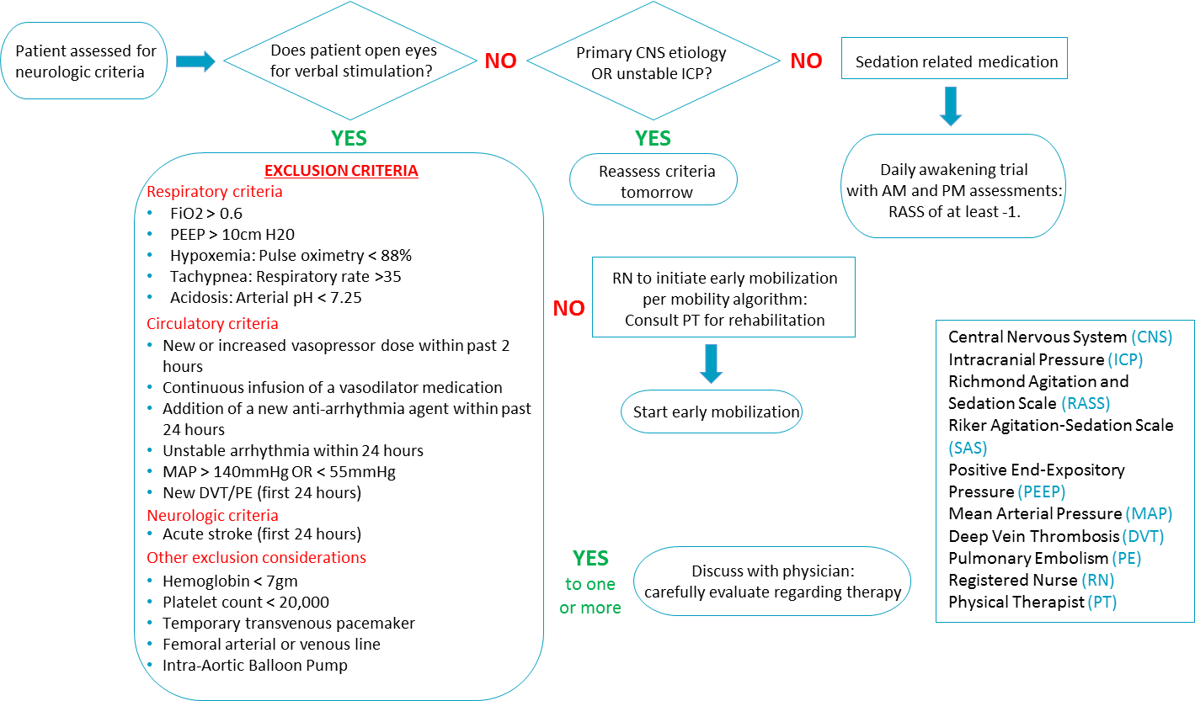
ICU Early Mobility Screening Algorithm

Slide 11
ICU Early Mobility Protocol
START
Patient meets
criteria for mobility algorithm
Does patient tolerate chair position?
NO
Neuro patients –
Try again tomorrow
All other patients –
Try again later same day
YES
Advance to dangle edge of bed
Consider PT consult if vital signs stable and patient does not maintain balance
NO
Does patient sit unassisted x 3 minutes?
YES
Advance to standing
Can patient stand?
NO
Consult PT
YES
Consult PT
NO
Does patient require ˂ 2 minimal assist?
Advance to stand – pivot transfer bed to chair
Prevent Excessive WOB – Desaturation
Increase baseline FiO2 up to 20% as needed to keep SaO2 >90% with maximum FiO2 80%
If intubated and not on ventilator during activity, have bag valve mask with 100% O2 available
If newly extubated: NO AMBULATION ON DAY OF EXTUBATION
YES
Advance to taking steps
/ambulation
Does patient ambulate > 50 feet?
Does patient maintain balance?
YES
NO
Consult PT
Consult PT
YES
Is this baseline?
If patient tolerates chair activity then patient should be up in chair for all meals
If PT is consulted nursing staff/patient care technician should continue to mobilize patient 1-2 times daily (in addition to PT)
Patient requiring airborne or acid-fast bacilli precautions may not participate in physical activity outside their room
NO
Continue with current mobility level

Slide 12
Intermediate Care Unit
3 designated patient care technicians (PCT) on the unit from 7 a.m. to 7 p.m.
2 designated PCTs on the unit from 7 p.m. to 7 a.m.
Each PCT will discuss level of activity with RN and determine how many times each patient will be walked.

Slide 13
Mobility Techs
Certified nursing assistants
“Bridge” between rehabilitation services and nursing
Mobilize patients who do not require skilled therapy
Mobilize patients in addition to receiving therapy
Receive training and guidance from therapy staff
Receive patient lists/assignments from both nurses and therapists

Slide 14
Mobility Tech Data
Comparison of patients ambulated within 24, 48, and 72 hours before and after addition of mobility tech staff on two hospital units.
 | 2012 | 2013 | 2014 | 2015 | VARIANCE
Patients ambulated within 72 hours on 4C | 93.17% | 94.70% | 94.24% | 94.81% | 1.65%
Patients ambulated within 48 hours on 4C | 86.00% | 88.63% | 87.89% | 89.04% | 3.04%
Patients ambulated within 24 hours on 4C | 68.92% | 74.28% | 73.18% | 74.24% | 1.34%
Patients ambulated within 72 hours on 4A | 93.83% | 94.56% | 94.84% | 95.00% | 1.17%
Patients ambulated within 48 hours on 4A | 86.75% | 86.56% | 87.20% | 88.09% | 1.34%
Patients ambulated within 24 hours on 4A | 71.08% | 72.33% | 74.35% | 75.59% | 4.50%

Slide 15
Framework To Guide Your Program⁶
Describe the problem
Formulate focused clinical question
Search for evidence
Appraise and synthesize evidence
Develop aim (goal) statement
ACT
PLAN
DO
STUDY
Disseminate best practices
6. Levin, RF, Keefer JM, Marren J, et al. Evidenced-based practice improvement: merging 2 paradigms. J Nurse Care Qual. 2010 Apr-Jun;25(2):117-26. PMID: 19680149.

Slide 16
Small Tests of Change⁶
A good way to start with early mobility
Develop a protocol based on evidence
Use with one patient first
Be selective about initial patient selection to increase likelihood of success
Review and revise the protocol
Try it again
News of your success spreads!
6. Levin, RF, Keefer JM, Marren J, et al. Evidenced-based practice improvement: merging 2 paradigms. J Nurse Care Qual. 2010 Apr-Jun;25(2):117-26. PMID: 19680149.

Slide 17
Measurement of Outcomes
Process evaluation
Percentage of patients who received the intervention of early mobility
Outcomes evaluation
Ventilator LOS
ICU LOS
Hospital LOS
Incidence and duration of delirium
Adverse events

Slide 18
Recommendations for Practice
Following review and synthesis of the literature
Incorporate early mobility into care of critically ill patient
Use contraindications to screen patient to ensure safety
Use contraindications for continuing PT/occupational therapy (OT)
Use a defined mobility protocol to enhance teamwork, consistency
Use a multidisciplinary group to help with implementation of protocol, continued look at quality of care
Perform Small Tests of Change
Disseminate early mobility protocol
Engage in multidisciplinary rounding
Promote communication
Conduct team meetings every 2 weeks
Focus on troubleshooting
Reinforce early mobility practice
Provide justification of the time allotment for PT

Slide 19
What W as the Patient Experience Like?
“
”
“
”
I was ready before you were…
It gave me something to do.
“
”
It gave me hope.
“
I wanted to walk farther than you wanted me to. You were nervous.
”

Slide 20
Sustaining Practice Through Standardization
Create organizational memory
Develop knowledge reservoirs
Maintain standard of nursing practice
Implement a mechanical ventilation order set

Slide 21
Measures for Sustainability
Continue consistent daily rounding and employ a rounding script
Reinforce a multidisciplinary and coordinated approach
Find and embrace ways to build knowledge on applying EM to different patients
Watch for any opportunities to support the process
Monitor process during times of increased census or increased acuity
Make it fun!

Slide 22
Continue the Sustainability Measures
Is practice sustained 1 year later?
Is a physical therapist assigned to the ICU?
Are personnel rotated every month?
Is early mobility ordered with initial mechanical ventilator orders and inclusive of a PT/OT consult?
Has early mobility rounding with a multidisciplinary team continued?

Slide 23
Questions?

Slide 24
References
Needham DM, Korupolu R, Zanni JM, et al. Early physical medicine and rehabilitation for patients with acute respiratory failure: a quality improvement project. Arch Phys Med Rehabil. 2010 Apr;91(4):536-42. PMID: 20382284.
Pohlman MC, Schweickert WD, Pohlman, AS, et al. Feasibility of physical and occupational therapy beginning from initiation of mechanical ventilation. Crit Care Med. 2010 Nov;38(11):2089-94. PMID: 20711065.
Schweickert WD, Pohlman MD, Pohman AS, et al. Early physical and occupational therapy in mechanically ventilated, critically ill patients: a randomized controlled trial. Lancet. 2009 May 20;373(9678):1874-82. PMID: 19446324.
Balas MC, Vasilevskis EE, Burke WJ, et al. Critical care nurses' role in implementing the "ABCDE bundle" into practice. Crit Care Nurse. 2012 Apr;32(2):35-8. PMID: 22467611.
Morandi A, Brummel NE, Ely EW. Sedation, delirium, and mechanical ventilation: the “ABCDE” approach. Curr Opin in Crit Care. 2011 Feb;17(1):43-9. PMID: 21169829.
Levin, RF, Keefer JM, Marren J, et al. Evidenced-based practice improvement: merging 2 paradigms. J Nurse Care Qual. 2010 Apr-Jun;25(2):117-26. PMID: 19680149.

