Slide 1
Labor and Delivery Unit Safety
AHRQ Safety Program for Perinatal Care
AHRQ Publication No. 17-0003-21-EF
May 2017

Slide 2
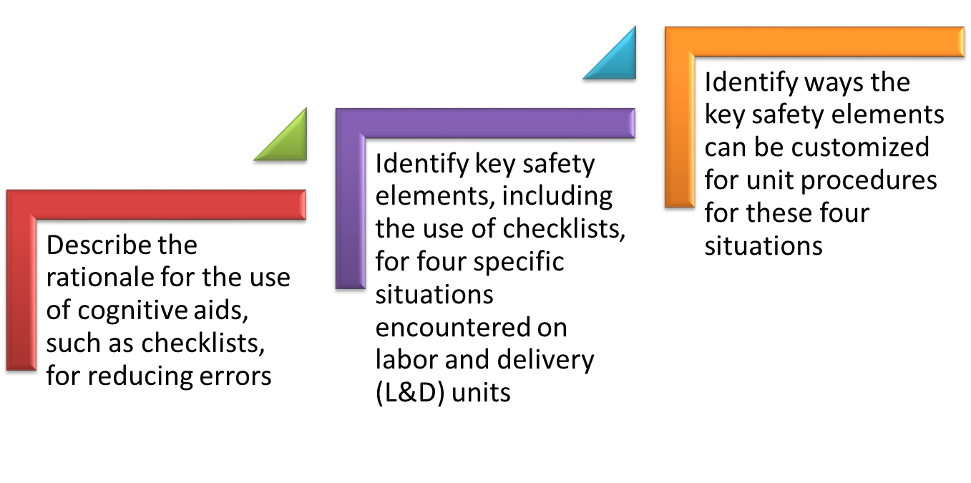
Learning Objectives

Slide 3
L&D Unit Safety Tools
The Labor and Delivery Unit Safety bundle focuses on key safety elements for four specific L&D situations:
  Safe cesarean section
  Shoulder dystocia
  Obstetric hemorrhage
  Umbilical cord prolapse
Training materials and tools offer key safety elements for these situations
Key safety elements
  Provide a comprehensive starting point for each unit to consider
  Can be adapted and applied to other perinatal situations requiring high reliability processes

Slide 4
Rationale for Use of Checklists¹⁻⁴
Checklists help to facilitate safety in high-complexity, high-risk, and high-reliability professions
Health care errors are often slips rather than mistakes
Checklists are cognitive aids that—
  reduce slips that occur due to lapses in concentration, distractions, fatigue, or lack of knowledge of evidence-based practices,
  decrease reliance on memory for tasks typically performed reflexively or “on auto-pilot,” and
  provide confidence that no step will be forgotten.

Slide 5
Role of Checklists
Checklist effectiveness for reducing errors can be enhanced when—
they are created or adapted to meet unit needs,
they are implemented within a culture that fosters teamwork and communication, and
staff gain experience with them during in situ simulation practice.

Slide 6
L&D Unit Safety Tools
Purpose
Who should use
How to use
Key safety elements
Sample checklists and references to externally developed checklists
Four tools are available as part of the AHRQ Safety Program for Perinatal Care (SPPC) in support of this module.

Slide 7
SPPC Key Perinatal Safety Elements for L&D Unit Safety
Situation specific
  Standardize When Possible (CUSP Science of Safety)
  Create Independent Checks (CUSP Science of Safety)
  Simulation (Safety Program for Perinatal Care Program Pillar)
General
  Learn From Defects (CUSP Module)
  Teamwork Training (TeamSTEPPS®)
  Patient and Family Engagement (CUSP Module)

Slide 8
Safe Cesarean Section
L&D Unit Safety

Slide 9
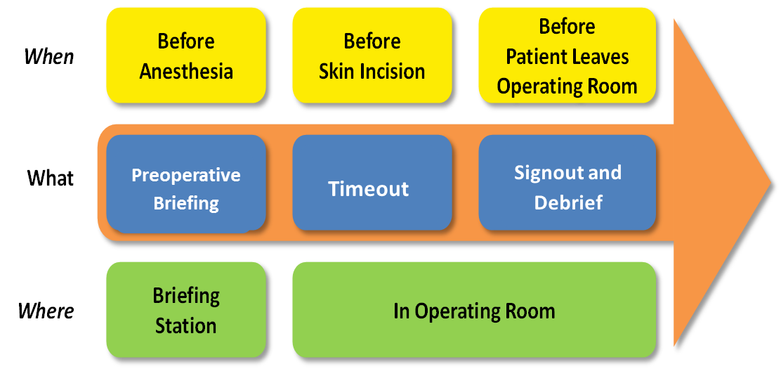
  Key Safety Elements: Standardize When Possible
Use a standard perioperative process for cesarean sections (C/S)^{5,6}

Slide 10
  Key Safety Elements: Standardize When Possible
Preoperative briefing
  Review plan for patient care, risks, or concerns
  Typically led by the obstetrician/surgeon
  Ensure shared mental model
  Include reviews of—
    Patient information
    C/S procedure
    Indications
    Anticipated complications
    Risk
    Medical history
    Fetal status
    Type of anesthesia

Slide 11
  Key Safety Elements: Standardize When Possible
Timeout
  Initiated once all team members are present in operating room (OR)
  Assures safety through a “huddle”
  Team members agree with plan and maternal/fetus status
Signout and debrief
  Standard approach for wrapping up and debriefing
  Often a moment for process improvement

Slide 12
Key Safety Elements: Create Independent Checks
Checklists can facilitate the three components of a safe perioperative process³⁻⁶ to —
  engage all relevant team members,
  introduce some redundancy into the perioperative process, and
  ensure critical factors are considered and addressed at each step.

Slide 13
Sample Checklist: Cesarean Section
A sample checklist for C/S, based on the
World Health Organization model,⁷ is
provided as an appendix to this tool.
It provides suggested specific checklist items for each of the three perioperative safety steps: the preoperative briefing, timeout, and signout and debrief.
  The sample is provided in two formats: an “at a glance” format or a “large print” format.
  The specific checklist items can be customized based on unit preference.

Slide 14

Key Safety Elements: Simulation
Team simulation can improve knowledge, practical skills, communication, and team performance in acute situations.
Any of the sample scenarios available through the SPPC that ultimately result in team decision to proceed to OR for C/S can be used.
Scenarios reinforce teamwork and communication related to—
  situational awareness;
  efficient use of safe surgery checklists to
  guide the perioperative process using a
  perioperative briefing, timeout, and signout;
  communication with rapid responders;
  communication with patient/family; and
  use of briefings, huddles, and debriefings.

Slide 15
Shoulder Dystocia
L&D Unit Safety

Slide 16
Key Safety Elements: Standardize When Possible
Use predetermined approach to managing shoulder dystocia.
  Care provider clearly states the concern
  for shoulder dystocia
  Communication to others for assistance to put
  plan for safe delivery into place
  Role designation of staff
  Clinical maneuvers and directed maternal pushing^{8,9}
  Recording time of dystocia identification, and time of maneuvers as performed
  Episode documentation elements¹⁰
Standardize communication of information during episode using callouts.¹¹

Slide 17
Key Safety Elements: Create Independent Checks
Cognitive aids such as checklists, algorithms, or protocols, may improve team response and management of shoulder dystocia.^{10,12-15}
  Such aids can provide clinical teams with an independent check on steps for facilitating a safe delivery by offering logic and a clear focus.
  Such aids help teams have a shared mental model and efficient approach for management and documentation during an episode.

Slide 18
Sample Checklist: Shoulder Dystocia
A sample checklist for shoulder dystocia
management and documentation is
provided as an appendix to this tool.
It provides the suggested checklist
items for safe care during a delivery
complicated by shoulder dystocia.
It can also foster accurate and comprehensive documentation, which can be critical for a medical
liability defense.
The checklist items can be customized based on unit preference. Other example checklists, algorithms, and protocols are also available. ^{10,12-15}

Slide 19
Key Safety Elements: Simulation
Simulation training can improve clinician skills. ^{13,16,17} A sample scenario is available through the SPPC to train teams on the key perinatal safety elements related to shoulder dystocia management. This scenario reinforces teamwork and communication related to—
  situational awareness,
  ability to get additional help quickly,
  use of cognitive aids, such as checklists,
  communication with rapid responders,
  communication with patient/family, and
  use of briefings, huddles, and debriefings.
Shoulder dystocia simulation training
focused on clinical/technical skills may
require a mannequin or high-fidelity birthing simulator.

Slide 20
Obstetric Hemorrhage
L&D Unit Safety

Slide 21
Key Safety Elements: Standardize When Possible
Use routine and standardized hemorrhage risk assessment on admission.¹⁸⁻²¹
Use standardized approach including obstetric
hemorrhage kits and carts for responding to hemorrhage episodes.^{19,20}
Use standardized approach for the active management of third stage of labor for vaginal births to prevent hemorrhage.²²⁻³¹

Slide 22
Key Safety Elements: Create Independent Checks
Use cognitive aids, such as checklists,
flow sheets, and algorithms based on
best practice guidelines to guide
clinical response to obstetric hemorrhage.
Many externally developed examples are available.^{18-20,26,32-35}

Slide 23
Key Safety Elements: Create Independent Checks
Quantify blood loss during all deliveries and during a hemorrhage episode.
  Underestimation of blood loss is common
  and leads to delays in recognition and
  management.^{19,27,36-41}
  Quantification of blood loss includes—
    using calibrated under-buttocks drapes,
    measuring blood in collection containers,
    weighing blood-soaked objects to estimate volume, and
    using standardized visual estimation methods.
  Resources for training staff to learn quantification methods are available.^{19,42,43}

Slide 24
Key Safety Elements: Simulation
Two sample scenarios related to obstetric hemorrhage are available through the SPPC:
  Antepartum hemorrhage
  Postpartum hemorrhage
These scenarios reinforce teamwork and communication related to—
  situational awareness,
  early identification of hemorrhage through
  quantification of blood loss,
  use of cognitive aids,
  communication with rapid responders,
  communication with patient/family, and
  use of briefings, huddles, and debriefings.
Several externally developed hemorrhage
scenarios are also available.⁴³⁻⁴⁵

Slide 25
Cord Prolapse
L&D Unit Safety

Slide 26
Key Safety Elements: Standardize When Possible
Use predetermined approach to management of cord prolapse
  Staff clearly state a prolapse has
  occurred
  Communication to others for assistance to put plan for safe delivery into place⁴⁶
  Role designation of staff
  Appropriate clinical interventions
  Recording time of prolapse identification and time of interventions performed
  Episode documentation elements

Slide 27
Key Safety Elements: Create Independent Checks
Increase situational awareness by using cognitive aids, such as checklists, of maternal and fetal criteria for procedures that increase risk for cord prolapse⁴⁷
such as—
  amniotomy
  intrauterine pressure catheter or
  fetal scalp electrode placement
  manual rotation
  placement of cervical balloon catheter
  external cephalic version
  amnioinfusion
  placement of forceps or vacuum
Cognitive aids such as checklists, algorithms, or protocols, may improve team response to cord prolapse.⁴⁸⁻⁵¹

Slide 28
Sample Checklist: Cord Prolapse
A sample checklist for Cord Prolapse
Management and Documentation is
provided as an appendix to this tool.
It provides the suggested checklist
items for safe care during a delivery
complicated by cord prolapse. It can
also foster accurate and comprehensive documentation, which can be critical for a medical liability defense.
The checklist items can be customized based on unit preference. Other example checklists, algorithms, and protocols are also available.⁴⁸⁻⁵⁰

Slide 29
Key Safety Elements: Simulation
A sample scenario is available through the SPPC to train teams on the key perinatal safety elements related to cord prolapse. This scenario reinforces teamwork and communication related to—
  situational awareness,
  ability to get additional help quickly,
  use of cognitive aids,
  communication with rapid responders,
  communication with patient/family, and
  use of briefings, huddles, and debriefings.
Cord prolapse simulation training focused on clinical/technical skills may require a mannequin or high-fidelity birthing simulator.

Slide 30
Labor and Delivery Unit Safety
General Key Safety Elements
L&D Unit Safety

Slide 31
Key Safety Elements: Learn From Defects
Debrief and analyze near misses and adverse events.
Have a process in place to review severe maternal or neonatal morbidity and mortality events.
Share outcomes or process improvements from the informal (debriefing) and formal analysis with staff to achieve transparency and organizational learning.

Slide 32

Key Safety Elements: Teamwork Training
Have situational awareness around maternal and fetal risks and status.
Use SBAR, callouts, huddles, and closed- loop communication techniques.
Communicate during
transitions of care.
Have high-reliability teams.

Slide 33

Key Safety Elements: Patient and Family Engagement
Communication with patient and family during episode.
Unit approach includes disclosure of any unintended outcomes.

Slide 34
Customizing the Key Elements & Checklists
Review the key perinatal safety elements with L&D leadership and relevant staff.
Determine how the elements will be tailored for the unit.
Consider any existing hospital procedures, policies, and processes related to these situations.
Reformat or build customized content into unit’s existing documentation systems.

Slide 35
Unit Next Steps
Decide whether to select components of the L&D Unit Safety bundle for implementation locally. Factors to consider:
  Unit and malpractice claims data suggesting adverse events or near misses related to cesarean section, shoulder dystocia, postpartum hemorrhage, or cord prolapse
  Synergy with related or similar initiatives
  Interest and enthusiasm of unit staff for implementing
Support implementation of unit procedure.
  Staff training/communication
  Simulation
Monitor implementation progress and impact of data.

Slide 36
Tips for Implementation Success
Use Comprehensive Unit-based Safety Program (CUSP) principles for implementing teamwork and communication (e.g., incorporating diverse perspectives) to develop consensus on the “clinical content” of the L&D Unit Safety tools.
Pilot test any new tools, including revisions, on a limited scale to work out any bugs or problems.
Comprehensively review unit procedures each year
to assess the need for updates to ensure content is
up to date.
Create a mechanism for identifying recurrent nonuse or deviation from the established procedure by clinicians. Seek to understand why, rather than assign blame.

Slide 37
References
Agency for Healthcare Quality and Research’s Patient Safety Network. Patient Safety Primer on Checklists. 2014 August. http://psnet.ahrq.gov/primer.aspx?primerID=14. Accessed May 2, 2016.
Hales B, Terblanche M, Fowler R, et al. Development of medical checklists for improved quality of patient care. Int J Qual Health Care. 2008 Feb;20(1):22-30. PMID: 18073269.
Physician-Patient Alliance for Health & Safety. 5 Benefits of Adopting Patient Safety Checklists. 2013 March 19. http://ppahs.org/2013/03/19/5-benefits-of-adopting-patient-safety-checklists/. Accessed May 2, 2016.
Gawande AA. The Checklist Manifesto: How to Get Things Right. 1st ed., New York, NY: Metropolitan Books; 2009.
Haynes AB, Weiser TG, Berry WR, et al. A surgical safety checklist to reduce morbidity and mortality in a global population. N Engl J Med. 2009 Jan 29;360(5):491-9. PMID: 19144931.
Russ S, Rout S, Sevdalis N, et al. Do safety checklists improve teamwork and communication in the operating room? A systematic review. Ann Surg. 2013 Dec;258(6):856-71. PMID: 24169160.

Slide 38
References
World Health Organization. Patient Safety: Safe Surgery: Why Safe Surgery Is Important. 2014. http://www.who.int/patientsafety/safesurgery/en/. Accessed May 2, 2016.
Sokol RJ, Blackwell SC, American College of O, et al. ACOG practice bulletin: Shoulder dystocia. Number 40, November 2002. (Replaces practice pattern number 7, October 1997). Int J Gynaecol Obstet. 2003 Jan;80(1):87-92. PMID: 12578001.
Bruner JP, Drummond SB, Meenan AL, et al. All-fours maneuver for reducing shoulder dystocia during labor. J Reprod Med. 1998 May;43(5):439-43. PMID: 9610468.
Patient safety checklist No. 6: documenting shoulder dystocia. Obstet Gynecol. 2012 Aug;120(2 Pt 1):430-1. PMID: 22825113.
Macones GA, Hankins GD, Spong CY, et al. The 2008 National Institute of Child Health and Human Development workshop report on electronic fetal monitoring: update on definitions, interpretation, and research guidelines. J Obstet Gynecol Neonatal Nurs. 2008 Sep-Oct;37(5):510-5. PMID: 18761565.

Slide 39
References
Stitely ML, Gherman RB. Shoulder dystocia: management and documentation. Semin Perinatol. 2014 Jun;38(4):194-200. PMID: 24863024.
Inglis SR, Feier N, Chetiyaar JB, et al. Effects of shoulder dystocia training on the incidence of brachial plexus injury. Am J Obstet Gynecol. 2011 Apr;204(4):322 e1-6. PMID: 21349495.
Deering SH, Tobler K, Cypher R. Improvement in documentation using an electronic checklist for shoulder dystocia deliveries. Obstet Gynecol. 2010 Jul;116(1):63-6. PMID: 20567169.
Kwek K, Yeo GS. Shoulder dystocia and injuries: prevention and management. Curr Opin Obstet Gynecol. 2006 Apr;18(2):123-8. PMID: 16601471.
Crofts JF, Fox R, Ellis D, et al. Observations from 450 shoulder dystocia simulations: lessons for skills training. Obstet Gynecol. 2008 Oct;112(4):906-12. PMID: 18827135.
Draycott TJ, Crofts JF, Ash JP, et al. Improving neonatal outcome through practical shoulder dystocia training. Obstet Gynecol. 2008 Jul;112(1):14-20. PMID: 18591302.

Slide 40
References
Audureau E, Deneux-Tharaux C, Lefevre P, et al. Practices for prevention, diagnosis and management of postpartum haemorrhage: impact of a regional multifaceted intervention. BJOG. 2009 Sep;116(10):1325-33. PMID: 19538416.
Lyndon A, Lagrew D, Shields L, et al., eds. Improving Health Care Response to Obstetric Hemorrhage (California Maternal Quality Care Collaborative Toolkit to Transform Maternity Care). Developed under contract #08-85012 with the California Department of Public Health; Maternal, Child and Adolescent Health Division. Stanford, CA: California Maternal Quality Care Collaborative; 2010.
Harvey CJ, Dildy GA. Obstetric Hemorrhage. Washington, DC: Association of Women’s Health, Obstetric, and Neonatal Nurses; 2012.
American Congress of Obstetricians and Gynecologists. ACOG Practice Bulletin: Clinical Management Guidelines for Obstetrician-Gynecologists Number 76, October 2006: postpartum hemorrhage. Obstet Gynecol. 2006 Oct;108(4):1039-47. PMID: 17012482.
Begley CM, Gyte GM, Devane D, et al. Active versus expectant management for women in the third stage of labour. Cochrane Database Syst Rev. 2011(11):CD007412. PMID: 22071837.

Slide 41
References
Oladapo OT, Okusanya BO, Abalos E. Intramuscular versus intravenous prophylactic oxytocin for the third stage of labour. Cochrane Database Syst Rev. 2012;2:CD009332. PMID: 22336865.
Westhoff G, Cotter AM, Tolosa JE. Prophylactic oxytocin for the third stage of labour to prevent postpartum haemorrhage. Cochrane Database Syst Rev. 2013;10:CD001808. PMID: 24173606.
Liabsuetrakul T, Choobun T, Peeyananjarassri K, et al. Prophylactic use of ergot alkaloids in the third stage of labour. Cochrane Database Syst Rev. 2007(2):CD005456. PMID: 17443592.
Burke C. Active versus expectant management of the third stage of labor and implementation of a protocol. J Perinat Neonatal Nurs. 2010 Jul-Sep;24(3):215-28; quiz 29-30. PMID: 20697238.
Tuncalp O, Souza JP, Gulmezoglu M, et al. New WHO recommendations on prevention and treatment of postpartum hemorrhage. Int J Gynaecol Obstet. 2013 Dec;123(3):254-6. PMID: 24054054.

Slide 42
References
McDonald SJ, Middleton P, Dowswell T, et al. Effect of timing of umbilical cord clamping of term infants on maternal and neonatal outcomes. Cochrane Database Syst Rev. 2013;7:CD004074. PMID: 23843134.
Du Y, Ye M, Zheng F. Active management of the third stage of labor with and without controlled cord traction: a systematic review and meta-analysis of randomized controlled trials. Acta Obstet Gynecol Scand. 2014 Jul;93(7):626-33. PMID: 24828584.
Hofmeyr GJ, Abdel-Aleem H, Abdel-Aleem MA. Uterine massage for preventing postpartum haemorrhage. Cochrane Database Syst Rev. 2013;7:CD006431. PMID: 23818022.
Soltani H, Hutchon DR, Poulose TA. Timing of prophylactic uterotonics for the third stage of labour after vaginal birth. Cochrane Database Syst Rev. 2010(8):CD006173. PMID: 20687079.
Skupski DW, Lowenwirt IP, Weinbaum FI, et al. Improving hospital systems for the care of women with major obstetric hemorrhage. Obstet Gynecol. 2006 May;107(5):977-83. PMID: 16648399.

Slide 43
References
ACOG Patient Safety and Quality Improvement Committee. ACOG Committee Opinion No. 526: Standardization of practice to improve outcomes. Obstet Gynecol. 2012 May;119(5):1081-2. PMID: 22525933.
Rizvi F, Mackey R, Barrett T, et al. Successful reduction of massive postpartum haemorrhage by use of guidelines and staff education. BJOG. 2004 May;111(5):495-8. PMID: 15104617.
American Congress of Obstetricians and Gynecologists. Patient Safety Checklist No. 10: postpartum hemorrhage from vaginal delivery. Obstet Gynecol. 2013;121(5):1151-2.
Schorn MN. Measurement of blood loss: review of the literature. J Midwifery Womens Health. 2010 Jan-Feb;55(1):20-7. PMID: 20129226.
Larsson C, Saltvedt S, Wiklund I, et al. Estimation of blood loss after cesarean section and vaginal delivery has low validity with a tendency to exaggeration. Acta Obstet Gynecol Scand. 2006;85(12):1448-52. PMID: 17260220.
Gabel KT, Weeber TA. Measuring and communicating blood loss during obstetric hemorrhage. J Obstet Gynecol Neonatal Nurs. 2012 Jul-Aug;41(4):551-8. PMID: 22548283.

Slide 44
References
Dildy GA, 3rd, Paine AR, George NC, et al. Estimating blood loss: can teaching significantly improve visual estimation? Obstet Gynecol. 2004 Sep;104(3):601-6. PMID: 15339775.
Zhang WH, Deneux-Tharaux C, Brocklehurst P, et al. Effect of a collector bag for measurement of postpartum blood loss after vaginal delivery: cluster randomised trial in 13 European countries. BMJ. 2010;340:c293. PMID: 20123835.
Zuckerwise LC, Pettker CM, Illuzzi J, et al. Use of a novel visual aid to improve estimation of obstetric blood loss. Obstet Gynecol. 2014 May;123(5):982-6. PMID: 24785850.
Association of Women’s Health, Obstetric and Neonatal Nurses. Practice Brief: Clinical Management Guidelines for Women's Health and Perinatal Nurses: Quantification of Blood Loss. 2014 May. http://www.pphproject.org/downloads/awhonn_qbl.pdf. Accessed May 2, 2016.
California Maternal Quality Care Collaborative. OB Hemorrhage Toolkit V 2.0. Improving Health Care Response to Obstetric Hemorrhage, Version 2.0: A California Toolkit to Transform Maternity Care. Released March 2015. https://www.cmqcc.org/resources-tool-kits/toolkits/ob-hemorrhage-toolkit. Accessed May 3, 2016.

Slide 45
References
Wisconsin Association for Perinatal Care. Postpartum Hemorrhage: Resources. 2014 http://www.perinatalweb.org/major-initiatives/postpartum-hemorrhage/resources. Accessed May 2, 2016.
American Congress of Obstetrics and Gynecology. ACOG Simulations Consortium Learning Objectives: Postpartum Hemorrhage Caused by Uterine Atony. n.d. http://www.acog.org/~/media/Departments/Simulations%20Consortium/Learning%20Objectives/Postpartum_Hemorrhage.pdf. Accessed May 2, 2016.
Macones GA, Hankins GD, Spong CY, et al. The 2008 National Institute of Child Health and Human Development workshop report on electronic fetal monitoring: update on definitions, interpretation, and research guidelines. J Obstet Gynecol Neonatal Nurs. 2008 Sep-Oct;37(5):510-5. PMID: 18761565.
Holbrook BD, Phelan ST. Umbilical cord prolapse. Obstet Gynecol Clin North Am. 2013 Mar;40(1):1-14. PMID: 23466132.
Phelan ST, Holbrook BD. Umbilical cord prolapse: a plan for an OB emergency. Contemp OB/GYN. 2013 Sept 1. http://contemporaryobgyn.modernmedicine.com/contemporary-obgyn/news/umbilical-cord-prolapse?page=full. Accessed May 2, 2016.

Slide 46
References
Government of Western Australia, Department of Health. Obstetric and Gynaecology Clinical Guidelines Section B. Obstetrics and Midwifery Care, Section b11.3.2 Umbilical Cord Prolapse. January 2015. http://kemh.health.wa.gov.au/development/manuals/O&G_guidelines/sectionb/11/b11.3.2.pdf. Accessed July 4, 2016.
Perinatal Services BC. Core Competencies for Management of Labor, Decision Support Tool 8A--Obstetrical Emergencies Cord Prolapse. 2014 April 14. http://www.perinatalservicesbc.ca/health-professionals/guidelines-standards/standards/core-competencies-for-management-of-labour. Accessed May 2, 2016.
Siassakos D, Hasafa Z, Sibanda T, et al. Retrospective cohort study of diagnosis-delivery interval with umbilical cord prolapse: the effect of team training. BJOG. 2009 Jul;116(8):1089-96. PMID: 19438496.

Slide 47
Disclaimer
Every effort was made to ensure the accuracy and completeness of this resource. However, the U.S. Department of Health and Human Services makes no warranties regarding errors or omissions and assumes no responsibility or liability for loss or damage resulting from the use of information contained within.
The U.S. Department of Health and Human Services cannot endorse, or appear to endorse derivate or excerpted materials, and it cannot be held liable for the content or use of adapted resources. Any adaptations of this resource must include a disclaimer to this effect.
Reference to any specific commercial products, process, service, manufacturer, company, or trademark does not constitute endorsement or recommendation by the U.S. Government, the U.S. Department of Health and Human Services , or AHRQ of the linked Web resources or the information, products, or services contained therein. The Agency does not exercise any control over the content on these sites.

