Slide 1
Rapid Response for Perinatal Safety
AHRQ Safety Program for Perinatal Care
AHRQ Publication No. 17-0003-20-EF
October 2017

Slide 2
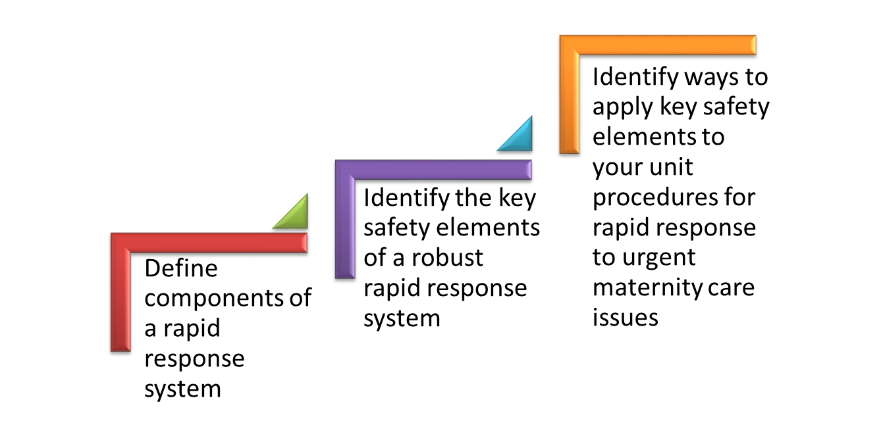
Learning Objectives

Slide 3
Rapid Response
Rapid response for maternal and fetal physiologic deterioration and urgent conditions is the focus of this bundle of the AHRQ Safety Program for Perinatal Care (SPPC).
The training materials and tools in this bundle review the key elements of a rapid response system within the framework of the Comprehensive Unit-based Safety Program (CUSP).
The key safety elements provide a comprehensive starting point for each unit to consider as it establishes its processes for ensuring rapid response capabilities.

Slide 4
Rapid Response System
A rapid response system (RRS) includes four components:^{1,2}
A mechanism for activating a clinical team response based on patient criteria
A multidisciplinary clinical team that can rapidly respond to assess and intervene in order to prevent further deterioration
A system for feedback, to help mitigate or improve response to similar situations in the future
An administrative structure to implement, train, and monitor all related activities

Slide 5
Obstetrical RRS
Distinct from a medical RRS or emergency “code” team
Distinct from neonatal RRS
Although distinct, close coordination is critical

Slide 6
Evidence for RRS
Some evidence supports the use of RRS for improving patient safety and outcomes, mainly for improving cardiac care.^{1,2}
Most studies of RRS in the literature are from unblinded, nonrandomized studies conducted at single centers.
Support for implementing RRS is based on the principle that early intervention can improve patient outcomes.³
Numerous hospitals are implementing RRS, many through participation in the Institute for Healthcare Improvement’s 5 Million Lives Campaign.
Studies and experience with the use of RRS for maternity patients are emerging.^{4,5,6,7}

Slide 7
RRS Tool
Purpose
Who Should Use
How To Use
Key Safety Elements
Supporting Materials
RRS Planning Worksheet
Sample RRS call log

Slide 8
SPPC Key Perinatal Safety Elements for RRS
Standardize When Possible (CUSP Science of Safety)
Create Independent Checks (CUSP Science of Safety)
Learn From Defects (CUSP Module)
Simulation (SPPC Pillar)
Teamwork Training (TeamSTEPPS®)
Patient and Family Engagement (CUSP)

Slide 9
Key Safety Elements: Standardize When Possible
Establish a unitwide approach for a rapid response to urgent maternity care issues.
System is established as part of a hospital’s larger rapid response system, or is established as a separate entity
Uniform mechanism for activating a rapid response
Uniform approach to responding to an activation
Staff and equipment
Scope of response
Documentation requirements
System feedback

Slide 10
Key Safety Elements: Standardize When Possible
Develop standard criteria for activation of a rapid response
General activation criteria
Specific activation criteria
Coordination with hospital medical emergency or “code” teams
Specific activation criteria for nonmaternity care urgencies or emergencies (e.g., cardiopulmonary issues or arrest)

Slide 11
Key Safety Elements: Standardize When Possible
Establishment of a standard rapid response kit or cart for the most common situations for which a rapid response is likely to be activated
Supplies
Equipment
Cognitive aids (e.g., checklists, protocols, algorithms, dosing guides, electronic fetal monitoring nomenclature)
Standard location
Process for checking kit/cart and restocking

Slide 12
Key Safety Elements: Create Independent Checks
Use a team of multidisciplinary staff for responding to rapid response activations.
Multidisciplinary responders offer built-in redundancy and another “set of eyes” on the situation.
Rapid responders should—
possess specialized maternity care clinical skills, knowledge, and equipment;
be able to assess and manage a maternity patient who has deteriorated physiologically; and
be able to intervene to minimize risk of serious harm and further deterioration.

Slide 13
Key Safety Elements: Create Independent Checks
Different models for the multidisciplinary team of responders exist and can vary by the following:
Volume and complexity of maternity patients cared for
Availability of in-house obstetric hospitalists (also called laborists) and dedicated anesthesiology support of labor and delivery (L&D)
Presence of graduate medical education or nurse midwifery programs with in-house residents or students
Other available hospital rapid response teams
Core rapid response staff typically includes a maternity care provider (obstetrician or midwife) and a staff L&D nurse.
Other responders may include an anesthesiology provider, an L&D or operating room technician, additional L&D staff nurses, or surgeon.
Units establish the scope and limits of rapid responders.

Slide 14
Key Safety Elements: Learn From Defects
Debrief and analyze near misses and adverse events, regardless of whether a rapid response was activated
Debrief among clinical team after rapid response, regardless of outcome
Have informal debriefs among clinical team
Rapid Response Call Log can facilitate a debrief
Have a process in place to review serious maternal or neonatal adverse outcomes
Share outcomes or process improvements from informal and formal analysis with staff to achieve transparency and organizational learning

Slide 15
Key Safety Elements: Simulation
Use of simulation to practice and train teams on rapid response processes
Simulation can reinforce teamwork and communication related to—
situational awareness
ability to get additional help quickly and activate a rapid response based on unit-established criteria and processes for activation
communication between primary care team and rapid responders
communication with patient/family
use of briefings, huddles, and debriefings

Slide 16
Key Safety Elements: Teamwork Training
Have situational awareness during rapid response events
Use SBAR, callouts, huddles, and closed-loop communication techniques during a rapid response
Communicate during transitions of care
Have high-reliability teams

Slide 17
Key Safety Elements: Teamwork Training
Characteristics of high-reliability teams
Anyone can sound an alarm, request help, or challenge the status quo.
Hierarchy is minimized.
Communication is continuous, valued and expected.

Slide 18
Key Safety Elements: Patient and Family Engagement
Unit approach incorporates—
mechanisms for patient activation of a rapid response
communication with patient/family during rapid response
disclosure of any unintended outcomes

Slide 19
Unit Next Steps
Decide whether to select the rapid response system bundle for implementation locally. Consider these factors:
Unit data suggesting adverse events or near misses that may have been minimized or averted as a result of a rapid response system
Synergy with related or similar initiatives, or existing hospital rapid response systems
Interest and enthusiasm of unit staff and administration for implementing

Slide 20
Unit Next Steps
Review the Key Safety Elements of the Rapid Response Tool, including the Planning Worksheet and Sample Call Log available as an appendix to the tool.
Support implementation of unit rapid response system through:
Staff training/communication
Simulation
Monitor implementation progress, collect data for quality improvement.

Slide 21
Tips for Implementation Success
Use CUSP principles for implementing teamwork and communication (e.g., incorporating diverse perspectives) to develop consensus on activation criteria and response expectations.
Provide education and training to staff on the use of the RRS and make routine education for patients and family on the rapid response activation a part of the admission process.
Debrief regularly after rapid response events, and solicit ongoing feedback from staff and patients to continually refine RRS processes.

Slide 22
References
Devita MA, Bellomo R, Hillman K, et al. Findings of the first consensus conference on medical emergency teams. Crit Care Med. 2006 Sep;34(9):2463-78. PMID: 16878033.
Jones DA, DeVita MA, Bellomo R. Rapid-response teams. N Engl J Med. 2011 Jul 14;365(2):139-46. PMID: 21751906.
Preparing for clinical emergencies in obstetrics and gynecology. Committee Opinion No. 590. American College of Obstetricians and Gynecologists. Obstet Gynecol 2014;123:722–5.
Skupski DW, Lowenwirt IP, Weinbaum FI, et al. Improving hospital systems for the care of women with major obstetric hemorrhage. Obstet Gynecol. 2006 May;107(5):977-83. PMID: 16648399.
Gosman GG, Baldisseri MR, Stein KL, et al. Introduction of an obstetric-specific medical emergency team for obstetric crises: implementation and experience. Am J Obstet Gynecol. 2008 Apr;198(4):367.e1-7. Epub 2007 Nov 5. PMID: 17981251.
Srinivas SK, Lorch SA. The laborist model of obstetric care: we need more evidence. Am J Obstet Gynecol. 2012 Jul;207(1):30-5. doi: 10.1016/j.ajog.2011.10.009. Epub 2011 Oct 15. PMID: 22138138.
Catanzarite V, Almyryde K, Bombard A. Ob team stat: developing a better L&D rapid response team. Contemp Ob/Gyn. 2007;52(9):52-65.

Slide 23
Disclaimer
Every effort was made to ensure the accuracy and completeness of this resource. However, the U.S. Department of Health and Human Services makes no warranties regarding errors or omissions and assumes no responsibility or liability for loss or damage resulting from the use of information contained within.
The U.S. Department of Health and Human Services cannot endorse, or appear to endorse derivate or excerpted materials, and it cannot be held liable for the content or use of adapted resources. Any adaptations of this resource must include a disclaimer to this effect.
Reference to any specific commercial products, process, service, manufacturer, company, or trademark does not constitute endorsement or recommendation by the U.S. Government, HHS, or AHRQ of the linked Web resources or the information, products, or services contained therein. The Agency does not exercise any control over the content on these sites.

