Slide 1
Assemble the Team and Engage Leadership for Perinatal Safety
AHRQ Safety Program for Perinatal Care
AHRQ Publication No. 17-0003-2-EF
May 2017

Slide 2
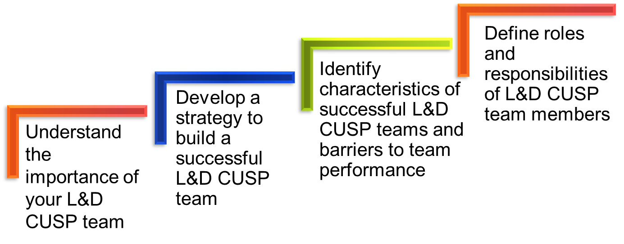
Learning Objectives

Slide 3

The L&D Unit-Based CUSP Team
Understands that patient safety culture is local
Is composed of engaged frontline providers who take ownership of patient safety
Includes staff members who have different levels of experience
Is tailored to include members
based on clinical intervention
Meets regularly (at least monthly)
Has adequate resources
AHRQ Safety Program for Perinatal Care

Slide 4
Success Depends on L&D Unit Team
Team members—
Start and sustain the initiative
Contribute to positive results through their engagement and belief in the project
Team should include—
Frontline providers with varying
backgrounds and expertise
Members with a shared
commitment to—
  Engage other
  team members
  Develop educational materials
  Execute the project
AHRQ Safety Program for Perinatal Care

Slide 5
Team Members
Nurses (including nurse educator, nurse manager, nurse midwives, nurse anesthetists)*
Physicians* (OB/GYN, family medicine, pediatricians, anesthesiologist)
Executive partners*
Pharmacists
Patient safety officers
Chief quality officers
Ancillary staff
Infection prevention specialists
*Key team members
AHRQ Safety Program for Perinatal Care

Slide 6
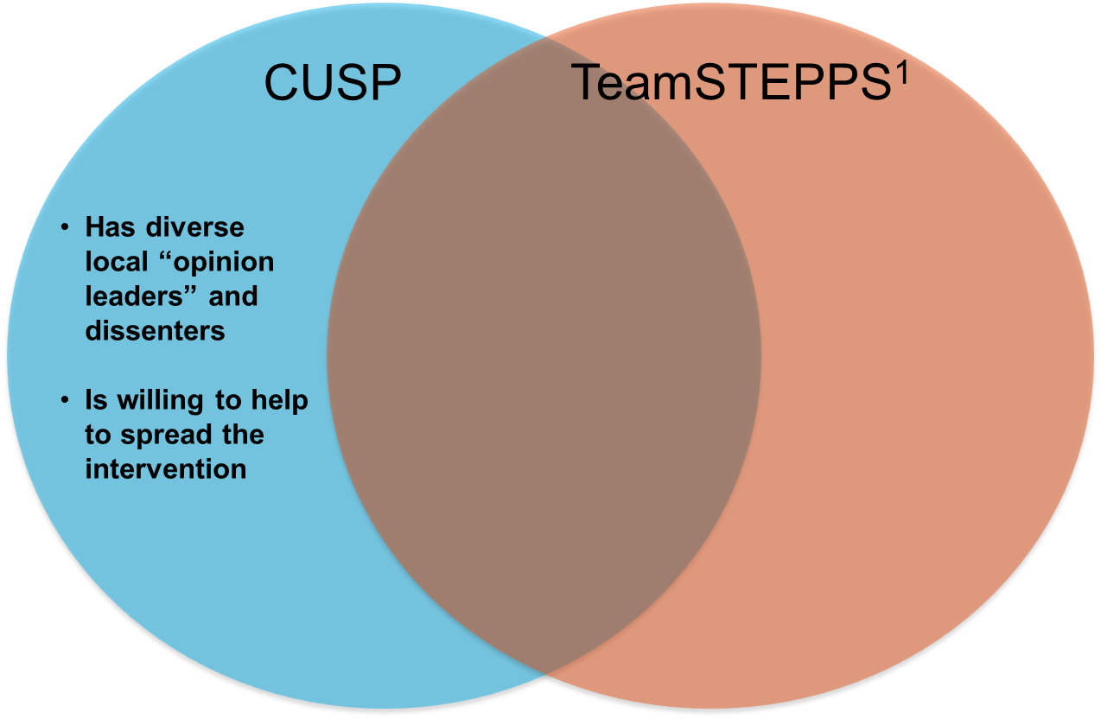
Team Characteristics

Slide 7
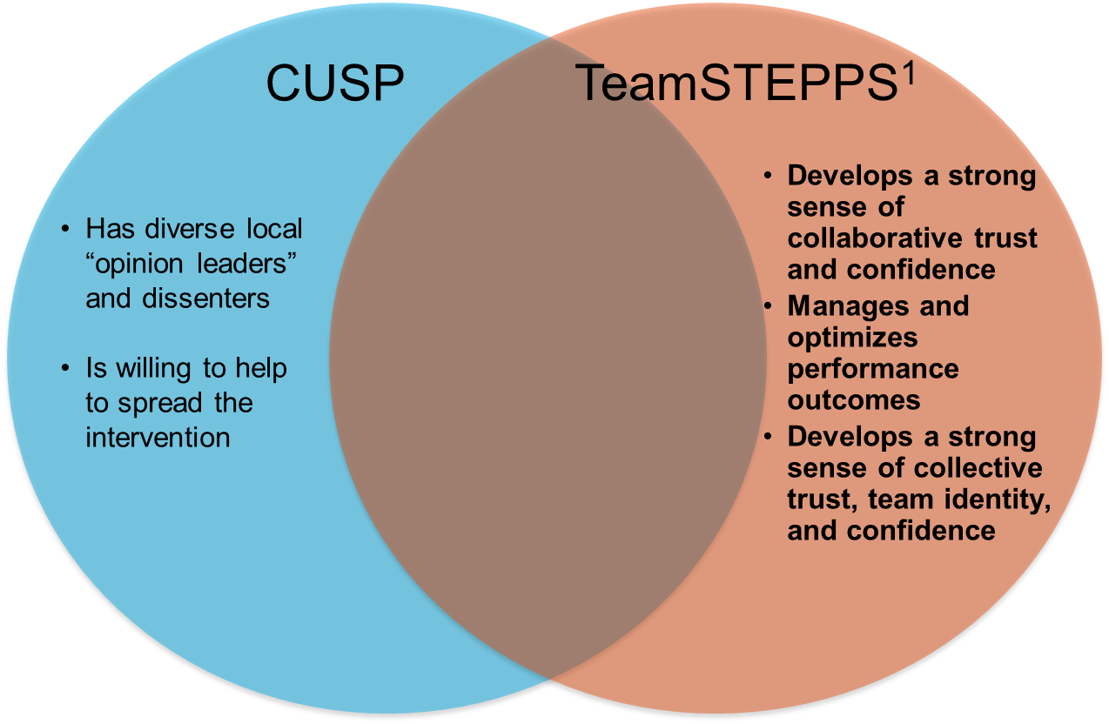
Team Characteristics

Slide 8
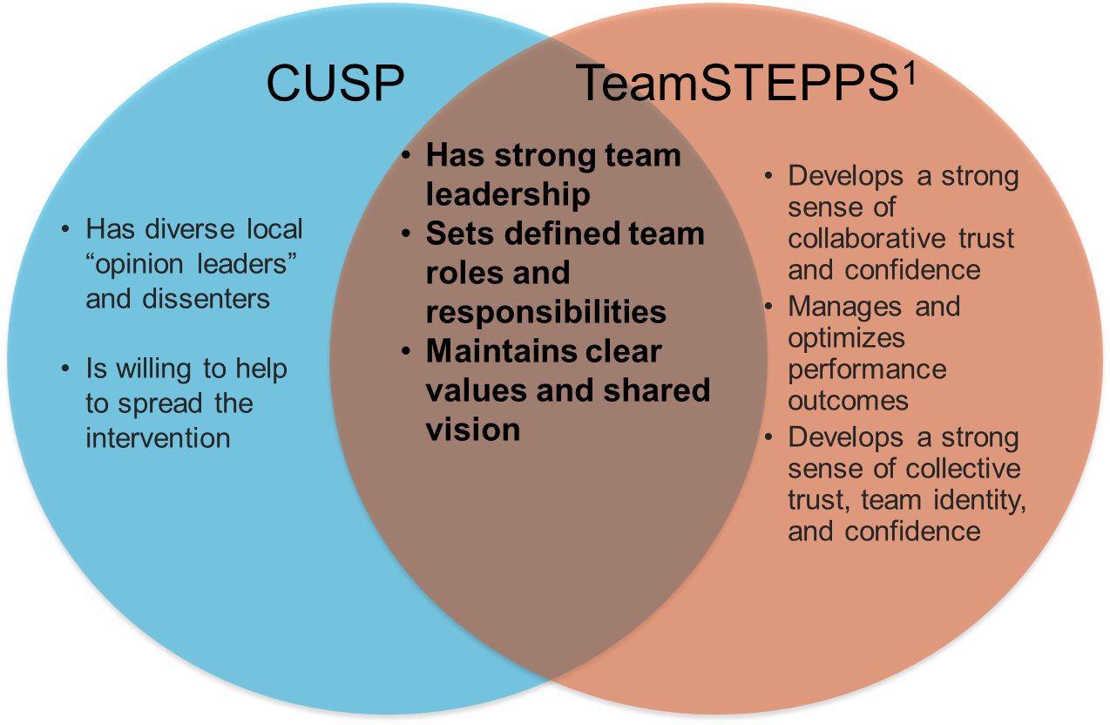
Team Characteristics

Slide 9
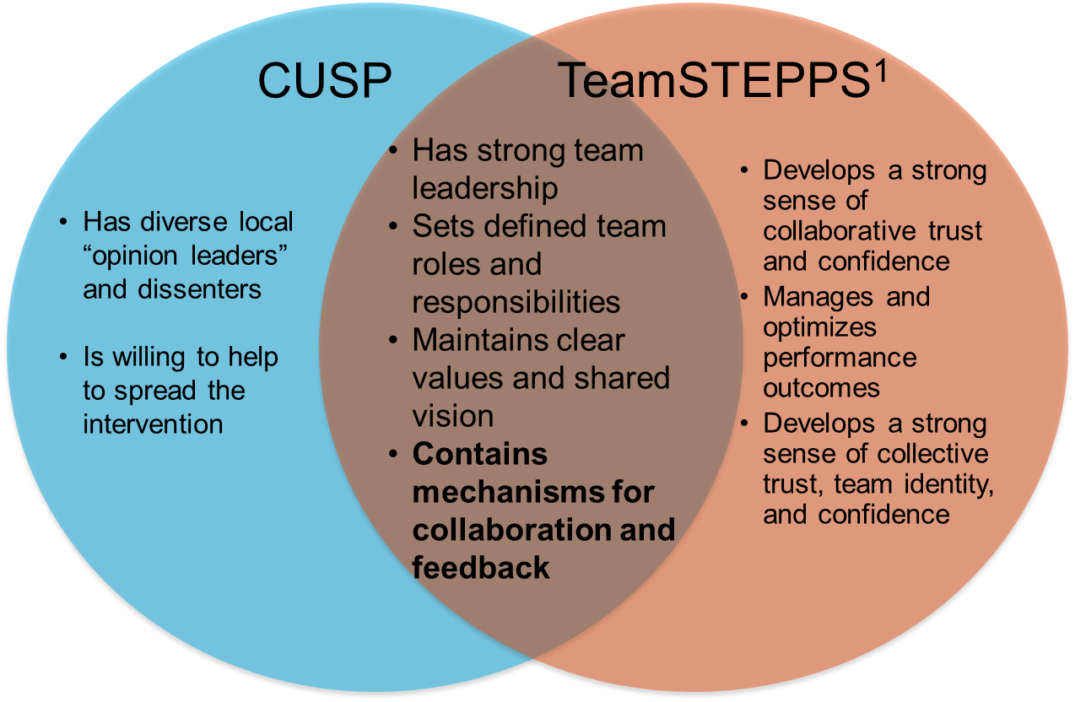
Team Characteristics

Slide 10
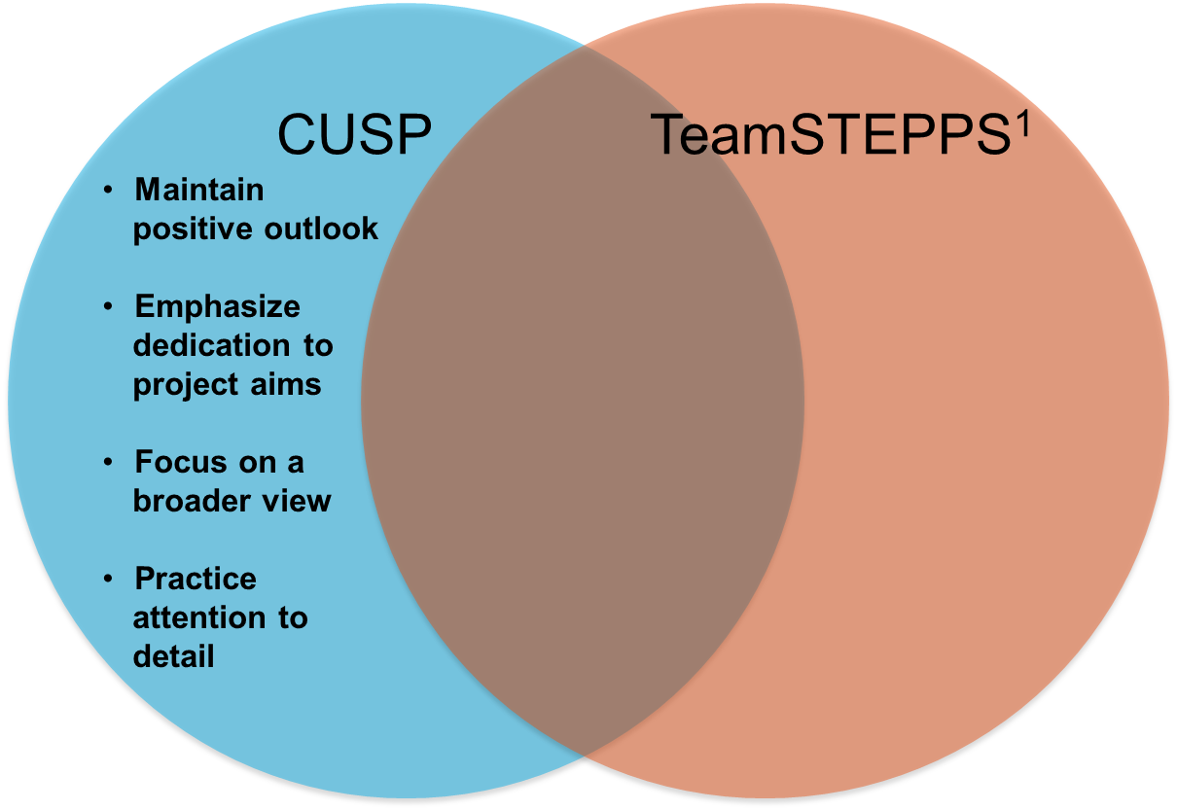
Team Member Characteristics

Slide 11
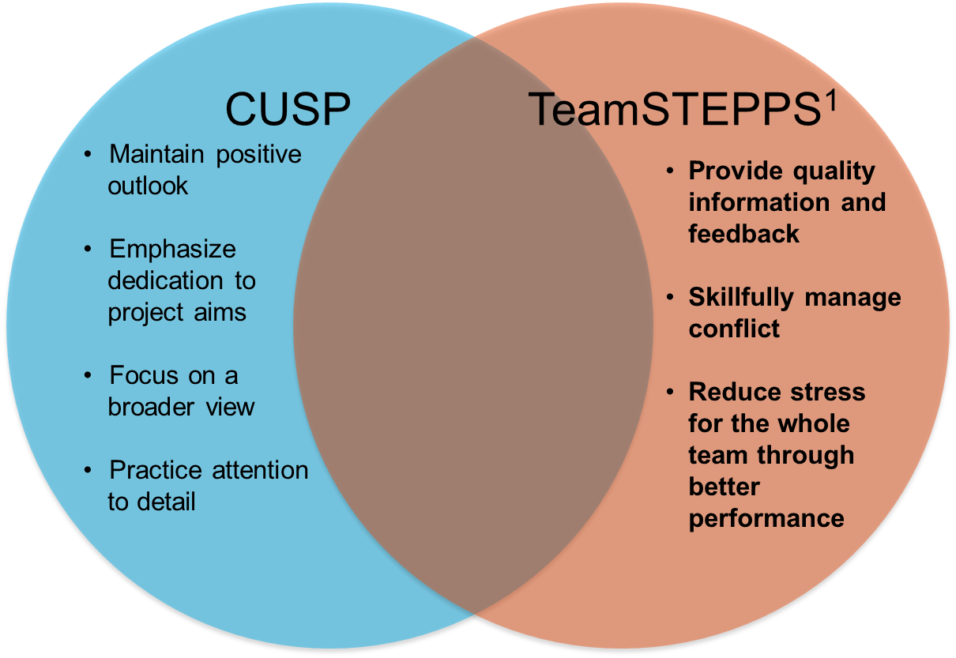
Team Member Characteristics

Slide 12
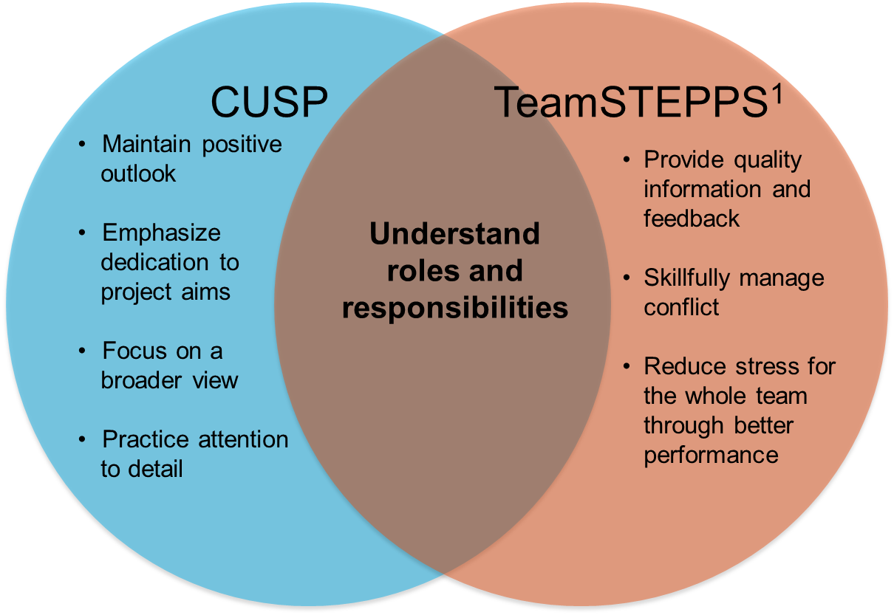
Team Member Characteristics

Slide 13

Building Your CUSP Team
CLICK LINK BELOW TO PLAY VIDEO:
http://www.ahrq.gov/professionals/education/curriculum-tools/cusptoolkit/videos/02c_build_cusp_team/index.html

Slide 14
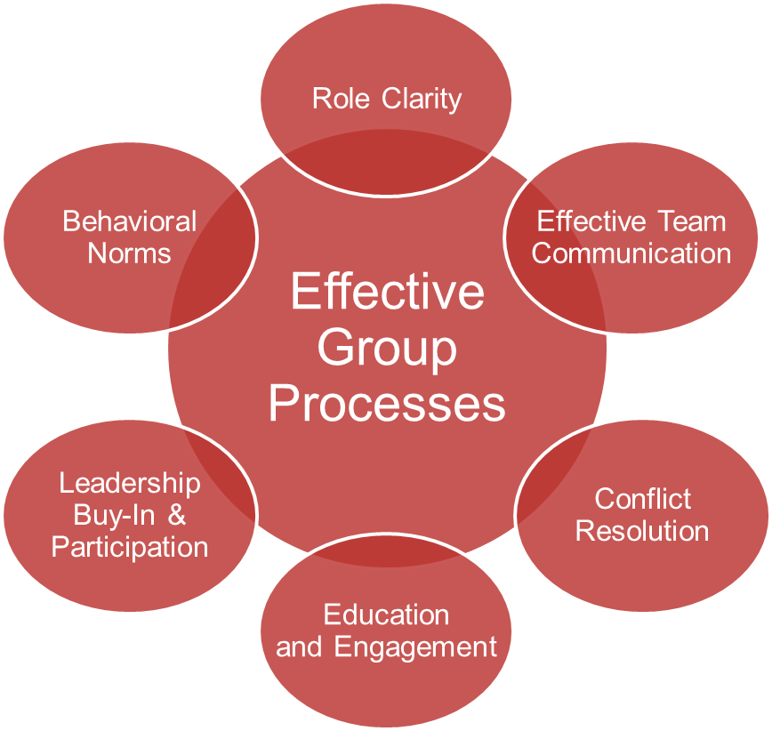
CUSP Teams’ Group Processes

Slide 15
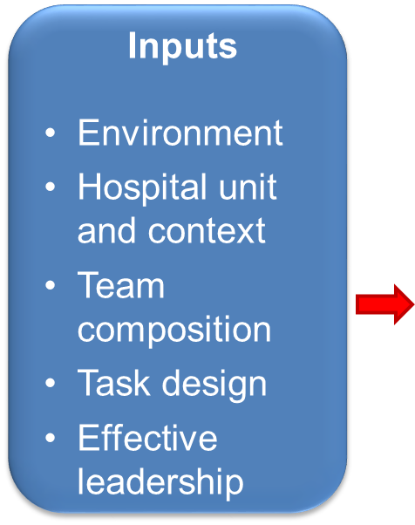
Team Performance

Slide 16
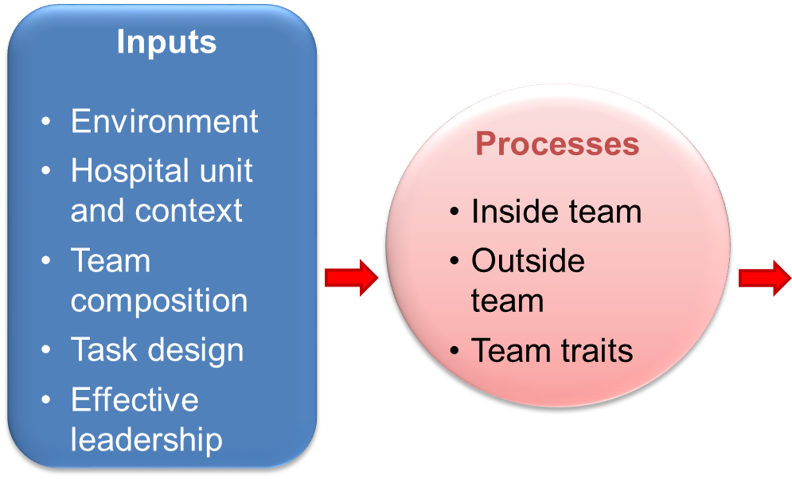
Team Performance

Slide 17
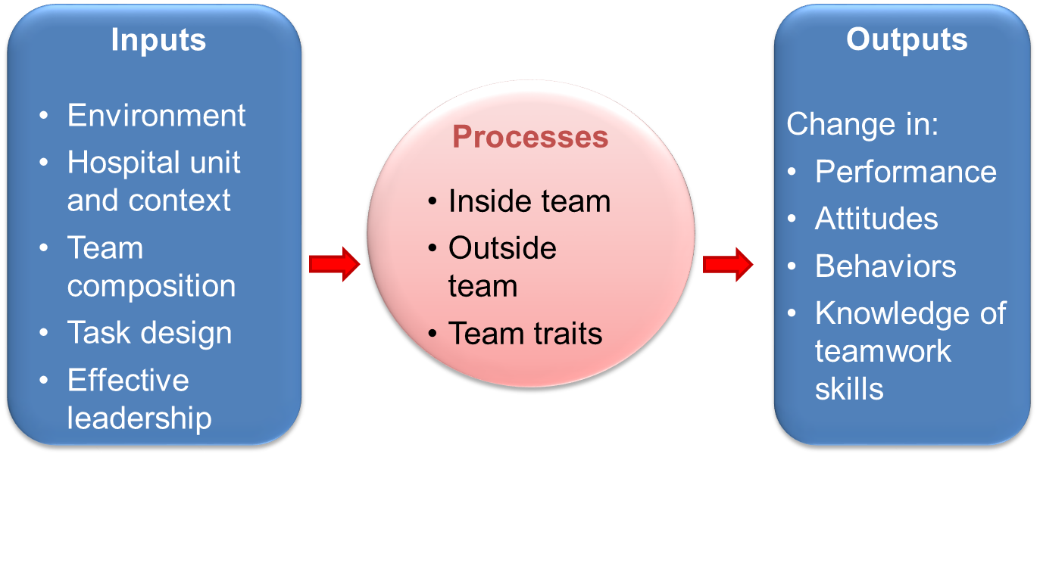
Team Performance

Slide 18

Barriers to Team Performance¹
Inconsistency in team membership
Lack of time
Lack of information sharing
Hierarchy
Varying communication styles
Presence of conflict
Lack of coordination
and followup
Misinterpretation of cues
Lack of role clarity
Ineffective leadership
Burnout

Slide 19
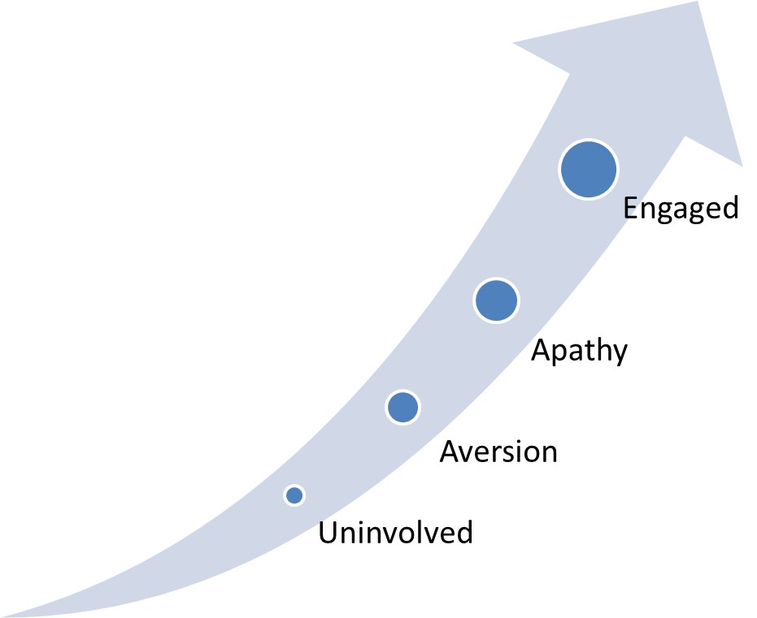
Stages of Engagement
Engagement: “To involve oneself or become occupied; to participate fully and deeply”
Active support of the project
AHRQ Safety Program for Perinatal Care

Slide 20
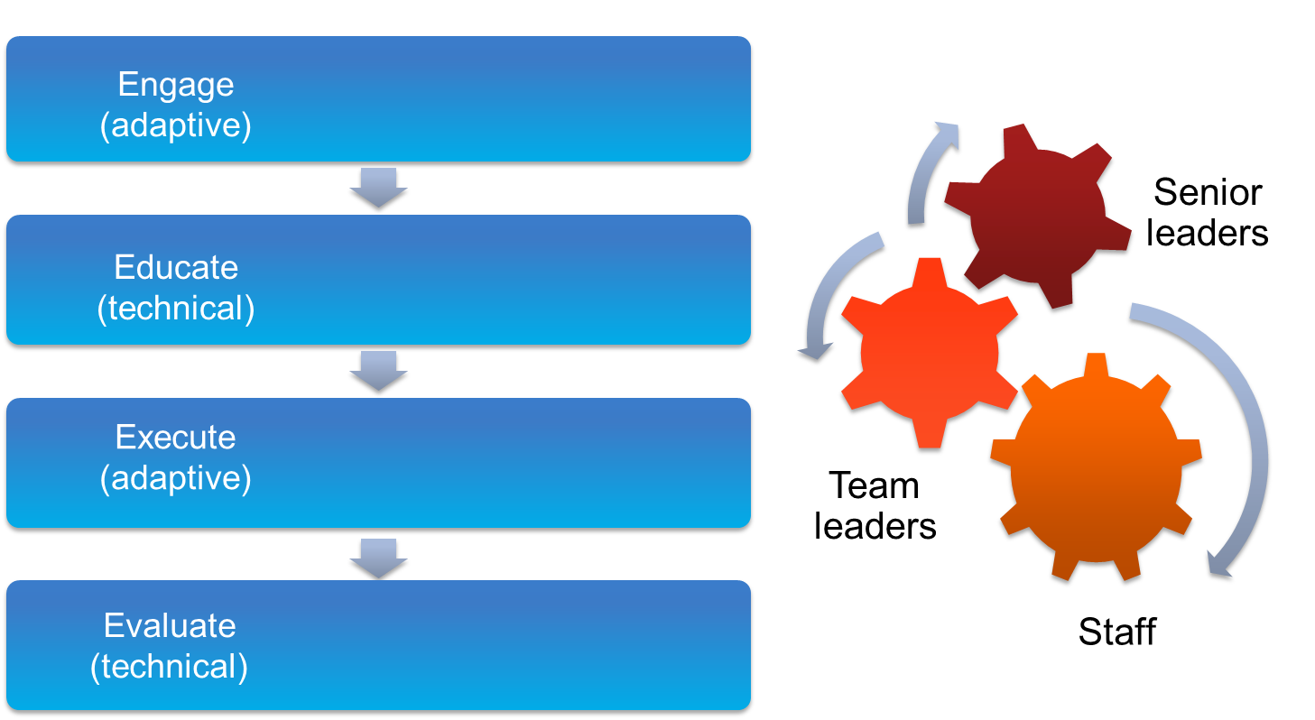
Engage Team Members Using the 4 Es²

Slide 21
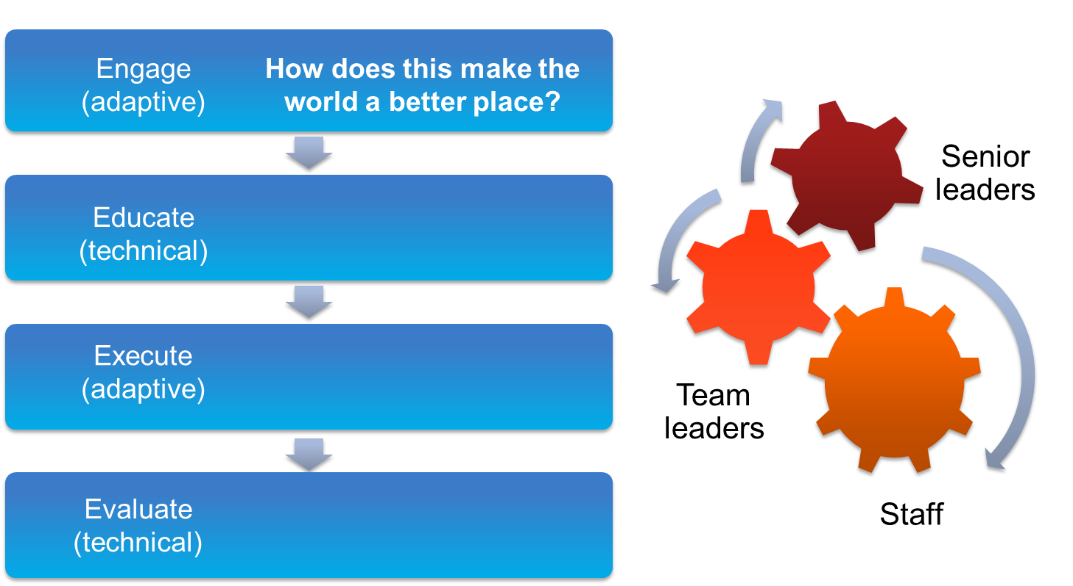
Engage Team Members Using the 4 Es²

Slide 22
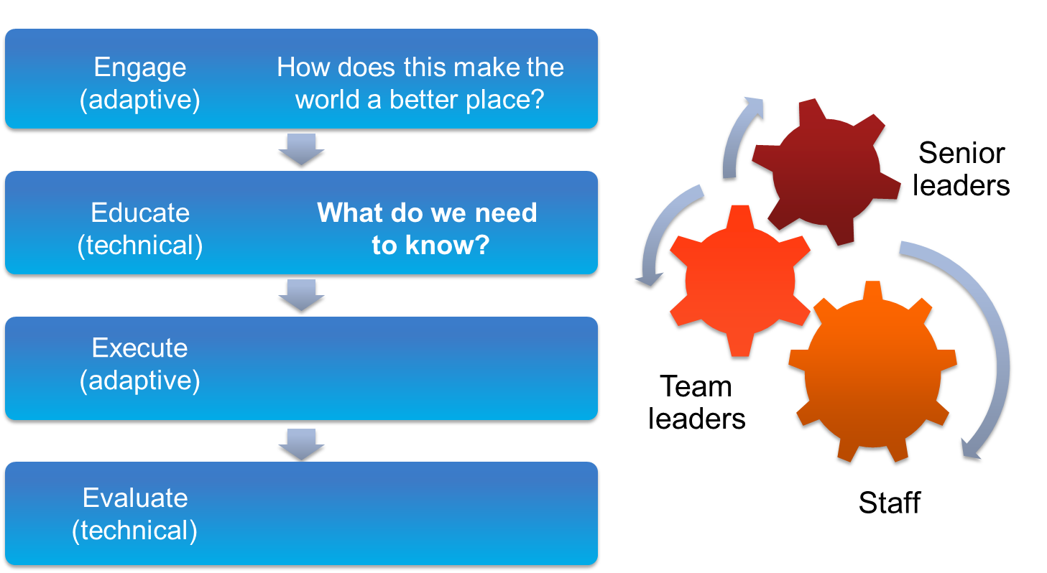
Engage Team Members Using the 4 Es²

Slide 23
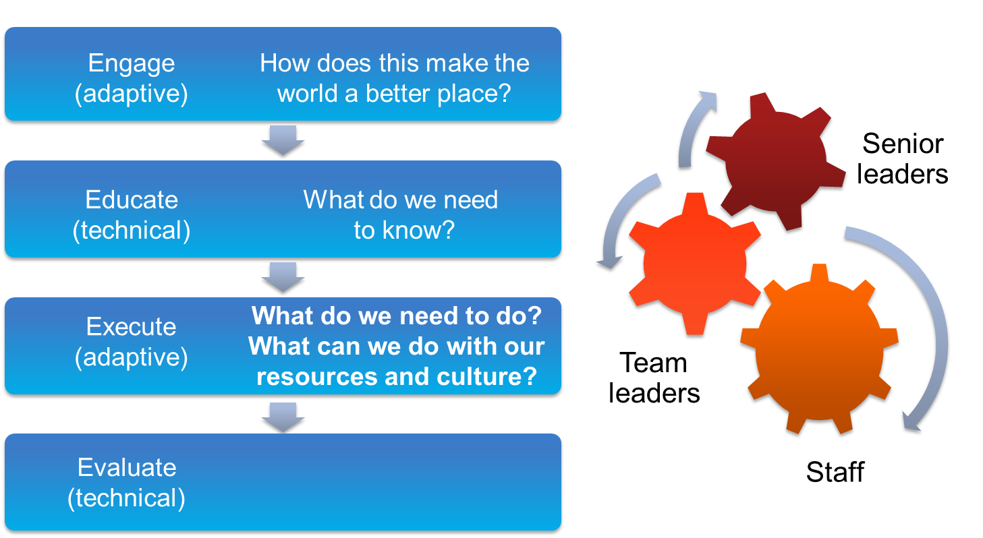
Engage Team Members Using the 4 Es²

Slide 24

Engage Team Members Using the 4 Es²

Slide 25

The CUSP Leader’s Role
Is a frontline provider, nurse educator, physician, or other staff member
Models teamwork behaviors
Encourages unit staff involvement
Fosters an environment of mutual respect and psychological safety
Obtains and encourages staff feedback and expects input
Manages documentation of
CUSP activities
Educates staff about CUSP
AHRQ Safety Program for Perinatal Care

Slide 26
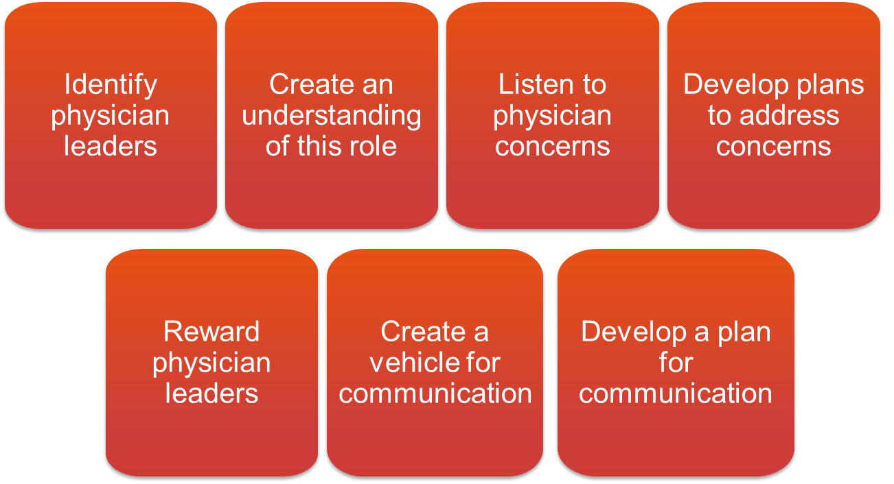
Engage Physicians on the CUSP Team

Slide 27

The Physician Champion’s Role
Receives education and support required for successful leadership
Serves as role model for CUSP activities
Meets with CUSP team at least monthly
Participates in monthly senior executive partnership meetings
Communicates with physician group regularly and as needed
Assists with implementation of interventions

Slide 28

Physician Engagement
CLICK LINK BELOW TO PLAY VIDEO:
http://www.ahrq.gov/professionals/education/curriculum-tools/cusptoolkit/videos/02e_phys_engagement/index.html

Slide 29

Engage Other CUSP Team Members
Executive partners
Nurses
Patient safety officers
Technicians
Clerks and receptionists
Patient advocates
Data analyst
Residents
Pharmacist

Slide 30

The Senior Executive’s Role
Holds monthly meetings with the CUSP team
Helps the team prioritize improvement efforts
Helps the team navigate organizational bureaucracy
Ensures the team has resources to fix problems

Slide 31
The Senior Executive’s Role
Makes rounds and meets monthly with frontline providers and managers on the L&D unit
Collaborates with others to develop and put into effect a plan that addresses safety issues
Holds all staff accountable for carrying out agreed-upon activities designed to reduce patient harm

Slide 32
Senior Executives Support Both Technical and Adaptive Work of Change
Technical work addresses problems for which—
The definition is clear, the potential solutions are relatively explicit, and solutions usually require minimal learning;
Responsibility for implementing a solution is fairly apparent between leaders and followers; and
Teams have the resources necessary to succeed.
AHRQ Safety Program for Perinatal Care

Slide 33
Senior Executives Support Both Technical and Adaptive Work of Change
Adaptive work addresses problems that require unitwide cultural adjustments. Senior executives—
Help people successfully adapt to change by reinforcing attitudes, beliefs, and behaviors that facilitate the initiative
Address issues that require adaptive solutions with measures such as—
  Implementing an evidence-based checklist for key procedures
  Creating an action policy if an evidence-based protocol is breached
  Holding individuals accountable for following new policies
AHRQ Safety Program for Perinatal Care

Slide 34
Senior Executives Support Both Technical and Adaptive Work of Change
Technical Work
Synchronizes with team members to create project goals and timelines and outlines the project mission
Coordinates with team members to ensure that necessary structures are in place—staff, roles, authority, and responsibility
Collaborates with team members to maintain the material needs of the project—budgets, resources, space, and staffing
Adaptive Work
Works with team members to clarify the decision-making, conflict management, and problem solving processes
Coordinates with team members to verify that necessary evaluation mechanisms are in place
AHRQ Safety Program for Perinatal Care

Slide 35

Senior Executive Collaborates To Develop and Implement a Plan Addressing Safety Issues
Considers patient risks identified in the staff safety assessment with team members
Involves frontline providers to help reduce risks
Helps prioritize hazards and constructs an improvement plan
Holds himself or herself and
L&D unit staff accountable for implementing the plan
AHRQ Safety Program for Perinatal Care

Slide 36

Senior Executive’s Characteristics
Vice president level or higher when possible
Actively engaged in progress of project
Interested in clinical care, but not required to be a clinician
Willing to learn from, listen to, and work with staff to improve patient safety on the unit
AHRQ Safety Program for Perinatal Care

Slide 37
The Challenges of Partnering With a Senior Executive
Lack of clinical background
Lack of recognition for the value of CUSP
Unavailability to meet with the L&D CUSP team regularly
AHRQ Safety Program for Perinatal Care

Slide 38

How To Engage Your Senior Executive and Develop Shared Accountability for the Work
Ensure an executive is assigned to the L&D CUSP team and participates regularly in meetings.
Set an expectation related to length of commitment: 6 months, 1 year, etc.
Acknowledge the senior executive’s perspective. (“What’s in it for me?”)
Increase the visibility of your senior executive.
List identified safety issues in the Safety Issues Worksheet for Senior Executive Partnership or a tracking log.
AHRQ Safety Program for Perinatal Care

Slide 39

The Nurse Manager’s Role
Leads or supports L&D CUSP activities
Ensures safety assessment results are shared with staff
Assigns project leaders to interventions
Assists with developing executive partnership
Manages local resources
AHRQ Safety Program for Perinatal Care

Slide 40
The Leadership and Management Roles of the Nurse Manager
Leadership
Embodies the vision, mission, and values of the
L&D unit with staff
Motivates staff to strive for professional excellence
Sets and models behavioral expectations of staff
Is a socio-adaptive component of a job
Management
Operations
Finance and budget
Strategic goals
Task-oriented, technical component of a job
AHRQ Safety Program for Perinatal Care

Slide 41
Frameworks Useful for Nurse Managers
Baldridge Health Care Criteria for Performance Excellence Framework
Quint Studer’s Five Pillars
Balanced Scorecard
American Organization of Nurse Executives Nurse Manager Leadership Partnership Learning Domain Framework
AHRQ Safety Program for Perinatal Care

Slide 42

The Patient Safety Coordinator’s/Officer’s Role
Serves as a senior executive partner in some institutions
Coordinates executive orientation with the initiative
Verifies that staff or patient surveys are analyzed and results are reviewed in a timely manner
Monitors progress of the intervention
Disseminates results and shares stories
AHRQ Safety Program for Perinatal Care

Slide 43
Psychological Safety³
Psychological safety is the degree to which team members feel that their environment supports the interpersonal risk involved in asking for help or learning from mistakes.
Team leaders and team members who promote psychological safety will—
  Invite input from all team members
  Encourage team members to contribute
  Promote active listening and learning from each other
  Ensure all team members are accessible
  Acknowledge the limits of current knowledge
AHRQ Safety Program for Perinatal Care

Slide 44
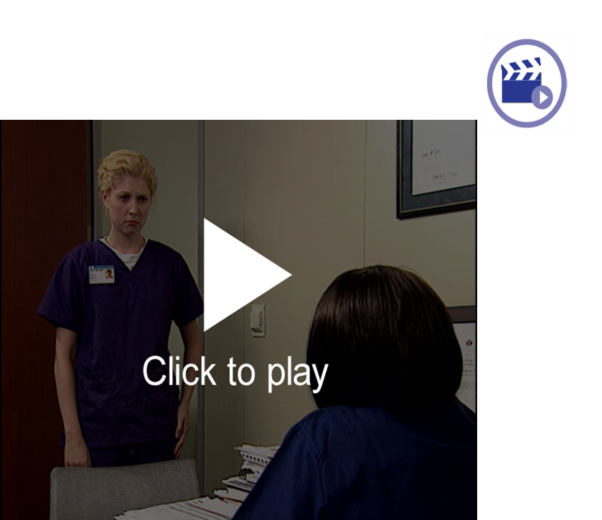
Psychological Safety
CLICK LINK BELOW TO PLAY VIDEO:
http://www.ahrq.gov/professionals/education/curriculum-tools/cusptoolkit/videos/02d_psych_safety/index.html

Slide 45
Assemble the Team: What the Team Needs To Do
Recruit a team lead, nurse manager, physician, and executive partner along with any other team members.
Meet with hospital departments (risk management, quality improvement) to ensure that L&D CUSP efforts are integrated into overall hospital quality improvement and patient safety efforts.
List team member names and contact information on the Background Quality Improvement Team Information Form and post the form in a central location.
Use the 4 Es to ensure team engagement—
  Engage them in the process
  Educate them about their roles
  Execute the processes
  Evaluate what you did
AHRQ Safety Program for Perinatal Care

Slide 46

CUSP Tools
Background Quality Improvement Team Information Form
Team Checkup Tool
Culture Checkup Tool
Safety Issues Worksheet for Senior Executive Partnership
CEO/Senior Leader Checklist
Staff Safety Assessment
Board Checklist
Shadowing Another Professional Tool
AHRQ Safety Program for Perinatal Care

Slide 47
Summary
The CUSP team will include health care professionals, support staff, and executive leadership staff.
The “4 Es” is a highly effective tool for recruiting team members.
Team members work together to identify barriers and address them as a group.
For teams to be successful, the roles and responsibilities of team members need to be clearly defined.
AHRQ Safety Program for Perinatal Care

Slide 48
References
Agency for Healthcare Research and Quality, Department of Defense. TeamSTEPPS. http://www.ahrq.gov/professionals/education/curriculum-tools/teamstepps/index.html.
Pronovost PJ, Berenholtz SM, Goeschel CA, et al. Creating high reliability in health care organizations. Health Serv Res. 2006;41(4, pt 2):1599-1617.
Edmondson AC. Managing the Risk of Learning: Psychological Safety in Work Teams. In West M, ed. International Handbook of Organizational Teamwork. London: Blackwell; 2003.
AHRQ Safety Program for Perinatal Care

Slide 49
Disclaimers
Every effort was made to ensure the accuracy and completeness of this resource. However, the U.S. Department of Health and Human Services makes no warranties regarding errors or omissions and assumes no responsibility or liability for loss or damage resulting from the use of information contained within.
The U.S. Department of Health and Human Services cannot endorse, or appear to endorse derivate or excerpted materials, and it cannot be held liable for the content or use of adapted resources. Any adaptations of this resource must include a disclaimer to this effect.
Reference to any specific commercial products, process, service, manufacturer, company, or trademark does not constitute endorsement or recommendation by the U.S. Government, HHS, or AHRQ of the linked Web resources or the information, products, or services contained therein. The Agency does not exercise any control over the content on these sites.

