Slide 1
Patient and Family Engagement for Perinatal Safety
AHRQ Safety Program for Perinatal Care
AHRQ Publication No. 17-0003-6-EF
May 2017

Slide 2
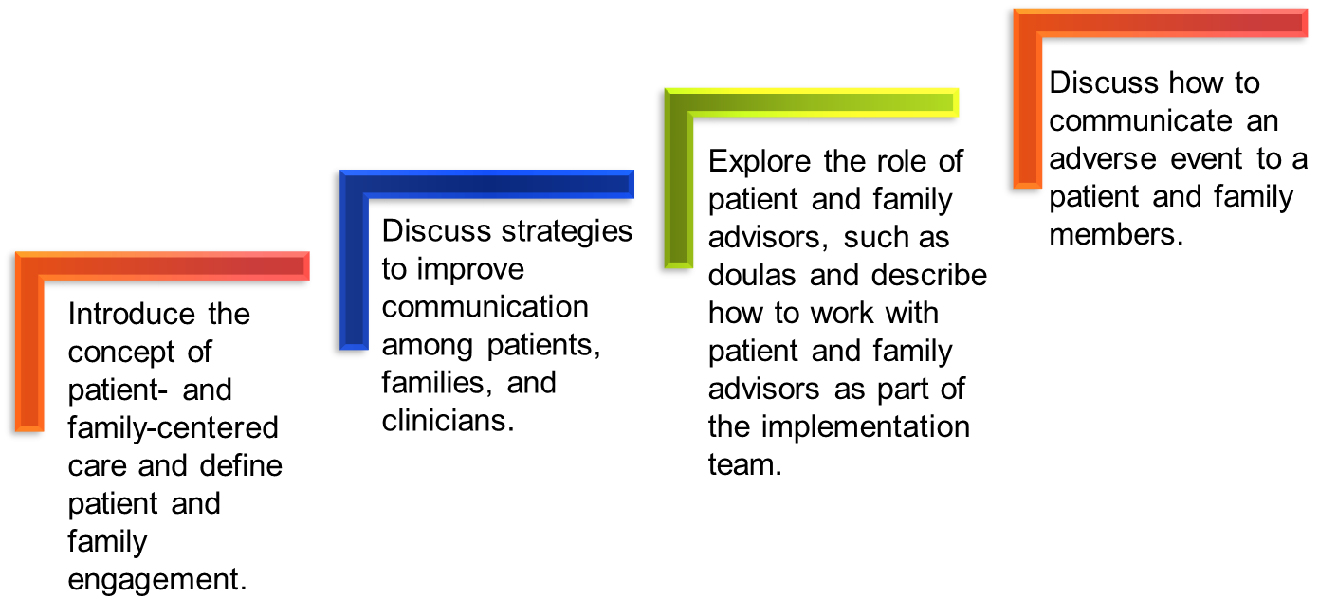
Learning Objectives

Slide 3


The Patient’s Hospital Experience¹
Clinicians and Hospital Staff | Patients
Know how the hospital works and how to achieve results | Are strangers in this environment Don’t understand the system or culture
Know who hospital staff are and what they do | Don’t know who different staff are or what they do
Are busy and under a lot of stress | Are often in pain or uncomfortable, vulnerable, or afraid Are aware that hospital staff are busy and may not want to bother anyone
Notes:
(Strategy 2 Tool 6 presentation)

Slide 4

Patient- and Family-Centered Care²
Involves “…collaborating with patients and families of all ages, at all levels of care, and in all health care settings …. acknowledges that families, however they are defined, are essential to patients’ health and well-being…”
Core concepts of patient- and family-centered care
  Dignity and respect
  Information sharing
  Participation
  Collaboration

Slide 5
What Is Patient and Family Engagement?¹
Patient and family engagement—
Is an important component of patient- and
family-centered care
Creates an environment where patients, families, clinicians, and hospital staff work together as partners to improve the quality and safety in all health care settings.
Involves patients and their families as members of the health care team

Slide 6

Engagement Strategies
Engaging in everyday care
Engaging after an adverse event
Engaging in planning and design

Slide 7
Engaging in Everyday Care
Care team members can provide opportunities for patients and family members to be involved in their care by—
Inviting patients and family members to partner with their health care team throughout their stay
Conducting change-of-shift report at the bedside so patients and families can participate
Involving patients and families in discharge planning and plans for safe care at home

Slide 8
Engaging From the Beginning¹
Labor and delivery (L&D) unit staff should read the patient’s chart before entering her room. Once they enter they should—
Make eye contact with the patient and her family
Introduce themselves by name and role
Introduce new people in the room by name and role, explaining what they will do

Slide 9
Engaging at the First Assessment¹
When staff first assess the patient, they should—
Ask how the patient prefers to be addressed
Identify family members or others, such as a doula, who are involved in the patient’s care
Highlight main points of communication strategies
Invite the patient and family members to write questions on the whiteboard to “talk” with the clinicians

Slide 10

The Link Between Communication and Patient Safety¹
Patient outcomes
Patient safety
Perceptions of quality

Slide 11

Communication Tips¹
When educating the patient and family—
Speak slowly.
Use plain language.
Reassure patient and family by giving information.
Thank patient or family for calling attention to any issue raised.
Invite them to continue asking questions.
11

Slide 12
Listening and Explaining¹
Staff should ask about and listen to the patient’s and family’s needs and concerns and should—
Use open-ended questions
Try to see the experience through the patient’s eyes
Listen to, respect, and act on what the patient and family say
Help the patient and family articulate their concerns when needed
Enlist a translator’s assistance when needed

Slide 13
Role of a Doula³
A doula accompanies a woman in labor to—
Provide emotional and physical support
Suggest comfort measures
Provide support and suggestions for the partner
Provide education on L&D practices and procedures before and during labor
Notes:
Source: DONA International Standards of Practice

Slide 14
Role of a Doula³
A doula also can—
Provide assistance in acquiring the knowledge necessary to make informed decisions
Advocate for clients by empowering them to speak up for themselves and encouraging patient-clinician communication
Improve engagement of mothers and families in the birthing process and communication with the clinical team
Notes:
Source: DONA International Standards of Practice

Slide 15
Engaging With the Help of a Doula
Doulas can help increase patient and family engagement by—
Helping clinicians better understand the patient’s birth plan or the woman’s and her family’s wishes or expectations for labor
Having more time available than clinicians to explain in plain language what to expect at various points throughout labor and any technical procedures that might be required

Slide 16
Engaging With the Help of a Doula
Doulas can help the L&D team increase patient and family engagement by—
Assessing the level of patient understanding and helping the patient or family ask questions or voice concerns
Leveraging the relationship built with the patient and her family prior to the labor and birth to collaborate with the care team
Being a constant presence throughout labor

Slide 17
Engaging After Adverse Events
An adverse event is an injury to a patient caused by medical intervention rather than by the underlying disease or condition of the patient.
The mission of health care providers is to help and care for patients without harming them, but adverse events happen.
When an adverse event occurs, it can be difficult for a health care worker to take ownership and communicate with the patient and family.
Prompt, compassionate, and honest communication with the patient and family after an adverse event is essential.

Slide 18
Immediate Response to an Adverse Event⁴
Care for the patient
Report to the appropriate parties
Communicate with the patient (who, what, when, where, and why)
Document the event in the medical record

Slide 19
Adverse Event Initial Communication⁴
During initial communication with patient and family—
Communicate only relevant facts
Advise the patient and family that communication will be ongoing during the followup investigation
Provide a designated contact person for patient and family concerns

Slide 20
How To Communicate About an Adverse Event⁵
Speak slowly and use clear language.
Give an advance alert (“I’m afraid I have some bad news to share with you.”).
Give the news in a few, brief sentences.
Quietly wait for the reaction.
Watch and listen for response signals.

Slide 21
Next Steps in Responding to an Adverse Event⁶
Investigation
Continued communication with the patient and family
Apology and remediation
System and process improvement
Measurement and evaluation
Education and training

Slide 22
The Second Victim: Health Care Workers⁷
Health care workers involved in an adverse event experience their own trauma.
Health care workers should request ongoing support from their hospital and peers.
Many hospitals have developed employee assistance programs and medically induced trauma support services.

Slide 23
Engaging in Planning and Design:
Continuing Patient and Family Involvement¹
Beyond their own care, patients can become organizational partners, known as advisors.
Advisors work with staff, clinicians, and leaders of the hospital to improve—
  Policies
  Processes
  Programs
  Facility design
  Education

Slide 24

Who Are Advisors and What Do They Do?
Advisors are—
  Collaborative partners in developing and revising hospital policies, procedures, and practices
  Patients and family members who have received care at our hospital and who want to help improve experiences for others
They help our hospital improve quality and safety of care by—
  Giving input and feedback
  Identifying potential changes
  Planning and implementing changes that
  matter to patients and families

Slide 25
Summary
Effective engagement and communication among patients, families, and members of the health care team affect health outcomes and patient and family satisfaction.
Doulas can be a valuable resource for mothers and their families and for labor and delivery units. They also can improve patient and family engagement during the birthing process.
Organizations should be prepared to respond and communicate proactively when adverse events occur.
Patient and family advisors provide valuable insight about patient and family experiences and care delivery.

Slide 26

Tools
Am I Ready To Become an Advisor?¹
Working With Patient and Family Advisors¹
Be a Partner in Your Care¹

Slide 27
References
Guide to Patient and Family Engagement in Hospital Quality and Safety. AHRQ Publication No. 13-0033. Rockville, MD: Agency for Healthcare Research and Quality; May 2013.
Conway J, Johnson B, Edgman-Levitan S, et al. Partnering with Patients and Families to Design a Patient- and Family-Centered Health Care System: A Roadmap for the Future. A work in progress. Bethesda, MD: Institute for Family-Centered Care; June 2006.
Dona International. Standards of Practice—Birth Doula. http://www.dona.org/PDF/Standards%20of%20Practice_Birth.pdf. Accessed May 11, 2016.
Bonacum D, Houk C, Moidel BI, et al. Communicating about episodes of harm to patients. In: Leonard M, ed. Achieving Safe and Reliable Healthcare. Chicago: Health Administration Press; 2004:93-112.

Slide 28
References
Hallenback JL. Palliative Care Perspectives. 1st ed. New York: Oxford University Press; 2003.
McDonald TB, Helmchen LA, Smith KN, et al. Responding to patient safety incidents: the “seven pillars.” Qual Saf Health Care. 2010 Dec;19(6):e11. PMID: 20194217.
Wu AW. Medical error: the second victim. The doctor who makes the mistake needs help, too. BMJ. 2000 Mar 18;320(7237):726-727. PMID: 10720336.

Slide 29
Disclaimers
Every effort was made to ensure the accuracy and completeness of this resource. However, the U.S. Department of Health and Human Services makes no warranties regarding errors or omissions and assumes no responsibility or liability for loss or damage resulting from the use of information contained within.
The U.S. Department of Health and Human Services cannot endorse, or appear to endorse derivate or excerpted materials, and it cannot be held liable for the content or use of adapted resources. Any adaptations of this resource must include a disclaimer to this effect.
Reference to any specific commercial products, process, service, manufacturer, company, or trademark does not constitute endorsement or recommendation by the U.S. Government, HHS, or AHRQ of the linked Web resources or the information, products, or services contained therein. The Agency does not exercise any control over the content on these sites.

