Slide 1
Implement Teamwork and Communication for Perinatal Safety
AHRQ Safety Program for Perinatal Care
AHRQ Publication No. 17-0003-3-EF
May 2017

Slide 2
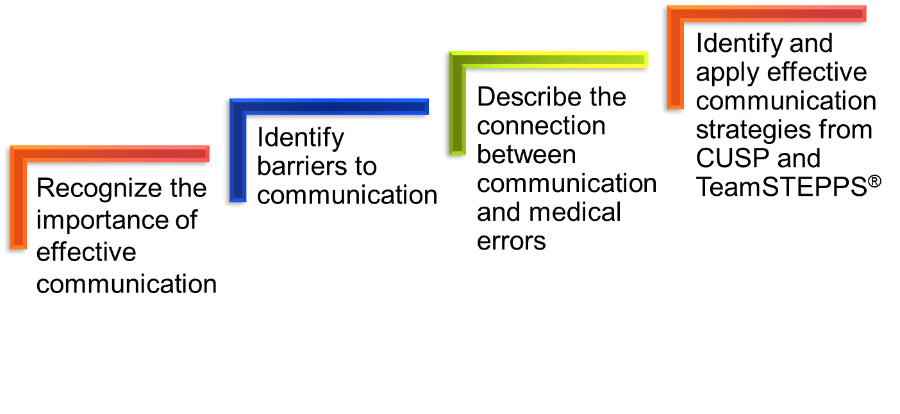
Learning Objectives

Slide 3
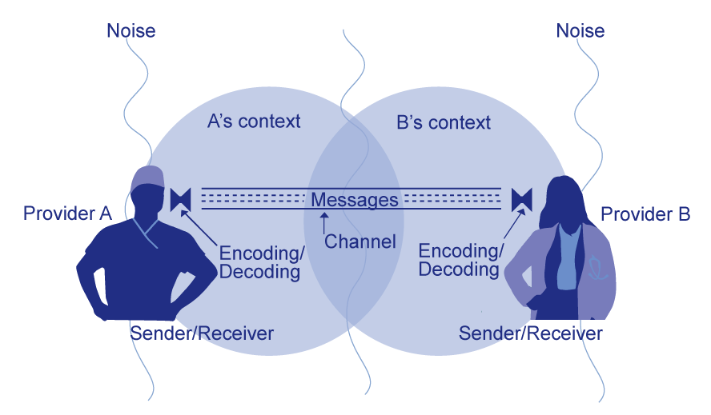
Basic Components and Process of Communication¹

Slide 4

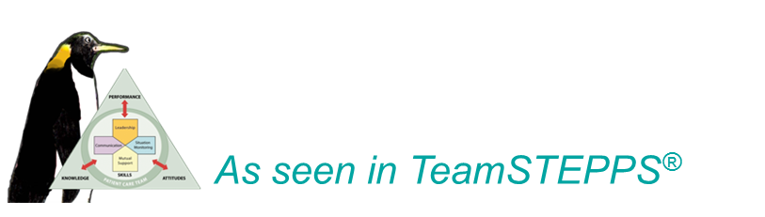
Four Key Components of Effective Communication²

Slide 5

Elements That Affect Communication and Information Exchange
Interruptions
Task absorption
Verbal abuse
Fatigue
Not following plan of care
Ambiguous orders or
directions
Change in team members
Work load
Language barriers
5

Slide 6
Root Causes of Maternal and
Perinatal Deaths and Injuries 2004-2012³
Top 5 Root Causes | Maternal Events (N=107) | Perinatal Events (N=239) | Op/Post-op Complication Events (N=719)
Human factors | 53% | 74% | 62%
Communication | 50% | 68% | 54%
Assessment | 45% | 66% | 50%
Leadership | 41% | 59% | 42%
Information management | 21% | 21% | 19%
Note: The majority of events have multiple root causes, so column percentages may add up to greater than 100%.
Teamwork & Comm.

Slide 7
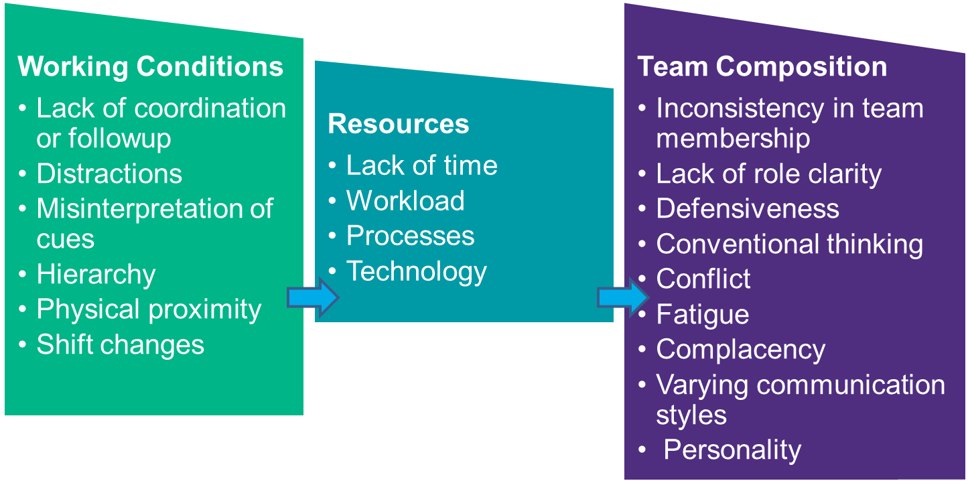
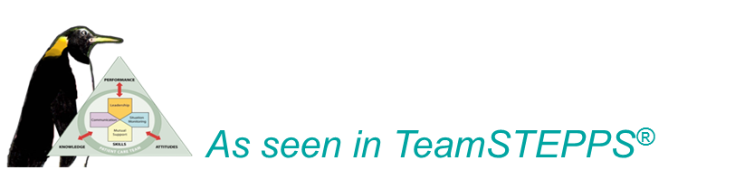
Barriers to Team Effectiveness²

Slide 8

Positive Outcomes of Effective Teamwork on Health Care⁴
Reduced length of stay
Higher quality of care
Better patient outcomes
Greater ability to meet family member needs
Improved patient experience
with care scores
Lower nurse turnover

Slide 9

Shadowing
Helps—
Team members gain perspective of other roles
Identify issues affecting teamwork and communication that may affect patient care, patient care delivery, and outcomes
Who should shadow?
Staff of patient care units where
culture scores indicate a poor
score in teamwork and safety
Units with little collaboration
between disciplines
9

Slide 10
Selected TeamSTEPPS Tools²
Four Components of Effective Teams
Leadership | Situation Monitoring | Mutual Support | Communication
Brief | STEP | Task Assistance | SBAR
Huddle | I’M Safe | Feedback | Call-Out
Debrief |  | Advocacy and Assertion | Check-Back
 |  | Two-Challenge Rule | Handoff (I-PASS the BATON)
 |  | DESC Script
 |  | CUS
 |  | Collaboration
http://teamstepps.ahrq.gov/

Slide 11


Briefing^{1,2}
A briefing is a discussion between two or more people, often a team, using succinct information pertinent to an event. A briefing immediately—
Maps out the care plan
Identifies each team member’s role and responsibilities
Heightens awareness of the situation
Permits the team to plan for the unexpected
Allows team members’ needs and expectations to be met
Sets the tone for the day
Encourages team members’ participation

Slide 12


Huddle^{1,2}
Employs ad hoc planning to re-establish situational awareness, reinforce plans that are already in place, and assess any need to adjust the plan
Gathers team members to review patient data and decide on a course of action
Can be requested by any team member at any time
Frequently uses the SBAR tool (a framework for effective communication)

Slide 13

Debriefing^{1,2}
Informal information exchange session designed to improve team performance and effectiveness after each review.
Debriefings Answer
Debriefing Checklist
What went well?
What did we learn?
What do we need to improve or change for
next time?
Is communication clear?
Are roles and responsibilities understood?
Is situational awareness maintained?
Is the workload distributed equally?
Is task assistance requested or offered?
Were errors made or avoided?
Are resources available?

Slide 14
STEP²
Status of the patient
Team members
Environment
Progress toward goal

Slide 15
I’m Safe²
I-illness
M-medication
S-stress
A-alcohol and drugs
F-fatigue
E-eating and elimination

Slide 16
Task Assistance²
Team members protect each other from work overload situations
Effective teams place all offers and requests for assistance in the context of patient safety
Team members foster a climate where it is expected that assistance will be actively sought and offered

Slide 17

Feedback²
Timely—given soon after the target behavior has occurred
Respectful—focus on behaviors, not personal attributes
Specific—be specific about what behaviors need correcting
Directed toward improvement—provide directions for future improvement
Considerate—consider a team member’s feelings and deliver negative information with fairness and respect

Slide 18

Advocacy and Assertion²
Advocacy and assertion are used to support the patient when a team member’s viewpoints do not coincide with those of the decision maker
When advocating for the patient, team members should assert their opinion in a firm and respectful manner, providing evidence or data to support their concerns
An assertive statement should—
  Open the discussion
  State the concern
  State the problem—real or perceived
  Offer a solution
  Obtain an agreement

Slide 19

Two-Challenge Rule²
Used when there is an information conflict and an initial assertion is ignored
Rule requires team members to state their observation at least twice to ensure that their interests and observations are being addressed
The Two-Challenge Rule empowers any team member to stop the action if he or she senses, or discovers, an essential safety breach that hinders patient well-being

Slide 20
DESC Script¹
A constructive approach for handling and managing personal conflict, the DESC script helps unit teams resolve these disputes.
Describe the specific situation
Express your concerns about the action
Suggest other alternatives
Consensus should be stated

Slide 21
CUS¹
I am CONCERNED!
I am UNCOMFORTABLE!
This is a SAFETY ISSUE!

Slide 22
Collaboration¹
Achieves a mutually satisfying solution resulting in the best outcome
Win-Win-Win for patient care team (includes the patient, team members, and team)
Commitment to a common mission
Meets goals without compromising relationships

Slide 23
SBAR^{1,2}
Provides a framework for effective communication between team members for the following information—
Situation―What is happening with the patient?
Background―What is the clinical background or context?
Assessment―What do I think the problem is?
Recommendation―What would I recommend?

Slide 24
Callout²
A strategy to communicate critical information to all team members to prepare them for upcoming procedures.
Informs all team members simultaneously
Helps team members anticipate next steps
Directs responsibility to a specific individual accountable for carrying out the task

Slide 25
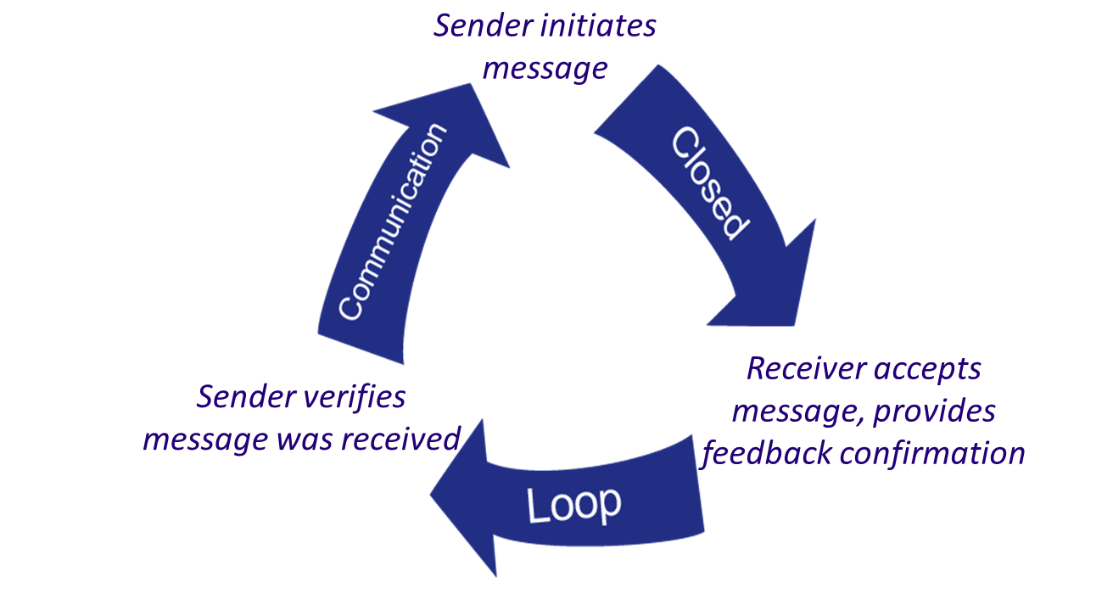
Check-Back^{1,2}
A strategy that ensures that messages are received.

Slide 26

Handoff¹
Transfer of information, along with authority and responsibility, during transitions in care across the continuum
Includes an opportunity to ask questions, clarify, and confirm
Tool used: I PASS the BATON
  Introduction
  Patient
  Assessment
  Situation
  Safety Concern
  Background
  Actions
  Timing
  Ownership
  Next

Slide 27
Situational Awareness¹
When team members have situational awareness,
they—
Know the game plan through briefings and team management (e.g., workload and workflow management, task coordination, policies, and procedures)
Have an understanding of what’s going on and
what is likely to happen next
Check back and verify information
Provide ongoing updates—briefings, callouts, and check-backs
Implement team huddles

Slide 28
Implement Teamwork and Communication: What the Team Needs To Do
Identify opportunities to improve teamwork and communication by reviewing barriers the team identified while learning from a safety defect
Discuss with frontline providers how and where they want to improve communication
Select a tool that best addresses providers’ concerns
Use teamwork and communication tools and incorporate them into team meetings and other relevant project processes

Slide 29

Additional CUSP Tools
Team Checkup Tool
Culture Checkup Tool

Slide 30
Summary
Effective communication plays an integral role in the delivery of high-quality, patient-centered care
Barriers to efficient teamwork and communication influence the outcomes of the unit team
Research supports the connection between communication errors and patient care delivery
CUSP and TeamSTEPPS employ successful tools and strategies that unit teams can implement to improve the effectiveness of teamwork and communication on their units

Slide 31
References
(Adapted from) Dayton E, Henriksen K. Communication failure: basic components, contributing factors, and the call for structure. Joint Commission Journal of Quality and Patient Safety. 2007 Jan;33(1):34-47. PMID: 17283940.
Agency for Healthcare Research and Quality, Department of Defense. TeamSTEPPS. http://www.ahrq.gov/professionals/education/curriculum-tools/teamstepps/index.html.
Joint Commission on Accreditation of Healthcare Organizations. Sentinel Events Statistics. Root Causes of Sentinel Events, 2005. http://www.jointcommission.org/sentinel_event.aspx.
Shortell SM, Marstellar JA, Lin M et al. The role of perceived team effectiveness in improving chronic illness care. Med Care. 2004 Nov; 42:1040-1048. PMID: 15586830.

Slide 32
Disclaimers
Every effort was made to ensure the accuracy and completeness of this resource. However, the U.S. Department of Health and Human Services makes no warranties regarding errors or omissions and assumes no responsibility or liability for loss or damage resulting from the use of information contained within.
The U.S. Department of Health and Human Services cannot endorse, or appear to endorse derivate or excerpted materials, and it cannot be held liable for the content or use of adapted resources. Any adaptations of this resource must include a disclaimer to this effect.
Reference to any specific commercial products, process, service, manufacturer, company, or trademark does not constitute endorsement or recommendation by the U.S. Government, HHS, or AHRQ of the linked Web resources or the information, products, or services contained therein. The Agency does not exercise any control over the content on these sites.

