Slide 1
Sensemaking and Learn From Defects for Perinatal Safety
AHRQ Safety Program for Perinatal Care
AHRQ Publication No. 17-0003-5-EF
May 2017

Slide 2
Learning Objectives

Slide 3
CUSP and Sensemaking Tools¹
CUSP Tools | Sensemaking Tools
Staff Safety Assessment | Discovery Form
Safety Issues Worksheet | Root Cause Analysis
Learn From Defects Form | Failure Mode and Effects Analysis
 | Probabilistic Risk Assessment
 | Causal Tree Worksheet

Slide 4
The Relationship Between CUSP and Sensemaking^{1,2,3}
Concept | CUSP | Sensemaking
Defect or failure identification | Defects | Human/active failure Latent/system conditions
Ways to identify defects or failure | - Staff Safety Assessment - Status of Safety Issues Worksheet | - Discovery Form - Root Cause Analysis - Failure Mode and Effects Analysis - Probabilistic Risk Assessment
Tools to examine defects or failures | Learn From Defects Form | Causal Tree Worksheet
Coding defects or failures | Learn From Defects Form | Eindhoven Model

Slide 5
Identify Defects Overview
Define defects
Identify sources of defects
Apply CUSP tools to identify defects

Slide 6
Sensemaking Overview⁴
A conversation among members of an organization involved in an event/issue
The purpose is to reduce the ambiguity about the event/issue—literally to make sense of it
Each person brings their experience of that event/issue to the discussion
The conversation is the mechanism that combines that knowledge into a new, more understandable form for the members
Members develop a similar representation in their minds that allows for action that can be implemented and understood by all who participated in the conversation

Slide 7
Examples of Defects or Failures That Affect Patient Safety
Defect | Intervention
Medication look-alike | Education conducted, medications physically separated, and letter sent to manufacturer
Missing equipment on cart | Checklist developed for stocking cart
Failure to respond rapidly and appropriately to clinical emergencies | Staff simulation training, use of checklists to guide response

Slide 8
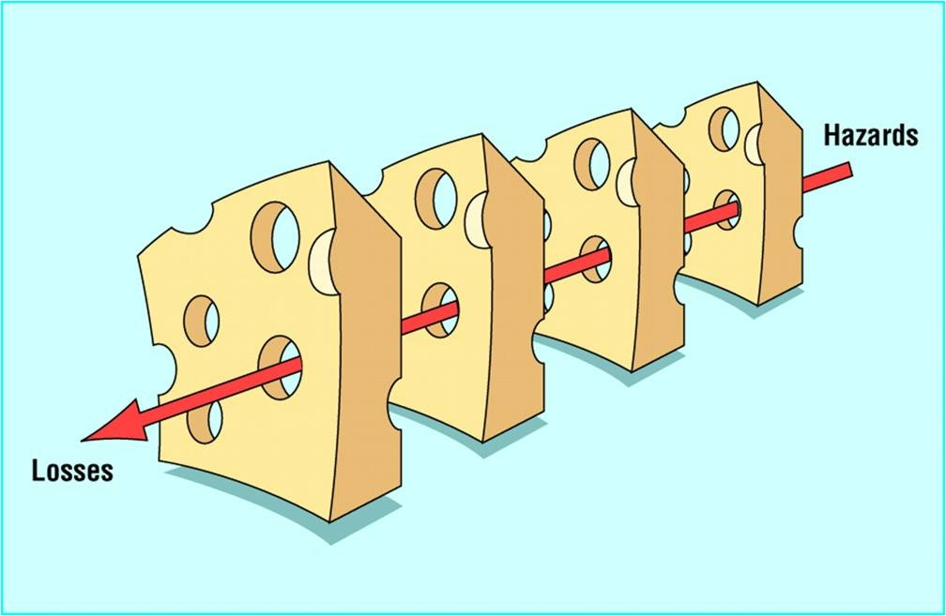
Reason’s Swiss Cheese Model⁵
Excerpted from the “Swiss Cheese” Model. Reason J. Human Error.
Cambridge: University Press; 1990.

Slide 9
Tools for Sensemaking and Learning From Defects

Slide 10
Staff Safety Assessment

Slide 11
Exercise
Please complete the following:
List all defects that have the potential to cause to cause harm
Discuss the three greatest risks
Rank these factors

Slide 12
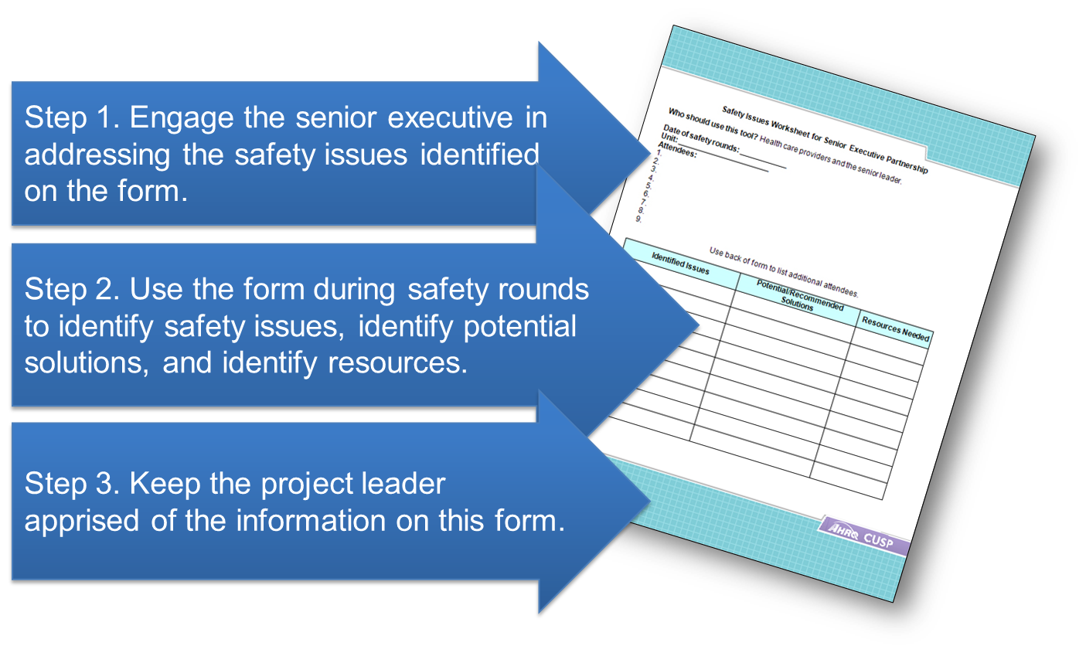
Use the Safety Issues Worksheet for Senior Executive Partnership

Slide 13
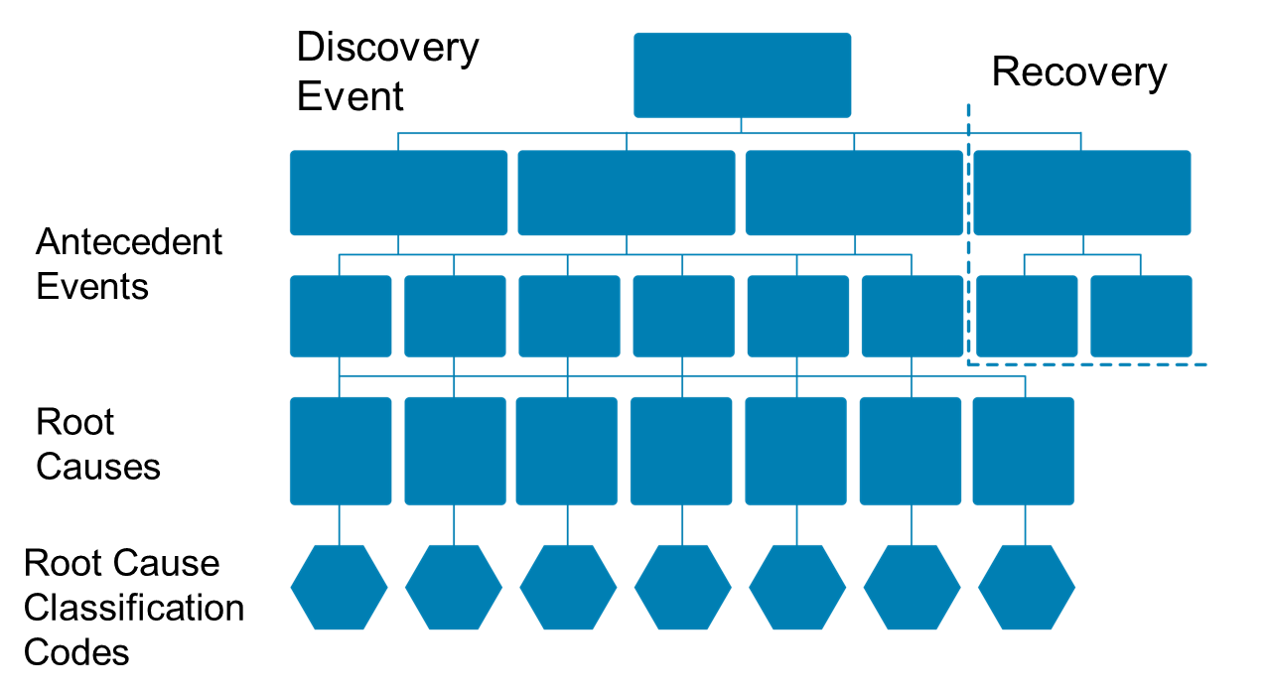
Root Cause Analysis: Causal Tree Worksheet⁶

Slide 14
Learning From Defects Overview
Health care providers are adept at reacting to an event and finding a solution
Providers must also correct the factors that contribute to an event

Slide 15
Exercise
Think of an unexpected situation that you recently encountered
When did you know it was not what you expected?
What were the clues?
What sense did you make of it?

Slide 16
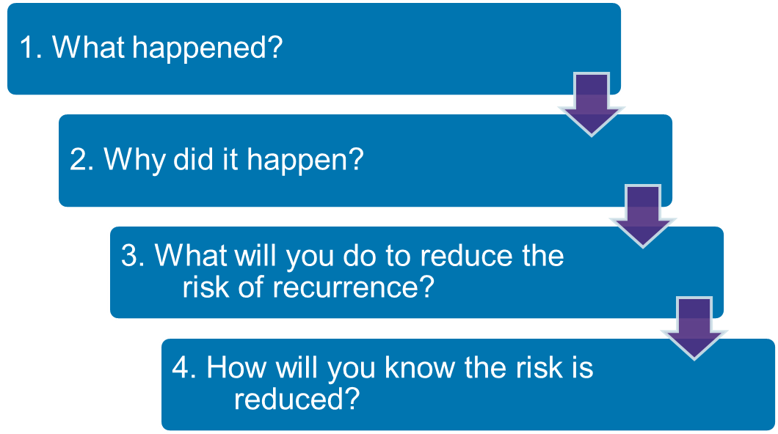
Learning From Defects: Four Questions

Slide 17
Causal Coding: Eindhoven Model⁶
20 separate event cause types in four categories
Technical
Organizational
Human
Other
Aim for three to seven root-cause codes for each event, a mixture of active and latent
All events involve multiple causes

Slide 18
Summarize and Share Findings
Create a one-page summary answering the four Learning From Defects questions
Share the summary within your organization
Engage staff in face-to-face conversations to provide opportunities to learn from defects
Share de-identified information with others in your state collaborative (pending institutional approval)

Slide 19
Communicating the Learning
Meeting to review data—monthly
Meeting with executive partner—monthly or more often
Executive review of data—monthly
Presentations to hospital colleagues as needed, including leadership, frontline staff, and hospital board

Slide 20
Summary: Sensemaking and Learn From Defects
Sensemaking and Learn From Defects share several common themes
Defects or failures are clinical or operational events that you do not want to happen again
CUSP and Sensemaking tools help teams identify defects and identify ways to deter them from occurring in the future

Slide 21
References
Battles JB, Kaplan HS, Van der Schaaf TW, et al. The attributes of medical event-reporting systems: Experience with a prototype medical event-reporting system for transfusion medicine. Arch Pathol Lab Med. 1998 March;122:231-238. PMID: 9823860.
Battles JB, Dixon NM, Borotkanics RJ, et al. Sensemaking of patient safety risks and hazards. Hlth Svcs Res. 2006;41(Aug 4 Pt 2.):1555-75. PMID: 16898979.
Sensemaking. Patient safety analysis training. [Columbia University's Digital Knowledge Ventures is no longer in operation.]

Slide 22
References
Sensemaking. Patient safety analysis training. [Columbia University's Digital Knowledge Ventures is no longer in operation.]
Pronovost PJ, Wu AW, and Sexton JB. Acute Decompensation after Removing a Central Line: Practical Approaches to Increasing Safety in the Intensive Care Unit. Ann Intern Med. 2004 June;140(12):1025-33. PMID: 15197020.
Sensemaking. Patient safety analysis training. [Columbia University's Digital Knowledge Ventures is no longer in operation.]

Slide 23
Disclaimers
Every effort was made to ensure the accuracy and completeness of this resource. However, the U.S. Department of Health and Human Services makes no warranties regarding errors or omissions and assumes no responsibility or liability for loss or damage resulting from the use of information contained within.
The U.S. Department of Health and Human Services cannot endorse, or appear to endorse derivate or excerpted materials, and it cannot be held liable for the content or use of adapted resources. Any adaptations of this resource must include a disclaimer to this effect.
Reference to any specific commercial products, process, service, manufacturer, company, or trademark does not constitute endorsement or recommendation by the U.S. Government, HHS, or AHRQ of the linked Web resources or the information, products, or services contained therein. The Agency does not exercise any control over the content on these sites.

