Slide 1
Understand the Science of Safety for Perinatal Safety
AHRQ Safety Program for Perinatal Care
AHRQ Publication No. 17-0003-4-EF
May 2017

Slide 2
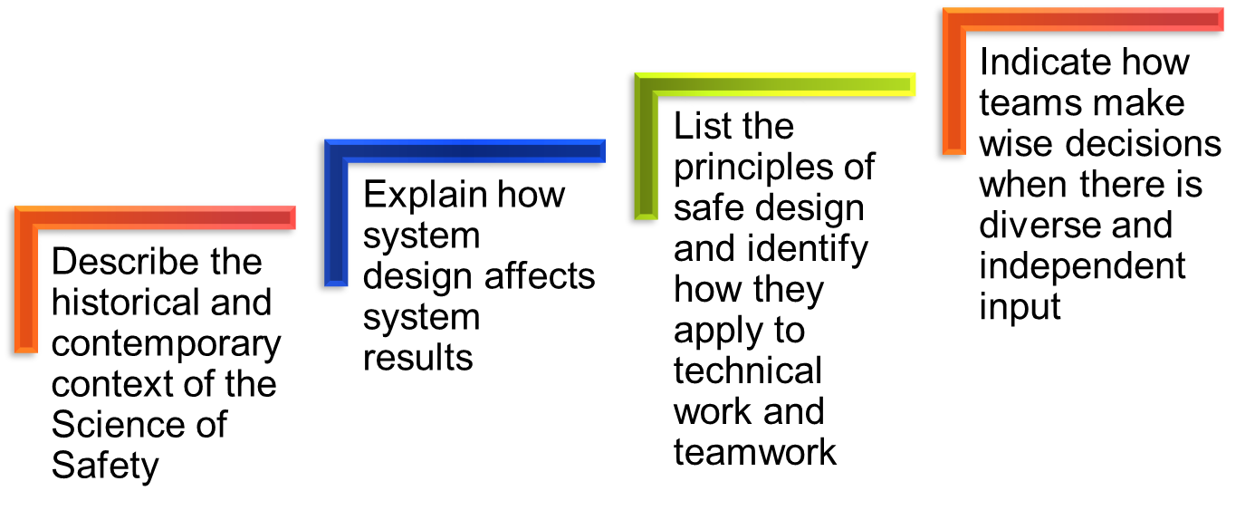
Learning Objectives

Slide 3
Health Care Defects
In the U.S. health care system—
7 percent of patients suffer a medication error¹
In 1999, it was estimated that 44,000 to 99,000 people die in hospitals each year as the result of medical errors²
More recent estimates suggest that between 210,000 and 440,000 patients who go to a hospital each year suffer some type of preventable harm that contributes to their death³
Over half a million patients develop catheter-associated urinary tract infections resulting in 13,000 deaths a year⁴
Nearly 100,000 patients die from health care-associated infections (HAIs) each year, and the cost of HAIs is $28 billion to $33 billion per year⁵

Slide 4

How Can These Errors Happen?
Health care professionals are humans, and humans are fallible
Medicine is still treated as an art, not a science
Systems do not catch mistakes before they reach the patient

Slide 5

The Science of Safety
Every system is perfectly designed to achieve its end results
Safe design principles must be applied to technical work and teamwork
Teams make wise decisions when there
is diverse and independent input

Slide 6
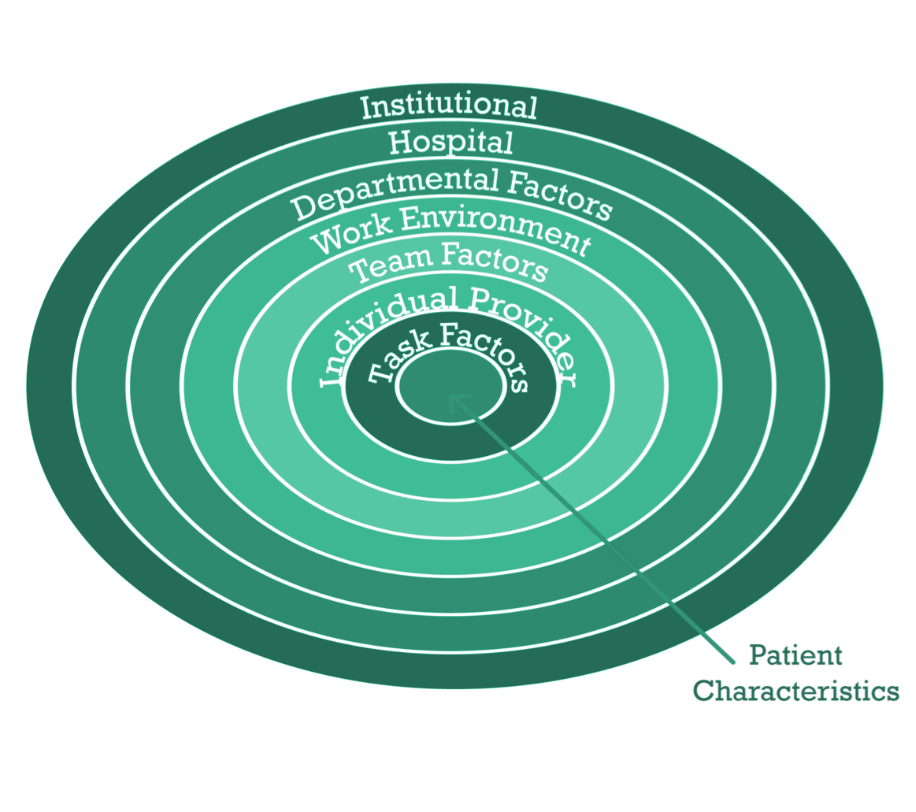
System-Level Factors Affect Safety⁶

Slide 7
System-Level Factors Can Predict Performance
Examples of Impact of System-Level Factors
System Factor | Effect
Nurse-to-patient ratios regularly exceed best practice | When nurse-to-patient ratios regularly exceed best practice based on the unit’s acuity and rate of volume change, there is an increased risk of patient complications.
Hierarchy issues | Disrupted the ability of unit nurses and doctors to work effectively together with respect to labor induction policies. A shift in authority led to a significant drop in the number of reported birth complications.

Slide 8
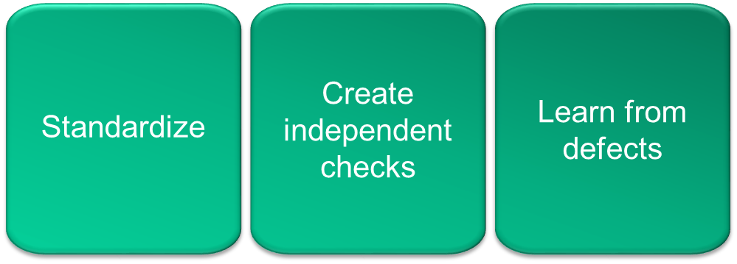
Three Principles of Safe Design

Slide 9

Standardize When You Can
CLICK LINK BELOW TO PLAY VIDEO:
http://www.ahrq.gov/professionals/education/curriculum-tools/cusptoolkit/videos/04c_standardize/index.html

Slide 10
Create Independent Checks
CLICK LINK BELOW TO PLAY VIDEO:
http://www.ahrq.gov/professionals/education/curriculum-tools/cusptoolkit/videos/04d_indchecks/index.html

Slide 11
Learn From Defects
CLICK LINK BELOW TO PLAY VIDEO:
http://www.ahrq.gov/professionals/education/curriculum-tools/cusptoolkit/videos/04e_learndefects/index.html

Slide 12

Principles of Safe Design Apply to Technical Work and Teamwork
CLICK LINK BELOW TO PLAY VIDEO:
http://www.ahrq.gov/professionals/education/curriculum-tools/cusptoolkit/videos/04f_techtmwork/index.html

Slide 13

Teams Make Better Decisions When
There Is Diverse and Independent Input
CLICK LINK BELOW TO PLAY VIDEO:
http://www.ahrq.gov/professionals/education/curriculum-tools/cusptoolkit/videos/04g_diverseinput/index.html

Slide 14
How To Ensure Diverse and Independent Input
Appreciate the wisdom of crowds
  Emphasize that health care is a team effort
  Develop an environment of mutual respect in which frontline providers can voice concerns, and are acknowledged when they express concerns
  Gather as many viewpoints as possible
Alternate between convergent and divergent thinking⁷
  Divergent thinking occurs during brainstorming sessions and when trying to understand what might be occurring
  Convergent thinking occurs while formulating a treatment plan or focusing on a specific task

Slide 15
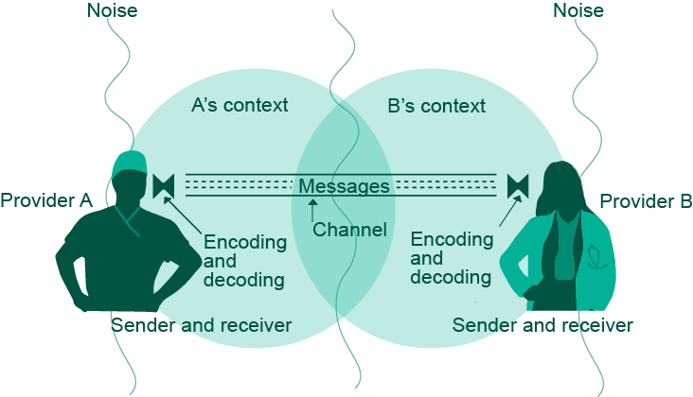
Basic Components and Process of Communication⁸

Slide 16

Understand the Science of Safety:
What the Team Must Do
Develop a plan so all staff on your unit view the Understand the Science of Safety videos
Track staff participation in viewing the videos
Staff should be able to describe the
three principles of safe design:
  Standardize
  Create independent checks
  Learn from defects

Slide 17
Summary
Every system is designed to achieve its end results
The principles of safe design are: standardize when you can, create independent checks, and learn from defects
The principles of safe design apply to technical work and teamwork
Teams make better decisions when there is diverse input

Slide 18
References
Bates DW, Cullen DJ, Laird N, et al. Incidence of adverse drug events and potential adverse drug events. JAMA. 1995;274(1):29–34. PMID: 7791255.
Kohn L, Corrigan J, Donaldson M. To err is human: building a safer health system. Washington, DC: National Academy Press; 1999.
James JT. A New, Evidence-based Estimate of Patient Harms Associated with Hospital Care. J Patient Saf 2013;9:122-128. PMID: 23860193.
Scott, RD. The Direct Medical Costs of Healthcare-Associated Infections in U.S. Hospitals and the Benefits of Prevention. http://www.cdc.gov/HAI/pdfs/hai/Scott_CostPaper.pdf. Accessed October 8, 2014.

Slide 19
References
Klevens M, Edwards J, Richards C, et al. Estimating Health Care-Associated Infections and Deaths in U.S. Hospitals, 2002. PHR. 2007;122:160–166. PMID: 17357358.
Vincent C, Taylor-Adams S, Stanhope N. Framework for analysing risk and safety in clinical medicine. BMJ. 1998;316:1154–57. PMID: 9552960.
Heifetz R. Leadership Without Easy Answers. Cambridge, MA: Harvard University Press; 1994.
Dayton E, Henriksen K. Communication failure: basic components, contributing factors, and the call for structure. Jt Comm J Qual Patient Saf. 2007;33(1):34–47. PMID: 17283940.

Slide 20
Disclaimers
Every effort was made to ensure the accuracy and completeness of this resource. However, the U.S. Department of Health and Human Services makes no warranties regarding errors or omissions and assumes no responsibility or liability for loss or damage resulting from the use of information contained within.
The U.S. Department of Health and Human Services cannot endorse, or appear to endorse derivate or excerpted materials, and it cannot be held liable for the content or use of adapted resources. Any adaptations of this resource must include a disclaimer to this effect.
Reference to any specific commercial products, process, service, manufacturer, company, or trademark does not constitute endorsement or recommendation by the U.S. Government, HHS, or AHRQ of the linked Web resources or the information, products, or services contained therein. The Agency does not exercise any control over the content on these sites.

