Slide 1
Module 2: Senior Leader Engagement

Slide 2
Objectives
Identify characteristics of successful senior leaders
List five practices of effective leaders
Describe the responsibilities of senior leaders
Explain the role of the senior leader in addressing technical and adaptive work
Describe how to engage the senior leadership in the facility’s initiatives and develop shared accountability for the work needed to achieve the facility’s safety goals

Slide 3
What Is Senior Leader Engagement¹?
Listening
Learning
Partnering with staff
Setting team goals
Facilitating progress toward goals
Removing identified barriers

Slide 4
Why Is Senior Leader Engagement Important?
Validates project importance
Demonstrates leadership support to staff and to resident safety
Increases staff motivation and buy-in for project
Provides accountability to project goals

Slide 5
Senior Leadership Characteristics
Senior leader clinical or administrative
Actively engaged
Interest in resident safety
Willing to listen, learn, and work with staff to improve patient safety and the quality of health care delivery in the facility

Slide 6
Models For Leadership²
What does a leader do? | How does a leader do it?
Model the Way | Effective communication
Inspire a Shared Vision | Align efforts and priorities Understand and support the work of change
Challenge the Process | Listen and learn though regular team meetings
Enable Others To Act | Collaborate with others Ensure project accountability
Encourage the Heart | Determine project success Reward and recognition

Slide 7
The Five Practices and
Ten Commitments of Leadership²
Practice | Commitment
Model the Way | 1. Find your voice by clarifying your personal values. 2. Set the example by aligning actions with shared values.
Inspire a Shared Vision | 3. Envision the future by imagining exciting and enabling activities. 4. Enlist others in a common vision by appealing to shared aspirations.
Challenge the Process | 5. Search for opportunities by seeking innovative ways to change, grow and improve. 6. Experiment and take risks by constantly generating small wins and learning from mistakes.
Enable Others to Act | 7. Foster collaboration by promoting cooperative goals and building trust. 8. Strengthen others by sharing power and discretion.
Encourage the Heart | 9. Recognize contributions by showing appreciation for individual excellence. 10. Celebrate the values and victories by creating a spirit of community.

Slide 8
Senior Leader Roles and Responsibilities^{1,3}
Demonstrates improved communication
Aligns effort with other strategic priorities
Understands and supports the technical and adaptive work of change
Meets with the facility team monthly to optimize teamwork
Holds all staff accountable for carrying out agreed-upon activities designed to reduce resident harms
Collaborates with others to develop and implement a plan that addresses the safety issues the facility staff, residents, and family members identify
Supports the process changes through recognition and reward, especially when goals are met
Determines with the facility team members when the project has been successful and assist in hardwiring the process

Slide 9

Model the Way
Clarify values
Set the example

Slide 10
Inspire a Shared Vision⁴
Envision the future
Enlist others in a common vision
Understand and support the work of change
  Technical
  Adaptive

Slide 11
A Shared Vision
PLAY VIDEO:
Video 2.1: Importance of Infection Prevention - https://youtu.be/RblXySGGKG8
Notes:
Video 2.1: Importance of Infection Prevention

Slide 12
Challenge the Process
Seek innovative ways to change, grow, and improve
Learn from mistakes

Slide 13
Enable the Team
PLAY VIDEO:
Video 2.2: Enabling the Team - https://youtu.be/9uL9vWEWAlk
Notes:
Video 2.2: Enabling the Team

Slide 14
Enable Others To Act
Foster collaboration
Strengthen others

Slide 15

A Collaborative Effort
PLAY VIDEO:
Video 2.3: A Collaborative Effort - https://youtu.be/Phd60ZMPs_U
Notes:
Video 2.3: A Collaborative Effort

Slide 16
Encourage the Heart
Recognize contributions and show appreciation
Celebrate the values and victories

Slide 17

An Engaged Team Effort
PLAY VIDEO:
Video 2.5: An Engaged Team Effort - https://youtu.be/sTEtDN9BNuU
Notes:
Video 2.5: An Engaged Team Effort

Slide 18
Tools for Senior Leaders
Staff Safety Assessment
Senior Leader Checklist
Executive Rounds

Slide 19
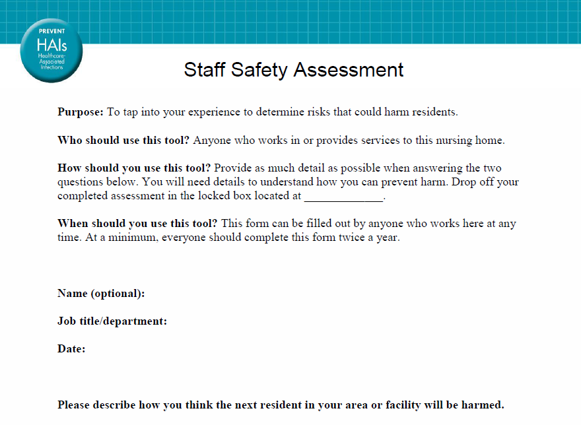
Staff Safety Assessment Tool

Slide 20
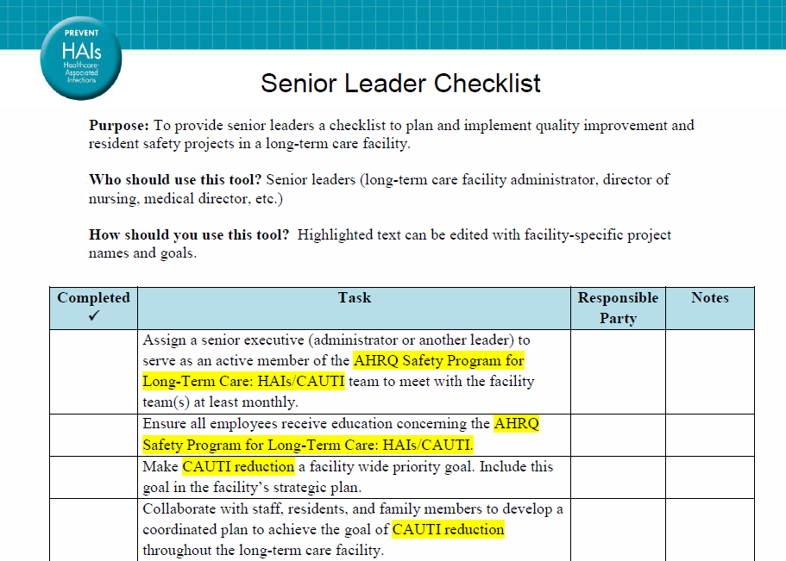
Senior Leader Checklist Tool

Slide 21
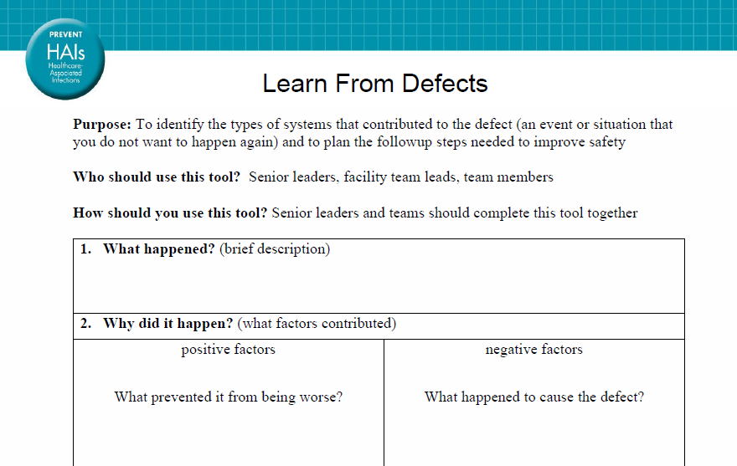
Learn From Defects Tool

Slide 22
Executive Rounds⁶
Structured interactions between hospital leadership and front-line staff
Example of Executive WalkRounds™ from Brigham and Women’s Hospital in Boston, Massachusetts

Slide 23
How To Engage Your Senior Leader and Develop Shared Accountability
Acknowledge the senior leadership’s perspective (“What’s in it for me?”)
  Present the senior leader with the benefits of his or her participation in the project
  Assure the visibility of senior leadership in the improvement work

Slide 24
Engaging your Senior Leader Using the 4 Es for Technical and Adaptive Work⁵
Engage
(adaptive)
How does this make the world a better place?
Senior leaders
Educate
(technical)
What do we need to know?
Execute (adaptive)
What do we need to do? How can we do it with our resources and culture?
Team leaders
Staff
Evaluate (technical)
How do we know we improved safety?

Slide 25
Potential Challenges
Lack of clinical background
Lack of recognition for the value of the initiative
Unavailability to meet regularly with the team

Slide 26
Tools for Engaging Senior Leadership
Brief leadership on the benefit of the program and the purpose of partnering with a senior leader
Express the role and responsibility for the senior leader
Share data on current problems
Ask the senior leader to be prepared to discuss their own safety concerns and suggestions for resolution during rounds and meeting discussions

Slide 27
Action Plan for Engaging Senior Leader
Collect data on current CAUTI rates or other safety concerns
Obtain an appointment to meet with the senior leader for 1 hour
Make a short “presentation” to provide during appointment about what is needed from the senior leader

Slide 28
Exercise
What are some effective ways for leaders to work with staff to facilitate change?
How can you use those methods to address the safety issues you identified in your organization?

Slide 29
Key Concepts Review
Senior leaders are needed to support the change management process
By engaging a senior leader, a facility team can gain a crucial ally in getting the resources needed for change. Senior leaders are essential to –
  Remove barriers
  Obtain assets when needed
  Empower staff to make data-driven decisions and changes

Slide 30
References
Engage the Senior Executive module, CUSP Toolkit. Rockville, MD: Agency for Healthcare Research and Quality. http://www.ahrq.gov/professionals/education/curriculum-tools/cusptoolkit/modules/engage/index.html.
Kouzes JM, Posner BZ. The Leadership Challenge. San Francisco: John Wiley & Sons; 2007.
Bowers N, Nolet K, Roberts, E, et al. Implementing Change in Long-Term Care: A Practical Guide to Transformation. University Wisconsin–Madison, School of Nursing; 2007. https://www.nhqualitycampaign.org/files/Implementation_Manual_Part_1_Attachments_1_and_2.pdf.
Patterson K, Grenny J, McMillan R, et al. Crucial Conversations. New York: McGraw-Hill; 2012.
Pronovost PJ, Berenholtz SM, Goeschel CA, et al. Creating high reliability in health care organizations. Health Services Research. 2006;41(4 pt. 2):1599-1617. PMID: 16898981.
Brigham and Women’s Hospital. Other Patient Safety Initiatives - Safety Matters: Executive WalkRounds, Quality of Patient Care. Boston, MA: Brigham and Women’s Hospital. http://www.brighamandwomens.org/about_bwh/quality/walk_rounds.aspx. Accessed Sept 22, 2014.
Frankel A, Leonard M, Simmonds T, et al. The Essential Guide for Patient Safety Officers. Chicago: Joint Commission Resources with the Institute for Healthcare Improvement; 2008.

