Slide 1
Module 4: Teamwork and Communication

Slide 2
Objectives
Describe effective communication and teamwork
Describe why teamwork training and improved communication optimizes resident safety
List barriers, tools, and strategies to effective teamwork and communication
Describe selected teamwork and communication tools
Review solutions to teamwork and communication challenges

Slide 3
Effective Teamwork and Communication^{1,2}
Teamwork and communication training
decreases medical errors,
improves outcomes and
improves satisfaction (e.g., Resident, Family and Staff), contributing to increased resident safety.

Slide 4
What Is Effective Communication Among Staff?³
Process by which needed information is exchanged between individuals, departments, or organizations
Information needed to keep residents safe should be received, understood as intended, and shared at the appropriate time

Slide 5
Why Is Effective Communication
Among Staff Important?⁴
Contributes to resident safety, which depends on information being relayed to the whole team at the right time
Improves staff satisfaction and morale, potentially lessening staff turnover, which leads to better outcomes

Slide 6

Staff Communication
PLAY VIDEO:
Video 1.1: Staff Communication - https://youtu.be/eL3woSFbsW4
Notes:
Video 1.1: Staff Communication

Slide 7
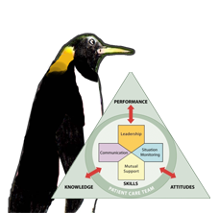
Barriers, Tools and Strategies, and Outcomes for Communication
Barriers | Tools and Strategies | Outcomes
Inconsistency in Team Membership Lack of Time Lack of Information Sharing Hierarchy Defensiveness Conventional Thinking Complacency Varying Communication Styles Conflict Lack of Coordination and Follow-up With Co-Workers Distractions Fatigue Workload Misinterpretation of Cues Lack of Role Clarity | Brief Huddle Debrief STEP Cross-Monitoring Feedback Advocacy and Assertion Two-Challenge Rule CUS DESC Script Collaboration SBAR Call-Out Check-Back Handoff | Shared Mental Model Adaptability Team Orientation Mutual Trust Team Performance Resident Safety!
As seen in TeamSTEPPS Long-Term Care®

Slide 8
TeamSTEPPS Communication Concepts³
Brief
Huddle
Debrief
SBAR
CUS
DESC
As seen in TeamSTEPPS Long-Term Care®

Slide 9
For Planning – The Brief
Facilitates clear and effective communication
Gets the team focused on the goals
Creates a sense of teamwork and collaboration
Fosters an environment where team members can and do speak up if they perceive a problem
Requires active participation by every member of the team
Sets the tone for the day and/or procedure
As seen in TeamSTEPPS Long-Term Care®

Slide 10
Brief Checklist
During the brief, the team should address the following questions:
Who is on the team?
Do all members understand and agree with goals?
Are roles and responsibilities understood?
What is the care plan?
What is the staff and availability throughout the shift?
What is the workload among team members?
What is the availability of resources?
Briefing video located at:
http://www.ahrq.gov/professionals/education/curriculum-tools/teamstepps/longtermcare/video/03brief_ltc/index.html.
As seen in TeamSTEPPS Long-Term Care®
Notes:
TeamSTEPPS Briefing Video
http://www.ahrq.gov/professionals/education/curriculum-tools/teamstepps/longtermcare/video/03brief_ltc/index.html

Slide 11

For Problem Solving – Huddle
Ad hoc planning
Reestablish situation awareness
Reinforce plans already in place
Assess the need to adjust the plan
Huddle video located at:
http://www.ahrq.gov/professionals/education/curriculum-tools/teamstepps/longtermcare/video/04huddle_ltc/index.html.
As seen in TeamSTEPPS Long-Term Care®
Notes:
TeamSTEPPS Huddle Video
http://www.ahrq.gov/professionals/education/curriculum-tools/teamstepps/longtermcare/video/04huddle_ltc/index.html

Slide 12
For Process Improvement – Debrief
Provides opportunity for an informal information exchange session
Designed to improve team performance and effectiveness
Reinforces positive behaviors demonstrated by the team
As seen in TeamSTEPPS Long-Term Care®

Slide 13
Debrief Checklist
The team should address the following questions during a debrief:
Communication clear?
Roles and responsibilities understood?
Situation awareness maintained?
Workload distribution equitable?
Task assistance requested or offered?
Errors made or avoided?
Availability of resources adequate?
Went well, change, improve?
As seen in TeamSTEPPS Long-Term Care®

Slide 14
Communication Tools
PLAY VIDEO:
Video 1.4 Communication Tools - https://youtu.be/ye9d7UchmRI
Notes:
Video 1.4 Communication Tools

Slide 15
For Information Exchange – SBAR
Situation—What is happening with the resident?
Background—What is the clinical background?
Assessment—What do I think the problem is?
Recommendation—What action would I recommend?
As seen in TeamSTEPPS Long-Term Care®

Slide 16
Practicing SBAR³
Situation — What is going on with the resident?
"I am calling about Mrs. Mary Smith, 88 years old, who has had a change in condition. She has a new onset of confusion, has developed a cough, ate very little today, and has been refusing all extra fluids.“
Background — What is the clinical background or context?
"Mrs. Smith has type 2 diabetes, arthritis, osteoporosis, cataracts, stress incontinence, and mild cognitive impairment.“
Assessment — What do I think the problem is?
"She is lethargic but responsive to simple verbal commands. She has a dry cough and on auscultation of her lungs has some rhonchi in the right base. Her urine looked cloudy.“
Recommendation and Request — What would I do to correct it?
"I am wondering if she is starting with a UTI or a respiratory infection. I think she is stable to stay here but should we get a urine sample, chest x ray, or any lab work?"
SBAR video located at: http://www.ahrq.gov/professionals/education/curriculum-tools/teamstepps/longtermcare/video/13sbar_ltc/index.html.
As seen in TeamSTEPPS Long-Term Care®
Notes:
TeamSTEPPS SBAR Video
http://www.ahrq.gov/professionals/education/curriculum-tools/teamstepps/longtermcare/video/13sbar_ltc/index.html

Slide 17
For Information Transfer – Handoffs
Includes the transfer of knowledge and responsibility
Designed to enhance information exchange at critical times
Maintains continuity of care despite changing caregivers and patients
Use I PASS the BATON
as a handoff checklist
As seen in TeamSTEPPS Long-Term Care®

Slide 18
Handoff Tools
I Introduction—Introduce yourself and your role/job (include resident)
P Patient/Resident—Name, identifiers, age, sex, location
A Assessment— Relevant diagnoses and complaints, vital signs and symptoms
S Situation—Current status
S Safety Concerns—Critical lab values/reports, allergies, alerts (falls, isolation, etc.)
THE
B Background—Other diagnoses, previous episodes, current medications, history
A Actions—What actions were taken or are required? Provide brief rationale
T Timing—Level of urgency and explicit timing and prioritization of actions
O Ownership—Who is responsible (nurse/doctor/APRN/nursing assistant)?
N Next—What will happen next? Anticipated changes? What is the plan?
Video located at:
http://www.ahrq.gov/professionals/education/curriculum-tools/teamstepps/longtermcare/video/17ipassthebaton_ltc/index.html.
Notes:
TeamSTEPPS I PASS the BATON Video
http://www.ahrq.gov/professionals/education/curriculum-tools/teamstepps/longtermcare/video/17ipassthebaton_ltc/index.html

Slide 19
Speaking Up Using Structured Language
Use special words that indicate there is a problem
Both the sender and the receiver need to understand these words

Slide 20
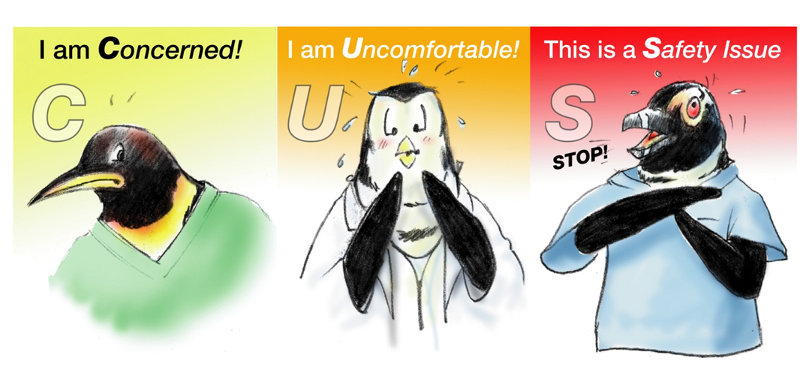
CUS
CUS video located at:
http://www.ahrq.gov/professionals/education/curriculum-tools/teamstepps/longtermcare/video/11cus_sa/index.html.
As seen in TeamSTEPPS Long-Term Care®
Notes:
TeamSTEPPS CUS Video
http://www.ahrq.gov/professionals/education/curriculum-tools/teamstepps/longtermcare/video/11cus_sa/index.html

Slide 21
DESC
Describe the specific situation or behavior; provide concrete data
Express how the situation makes you feel/what your concerns are
Suggest alternatives and seek agreement
Consequences should be stated in terms of impact on established team goals
DESC video located at:
http://www.ahrq.gov/professionals/education/curriculum-tools/teamstepps/longtermcare/video/12descscript_ltc/index.html.
As seen in TeamSTEPPS Long-Term Care®
Notes:
TeamSTEPPS DESC Video
http://www.ahrq.gov/professionals/education/curriculum-tools/teamstepps/longtermcare/video/12descscript_ltc/index.html

Slide 22
Communication Strategies for Use With Residents and Family Members

Slide 23
Why Is It Important?
Positively affect outcomes, perceptions of quality, and resident safety
Residents are more likely to experience higher levels of satisfaction and follow care plans
Leads to better clinical outcomes

Slide 24
What Is Effective Communication Between Staff and Residents and Family?
Complete, clear, brief, and timely
No jargon: using language the residents/families can understand
Making sure they truly understand what is being communicated to them

Slide 25
Communication and Engaging the Family
PLAY VIDEO:
Video 1.2 Communication and Engaging the Family - https://youtu.be/U3gyL_p7FyA
Notes:
Video 1.2 Communication and Engaging the Family

Slide 26
Addressing Challenges
Residents who are impaired in some way
  Hard of hearing
  Dementia
  Language differences
Family members not available
  Logistical challenges
  Frequency of visitation
  Language differences

Slide 27
Barriers to Speaking Up for
Staff, Residents, and Families
Fear of –
  Being embarrassed
  Feeling stupid
  Being ridiculed
  Someone yelling at them
  Being wrong
  Saying something that’s not important
Thinking that –
  “No one will listen anyway”
  “It’s not that important”

Slide 28
Communicating Adverse Events
Adverse event: An injury to a resident caused by medical intervention rather than by the underlying disease or condition of the resident
The mission of frontline care providers is to help and care for residents without harming them, but adverse events happen
When an adverse event occurs, it can be difficult for a care provider to take ownership and communicate with the patient and family
Prompt, compassionate, and honest communication with the resident and family after an adverse event is essential

Slide 29
Disclosure and Apology for Unexpected
Adverse Outcomes
Immediate Response to an Adverse Event | Next Steps in Responding to an Adverse Event
Care for the resident Report to the appropriate parties Communicate with the resident and family (who, what, when, where, and why) Document the event and follow all related facility policy. | Investigation Continued communication with the patient and family Apology and remediation System and process improvement Measurement and evaluation Education and training

Slide 30
How To Communicate About An Adverse Event
Speak slowly and use clear language
Give an advance alert (“I’m afraid I have some news to share with you.”)
Give the news in a few, brief sentences
Quietly wait for the reaction
Watch and listen for response signals

Slide 31
Communication in Action
PLAY VIDEO:
Video 1.3 Communication in Action - https://youtu.be/cavAprwMeG0
Notes:
Video 1.3 Communication in Action

Slide 32
Key Concepts Review
Effective communication involves sending, recurring, verifying, and validating techniques
Using tools, such as TeamSTEPPS, can improve communication and teamwork with staff, residents, and residents’ families
Effective teamwork and communication decreases medical errors, improves outcomes and improves satisfaction for staff, residents and resident’s families
Improved communication and teamwork contributes to resident safety

Slide 33
References
Fuqua RM. Long term care nurses' feelings on communication, teamwork and stress in long term care. Journal of Sociological Research. 2013;4(2):61.
Salas E, Frush K. Improving Patient Safety Through Teamwork And Team Training. Oxford: Oxford University Press; 2012.
TeamSTEPPS Long-Term Care Toolkit. Rockville, MD. Agency for Healthcare Research and Quality; October 2012. http://www.ahrq.gov/professionals/education/curriculum-tools/teamstepps/longtermcare/scenarios/index.html.
CUSP Toolkit. Rockville, MD: Agency for Healthcare Research and Quality; December 2012. http://www.ahrq.gov/professionals/education/curriculum-tools/cusptoolkit/toolkit/index.html.

