Slide 1
Module 5: Resident and Family Engagement

Slide 2
Objectives
Define resident- and family-centered care
Describe the key concepts of resident- and family-centered care in long-term care (LTC) facilities
Explain the importance of engaging residents and family members
Describe different methods to engage residents and family members in safety initiatives, especially in the area of reducing infections due to urinary catheters
Discuss the roles of resident and family advisors and LTC ombudsman programs in nursing homes’ safety teams

Slide 3
Resident- and Family-Centered Care

Slide 4
What Is Resident- and Family-Centered Care?^{1,2}
A philosophy that keeps the person, the resident and their family, at the center of every decision-making process
A focus assuring residents’ preferences are valued and respected
Care that reflects dignity and respect, information sharing, participation and collaboration

Slide 5
What Does Person-Centered Care Look Like?³
Eliminating the assembly-line approach to care and embracing a philosophy of residents as individuals
Improving the quality of care and quality of life for residents by accommodating resident choices and preferences
Equipping staff with relevant knowledge and decision-making authority so they can effectively engage residents as partners in safety
Collaborating with resident advisors, advocates, and long-term care ombudsman programs at all levels

Slide 6
Comparing Traditional Care to
Person-Centered Care¹
Traditional Care | Person-Centered Care
Decisions about policies, procedures, and work environment are made exclusively by management. | Management works with staff, residents, and family members to accommodate resident choice and preferences.
Frontline staff are not involved in the decision-making process. | Staff are empowered with relevant knowledge and included in the decision-making process.
Traditional medical model where care is driven by diagnosis, care tasks, and the individuals who perform the tasks. | Residents are given choice and input around their care and care plan based on their needs and preferences.

Slide 7
Benefits For Residents and Families¹
Having personal autonomy and the ability to direct care
Being offered choices that foster engagement and improve quality of life
Living in an environment that promotes trust and respect
Collaborating with staff who are attuned to resident preferences and needs and who will respond appropriately to the resident’s preferences
The opportunity to achieve the best quality of life possible

Slide 8
Benefits for Staff¹
Establishing better partnerships with residents and their families
Understanding resident preferences makes staff better equipped to anticipate resident and family needs and act accordingly
Feeling valued in person-centered care organizations

Slide 9
Benefits for the Long-Term Care Facility¹
Increased ability of staff to identify and respond appropriately to changes in a resident’s condition
Increased referrals from people who have a good experience and recommend the nursing home to others as a place for care
Increased staff retention due to a strong relationship between staff and residents

Slide 10

Residents' Preference Satisfaction Interviews⁴
Use a preference collection tool to increase the facility’s understanding of what their residents desire for their care.
See the Advancing Excellence Campaign for more information on their Resident Preference Satisfaction Interview tool.

Slide 11
Resident and Family Engagement

Slide 12
What Is Resident and Family Engagement?⁵
Resident and family engagement—
  Is an important component of person-centered care
  creates an environment in which every team member, including the resident and their family, can work as partners to improve health care quality and safety.
Recognizes residents and family as —
  Valuable members of the health care team

Slide 13
Importance of Resident and Family Engagement¹
Outcomes associated with enhanced resident and family engagement
  higher resident satisfaction
  better clinical outcomes
  higher staff satisfaction

Slide 14
How To Engage Residents and Families⁵
Establish positive relationships with residents and family
Focus on the needs and preferences of individual residents and family
Encourage resident and family participation in all decisions
Communicate that resident- and family-centered care is a priority at all levels

Slide 15
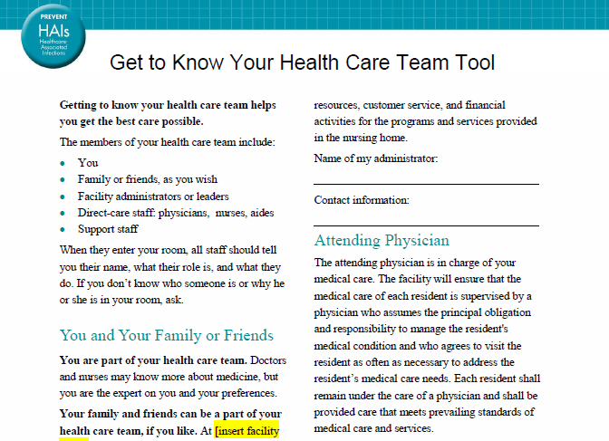
Get to Know Your Health Care Team Tool

Slide 16

Establishing a Relationship
PLAY VIDEO:
Video 1.1: Staff Communication - https://youtu.be/eL3woSFbsW4
Notes:
Video 1.1: Staff Communication

Slide 17
Understanding Resident Preferences^{1,5}
What are the resident’s likes and dislikes?
Does staff have the authority to do something about the residents’ preferences?
Are staff members allowed time to sit with residents and have meaningful conversation?

Slide 18
Encourage Participation in Care Planning
Encourage residents and their families to participate in all aspects of care
Assess the residents’ preferences regarding their involvement
Listen for the needs and preference of residents and their families
Give residents and families access to information they need in a way they can understand it
Document specific preferences in care plans so resident preferences can be shared with all staff

Slide 19
Communication and Engaging the Family
PLAY VIDEO:
Video 1.2 Communication and Engaging the Family - https://youtu.be/U3gyL_p7FyA
Notes:
Video 1.2 Communication and Engaging the Family

Slide 20
Listening to the Resident and Family
Ask about and listen to the resident and family’s needs and concerns
  Use open-ended questions
  Listen to, respect, and act on what the resident and family say
  Help residents articulate concerns
  Get a translator’s assistance if the resident or family member cannot understand you (e.g., speaks primary language other than English)
  Share specific preference information with everyone on the care team

Slide 21
Explaining Care Plans
Help the resident and family understand health concerns, care plans and next steps in their care
  Take every opportunity to educate the resident and family by giving timely and complete information in a way they can understand it
  Share information using language or tools that resident can understand
  Invite the resident or family to take notes and ask questions
  Follow up with the resident and family to see if they understood the information or have additional questions

Slide 22
Explaining Care Plans
PLAY VIDEO:
Video 1.3 Communication in Action - https://youtu.be/cavAprwMeG0
Notes:
Video 1.3 Communication in Action

Slide 23
Explaining How We Are Changing To Improve Care⁶
Residents and their family members need to know what changes are coming, when the changes will be implemented, and how these changes may impact services and routines
Staff can also discuss how change can be difficult and that all improvements involve some change

Slide 24
Questions That You Answer⁶
WHY are you making these changes?
HOW will the changes impact the entire facility?
HOW will the changes impact me, as a resident?
HOW will the changes impact me, as a family member?
WHEN will the changes be implemented?

Slide 25
Communication Tools⁶
Newsletter articles
Town hall meetings
Resident or family council meetings
Care conferences
Posters
Individual meetings
Local newspaper or TV news station stories

Slide 26
New Ideas for Communicating⁶
Ask frontline staff to introduce the project through word, song, dance, drama, etc.
Put explanations in bills or other family or resident mailings
Create talking points to help staff respond to questions about any changes

Slide 27
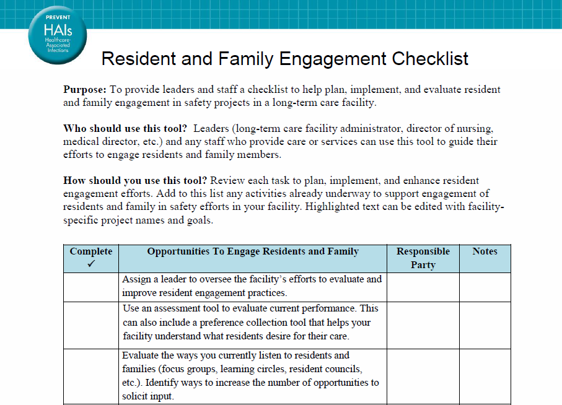
Resident and Family Engagement Checklist

Slide 28
Challenges to Communication
It can be challenging to communicate with residents who may be hard of hearing or have dementia or language differences
It can also be difficult to communicate with family members due to logistical challenges, frequency of visits, or language differences
Staff can have challenges with communication due to limited experience, skills, or confidence

Slide 29
How To Address Communication Challenges
Ask how the resident and family prefer to receive information
Use face-to-face communication to promote visual contact
Use written materials to provide residents useful content
Plan for repetition of the information in multiple interactions and formats
Use teach back to confirm understanding

Slide 30
Engagement Using Resident and Family Advisers⁷
Residents and their family members can serve as advisors
Residents, family members, and prospective residents can serve on teams designated to improve resident experience, including resident safety
Resident and family advisors provide unique feedback, input, and perspectives that can help the facility and staff improve outcomes

Slide 31
Resident and Family Advisers in Nursing Homes⁷
Are partners on teams developing or revising policies, procedures, and practices
Want to improve experiences for other residents and family members
Help facilities improve quality and safety by giving input and feedback
Can help identify changes that matter to other residents and family members and recognize the impact of changes in the facility on staff and residents

Slide 32
Characteristics of an Engaged Adviser⁷
An engaged advisor will—
  Listen
  Share honest views
  Draw on communication skills
  Ask questions
  Be ready for disagreements

Slide 33
How To Work With Resident and Family Advisers⁷
Invite two or three residents and family members to a team meeting to discuss their experiences
Ask residents and families to give feedback on educational or informational materials
Invite residents and families to present at staff orientations and in-service programs
Explore the facility through the eyes of residents and their families by doing a “walk-about” with residents and families

Slide 34

How To Work with Resident and Family Advisers
PLAY VIDEO:
Video 1.4 Communication Tools - https://youtu.be/ye9d7UchmRI
Notes:
Video 1.4 Communication Tools

Slide 35
Long-Term Care Ombudsman Program⁸
Long-term care ombudsman serve as advocates for residents of nursing homes and—
  Help to resolve problems and assist with complaints
  Educate LTC providers about residents’ rights and quality care practices
  Advocate for residents' rights and quality care in nursing homes, personal care, residential care, and other long-term care facilities
  Promote the development of citizen organizations, family councils, and resident councils
More information can be accessed on the National Long-Term Care Ombudsman Resource Center Web site.

Slide 36
Key Concepts Review
Resident-centered care and effective engagement among residents and family members and care providers improves health outcomes and resident and family satisfaction
Advisors and long-term care ombudsman programs provide valuable insight about resident and family experiences and care delivery

Slide 37
Tools
For staff, facilities, residents and families
  Get to know your Health Care Team Tool
  Resident and Family Engagement Checklist
  Residents' Preference Satisfaction Interviews from Advancing Excellence in America’s Nursing Homes⁴
  National Long-Term Care Ombudsmen Resource Center Web site

Slide 38
References
Bowers N, Nolet K, Roberts, E, et al. Implementing Change in Long-Term Care: A Practical Guide to Transformation. University of Wisconsin–Madison, School of Nursing; 2007. https://www.nhqualitycampaign.org/files/Implementation_Manual_Part_1_Attachments_1_and_2.pdf. Accessed September 22, 2014.
Institute for Patient and Family Centered Care. Bethesda, MD; December 2010. http://www.ipfcc.org/faq.html. Accessed September 22, 2014.
Love K. Person-Centered Care in Assisted Living: An Informational Guide. Center for Excellence in Assisted Living; June 2010. http://www.theceal.org/component/k2/item/644-person-centered-care-in-assisted-living-an-informational-guide. Accessed September 22, 2014.
Advancing Excellence in America’s Nursing Homes. Person-Centered Care. Advancing Excellence in America’s Nursing Homes. https://www.nhqualitycampaign.org/goalDetail.aspx?g=PCC#tab2. Accessed November 11, 2014.
Frampton S, Gil H, Guastello S, et al. Long-Term Care Improvement Guide, Planetree, Inc: Derby, CT; 2010. http://planetree.org/wp-content/uploads/2011/12/LTC-Improvement-Guide-For-Download.pdf. Accessed September 22, 2014.
Turnham H. Resident and Family Centered Care. AHRQ Safety Program for Long-Term Care: CAUTI, July Content Webinar; July 2014.
Patient and Family Engagement module, CUSP Toolkit. Rockville, MD: Agency for Healthcare Research and Quality; December 2012. http://www.ahrq.gov/professionals/education/curriculum-tools/cusptoolkit/modules/patfamilyengagement/index.html. Accessed September 22, 2014.
National Long-Term Care Ombudsman Resource Center. About Ombudsmen. Washington, D.C.: National Long-Term Care Ombudsmen Resource Center. http://www.ltcombudsman.org/about-ombudsmen. Accessed September 22, 2014.

