Slide 1
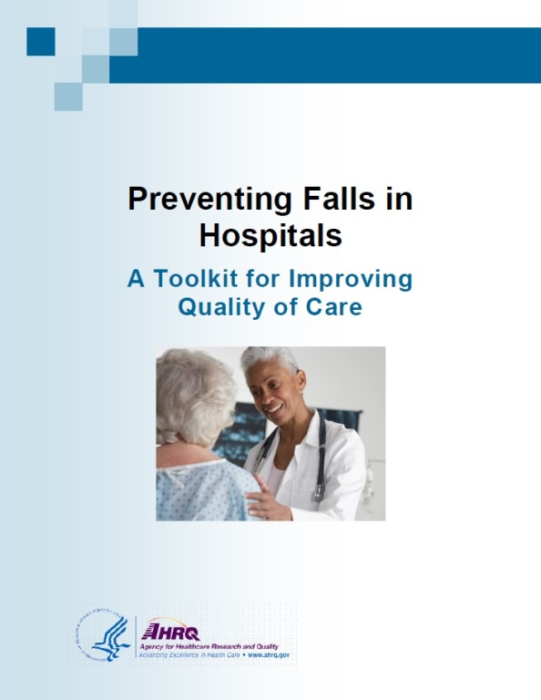
Preventing Falls in Hospitals
ADD Hospital Name Here
Module 1

Slide 2

Ice Breaker
Describe an interesting fact about yourself.

Slide 3

Compelling Reasons To Implement Program
Falls are common.
  They are the most frequently reported incident in adult inpatient units.
  The rate of falls ranges from 1.3 to 8.9 falls per 1,000 patient days or bed days.
  Module 5 will discuss how to measure fall rates.

Slide 4
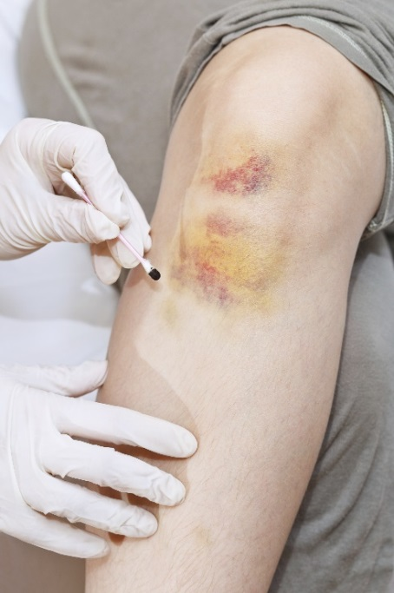
Compelling Reasons To Implement Program
Falls increase costs, which are associated with:
  Increased length of stay.
  Additional costs ($14,000 on average).
  Higher rates of discharge to nursing homes.
Medicare won’t pay for
increased costs due to injury
from inpatient falls.
Falls harm patients.
  30% to 51% of falls result in injury.
Many falls are preventable.

Slide 5
Compelling Reasons To Implement Program
Multicomponent fall prevention programs reduce falls.
  Systematic reviews show that fall prevention programs result in statistically and clinically significant reductions in fall rates.
  A 27% to 31% decrease in fall rates was found.
Miake-Lye IM, Hempel S, Ganz D, et al., 2013

Slide 6
Are You Ready To Change?
Do organizational members understand why change is needed? (Tool 1A)
Is there urgency to change? (Tool 1B)
Does senior leadership support this initiative? (Tools 1C, 1D)
Who will take ownership of this effort?
What resources are needed? (Tools 1E, 1F)

Slide 7

Practice Insight
Value of Pre-Assessment Tools

Slide 8
Implementation Training Objectives
Educate hospital leadership and Implementation Team on the Preventing Falls in Hospitals Toolkit to facilitate the change process in hospitals.
Develop hospital-specific action plans for implementing a Fall Prevention Program using the Toolkit.
Address specific challenges of preventing falls in your hospital.
Use and adapt the tools and resources to implement the Fall Prevention Program.

Slide 9
Today’s Group Dynamics
Your Implementation Team Leader (or the designee) will present assessments of your hospital’s current procedures and policies.
Everyone here plays an important role.
  We encourage everyone to participate in planning activities.

Slide 10
Today’s Group Dynamics
“Parking lot” to capture your ideas:
  We’ll try to address your comments. We may need to address them later during the Implementation Phase.
Much ground to cover today:
  We will follow the timeframe listed on the agenda.

Slide 11
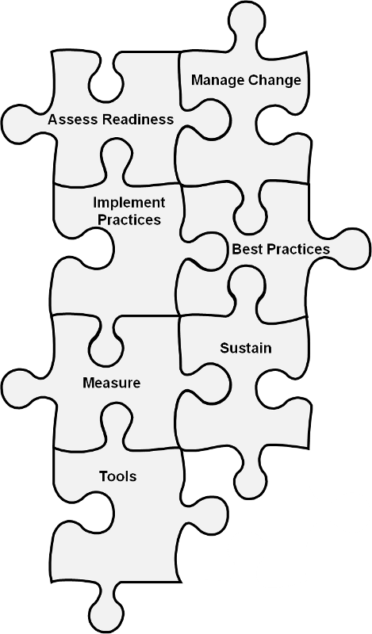
Implementation Training
The Toolkit focuses on:
Reducing falls during a patient’s hospital stay.
Successfully negotiating a change process at your hospital.

Slide 12

Preventing Falls in Hospitals Toolkit
Toolkit Sections:
Is your hospital ready for this change?
How will you manage change?
Which practices do you want to use?
How do you implement best practices?
How do you measure fall rates and prevention practices?
How do you sustain an effective Fall Prevention Program?

Slide 13

Toolkit Approach
The Toolkit is focused on an interdisciplinary approach.
  This approach pulls staff members from many areas with needed expertise to address the problem.
  No clinician working alone can prevent falls.
  Fall prevention requires active
  engagement of multiple
  disciplines and teams that
  care for the patient.

Slide 14
Toolkit Approach
The Toolkit includes accurate, evidence-based, and effective risk assessments that call for:
  Critical thinking and clinical judgment.
  Consistency in approach.
  Identifying and communicating risk at the earliest possible time.

Slide 15

Toolkit Approach
The Toolkit focuses on optimizing the effectiveness of interventions by:
  Tailoring interventions to address individual risk factors.
  Assessing their effectiveness.
  Modifying interventions as appropriate.

Slide 16
Sustainment
“Holding the gains and evolving as required, definitely not going back to the old way.”
Maher L, 2013
Maher L, 2012

Slide 17
When Should We Worry About
Sustaining the Gains?
Actions to ensure sustainability must start at the beginning of a project.
If you leave it to the end, it will be too late to make any changes that are needed to maximize the potential of sustainability.
It is very important to ensure that you have things in place from the beginning to achieve and sustain the best improvement outcome you can.

Slide 18
Steps to Sustainability
Your Journey
Managing Change Checklist
Implementation Team composition
Team Leader has been identified and is in place.
Members with necessary expertise/role have been identified/invited.
Linkage to senior leadership has been defined and established.
Team startup
Team agenda and charge are clearly stated.
Team has necessary training and resources to get started.
Current state of fall prevention practice and knowledge
Current practice and policies have been systematically examined.
Challenges to good practice have been identified at organization and unit levels.
Staff knowledge has been assessed.
Starting the work of redesign
Approaches to redesign have been explored and chosen.
Gap analysis has been conducted between current practice and recommended practice.
Setting goals and plans for change
Specific goals have been set.
A plan for making changes to meet those goals has been initiated.
A preliminary plan for sustaining the changes is in place.
Source: AHRQ Preventing Falls in Hospitals Toolkit

Slide 19
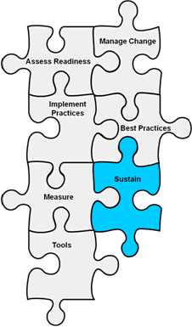
Sustaining Change
Sustain: Changes need to become so integrated into existing organizational structures and routines that they are no longer noticed as separate from business as usual.

Slide 20
High-Reliability Organizations
High-reliability organizations:
  Provide consistent performance at high levels of safety over long periods of time.
  Practice “collective mindfulness,” understanding that even small failures in safety protocols or processes can lead to catastrophic or adverse events if action is not taken to solve the problem.
  Eliminate deficiencies in safety processes through the use of powerful tools to improve their processes.
  Create an organizational culture that focuses on safety; they are constantly aware of the possibility of failure.
  Chassin MR, Loeb JM, 2013
  Chassin MR, Loeb JM, 2011

Slide 21
Components of Sustainability
Four key strategies:
  Engage Leadership
  Measure Continuously/Evaluate for Change
  Collaborate With All Disciplines
  Hardwire Practices and Educate

Slide 22

Leadership Engagement
High-level senior leadership buy-in
Designated fall prevention Implementation Team Leader
Designated fall prevention
Implementation Committee/ Interdisciplinary Team

Slide 23
Engage Leaders
It is the right thing to do—patient stories, their stories.
WIFM: What’s in it for me/them?
  Cost avoidance estimation
  Patient throughput
  Turnover reduction
Leaders: Alignment of improvement efforts and organizational priorities
Senior executives: Rounding on units
Duval-Arnould J, Mathews SC, Weeks K, et al., 2012
Waters HR, Korn R Jr, Colantuoni E, et al., 2011

Slide 24
Engage Leaders
Leadership support:
  Seek vice president or higher.
  Engage support for Team’s work.
  Rounding on unit—be purposeful.
    Script the rounds.
      How will the next patient in this unit be harmed?
      How can I help to remove barriers so that the safety defects we are most concerned about can be better addressed?
      How well does teamwork occur on this unit?
      What doesn’t work well?
    Use learning board as unit’s meeting point.
    Sexton JB, 2010

Slide 25
Practice Insight
Increase Leadership Buy-in

Slide 26
Components of Sustainability
Four key strategies:
  Engage Leadership
  Measure Continuously/Evaluate for Change
    Harness the power of local data to drive improvement efforts.
    Track prevention practices.
    Learn from defects.
  Collaborate With All Disciplines
  Hardwire Practices and Educate

Slide 27
Using Data for Continued Improvement
Continue to collect process and outcome data.
Set targets for process and outcome data.
Gather information from defects.
Use the data to identify opportunities and hardwire practices.
Share data with:
  Improvement Team.
  Frontline staff.
  Leadership.

Slide 28
Annotated Run Chart

Slide 29
Components of Sustainability
Four key strategies:
  Engage Leadership
  Measure Continuously/Evaluate for Change
  Collaborate With All Disciplines
      Collaborate with multiple disciplines.
      Identify physician and nurse champions.
      Tap into the wisdom of the frontline staff.
  Hardwire Practices and Educate

Slide 30

Sustainable Collaboration
Senior leadership support is important, but change comes most effectively from frontline staff. Tap into their wisdom.
Multidisciplinary collaboration is essential to carrying out fall prevention.
Gaining buy-in from all involved
results in shared ownership of
positive prevention results.

Slide 31
Sustainable Collaboration
The fall prevention group should:
  Continue to meet (or merge with an existing group).
  Report up through a quality structure.
  Have a vision with clearly defined goals and an associated Action Plan. (Update every 6-12 months.)
The Team and its goals should be:
  Aligned with its organization’s goals of preventing harm.
  Part of the dashboard.

Slide 32
Components of Sustainability
Four key strategies:
  Engage Leadership
  Measure Continuously
  Collaborate With All Disciplines
  Hardwire Practices and Educate
    Standardize care: prevention practices.
    Include practices in patients’ daily goals.
    Train new staff in evidence-based prevention practices.

Slide 33

Resource Needs Assessment
1E: Resource Needs Assessment
Background: The purpose of this tool is to identify resources that are available for a fall prevention program.
Reference: Developed by Falls Toolkit Research Team.
How to use this tool: Complete this checklist to assess the resources that are available and the resources that are still needed. This assessment is best suited for hospital supervisors, managers, and administrators.
Use this tool to ensure that all resources needed for launching a fall prevention program are available.
Filled out by Implementation Team Leader with support from hospital supervisors, managers, and administrators
Resource | Needed: Yes/No | Notes on what is needed
Staff education programs
Quality improvement experts
Physical/occupational therapy consultation on work practices
Information technology support
Specific products/tools (e.g., low beds, floormats, assistive devices, safe patient handling equipment)
Facilities and supplies (e.g., meeting rooms)
Printing/copying
Graphics/design
Nonclinical time for team meetings and activities
Other
Funds
Tool 1E

Slide 34
Resource Needs Assessment Results
Team Leaders: Let’s share results of this assessment for your organization.

Slide 35


Team Charge
Implement a Fall Prevention Program within
8-10 months.

Slide 36
References
Chassin MR, Loeb JM. High-reliability health care: getting there from here. Milbank Q 2013 Sep;91(3):459-90. https://www.ncbi.nlm.nih.gov/pmc/articles/PMC3790522/. Accessed June 16, 2017.
Chassin MR, Loeb JM. The ongoing quality improvement journey: next stop, high reliability. Health Aff (Millwood) 2011 Apr;30(4):559-68. http://content.healthaffairs.org/content/30/4/559.long. Accessed June 16, 2017.
Duval-Arnould J, Mathews SC, Weeks K, et al. Using the Opportunity Estimator tool to improve engagement in a quality and safety intervention. Jt Comm J Qual Patient Saf 2012 Jan;38(1):41-7,1.
Maher L. Starting for Success. Partners In Care Programme: Webcall One. Health Quality & Safety Commission New Zealand. Counties Manukau Health. 2013. https://www.hqsc.govt.nz/assets/Consumer-Engagement/Partners-in-Care-Resource-page/Webex-1-starting-for-success-Oct-2013.ppt. Accessed June 16, 2017.
Maher L. Welcome to the Partners In Care Webex 6 – 3 October 2012. Health Quality & Safety Commission New Zealand. NHS. https://www.hqsc.govt.nz/assets/Consumer-Engagement/Partners-in-Care-Resource-page/Sharing-Partner-in-Care-Webex-6-Oct-2012.ppt. Accessed June 16, 2017.
Miake-Lye IM, Hempel S, Ganz D, et al. Chapter 19. Preventing in-facility falls. In: Making Health Care Safer II: An Updated Critical Analysis of the Evidence for Patient Safety Practices. Rockville, MD: Agency for Healthcare Research and Quality; March 2013. https://www.ncbi.nlm.nih.gov/books/NBK133389/. Accessed June 15, 2017.
Sexton JB. Engaging Leaders Webinar. 2010.
Waters HR, Korn R Jr, Colantuoni E, et al. The business case for quality: economic analysis of the Michigan Keystone Patient Safety Program in ICUs. Am J Med Qual 2011 Sep-Oct;26(5):333-9.

