Slide 1
How To Manage Change
ADD Hospital Name Here
Module 2

Slide 2
QI Change Process
Change process strategies can be applied to other quality improvement efforts:
Hospital-acquired pressure injuries
Catheter-associated urinary tract infections
Deep vein thrombosis or pulmonary embolism following knee and/or hip replacement
Blood incompatibility

Slide 3
Module 2 Goals
Identify actions needed to improve organizational readiness.
Maximize the possibility of successful implementation by addressing these questions:
How can you set up the Implementation Team for success?
What needs to change, and how do you redesign practice?
How should goals and plans for change be developed?
How do you bring staff into the process?

Slide 4
Expected Outcomes of Module 2
Finalize Implementation Team members and assign roles. (Tool 2A)
Present the completed process analysis on one patient care unit. (Tool 2C)
Present the assessment of current fall prevention policies and procedures. (Tool 2D)
Team Leader or designee completes assessment and folds recommendations into the Action Plan.

Slide 5
Expected Outcomes
Begin to write a draft fall prevention Action Plan, tailored to your hospital.

Slide 6
Implementation Team Guidelines
How often will you meet?
What are the ground rules for managing meeting time and communication?
How will you communicate with each other?
How will you communicate successes?
How will the Team do its work?
Small group work
Working meetings

Slide 7
Finalize Team Members
The first goal is to finalize the Implementation Team members and assign roles.

Slide 8
Successful Implementation Team
A strong link to hospital leadership
Members with the needed expertise (Tool 2A)
Access to resources needed to accomplish the aim
Links to quality improvement expertise
Members who influence the areas involved in fall prevention

Slide 9
Interdisciplinary Team
Tool 2A
Part 1: Team Members – You are the core Implementation Team
Position/Discipline | Names of Possible Implementation Team Members From Each Area | Area of Expertise
Nursing
Staff nurses
Nursing assistants
Rehabilitation
Physical therapists
Occupational therapists
Prescribing Clinicians
Physicians (e.g., hospitalist)
Other providers (e.g., nurse practitioner or physician assistant)
Pharmacy
Pharmacists
Facilities and Environment
Materials manager
Environmental services staff
Facilities engineer
Managers
Senior manager
Quality improvement/safety/risk manager
Reference: Developed by Falls Toolkit Research Team.

Slide 10
QI Process
Link the Fall Prevention Program with quality improvement.
This information helps you define resources your hospital has for quality improvement.
Plan, Do, Study, Act (PDSA) is one systematic approach to analysis and implementation.
Tool 2B
Page 21

Slide 11
QI Process
Your Implementation Team Leader has filled out many assessment forms already.
We’ll be working to find solutions for positive change.
Let’s hear from your Implementation Team Leader now about your hospital’s QI program and how to link with QI.

Slide 12
Assess Current Prevention Processes
Use process mapping to examine key processes on selected units.
Analyze the process maps.
Do your processes incorporate best practices? (See Module 3.)
Which practices need changing?
How should processes be changed to build in the new practices?
Tool 2C

Slide 13
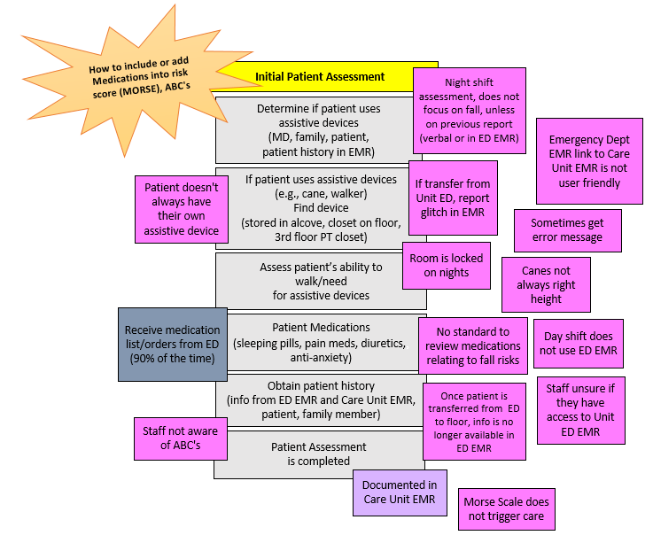
Process Map Example 1

Slide 14
Process Map Example 2

Slide 15
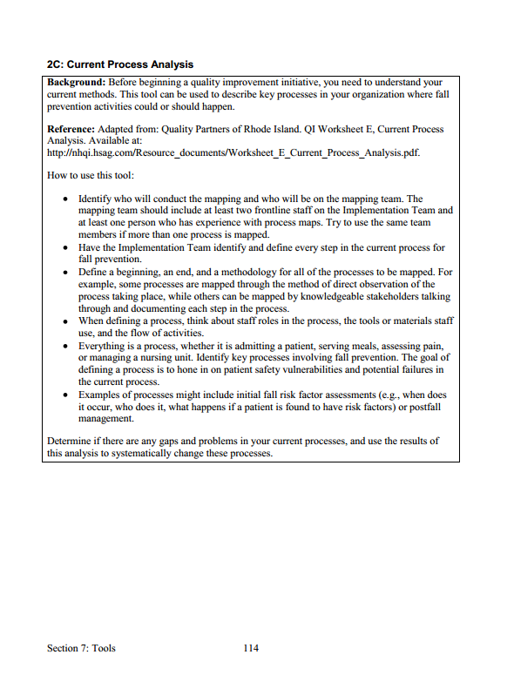
Current Process Analysis
Tool 2C

Slide 16
Current Process Analysis
Let’s hear from the Team members who completed the process analysis.
Share process analysis from the unit.
Point out key processes being used.

Slide 17
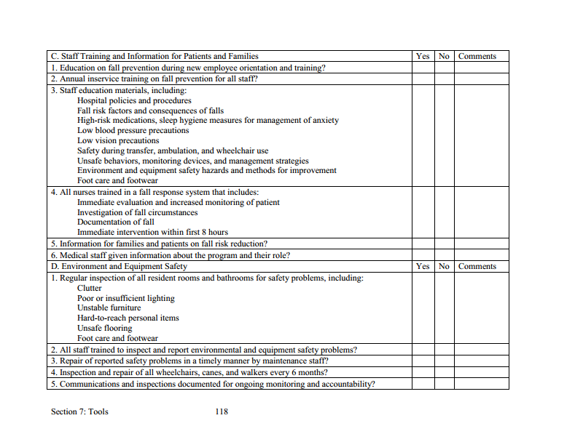
Fall Prevention Policies/Practices
Tool 2D

Slide 18
Assess Current Policies
The Implementation Team Leader identified the policies in place and areas for improvement.
You’ll want to address these areas in the Action Plan.
Then, we will compare this assessment with best practices in Module 3.
A group you designate may opt to do further fine tuning at a later time.
Let’s look at the completed Tool 2D now.

Slide 19
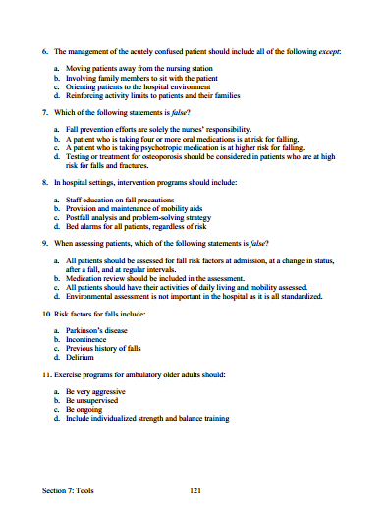
Fall Knowledge Test
Tool 2E

Slide 20
Staff Knowledge Assessment
Who will administer Tool 2E?
How will it be administered?
Who will be in charge of assessing the results?

Slide 21
Implementation Action Plan
The implementation Action Plan for change should address the following:
Membership and operation of the Implementation Team
Standards of care and practices to be met
How gaps in staff education and competency will be addressed

Slide 22
Implementation Action Plan
The Action Plan also addresses:
Plans for rolling out new standards and practices, where needed
Staff accountable for monitoring the implementation
How changes in performance will be assessed
How this effort will be sustained

Slide 23
Action Plan
Tool 2F
Key Interventions/Tasks | Steps To Complete Task and Tools To Use | Team Members Responsible for Task Completion | Target Date for Task Completion
 | Examples | Examples | Examples
Analyze current state of fall prevention practices in this organization. | Identify strengths and weaknesses using process mapping and gap analysis. Tool 2C and Tool 2D. | Team leader, RNs | Within 6 weeks from initiative start
 | Assess the current state of staff knowledge about fall prevention. Tool 2E. | Education department | Within 6 weeks from initiative start
 | Set target goals for improvement. | QI department | Within 8 weeks from initiative start
Identify the set of prevention practices to be used in redesigned system. | Determine how comprehensive universal fall precautions should be performed. | Implementation Team | Within 12 weeks from initiative start
 | Decide which scale or questions will be used for performing fall risk factor assessment. | Implementation Team | Within 12 weeks from initiative start
 | Decide which fall prevention activities should be in your program. | Clinical staff members | Within 12 weeks from initiative start
Assign roles and responsibilities for implementing the redesigned fall prevention practices. | Determine who will complete the fall risk factor assessment on admission. Tool 4A. | Implementation Team | Within 16 weeks from initiative start
 | Identify unit champions. | Team leader | Within 16 weeks from initiative start
 | Determine how prevention work will be organized at the unit level, such as paths of communication and lines of oversight. | QI team | Within 16 weeks from initiative start
Put the redesigned set into practice. | Engage staff and get them excited about the changes needed. | Team leader, unit staff | Within 12 weeks from initiative start
 | Pilot test the new practices. | QI department | Within 20 weeks from initiative start
Monitor fall rates and practices. | Determine how incidence data on fall rates and fall prevention care processes will be collected. Tools 5A and 5B. | QI department | Within 6 weeks from initiative start
 | Organize quarterly reviews of data. | QI department | Within 6 weeks from initiative start, ongoing
Reference: Adapted from material produced by MassPro, a participant in the Centers for Medicare & Medicaid Services Quality Improvement Organization Program.

Slide 24
Action Plan Example – Key Intervention 1
Key Tasks | Steps To Complete Task and Tools To Use | Person Responsible | Target Date for Task Completion | Date Completed
Analyze Readiness for Change | Tool 1E Resource Needs Assessment | Mary and Jack | April | √
 | Tool 2A Interdisciplinary Team Assessment | Mary and Jackie | April | √
 | Tool 2B Quality Improvement Process Assessment | Susan and Jack | April | √
Analyze Current Fall Prevention Practices | Identify strengths and weaknesses using process mapping and gap analysis. Tool 2C and Tool 2D. | Susan and Cathy | April | √
 | Tool 4C Assess Staff Education and Training | Peggy and Jim | April | √
Determine How Risk Is Identified | Present R, Y, G definitions and get Team buy-in. | Team | June | √
 | Get Team buy-in on who does risk assessment and when (Nursing/4 hours). | Team | June | √
 | Define levels of independence. | Team | September
 | Determine how to communicate independence level when patient is Green (i.e., wheelchair or standing level). | Team | September
 | Determine how to communicate if patient can be in room alone in wheelchair when Red/High risk. | Team | September

Slide 25
Action Plan
Tool 2F
Key Interventions/Tasks | Steps To Complete Task and Tools To Use | Team Members Responsible for Task Completion | Target Date for Task Completion
 | Examples | Examples | Examples
Analyze current state of fall prevention practices in this organization. | Identify strengths and weaknesses using process mapping and gap analysis. Tool 2C and Tool 2D. | Team leader, RNs | Within 6 weeks from initiative start
 | Assess the current state of staff knowledge about fall prevention. Tool 2E. | Education department | Within 6 weeks from initiative start
 | Set target goals for improvement. | QI department | Within 8 weeks from initiative start
Identify the set of prevention practices to be used in redesigned system. | Determine how comprehensive universal fall precautions should be performed. | Implementation Team | Within 12 weeks from initiative start
 | Decide which scale or questions will be used for performing fall risk factor assessment. | Implementation Team | Within 12 weeks from initiative start
 | Decide which fall prevention activities should be in your program. | Clinical staff members | Within 12 weeks from initiative start
Assign roles and responsibilities for implementing the redesigned fall prevention practices. | Determine who will complete the fall risk factor assessment on admission. Tool 4A. | Implementation Team | Within 16 weeks from initiative start
 | Identify unit champions. | Team leader | Within 16 weeks from initiative start
 | Determine how prevention work will be organized at the unit level, such as paths of communication and lines of oversight. | QI team | Within 16 weeks from initiative start
Put the redesigned set into practice. | Engage staff and get them excited about the changes needed. | Team leader, unit staff | Within 12 weeks from initiative start
 | Pilot test the new practices. | QI department | Within 20 weeks from initiative start
Monitor fall rates and practices. | Determine how incidence data on fall rates and fall prevention care processes will be collected. Tools 5A and 5B. | QI department | Within 6 weeks from initiative start
 | Organize quarterly reviews of data. | QI department | Within 6 weeks from initiative start, ongoing
Reference: Adapted from material produced by MassPro, a participant in the Centers for Medicare & Medicaid Services Quality Improvement Organization Program.

Slide 26
Managing Change Checklist
Tool 2G
Implementation Team composition
Team leader identified and in place | ✓
Members with necessary expertise/role identified and invited | ✓
Linkage to senior leadership defined and established | ✓
Team startup
Team agenda and charge clearly stated | ✓
Necessary training and resources in place for team to get started
Assessment
Current state of fall prevention practice and knowledge assessed | ✓
Current practice and policies systematically examined | ✓
Challenges to good practice identified at organization and unit levels
Reference: Developed by Falls Toolkit Research Team.

