Slide 1
Best Practices in Fall Prevention
ADD Hospital Name Here
Module 3

Slide 2
Best Practices
Best practices are those care processes—based on literature and expert opinion—that represent the best ways we currently know of preventing falls in the hospital.
AHRQ Patient Safety Network (PSNET)
https://psnet.ahrq.gov/

Slide 3
Module 3 Goals
Identify and make decisions about:
Which fall prevention practices to use.
Which universal fall precautions to use.
How a standardized assessment of fall risk factors should be conducted.
How risk factors should be incorporated into care planning.
How to assess and manage patients after a fall.
How to incorporate these practices into a Fall Prevention Program.

Slide 4
Which Practices Should Be Used?
Fall prevention practices are broken down into four separate activities:
Universal fall precautions
Standardized assessment of fall risk factors
Care planning and interventions that address risk factors within an overall patient care plan
Analysis of post-fall procedures, including clinical review and huddles

Slide 5
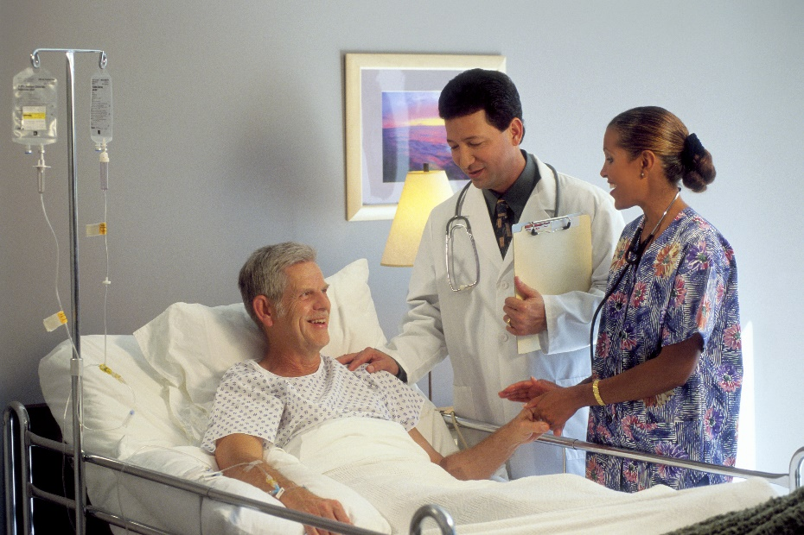
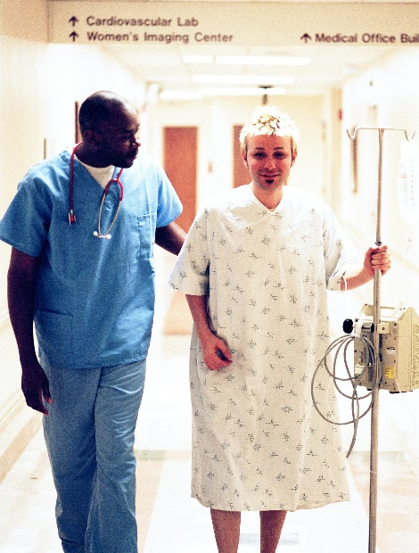
Tailoring Practices
The practices selected and used need to be tailored to your hospital and the type of patients and care flow on individual units.

Slide 6
Universal Fall PRecautions

Slide 7
Universal Fall Precautions
They apply to all patients.
The purpose is to keep all patients safe.
The choice of precautions varies by hospital.
All staff who interact with patients should be trained on universal fall precautions.
Fall prevention becomes embedded into hospital safety culture.

Slide 8
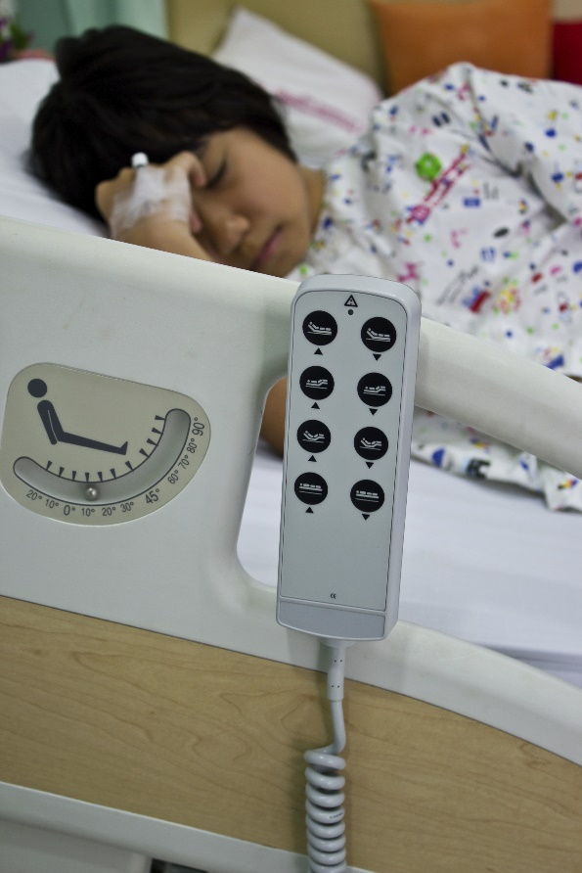
Universal Fall Precautions
What are your hospital’s universal precautions?

Slide 9
Environmental Safety at the Bedside
Inspection List
Write the unit name, date, and room numbers across the top line. Put the bed number or letter across the second line and sign it. Put an “X” under the room number and bed beside all the tasks that need to be done (leave blank if no safety issue is identified or problem can be fixed immediately). Indicate whether this task should be completed by the nursing staff or facilities staff in the Assigned column. Tasks that are typically completed by the facility engineers are denoted with an “(f).” Write notes about special problems or add details in the Notes column.
Tool 3C
Unit | Date: | Room Number: |  |  |  |  |  |  |  |  |  |  |  |  |  |  | Assigned to | Notes
Signature: | Bed:
1. Paths | Remove unused equipment (canes/walkers).
 | Remove bedside commode, if unused.
 | With patient’s permission, rearrange room to clear paths.
 | Put the bedside table next to the bed or across bed.
 | Remove unused items from bathroom and store elsewhere.
 | Make tiebacks for divider curtains. |  |  |  |  |  |  |  |  |  |  |  |  |  |  |  | (f)
 | Tie electrical cords out of path (TV, phone). |  |  |  |  |  |  |  |  |  |  |  |  |  |  |  | (f)
2. Furniture | Adjust bed into locked position.
 | Replace unstable bed with a stable one.
 | Push bed to wall (check local and state fire codes).
 | Remove all lightweight or unstable furniture.
 | Clean, repair, or replace broken bed wheel locks. |  |  |  |  |  |  |  |  |  |  |  |  |  |  |  | (f)
 | Fix unstable furniture. |  |  |  |  |  |  |  |  |  |  |  |  |  |  |  | (f)
 | Secure loose bathroom handrails. |  |  |  |  |  |  |  |  |  |  |  |  |  |  |  | (f)
 | Replace missing rubber tips on bedside commode. |  |  |  |  |  |  |  |  |  |  |  |  |  |  |  | (f)
 | Replace missing rubber tips on handrails that rest on floor. |  |  |  |  |  |  |  |  |  |  |  |  |  |  |  | (f)
 | Secure raised toilet seat to commode. |  |  |  |  |  |  |  |  |  |  |  |  |  |  |  | (f)
3. Easy Access | Arrange room so that items are within patient’s reach (e.g., walking aids are within safe reach). |  |  |  |  |  |  |  |  |  |  |  |  |  |  |  | (f)
4. Floor | Repair or replace floor covering. |  |  |  |  |  |  |  |  |  |  |  |  |  |  |  | (f)
 | Replace high, broken, or missing thresholds. |  |  |  |  |  |  |  |  |  |  |  |  |  |  |  | (f)
 | Add grading to thresholds between room and bathroom. |  |  |  |  |  |  |  |  |  |  |  |  |  |  |  | (f)
5. Lighting | Replace burned out or flickering bulbs. Use max wattage. |  |  |  |  |  |  |  |  |  |  |  |  |  |  |  | (f)
 | Replace burned out or flickering bulbs. Use max wattage. |  |  |  |  |  |  |  |  |  |  |  |  |  |  |  | (f)
 | Replace broken call light cords or lengthen cords. |  |  |  |  |  |  |  |  |  |  |  |  |  |  |  | (f)
6. Equipment | Inspect wheelchair (for all wheelchairs found). |  |  |  |  |  |  |  |  |  |  |  |  |  |  |  | (f)
 | Repair cane. |  |  |  |  |  |  |  |  |  |  |  |  |  |  |  | (f)
 | Repair walker. |  |  |  |  |  |  |  |  |  |  |  |  |  |  |  | (f)

Slide 10
Environmental Safety Hazard Report
Hazard Report Form
To: Nurse Manager
Equipment or Condition Presenting Hazard:
Location of Hazard:
Date Hazard Reported:
Hazard Reported by (your name):
Corrective Action Taken (describe what you did to eliminate the hazard):
Work Order Initiated (describe what still needs to be done to eliminate the hazard):
Work Order Completed on:
Work Order Completed by:
Action Taken to Eliminate Future Occurrences:
Hazard Reported at:
Staff Meeting (date):
Shift Reports (date):
Posting on Bulletin Boards (date):
Copies of this form must be forwarded to the Risk Manager.
Reprinted with permission. © 2006, ECRI Institute, 5200 Butler Pike, Plymouth Meeting, PA 19462, www.ecri.org.
Tool 3D

Slide 11
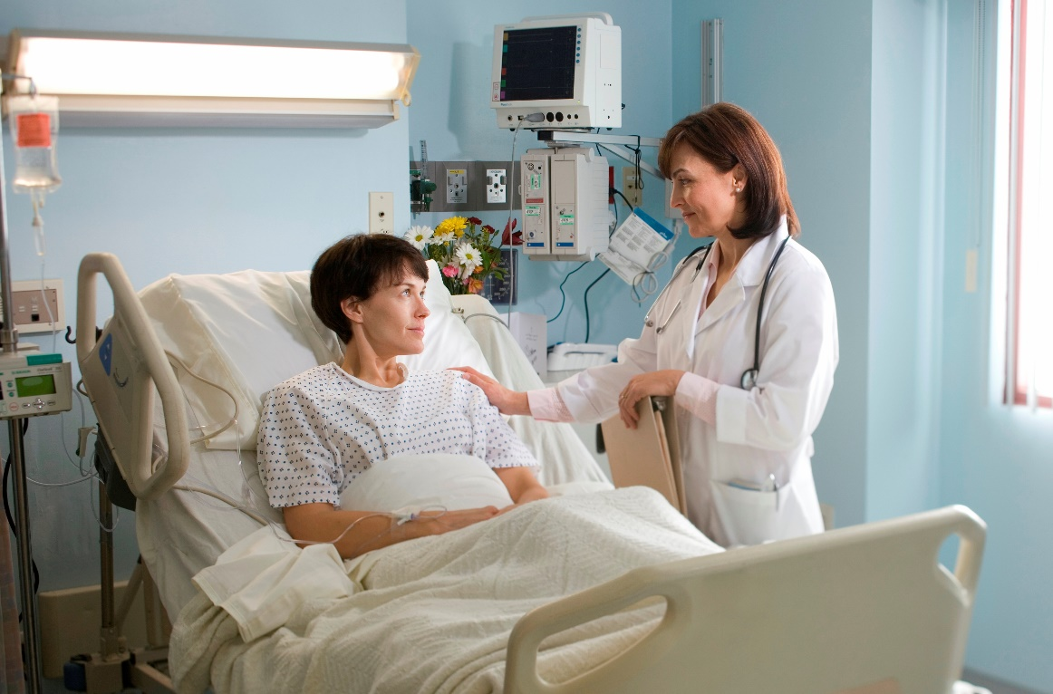
Purposeful Hourly Rounding
This is a strategy for fall precautions.

Slide 12
Scheduled Rounding Protocol
3B: Scheduled Rounding Protocol
Tool 3B
Background: Hourly rounds are an opportunity to ensure that universal fall precautions are implemented and that patients’ needs are being met. These rounds integrate fall prevention activities with the rest of a patient’s care.
Reference: Adapted from Meade CM, Bursell AL, Ketelsen L. Effects of nursing rounds: on patients’ call light use, satisfaction, and safety. Am J Nurs 2006;106(9):58-70 with permission. Items that have been modified or added are marked with an asterisk.
How to use this tool: Review the hourly rounding protocol and adapt it to your specific circumstances. For example, components of the fall risk factor assessment can be added, such as a brief mental status screen.
This protocol can be used by staff nurses, nursing assistants, and the unit manager to ensure that universal fall precautions are in place.
The following items should be checked and performed for each patient. Upon entering the room, tell the patient you are there to do your rounds.
1 | Assess patient pain levels using a pain-assessment scale (if staff other than RNs are doing the rounding and the patient is in pain, contact an RN immediately so the patient does not have to use the call light for pain medication).
2 | Put medication as needed on RN’s scheduled list of things to do for patients and offer the dose when due.
3 | Offer toileting assistance.
4 | Check that patient is using correct footwear (e.g., specific shoes/slippers, nonskid socks).*
5 | Check that the bed is in locked position.*
6 | Place hospital bed in low position when patient is resting; ask if patient needs to be repositioned and is comfortable.*
7 | Make sure the call light/call bell button is within the patient’s reach and patient can demonstrate use.*
8 | Put the telephone within the patient’s reach.
9 | Put the TV remote control and bed light switch within the patient’s reach.
10 | Put the bedside table next to the bed or across bed.*
11 | Put the tissue box and water within the patient’s reach.
12 | Put the garbage can next to the bed.
13 | Prior to leaving the room, ask, “Is there anything I can do for you before I leave? I have time while I am here in the room.”
14 | Tell the patient that a member of the nursing staff (use names on white board) will be back in the room in an hour to round again.

Slide 13
Fall Prevention Is a 3-Step Process
American Geriatrics Society, 2010
Ganz DA, Huang C, Saliba D, et al., 2013
Centers for Disease Control and Prevention
1. Fall Risk Screening/Assessment
2. Tailored/Personalized Care Planning
3. Consistent Preventive Interventions
● Universal Precautions
● Tailored Interventions to address patient-specific areas of risk
3-Step Fall Prevention Process

Slide 14
Fall Risk Assessment

Slide 15
Step 1: Fall Risk Screening/Assessment
Use a reliable, prospectively validated scale.
Helps identify patients at risk for anticipated physiological falls
Provides basis for tailored or personalized care planning
1. Fall Risk Screening/
Assessment
2. Tailored/Personalized Care Planning
3. Consistent Preventive Interventions
● Universal Precautions
● Tailored Interventions to address patient-specific areas of risk
3-Step Fall Prevention Process

Slide 16
Standardized Assessment Tool
Use a standard assessment tool throughout adult units.
Add unit-level risk factors as needed.
For example, on a geriatric psychiatry ward, orthostatic hypotension due to medications may be a fall risk factor.
Refer to Tool 3F for evaluating orthostatic vital signs.

Slide 17
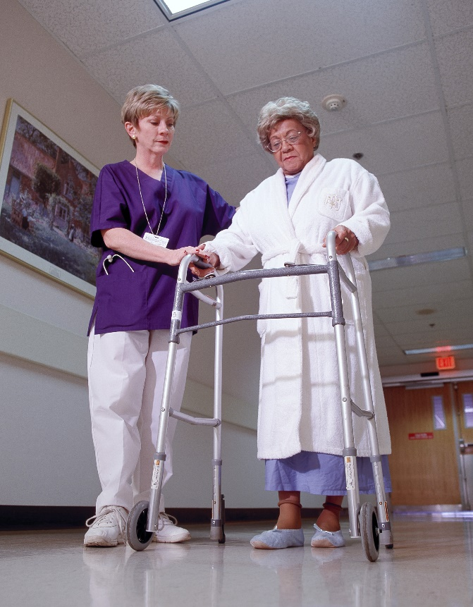
Key Factors To Assess for Fall Risk
History of falls
All patients with a recent history of falls in the past 3 months should be considered at higher risk for future falls.
Mobility problems and use of assistive devices
Patients who have problems with their gait, or who use a cane or walker, are more likely to fall.
Assess patients’ ability to use their assistive devices.

Slide 18
Key Risk Factors for Falls
Medications
Patients taking a large number of medications that could cause sedation, confusion, impaired balance, or orthostatic blood pressure changes are at higher risk for falls.
Mental status
Patients with delirium, dementia, or psychosis may be agitated and confused, putting them at risk for falls.

Slide 19
Key Risk Factors for Falls
Continence
Patients who have urinary frequency, or who have frequent toileting needs, are at higher risk.
Other risks
IV pole
Orthostatic hypotension
Oxygen tubing
Clutter in the patient’s room
Vision problems that cause patients to not see environmental hazards

Slide 20
Role of Risk Factor Scores
The most important use of an assessment tool is to identify fall risk factors for developing care plans.
Excessive focus on a risk score is not recommended.
In fact, research has shown that scores from fall risk prediction tools do not predict falls any better than a clinician’s judgment.
Page 36

Slide 21
Fall Risk Assessment Tools
Tools to use:
STRATIFY Scale
Morse Fall Scale
Medication Fall Risk Scale and Evaluation Tools
Delirium Evaluation Bundle
Tool 3G
Tool 3H
Tool 3I
Tool 3J

Slide 22
Morse Fall Scale
Morse Fall Scale
Item | Item Score | Patient Score
1. History of falling (immediate or previous) | No 0 Yes 25 | ______
2. Secondary diagnosis (≥ 2 medical diagnoses in chart) | No 0 Yes 15 | ______
3. Ambulatory aid None/bedrest/nurse assist Crutches/cane/walker Furniture | 0 15 30 | ______
4. Intravenous therapy/heparin lock | No 0 Yes 20 | ______
5. Gait Normal/bedrest/wheelchair Weak* Impaired† | 0 10 20 | ______
6. Mental status Oriented to own ability Overestimates/forgets limitations | 0 15 | ______
Total Score‡: Tally the patient score and record. <25: Low risk 25-45: Moderate risk >45: High risk |  | ______
The Morse Fall Scale is most widely used in the United States.
* Weak gait: Short steps (may shuffle), stooped but able to lift head while walking, may seek support from furniture while walking, but with light touch (for reassurance).
† Impaired gait: Short steps with shuffle; may have difficulty arising from chair; head down; significantly impaired balance, requiring furniture, support person, or walking aid to walk.
‡ Suggested scoring based on Morse JM, Black C, Oberle K, et al. A prospective study to identify the fall-prone patient. Soc Sci Med 1989; 28(1):81-6. However, note that Morse herself said that the appropriate cut-points to distinguish risk should be determined by each institution based on the risk profile of its patients. For details, see Morse JM, , Morse RM, Tylko SJ. Development of a scale to identify the fall-prone patient. Can J Aging 1989;8;366-7.
Tool 3H

Slide 23
Morse Fall Scale
The Morse Fall Scale is made up of six subscales:
History of falls
Secondary diagnosis
Ambulatory aid
IV/heparin lock
Gait
Mental status

Slide 24
Case Study
45-year-old male with type 2 diabetes
Post-hip replacement
No recent history of falling
Difficulty walking due to hip pain
No ambulatory aid
No IV/heparin lock
Currently on pain medication, which makes him dizzy
Underestimates his limitations

Slide 25
Case Study Risk Assessment
3H: Morse Fall Scale for Identifying Fall Risk Factors
Item | Item Score | Patient Score
1. History of falling (immediate or previous) | No 0 Yes 25 | 0
2. Secondary diagnosis (≥ 2 medical diagnoses in chart) | No 0 Yes 15 | 15
3. Ambulatory aid None/bedrest/nurse assist Crutches/cane/walker Furniture | 0 15 30 | 0
4. Intravenous therapy/heparin lock | No 0 Yes 20 | 0
5. Gait Normal/bedrest/wheelchair Weak* Impaired† | 0 10 20 | 20
6. Mental status Oriented to own ability Overestimates/forgets limitations | 0 15 | 15
Total Score‡: Tally the patient score and record. <25: Low risk 25-45: Moderate risk >45: High risk |  | 50

Slide 26
Assessment of Risk Factors in Your Hospital
The questions for your Team to address are:
Which tools will we use to assess fall risk in patients at our hospital?
Do unit staff members understand why they are assessing fall risk factors?
Discussion
Which standardized fall risk assessment tool will you use?

Slide 27
Care Planning

Slide 28
Step 2: Tailored/Personalized Care Planning
1. Fall Risk Screening/ Assessment
2. Tailored/
Personalized Care Planning
3. Consistent Preventive Interventions
● Universal Precautions
● Tailored Interventions to address patient-specific areas of risk
Review areas of risk identified.
Select interventions to address each area of risk.
Communicate the tailored fall prevention plan to all staff who interact with the patient.
Share the plan with the patient and his or her family members.
3-Step Fall Prevention Process

Slide 29
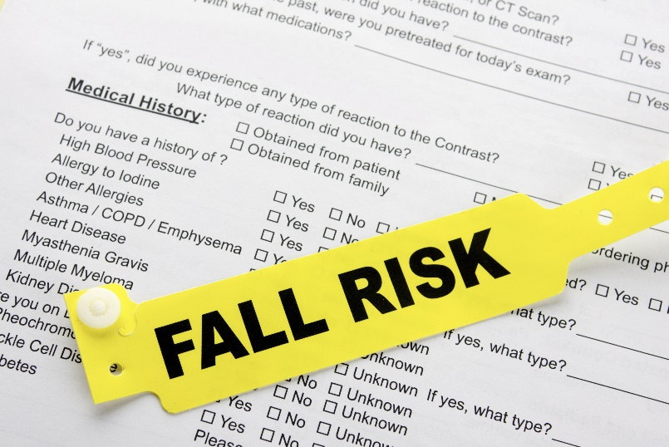
Fall Prevention Care Planning
It is not enough to know which patients have risk factors for falls.
Care planning guides staff on how to prevent falls.
Care planning is a process whereby the patient’s risk information is translated into an Action Plan, ensuring continuity of care.

Slide 30
Practice Insight
Care Plan Documentation

Slide 31
Step 3: Consistent Preventive Interventions
Implement the plan consistently.
All staff should practice universal precautions for all patients every day.
All care team members (including patient and family) should be aware of patient-specific areas of risk and interventions.
1. Fall Risk Screening/ Assessment
2. Tailored/Personalized Care Planning
3. Consistent Preventive Interventions
● Universal Precautions
● Tailored Interventions to address patient-specific areas of risk
3-Step Fall Prevention Process

Slide 32
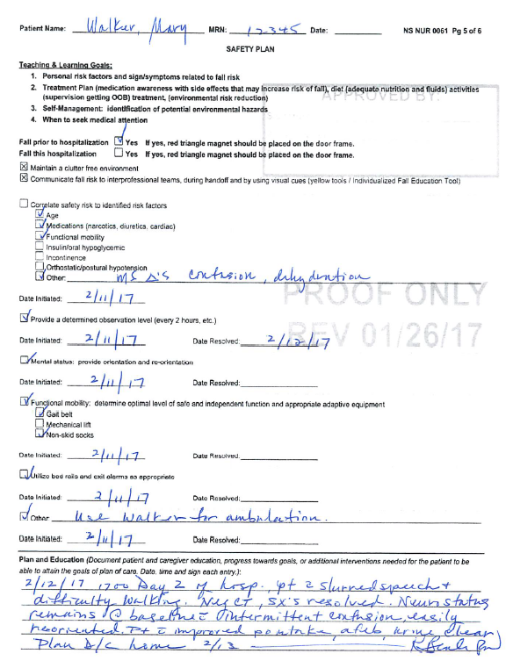
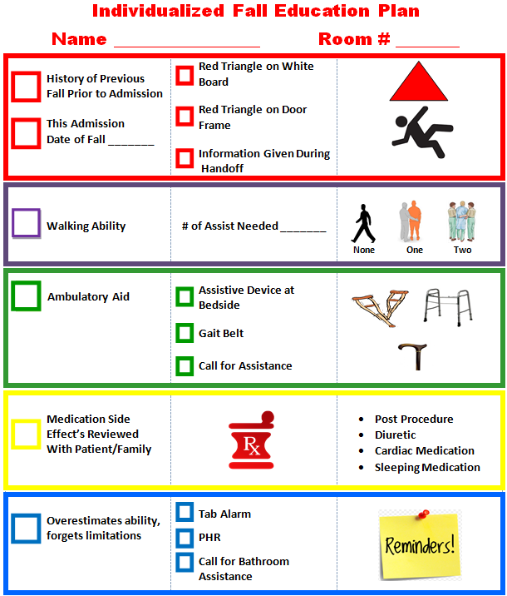
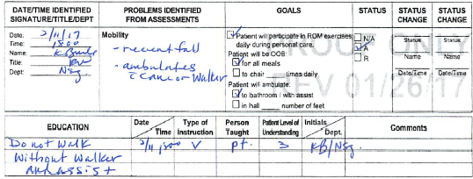
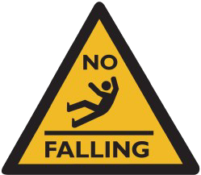
Case Study – Engage Patient/Family
1
2
3
Falls | Morse Score ______
Patient Gets Up at Night To Use the Bathroom  No  Yes | How Many Times  Once  Twice  3 or More
Morse Scale for Predicting Fall Risk Low 0-35 Medium 36-54 High 55-125
History of Falling Immediate Within the Last 3 Months  No 0  Yes 25 Ambulatory Aid  None/Bedrest/Nurse 0 Crutches/Cane/ Walker 15  Furniture 30 Gait/Transferring  Normal/Bedrest/ Immobile 0  Weak 10  Impaired 20 |  | Has Secondary Diagnosis  No 0  Yes 15 IV Heparin Lock  No 0  Yes 20 Mental Status  Oriented to Own Ability 0  Forgets Limitations 15

Slide 33
Sample Care Plan
Tool 3M

Slide 34
Care Plan Development
An individualized care plan is developed for patients with any of the following:
Patient has risk factors for falling (found on risk assessment form).
Patient has fallen since admission.
Patient’s attempts to walk alone result in unsteady/unsafe movements.
Patients or relatives are anxious about falls.

Slide 35
Hospital Fall Prevention Care Plan – Comparison With Tool 3M
Is the stated goal the same between the two plans?
Are you happy with your stated goal?
If not, how would you change it?
Are the categories to be addressed in the care plan the same between your plan and Tool 3M?
If not, would you consider adding any categories to your hospital’s plan?
What other changes could be made to your hospital’s care plan?
Discussion
Do you need to revise or update your hospital’s care plan? If so, how?

Slide 36
Document and Communicate
Use medical records and patient care worksheet documentation of risk factors.
Communicate patient’s risk factors orally at shift change and medical rounds.

Slide 37
Document and Communicate
Safety huddles (safety briefing)
Page 44

Slide 38
Practice Insight
Convene safety huddles at every shift change.
Identify who fell and communicate prevention strategies.
Identify top 3 patients at risk for falling on next shift.

Slide 39
Post-Fall Assessment

Slide 40
Assess and Manage Patients After a Fall
Post-fall clinical review is a structured way to collect information after a fall.
Carefully assess patients for any injuries in a systematic way. Document your findings in the medical record, and report the incident.

Slide 41
Post-Fall Huddle: Essential Components
A brief staff gathering, interdisciplinary when possible, that immediately follows a fall event
Convenes within 15 minutes of the fall event
Led by clinician(s) responsible for patient/resident during the fall event
Involves the patient/resident whenever possible in the environment where the patient/resident fell
Requires group discussion to learn what happened
Uses discovery to determine the root cause/immediate cause of the fall (why the patient/resident fell)

Slide 42
Outcomes of Post-Fall Huddles
Specify root cause (proximal cause).
Specify type of fall.
Identify actions to prevent recurrence.
Change plan of care.
Involve patient/family in learning about the fall occurrence.
Prevent repeat falls.

Slide 43
Decision Tree for Types of Falls
Fall
Post-Fall Huddle
Determine Immediate Cause
What was different this time?
Immediate Causes
E.g., Spill on floor
Trip over tubing
Broken equipment or furniture
E.g., Postural hypotension
Weak or impaired gait
Loss of balance
Confusion
Centrally acting medication
E.g., Heart Attack
Seizure
Drop Attack
Unknown sudden condition that cannot be predicted before the first occurrence
Environmental
Known Intrinsic/Extrinsic Risk Factors
Types of Falls
Accidental Fall
Anticipated Physiological Fall
Unanticipated Physiological Fall
Determine Preventability
Unpreventable Falls

Slide 44
Analysis of Huddles Shows Trends
Preventable falls related to toileting
Notification
Observation
Falls related to environmental causes
Doorways
Shower stalls
Long bedspreads
Lunch and other breaks or shift handoff
Days of the week (barbershop/activities)

Slide 45
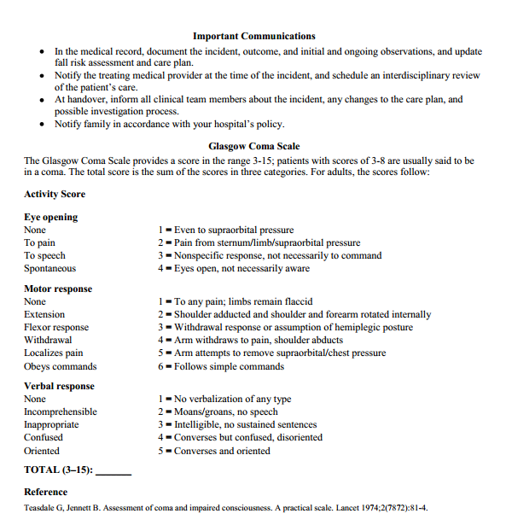
Post-Fall Assessment, Clinical Review
Tool 3N

Slide 46
Root Cause Analysis
After an injurious fall, collect data to reconstruct the event and determine the causes of and contributing factors to the fall.
Analysis of the data collection may help prevent the next fall in this patient or future patients.
The analysis captures information from the patient, staff, and other witnesses about the fall.
Refer to Tool 3O: Post-Fall Assessment for Root Cause Analysis.

Slide 47
Incorporate Best Practices
Research evidence suggests that your program is more likely to succeed when it addresses multiple components:
Risk factor assessment
Universal precautions
Care planning
Post-fall assessment
Some units (e.g., Rehab, Neurology, Pediatrics) may need customization.

Slide 48
Hospital Unit Fall Prevention Examples
Geri-psych unit
Medical unit
Neurology and/or post-neurosurgical units
Inpatient rehab
Page 50

Slide 49
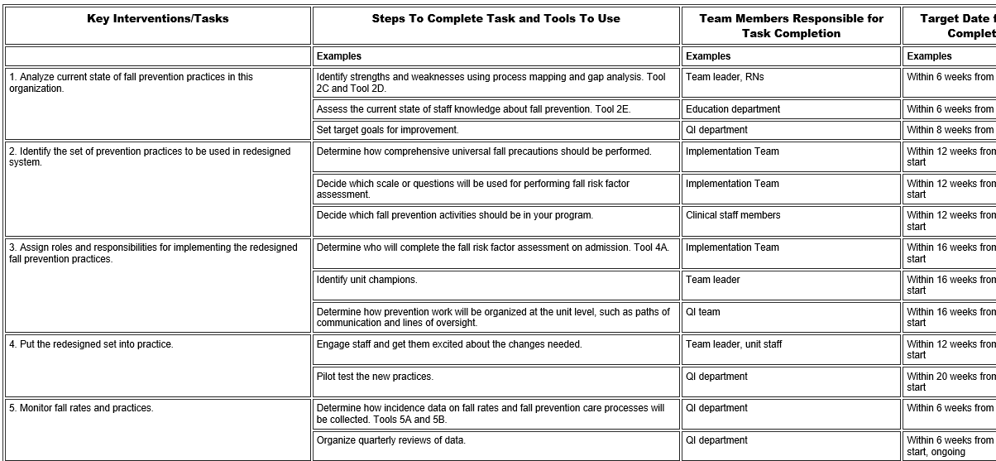
Action Plan
Discuss action steps for Key Intervention 2.
Determine who is responsible for this task and when it will be completed.
Refer to your Action Plan template.

Slide 50
Summary
Tool 3P: Best Practices Checklist
Identify a set of best practices. | ✓
Create a clinical pathway.
Identify key elements of a fall risk factor assessment.
Choose a tool for assessing risk factors. | ✓
Explore approaches to documenting and reporting results of fall risk factor assessment.
Develop fall prevention care plan based on identified risk factors. | ✓
Identify approaches to documenting and communicating care plan.
Develop system linking changes in fall risk factors to changes in care plan.
Ensure all levels of staff are aware of care plan.
Develop system linking care planning to actual interventions.
Choose or develop post-fall assessment protocol. | ✓
Customize the set of practices for specific work units.

Slide 51
References
American Geriatrics Society. 2010 AGS/BGS Clinical Practice Guideline: Prevention of Falls in Older Persons. http://www.americangeriatrics.org/files/documents/health_care_pros/Falls.Summary.Guide.pdf. Accessed June 16, 2017.
Centers for Disease Control and Prevention. STEADI - Older Adult Fall Prevention. http://www.cdc.gov/steadi/materials.html. Accessed June 16, 2017.
Ganz DA, Huang C, Saliba D, et al. Preventing falls in hospitals: a toolkit for improving quality of care. Rockville, MD: Agency for Healthcare Research and Quality; January 2013. AHRQ Publication No. 13-0015-EF. http://www.ahrq.gov/sites/default/files/publications/files/fallpxtoolkit.pdf. Accessed June 16, 2017.

