Slide 1
How To Implement the Fall Prevention Program in Your Organization
ADD Hospital Name Here
Module 4

Slide 2
What We Have Done Thus Far
Up to this point, you have:
Examined compelling reasons for implementing a Fall Prevention Program and strategies for sustaining effective practices (Module 1).
Identified current practices and aspects needing improvement (Module 2).
Identified best practices and made preliminary decisions on what best practices will be included in your Fall Prevention Program (Module 3).

Slide 3
Following Best Practice
In this module, the Implementation Team will plan for implementation of new/modified prevention practices at the clinical care level.

Slide 4
Implementation Planning Goals
Determine the role/responsibilities of staff in preventing falls.
What role will the Unit Team play?
What role will the Unit Champions play?
How should prevention work be organized at the unit level?
What fall prevention practices go beyond the unit?

Slide 5
Implementation Planning Goals
Put the new practices into operation.
How do you manage the change process at the patient care level?
How do you pilot test the new practices?
How do you get staff engaged and excited about fall prevention?
How can you help staff learn new practices?

Slide 6
Staff Roles
Assign staff to perform each specific task in your set of best practices, based on training and experience.

Slide 7
Staff Roles
In some cases, a group will perform the task based on specific roles, such as the nursing assistants.
Other tasks may be assigned to a specific person.
In that case, be sure to assign a backup person.

Slide 8
Best Practices
4A: Assigning Responsibilities for Using Best Practices
Background: This tool can be used to determine who will be responsible for each task identified in your set of best practices for preventing falls. One way to generate interest and buy-in from the staff is to ask them to self-assign their responsibilities from a prioritized list of tasks that need to be accomplished.
Reference: Developed by Falls Toolkit Research Team.
How to use this tool: Complete the table by entering the different best practices and the specific individuals who will be responsible for completing each task. This tool should be filled out by the Implementation Team leader in collaboration with the other team members.
Use this tool to assign and clarify the roles and responsibilities of each staff member. Types of staff and the types of responsibilities they might take on are summarized in Tool 4B, “Staff Roles.”
What practices will we use? | Who will be responsible?
Example: Perform comprehensive fall risk assessment on admission, daily, or if condition deteriorates. | Example: RN
Tool 4A

Slide 9
Staff Roles

Slide 10
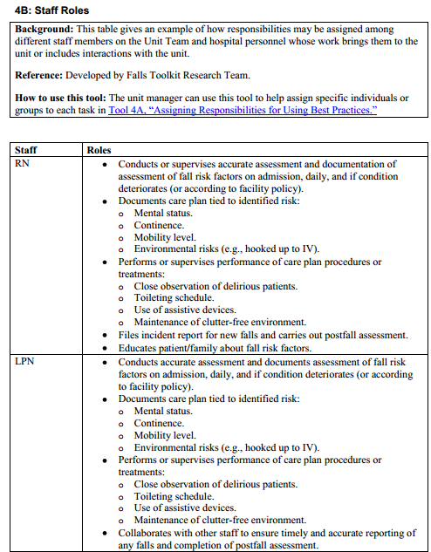
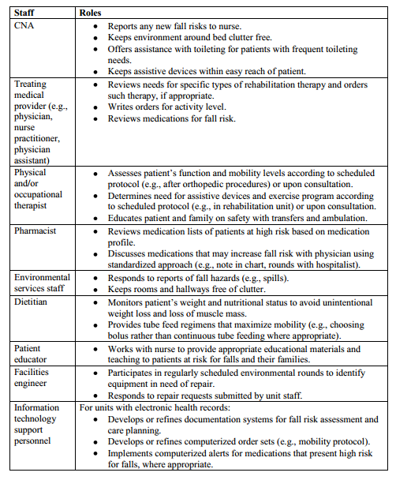
Staff Roles
Examples of how responsibilities may be assigned
Tool 4B

Slide 11
Unit Team
A Unit Team comprises staff members who provide daily direct patient care by:
Conducting fall risk assessments.
Planning care for fall prevention.
Ensuring care is performed and documented.

Slide 12
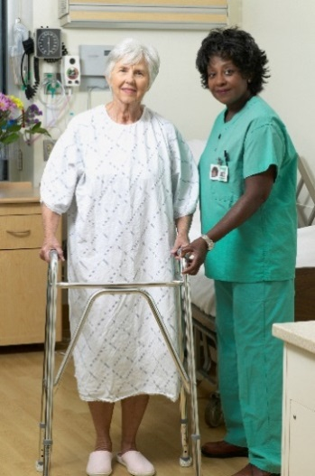
Unit Team
A Unit Team is composed of those who provide daily direct care:
Nurse
Nurse assistant
Treating medical provider
Pharmacist
Physical or occupational therapist
Other staff assigned to the unit on a regular basis
Patient and family
Page 55

Slide 13
Staff Turnover
All hospitals experience the challenges of staff turnover.

Slide 14
Practice Insight
Staff Turnover

Slide 15
Unit Champion
Staff member who serves as the liaison between the Implementation Team and the unit staff
Most familiar with the program goals, care processes, and outcome data to be used
Critical during the implementation process (may be temporary)
Ideally, one champion per shift, per unit

Slide 16
Communication During Implementation
Staff at all levels need to communicate.
Within the unit – among nurses, nurses and assistants, nurses and physicians, and nurses and patients and their families
Among unit staff, the Implementation Team, and senior management

Slide 17
Communication During Implementation
Develop a communication process to share information about the effectiveness of implemented changes.
Unit Champions can present updates on implementation at regularly scheduled meetings.
Updates can be given thoroughly and succinctly with the least amount of time and effort.

Slide 18
Integrate Into Ongoing Processes
Necessary for sustainability
Universal fall precautions
Integrated into regular communications (e.g., shift handoffs)
Use of visual cues/logos (e.g., sign above patient’s bed noting need for assistance with toileting)
Page 58

Slide 19
Electronic Health Record
What information about fall risk factors is already part of the patient record?
What is the most logical place in the record to collect, organize, and assess information about patient fall risk factors and any necessary precautions?
Page 59

Slide 20
Manage the Change Process
Ensure staff understand new roles.
Ensure staff understand reasons for change and agree change is needed.
Convey that fall prevention is part of high-quality care, and it is valued by all, including senior hospital leadership.

Slide 21
Manage the Change Process
Have adequate access to supplies and equipment available.
Assistive devices
Low beds
Floor mats
Engage staff to gain support and buy-in to tailor new practices.

Slide 22
Monitor Implementation Progress
Baseline measures of fall rates and processes should be obtained before any change.
Tracking care processes to prevent falls is a measure of implementation success, and it should translate into better outcomes.
Outcome measures – track changes in fall rates.
Inform the Implementation Team and staff about results.

Slide 23
Communicate Success
Tips for how to convey updates and information on successes from prevention activities include using:
Posters with results on the units or in the lunch room.
Storyboards highlighting successes.
Newsletter articles.
Email blasts.
Announcements on the hospital home page.
Discussions during staff meetings.

Slide 24
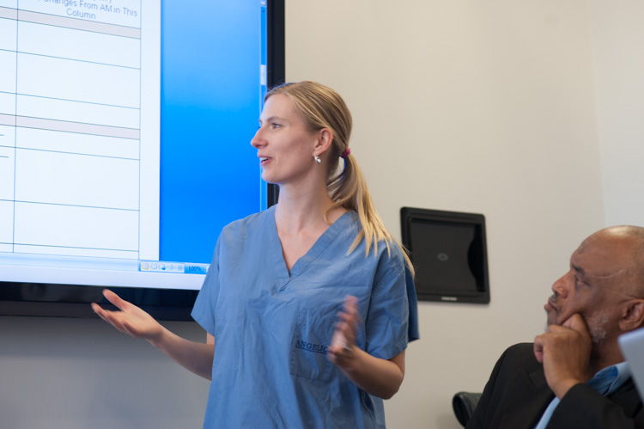
Sustain Fall Prevention
Close the information loop. Inform senior leaders and middle managers about progress.
Keep clinical staff informed about progress with the Fall Prevention Program.

Slide 25
Staff Education and Training
Develop an education plan.
Adults learn best through experiential activities.
Don’t forget prevention education for the patient, family members, and significant others.
See Tool 3L

Slide 26
Practice Insight
Frontline Staff Training/Coaching

Slide 27
Staff Education and Training
Regular/ongoing education means including fall prevention in four areas of training:
Annual fall prevention education for all staff
Staff competencies
New staff orientation
Training of temporary staff

Slide 28
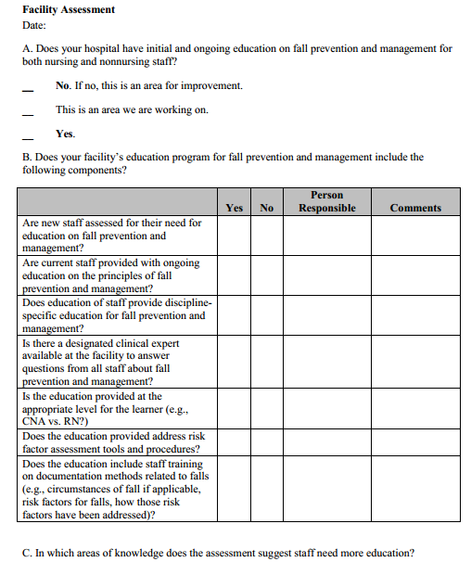
Assess Staff Education
Tool 4C

Slide 29
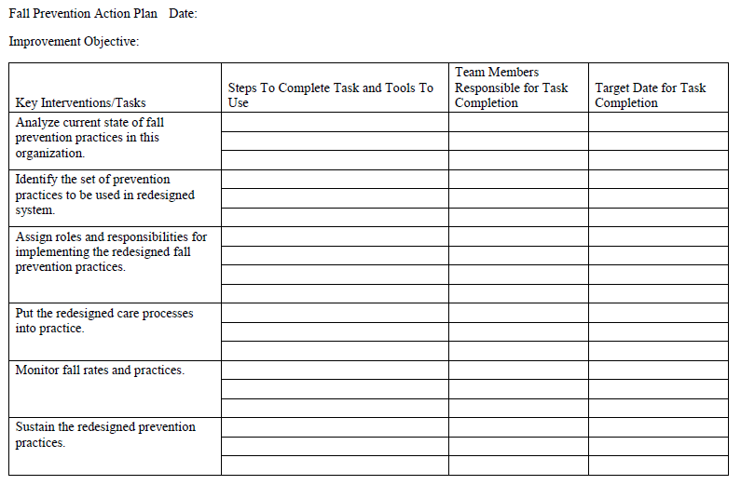
Action Plan
Action steps for Key Interventions 3 and 4.
Who is responsible for these tasks, and when will they be completed?
Refer to your Action Plan.

Slide 30
Summary
Make sure we haven’t skipped any essential steps in the fall prevention efforts.
Implementing best practices checklist
Task | Date Completed
Roles and Responsibilities of Staff | ✓
Assign specific roles and responsibilities to:
Members of the Unit Team
Unit Champion
Organizing the Prevention Work
Identify paths of ongoing communication and reporting | ✓
Develop mechanisms to address accountability
Identify strategies for building new practices into daily routine
Refine preliminary implementation plan
Ensure support from key stakeholders
Initiate plan to pilot test new practices | ✓
Establish strategy for engaging staff
Create education plans to help staff learn new practices | ✓
Tool 4D

