Slide 1
How To Measure Fall Rates and Fall Prevention Practices
ADD Hospital Name Here
Module 5

Slide 2
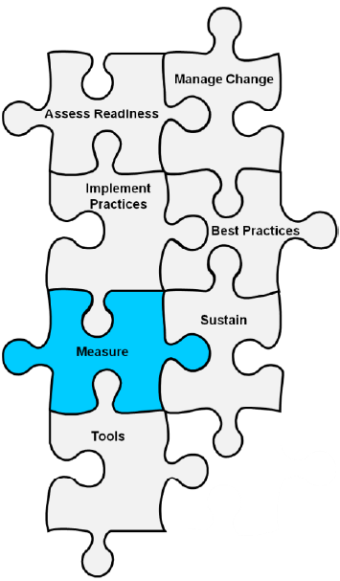
Basic Quality Improvement Principle
If you can’t measure it,
you can’t improve it.

Slide 3

Basic Quality Improvement Principles
Fall rates and fall prevention practices must be tracked.
By tracking performance, you will know whether care is improving, staying the same, or getting worse in response to efforts to change practice.
Continued monitoring
will help you see if your
improvement gains are
being sustained.

Slide 4
Module 5 Goals
The Implementation Team will agree on and develop a plan for:
  Measuring falls and fall-related injury rates.
  Measuring fall prevention practices.
  Communicating trends in fall and fall-related injury rates to key stakeholders.

Slide 5
2012 NDNQI Definition of a Fall
A patient fall is an unplanned descent to the floor with or without injury to the patient. Include falls that result when a patient lands on a surface where you wouldn’t expect to find a patient.
NDNQI–National Database of Nursing Quality Indicators

Slide 6


NDNQI Definition
All unassisted and assisted falls are to be included whether they result from physiological reasons (fainting) or environmental reasons (slippery floor).
Page 70

Slide 7

Practice Insight
Assisted Falls

Slide 8
How Will This Hospital Define a Fall?
Develop a uniform definition and share it throughout the hospital.
Make sure it is coupled with a culture of trust to encourage reporting fall incidents.
Will you use NDNQI’s definition to measure and monitor falls?

Slide 9

NDNQI Repeat Fall Definition
A repeat fall is more than one fall in a given month by the same patient after admission to the unit.
Do you agree to use this
definition?

Slide 10
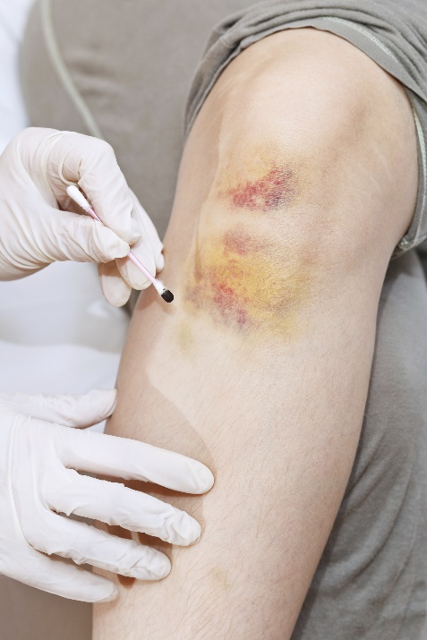

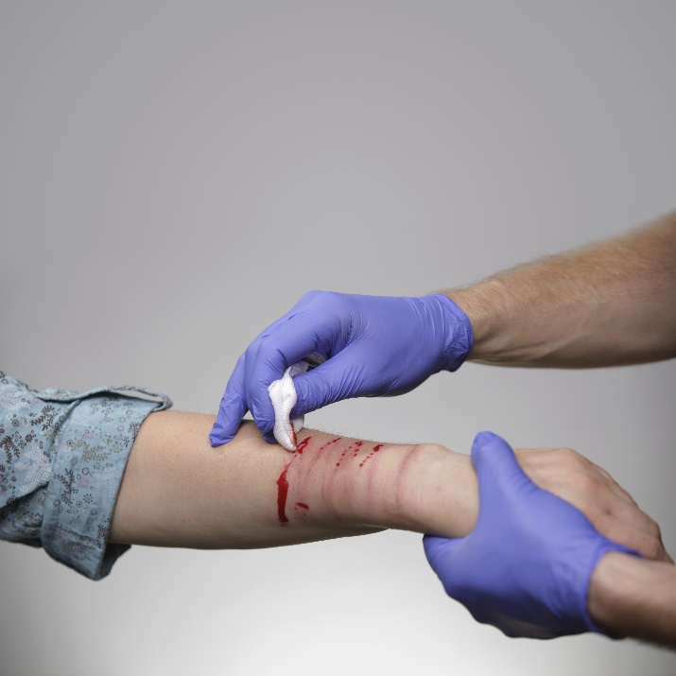
NDNQI Definitions of Fall Injury
None or no injury: The patient is free of injuries (no signs or symptoms) resulting from a fall.
Minor: Bruise, abrasion; needs dressing, ice, limb elevation, topical medications, etc.

Slide 11
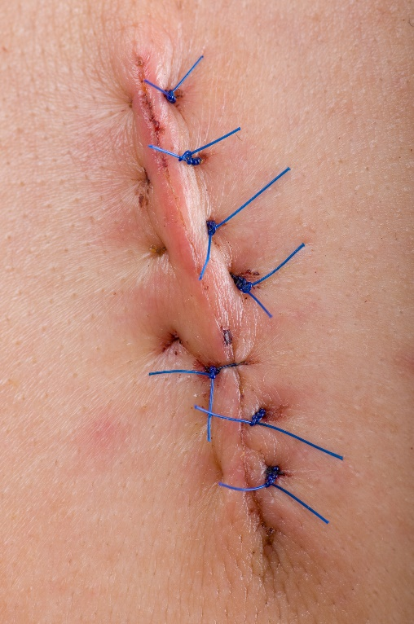
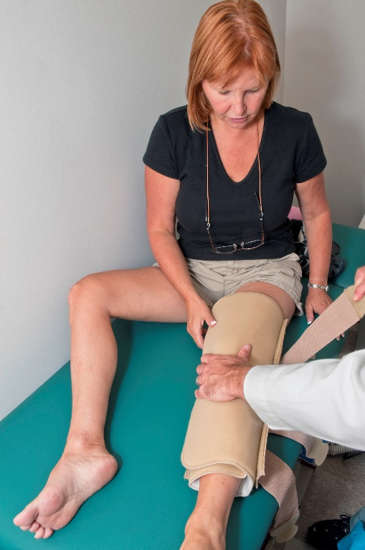
NDNQI Definitions of Fall Injury
Moderate: Needs sutures, Steri-Strips™/skin glue, splint; or resulted in muscle/joint strain.

Slide 12

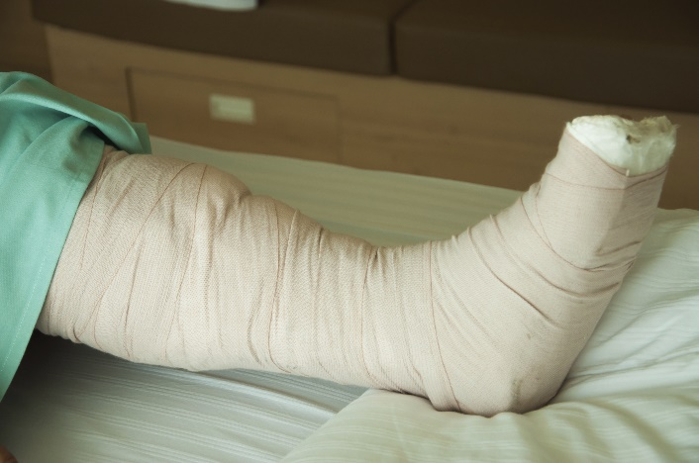

NDNQI Definitions of Fall Injury
Major: Needs surgery, cast, traction; and/or results in neurological or internal injury.
Death: The patient died as a result of injuries sustained from the fall (not from physiologic events causing the fall).

Slide 13
NDNQI Definitions of Fall Injury
None: No injury
Minor: Resulted in bruise, abrasion; needs dressing, ice, limb elevation, topical medications, etc.
Moderate: Needs suturing, splinting; or caused muscle/joint strain
Major: Needs surgery, cast, traction; results in neurological or internal injury
Death
Do you agree to use these definitions?
What other definitions of fall injury would be appropriate for this hospital?

Slide 14

Agreed-Upon Definitions
Definitions of a fall, repeat fall, and level of injury from a fall should be incorporated into:
  Policies and procedures.
  Incident reports.
  Root cause analyses/huddles.
  Staff education.

Slide 15
Measuring fall rates

Slide 16
Measurement Recommendations
Measure falls over time within a unit to see if care is improving.
Calculate falls as a rate (the rate of falls per 1,000 occupied bed days).
  This measure considers if the unit census is running high or low.
Use this measurement approach consistently throughout the hospital.

Slide 17


Needed for Fall Rate Calculation
Use incident reports to track data about the fall, date, patient, unit, location, circumstances, and level of injury.
Some hospitals have electronic
incident reporting systems,
making it easier to count falls.
What system do you use?

Slide 18
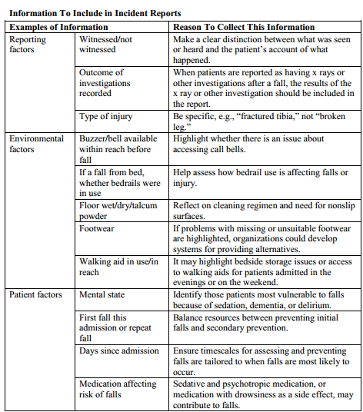
Incident Report Information
Tool 5A

Slide 19
Needed for Fall Rate Calculation
Average daily census of unit or hospital, provided by hospital information system
More recommendations on capturing data (NDNQI Data Web site)
Standard structure for data collection (AHRQ Common Formats Web site)
Page 72

Slide 20
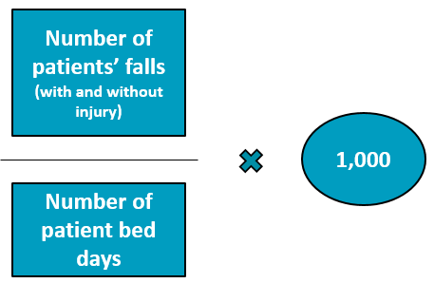
How To Calculate Fall Rate
Count the number of falls in the month.
Figure out how many beds were occupied each day.
Add up the total occupied beds each day for the month (patient bed days).
Divide the number of falls by the number of patient bed days for the month.
Multiply the results by 1,000 to get the fall rate per 1,000 patient bed days.

Slide 21
Fall Rate Calculation Example
Directions | Example
Count number of falls in April. | 3 falls in April
Count occupied beds each day in April. | 26 on April 1, 28 on April 2, …
Add up the total occupied beds each day for April (patient bed days). | 879 occupied beds
Divide the number of falls by the number of patient bed days in April. | 3/879 = 0.0034
Multiply by 1,000. | 0.0034 x 1,000 = 3.4 falls per 1,000 patient bed days

Slide 22
Calculate Fall Rate
Directions | Example
Count number of falls in February. | 5 falls in February
Count occupied beds each day in February. | 26 on February 1, 28 on February 2, …
Add up the total occupied beds each day for February (patient bed days). | 901 occupied beds
Divide the number of falls by the number of patient bed days in February. | ____/____ = ____
Multiply by 1,000. | ____ x 1,000 = ____ falls per 1,000 patient bed days

Slide 23


Calculation of Fall Rates
When you complete your Action Plan, you will:
  Identify sources of data to collect.
  Select a person or team responsible for doing the calculations and tracking. Count the number and level of injury of falls in a month.

Slide 24
Use of Data
Examine the rates for trends over time.
  Graph data in a run chart to visually examine.
  Are rates getting better or worse?
  Can you relate changes in rates to changes in practice?
  Rates are probably quite different by patient unit.
  Focus on trends over time. There will be fluctuations. Don’t overreact.

Slide 25


Fall Rate Data
When you first start tracking, you may notice increased fall rates. This is not necessarily due to worse care. Instead, unit staff members are becoming better at reporting falls that were missed in the past.

Slide 26

Use of Data
Find ways to disseminate the information to key stakeholders and unit staff.
  Post monthly rates where all staff can see how the unit is doing.
  Send reports to leadership.

Slide 27
Examining Data
Study your post-fall huddle data in detail to understand what leads to each fall.
Determine whether falls are irregular events, or whether there is a pattern in the types of falls (e.g., related to toileting).
Page 76

Slide 28
Benchmarks for Comparison?
Currently, no national benchmarks exist for comparing fall rates.
  It’s difficult to compare patients across hospitals because some patients are more likely to fall.
  Focus on improvement over time in your hospital.
There are a number of ongoing initiatives to determine fall rates using a standardized method.
Monitor current literature on fall rates for benchmarking.
Page 77

Slide 29
Practice Insight
Benchmarking

Slide 30
Displaying Data/Storytelling
Run charts
Control charts
Annotation (show your interventions)

Slide 31
Run Charts
Put data in context for the viewer.
Allow staff to look for trends in the data.

Slide 32
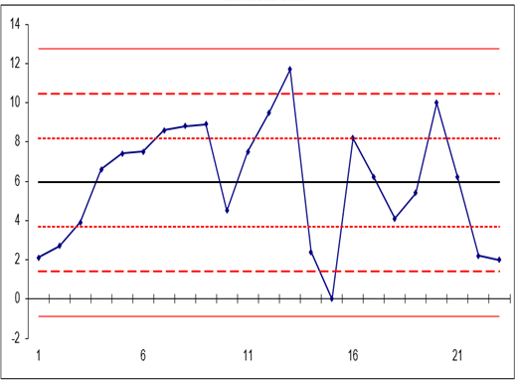
Control Charts
Assess the amount of variation within a range of data points.
Provide visual cues to help the viewer interpret the data, including points that fall outside the control limits.
Page 74

Slide 33
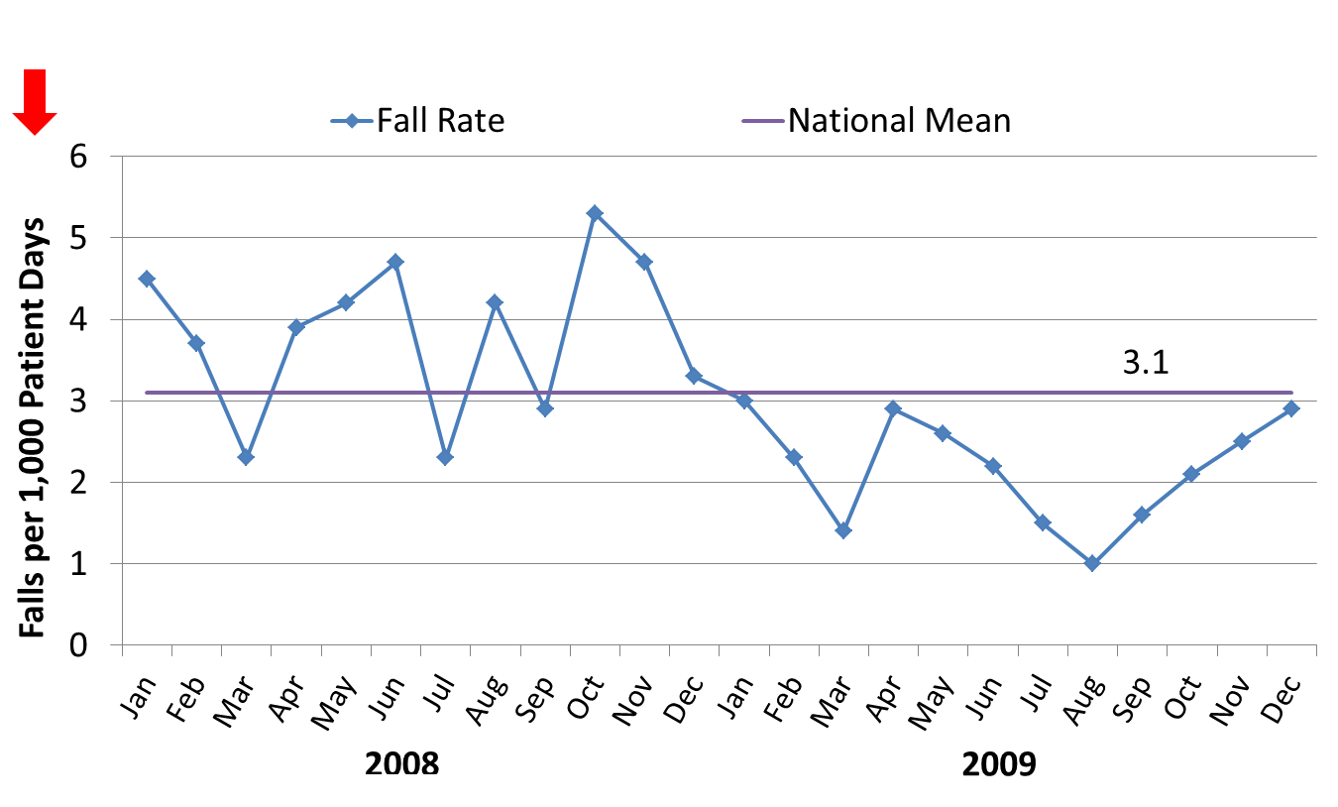
Falls per 1,000 Patient Days

Slide 34
Calculate Fall Rate by Type of Fall
2008

Slide 35
Annotated Run Chart

Slide 36
Painting the Picture With Data
Is your program improving?
Are your patients safer?

Slide 37
Measuring Fall prevention practices

Slide 38
Measuring Fall Prevention Practices
Measuring fall rates tells you how your facility is performing.
Measuring fall prevention practices may tell you how to improve care.
  If the fall rate is high, what specific areas should you focus on?
  Are key practices to reduce falls being done consistently?

Slide 39

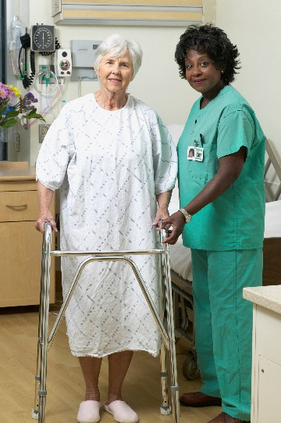
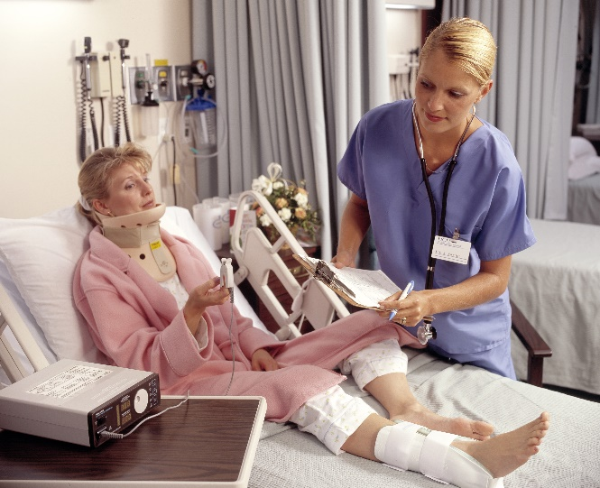
What Practices Should Be Measured?
Initially, look at two practices:
  Performance of fall risk factor assessment within
  24 hours of admission
  Performance of care planning that addresses each risk factor identified during fall risk factor assessment

Slide 40

Performance Review of Fall Risk Factor Assessment Within 24 Hours
Use the Morse Fall Scale (or the one your hospital agreed on).
Ensure that known risk factors for falls are assessed.
See the sample protocol for assessing performance.
Page 78

Slide 41
Care Planning Assessment
All risk factors identified on the fall risk factor assessment need to be addressed in the care plans.
Next, act on the care plans.
  Critical thinking by staff
  Tailored approach to each patient, based on the patient’s risk factors
Ensure that care plans address all areas of risk.

Slide 42
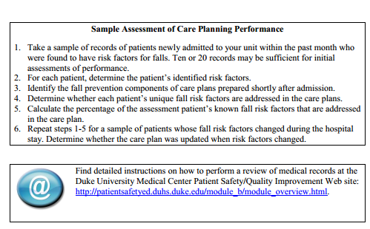
Assessment of Care Plan Performance
See the sample protocol for assessing care plan performance.
Page 79

Slide 43

Care Process Assessment
Tool 5B combines medical record review with direct observation.

Slide 44
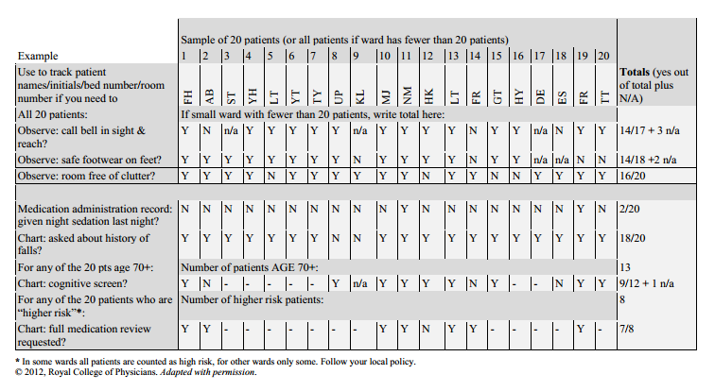
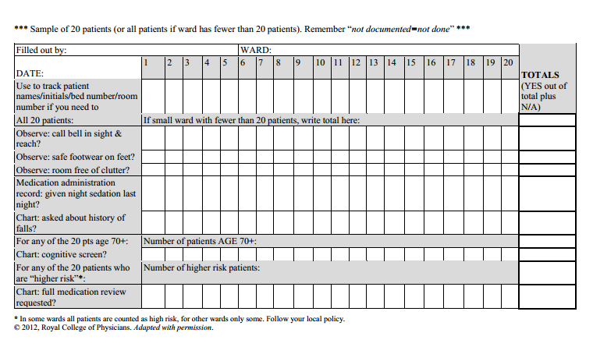
Assessing Fall Prevention Care Processes
Tool 5B

Slide 45
Measurement Action Plan
Action Plan Tool To Measure Fall Rates and Fall Prevention Practices
Measure Fall Rates
Key indicator |  | Who is responsible? | Completion date for plan
Fall rates (e.g., falls per 1,000 occupied bed days) are calculated.
Fall rates are monitored at least quarterly, and preferably monthly.
Information on rates is disseminated to key stakeholders and staff.
Post-fall huddle is conducted for each fall.
Measure Fall Prevention Practices
Key indicator | Who is responsible? |  | Completion date for plan
Fall risk factor assessment is accurately performed within 24 hours of admission.
A care plan addressing every deficit on the fall risk factor assessment has been developed and is being implemented.
Staff know the definitions of a fall and injurious fall.

Slide 46
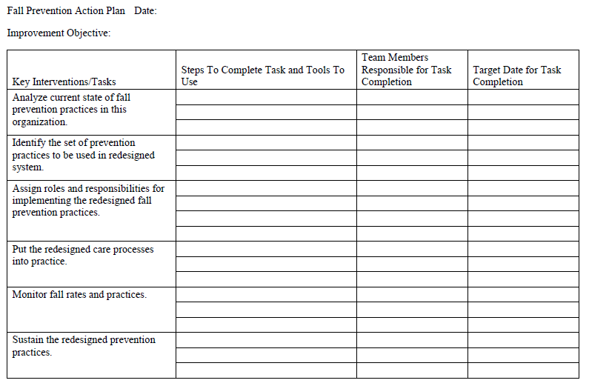
Action Plan
  Action steps for Key Intervention 5.
Refer to your
Action Plan.

Slide 47
Summary
In this module, we discussed the following:
  This hospital’s definition of a fall
  How to measure fall and fall-related injury rates
  How to measure fall prevention practices
  How to communicate the trends in fall and fall-related injury rates to key stakeholders

Slide 48
Next Steps
Over the next several weeks, we will meet weekly to refine your Action Plan for the Fall Prevention Program.
Thank you for being a part of this Team to make this hospital safer for patients.

