Slide 1
Preventing Falls in Hospitals
A Toolkit for Improving Quality of Care
Agency for Healthcare Research & Quality
Toolkit: http://www.ahrq.gov/professionals/systems/long-term-care/fallpxtoolkit/index.html
William Spector, PhD

Slide 2
What’s New?
Falls Prevention Toolkit for Hospitals
  Web based design
  Evidence-based tools for falls prevention (35 tools)
  Guidance for multidisciplinary change team
  Focuses on overcoming the challenges associated with developing, implementing, and sustaining a fall prevention program
  Developed by RAND Corporation ,ECRI Institute, and Boston University for AHRQ

Slide 3

David Ganz, MD, PhD
RAND Corporation

Slide 4
Purpose of this project
Develop text and tools to guide implementation and maintenance of a hospital fall prevention program
  Audience: mid-level managers and clinicians
  Coverage: all stages of organizational change
Reference for hospital teams at different levels of sophistication
Approaches adaptable to local circumstances

Slide 5
Toolkit/Resource Guide
Six sections:
  Hospital readiness for change
  Managing change
  Choosing fall prevention practices
  Implementing best practices
  Measuring fall rates and fall prevention practices
  Program sustainability

Slide 6
Inputs to toolkit
Evidence review
Expert panel
  In person meeting + follow-up conference call
Hospital workgroup
  Self-assessment + follow-up phone call
  In-person meeting + monthly teleconferences
  Tool evaluation forms
  Site visits

Slide 7
Hospital workgroup
Six hospitals
  Vary on geography, safety net status, profit/non-profit, unionization, use of electronic health record
  Units selected for piloting:
    Medicine
    Neurology/neurosurgery
    Progressive care unit (telemetry/post-cath)
    Inpatient rehabilitation
    Geriatric psychiatry

Slide 8

Kathryn M. Pelczarski
ECRI Institute

Slide 9
Fall Prevention Tools
Tailored with input from the pilot hospitals to ensure tools are:
  Realistically implementable
  Easy to use
  Broadly applicable in the acute care setting
Highly relevant to addressing common challenges

Slide 10
Relevant Tools
Challenges
Opportunities
Tools That Really Help

Slide 11
Challenge
Atlas Syndrome
Unlikely to succeed
© ECRI Institute 2013

Slide 12
Opportunity
An interdisciplinary approach
  Essential input from key stakeholders
  Harnessing the power of collaboration
  Securing support and resources
  Gaining buy-in
  Shared ownership

Slide 13
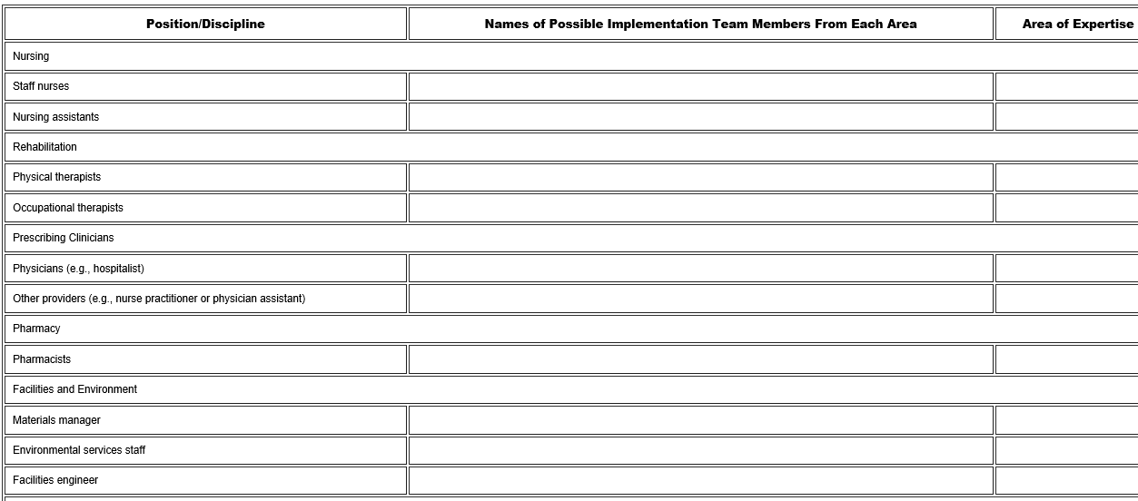
Tool:
Interdisciplinary Team (2A)
Part 1: Team Members

Slide 14
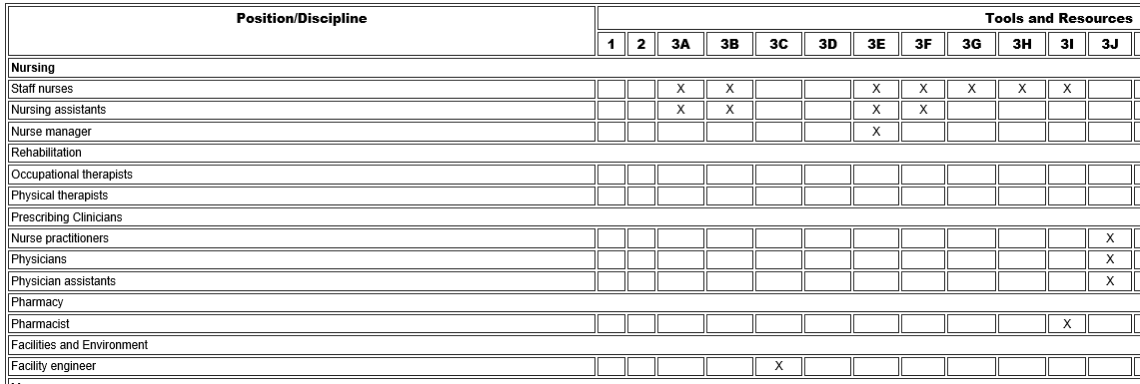
Tool:
Interdisciplinary Team (2A)
Part 3: Matrix of Applicable Tools by Role

Slide 15
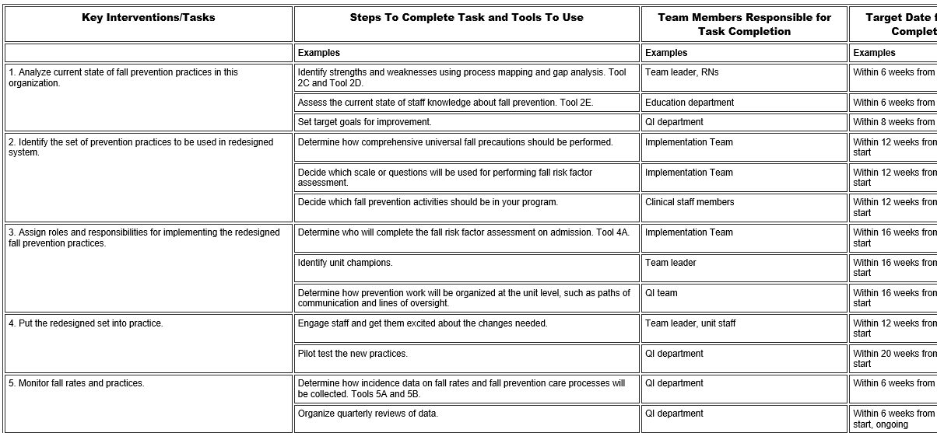
Tool: Action Plan (2F)
Improvement Objective: Implement standard fall prevention practices within 6 months

Slide 16
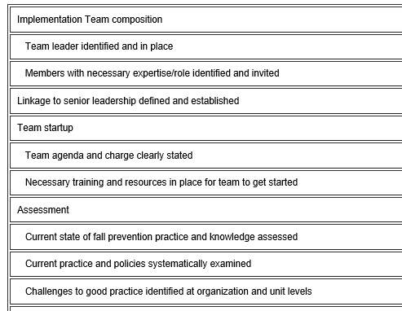
Tool: Managing Change Checklist (2G)

Slide 17
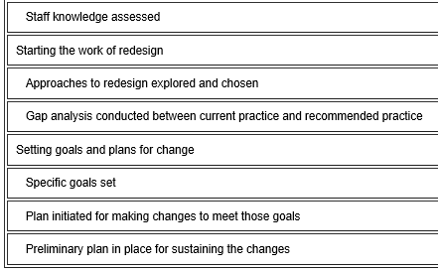
Tool: Managing Change Checklist (2G)
Continued

Slide 18
Challenge
Inadequate Risk Assessments and Reassessments
© ECRI Institute 2013

Slide 19
Opportunity
Accurate and effective risk assessments
  Employing critical thinking and clinical judgment
  Consistency in approach
  Identifying and communicating risk at the earliest possible time

Slide 20
Tools
Morse Fall Scale (3H)
STRATIFY Scale (3G)
Medication Fall Risk Scale (3I)
Orthostatic Vital Sign Measurement (3F)
Delirium Evaluation Bundle (3J)

Slide 21
Challenge
Inadequate and ineffective interventions
Morse Fall Score = 70
One set of interventions does not fit all
Over-reliance on bed exit alarms
© ECRI Institute 2013

Slide 22
Opportunity
Optimizing the effectiveness of interventions
  Tailoring interventions to address individual risk factors
  Assessing their effectiveness
  Modifying interventions, as appropriate

Slide 23
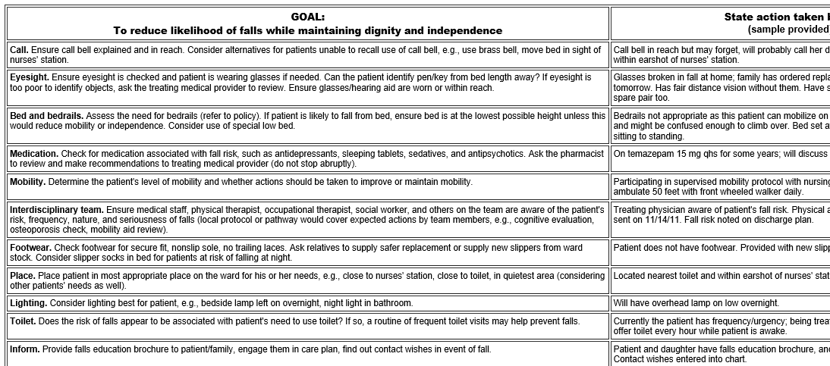
Tool: Sample Care Plan (3M)

Slide 24
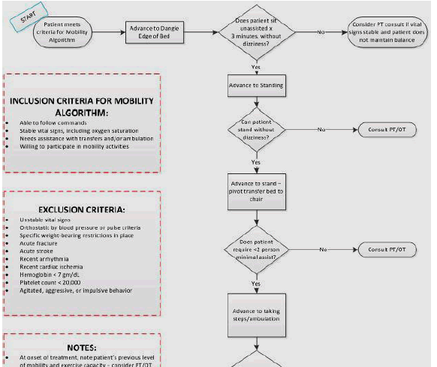
Tool: Algorithm for Mobilizing Patients (3K)

Slide 25
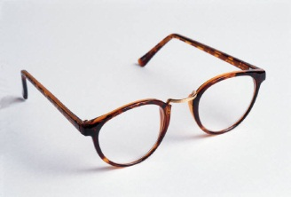

Challenge
Inconsistent or Ineffective rounds to address personal needs
© ECRI Institute 2013

Slide 26
Opportunity
Consistent and effective rounds to address a patient’s personal needs
  Purposeful rounding
  Standardized inclusion of key elements
  Optimizing safety during rounds

Slide 27
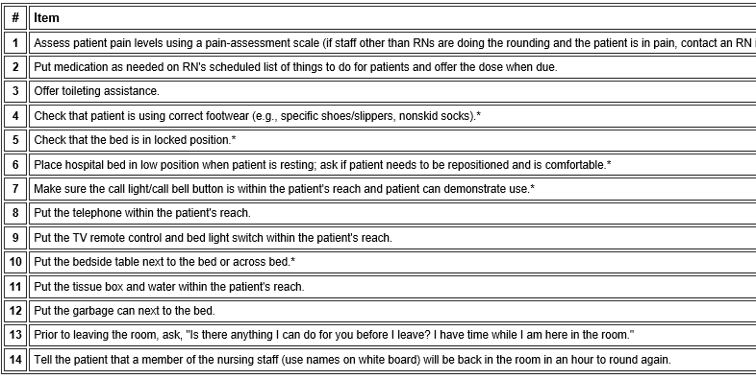
Tool: Scheduled Rounding Protocol (3B)

Slide 28
Challenge
Unable to sustain falls prevention
Rate per 1000 Patient Days
2009 Falls Prevention Initiative
© ECRI Institute 2013

Slide 29
Opportunity
Continuous Improvement
  Identifying and addressing process challenges
  Improving compliance
  Learning from near falls and falls that do not involve harm, in addition to learning from falls with harm

Slide 30
Tools
Assessing Fall Prevention Care Processes (5B)
Postfall Assessment for Root Cause Analysis (3O)
Information to Include in Incident Reports (5A)
Measuring Progress Checklist (5C)
Sustainability Tool (6A)

Slide 31
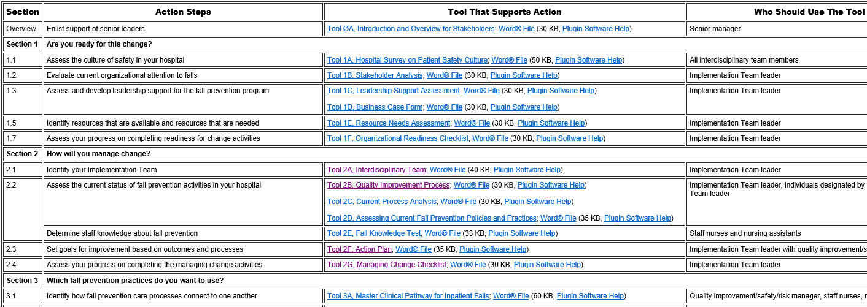
Tool Roadmap

Slide 32
Pilot Hospitals

Slide 33
Charlton Memorial Hospital
Fall River, Massachusetts
Kendra Belken, PT, DPT
Physical Therapy Practice Specialist

Slide 34
Falls Knowledge Test (2E)
Employees with various job functions in the Rehab Unit completed the test
Tool was revised based on our input to provide more clarity in instructions and question format
Results helped us to target education to address gaps in staff knowledge
  Environmental safety
  Medications associated with risk of falls

Slide 35
Assessing Fall Prevention
Care Processes (5B)
Tailored tool by grouping required information by location (e.g., environmental safety information in patient room, patient chart information at nurse’s station) --- reduced required audit time
Added elements for patient room assessment (e.g., hourly rounding log complete)
Helped monitor progress
Plan to roll out this audit tool for use by fall prevention champions in all units

Slide 36
Augusta Health
Fishersville, Virginia
Pat Benson, BSN, RN-BC
Nursing Quality Coordinator

Slide 37
Environmental Safety
Inspection List (3C)
Added picture of typical patient room to show optimum environmental set-up corresponding to items on checklist
Used by environmental services and nursing

Slide 38
Environmental Safety
Inspection List (3C)
Audit identified problems with bed function & provided justification for implementing bed replacement plan
Incorporated in Post-Fall Assessment for Root Cause Analysis Tool to investigate environmental safety issues that may have contributed to patient fall

Slide 39
Thanks

