Slide 1

PA SPREAD:
Pennsylvania Spreading Primary Care Enhanced Delivery Infrastructure
Alan M. Adelman, MD, MS
Penn State University College of Medicine; Hershey, PA
Robert A. Gabbay, MD, PhD, FACP
Joslin Diabetes Center, Harvard Medical School; Boston, MA
This project was supported by grant number U18HS020988 from the Agency for Healthcare Research and Quality. The content is solely the responsibility of the authors and does not necessarily represent the official views of the Agency for Healthcare Research and Quality.

Slide 2
Affordable Care Act: Sec. 5404 Primary Care Extension Program (PCEP)
“PCEP shall provide support and assistance to primary care providers to educate providers about preventive medicine, health promotion, chronic disease management, mental and behavioral health services (including substance abuse prevention and treatment services), and evidence-based and evidence-informed therapies and techniques, in order to enable providers to incorporate such matters into their practice and to improve community health by working with community-based health connectors.”

Slide 3
Background
PA SPREAD (Pennsylvania Spreading Primary Care Enhanced Delivery Infrastructure) funded by the Agency for Healthcare Research and Quality (AHRQ) in 2011 for an ‘IMPaCT’ award – Infrastructure for Maintaining Primary Care Transformation
GOAL: Develop infrastructure for supporting/spreading primary care transformation (via a Primary Care Extension Program)
  How to disseminate best practices and new knowledge to primary care
  Create regional models that provide infrastructure that link to a national network of collaboration
  4 initial states chosen (New Mexico, North Carolina, Oklahoma, Pennsylvania)
  Each state worked with 3+ dissemination states

Slide 4
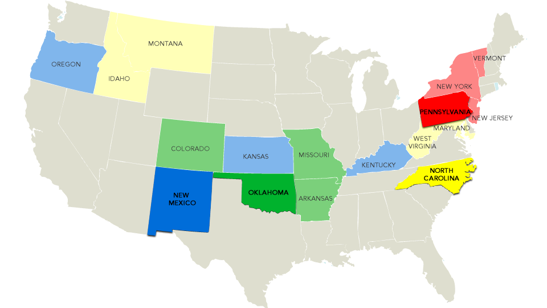
AHRQ Grantees and Their Dissemination States

Slide 5
Agricultural Cooperative Extension as Model for PCEP
Agricultural Cooperative Extension Model
  Most successful innovation spread program in U.S.
  1914 – Collaboration of federal, state, county governments, land grant universities
  Helped famers adopt best practices
  Network of local change agents

Slide 6
Plan for National PCEP
Establish state hubs and local primary care extension agents (practice facilitators)
Community-based services but central administration
An organized mechanism to spread new care models and innovations

Slide 7
Aims of PA SPREAD
The PA SPREAD initiative aimed to build on success of PA Chronic Care Initiative.
  https://www.pcpcc.org/initiative/pennsylvania-chronic-care-initiative-cci
Apply lessons learned from PA initiative to 2 new collaboratives (Southcentral and Northwest PA).
Disseminate model, lessons learned in 3 other states (NJ, NY, VT).

Slide 8
National Advisory Board
Leaders in practice transformation support, QI, testing and implementing innovations, and taking successful innovations to scale. Input from the group led to refinements in our approach within PA and as we partnered with other states.
Members of National Advisory Board
Benjamin Crabtree, PhD | Robert Wood Johnson Medical School
Darren DeWalt, MD, MPH | University of North Carolina School of Medicine
Kevin Grumbach, MD | University of California, San Francisco School of Medicine
William Miller, MD, MA | Lehigh Valley Health Network
James Mold, MD, MPH | University of Oklahoma Health Sciences Center
Jay Moskowitz, PhD | Health Sciences South Carolina
Warren Newton, MD, MPH | University of North Carolina School of Medicine
Patrick O’Connor, MD, MPH | HealthPartners
Leif Solberg, MD | HealthPartners

Slide 9
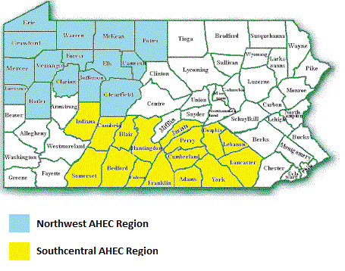
Pennsylvania AHEC
The Pennsylvania Area Health Education Center (AHEC) served as the dissemination infrastructure for PA SPREAD.
  Mission: Promote primary care in rural and medically underserved areas and train future generations of health care professionals.
  Statewide presence
Learning collaboratives were conducted in the Northwest and Southcentral regions.

Slide 10
Practice Demographics
21 diverse practices were recruited; 16 practices completed the year long collaborative
  1-15 Physicians per practice
  Panels sizes ranging from 611-40,000
  Geography: rural, urban and suburban
  Payer Mix: Medicaid, Medicare, Private and Uninsured
  Most had EHRs to start and were working toward Meaningful Use
  One practice was a Federally Qualified Health Center, and two were Rural Health Centers
  Some were hospital owned (n=3), some were independent (n=7), and some were part of a network of physician practices (n=6)
  56% of practices were located in a rural county
  2 practices sites were in Primary Care Health Professional
  Shortage Areas

Slide 11
Focus of Collaboratives
Transformation/Paradigm Shift
  Population Management - shift from treating one patient at a time to managing populations of patients
  Continuum of care - shift from defining a single medical encounter as a complete entity to viewing it as one point on a continuum of care
  Team-based care - shift from the physician providing care alone to coordinated, physician-led interprofessional team care.
Educated practices about
  Patient Centered Medical Home
  Chronic Care Model

Slide 12
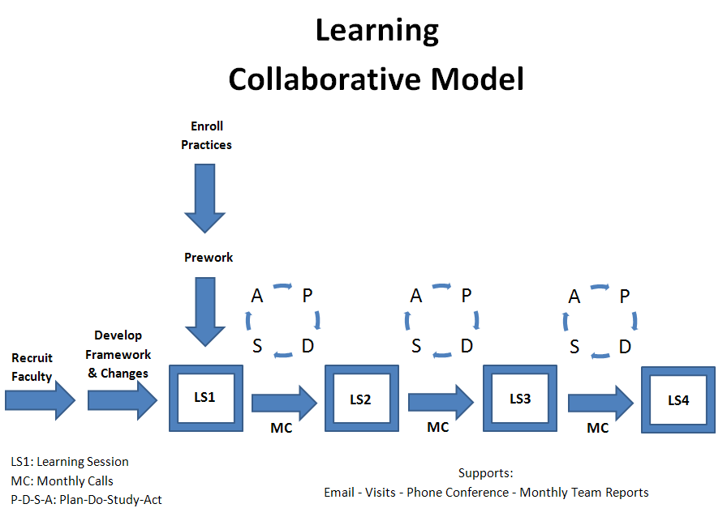
Learning Collaborative Model: Rapid Cycle Tests of Change
Source: Institute for Healthcare Improvement

Slide 13
Learning Sessions
The collaborative consisted of four quarterly Learning Sessions held in the evenings in each region. The focus of each Learning Session was as follows:
Learning Session 1 | Learning Session 2 | Learning Session 3 | Learning Session 4
Population management/ Planned care at every visit | Patient self-management support | Risk stratification of patients | Celebration of improvement
Process redesign | Case discussion on diabetes care | Care coordination/care management | Sustaining and spreading improvement
Using Plan-Do-Study-Act cycles to rapidly test improvement ideas | NCQA PCMH Standards | Linking with community resources

Slide 14
Practice Facilitation
Practice facilitators:
  Supported practice with QI processes, techniques
  Served as sounding board/provide feedback and benchmarking
  Assisted in finding tools and resources
  Helped prioritize change activities
  Served as “honey bee” networker
  Assessed practice education, training needs
  Provided “motivational coaching” (cheerleader)
  Assisted with problem-solving

Slide 15
Practice Facilitator Training
Two-day in-person training with experts in practice facilitation to learn PCMH and Chronic Care models, coaching Plan-Do-Study-Act rapid improvement cycles, and spend time with practice leader.
Weekly conference calls with the PA SPREAD team to debrief, network, and troubleshoot.
Statewide Practice Facilitator Forum to foster networking and learning among all facilitators working across Pennsylvania.
  To date, 3 forums have been held with the last being in September 2014.

Slide 16
Data Collection
Practices submitted monthly diabetes process and outcome measures during the intervention, as well as at one-year post intervention.
Practices also submitted brief written reports on the changes they were making and the challenges they were facing.
These reports guided practice facilitators’ work with the practices.

Slide 17
Diabetes Quality Measures
A1C>9
A1C<8
BP<140/90
LDL<100
Tobacco Query
Nephropathy Screening/Treatment
Dilated Eye Exam Results Documented
Foot Exam
Patients with Self-Management Goal(s)
Tobacco Cessation Intervention

Slide 18
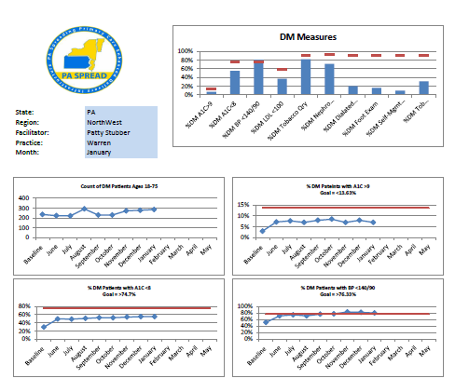
Monthly Run Charts
Allowed an overall view of practice performance.

Slide 19
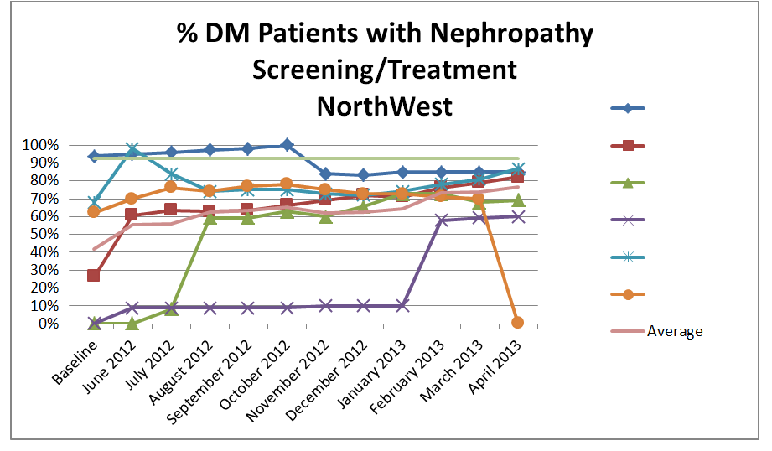
Benchmarking Reports
Enabled practices to see how they measured up to their peers.

Slide 20
‘Medical Homeness’ Assessment
Patient Centered Medical Home Assessment (PCMH-A) at baseline, end of collaborative, and 12 months later
  Allowed practices to self-assess their level of “medical homeness” in eight PCMH concept areas:
  Empanelment, Continuous Team-Based Healing Relationships, Patient Centered Interactions, Engaged Leadership, Quality Improvement Strategy, Enhanced Access, Care Coordination, and Organized Evidence-Based Care
  http://www.improvingchroniccare.org/downloads/ pcmha.pdf

Slide 21
Incentives for Practices
CME and Maintenance of Certification (MOC) credits for attending learning sessions and leading practice QI.
Helped sustain engagement (i.e., attendance and reporting) in the absence of financial incentives.

Slide 22
Collaborative Results
Learning sessions consistently rated a 4 or better on a scale of 1-5, with 5 being the highest on evaluation surveys.
By last learning session, attendees said they were highly confident about accomplishing what they wanted or needed to do in terms of practice improvement (8.5 average in Southcentral PA and 8.9 average in Northwest PA), on a scale of 1-10, with 10 being the highest.
Consistently appreciative feedback for the assistance provided by PA SPREAD.

Slide 23
Participant Comments
“The entire program was very well done. I thoroughly enjoyed this program.”
“I liked the examples and gentle accountability pressure.”
“Sharing ideas, what worked/what didn’t has been most beneficial.”
“PA SPREAD provided great info, support and preparation.”
“Without our AHEC practice facilitator’s encouragement I might not have been able to finish this year.”
“I know my EMR, finally.”
“It’s been most helpful in getting all members of our staff involved and invested in a common goal.”
“The PA SPREAD initiative is preparing us for everything still to come.”
“Make sure everyone learns about this!”
“Developing successful processes within one site.”

Slide 24
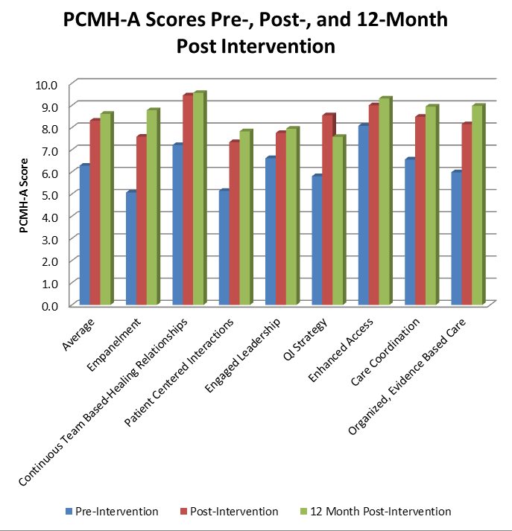
PCMH Improvement
Steady and sustained improvement across all practices in all eight PCMH-A content areas.
More than half of participating practices obtained NCQA Level 3 PCMH recognition within a year post-collaborative.

Slide 25
Clinical Improvement
In the statewide aggregate, PA SPREAD practices achieved significant improvement on diabetes process measures (eye exams, foot exams, nephropathy screening) by the end of the learning collaborative.
Diabetes outcome measures (A1c, BP, LDL) trended towards improvement but did not show statistical significance. Changes in process measures support the notion that practice changes may ultimately lead to changes in clinical measures.

Slide 26
PA SPREAD Partners
Convened partners from across the state to begin to discuss what may be needed in a Primary Care Extension Program. Partners included:
    State Department of Health
    State Medicaid Program
    Primary care professional societies
    State Medicaid Quality Improvement Organization (QIO)
    Area Health Education Center (AHEC)
    Consumer groups
    Pennsylvania’s Primary Care Association
A full list of partnering organizations can be found here: http://paspread.com/partners/

Slide 27
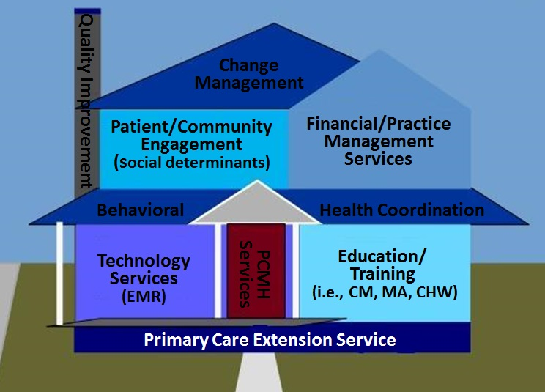
General Contractor Model
Model for collaboration developed by the PA SPREAD Partners, where the PCEP would coordinate partners’ expertise to support practice transformation.

Slide 28
Statewide Provider Survey
“How can the Primary Care Extension Service most help you and your practice?”
  Quality Improvement
  Practice Management
  Patient Care
  Medical Records
  Financial Management
  External Partnerships and Collaborations
Distributed by PA Partners, June-Oct 2012
556 responses – at least 1 response from every county in PA
6 domains
surveyed

Slide 29
Provider Survey Demographics
Specialty/Training
Type of Practice

Slide 30
Provider Survey Demographics
Practice Size
NCQA Recognized

Slide 31
Provider Survey Demographics
Involved with PA CCI
Involved in Another PCMH Effort

Slide 32
Provider Survey Results
Want Access to Practice Coach
Plans to Be PCMH Recognized
If Not Already

Slide 33
Provider Survey Results
Time Spend Monthly on QI
Time Willing to Spend Monthly on QI

Slide 34
Provider Survey Results
Top 10 Rated Needed Services
Identifying and coordinating referrals to mental health services.
Improving office efficiency (workflow).
Increasing overall revenues.
Strategies to help Implement evidence-based clinical guidelines.
Helping patients set self-management goals.

Slide 35
Provider Survey Results
Top 10 Rated Needed Services
Identifying and connecting with local community resources (e.g. Area Agencies on Aging, transportation and housing services, food banks) to support patients.
Improving staff satisfaction.
Providing self-management support to patients.
Making changes in clinical and administrative processes to improve quality.
Increasing pay-for-performance revenue.

Slide 36
Provider Survey Results
Bottom 10 Rated Needed Services
Implementing e-prescribing.
Implementing an electronic medical record (EMR) system.
Implementing group visits.
Recruiting new patients (marketing).
Implementing open or advanced access scheduling.

Slide 37
Provider Survey Results
Bottom 10 Rated Needed Services
Identifying support services (in addition to your customer service rep) for your EMR.
Achieving “meaningful use” standards for using and sharing electronic health information.
Managing human resources.
Establishing a patient portal or electronic communication with patients to share test results, etc.
Participating in practice-based research to answer practice-informed research questions.

Slide 38
Few Statistical Differences
No statistical difference in needs/wants based on:
  Practice size
  Practice type
Non-PCMH recognized wanted more help:
  Recruiting new patients
  Improving collections
  Increasing overall revenues
Providers that did not participate in the PA CCI wanted more help applying for PCMH recognition.
Family physicians wanted less assistance with e-Rx than internists and pediatricians.

Slide 39
Multi-State Meetings
3 meetings with representatives from Pennsylvania, New York, New Jersey, and Vermont
Key Participants Included:
  State Government:
    State Department of Health
    State Medicaid Program
  Other Stakeholders:
    Primary care professional societies
    State Medicaid Quality Improvement Organization (QIO)
    Area Health Education Centers (AHEC)
    Consumer groups
    State Primary Care Associations
    Academic primary care training programs

Slide 40
Ideas from Multi-State Meetings
Initiate efforts to educate purchasers about value of primary care.
Connect primary care with purchasers.
Think about a developmental model of the Primary Care Extension Program (see next slide).
How a general contractor model or public utility model might work as financing models.
Discuss within each state what aspects of the Extension Service already exists and how to coalesce these elements.

Slide 41
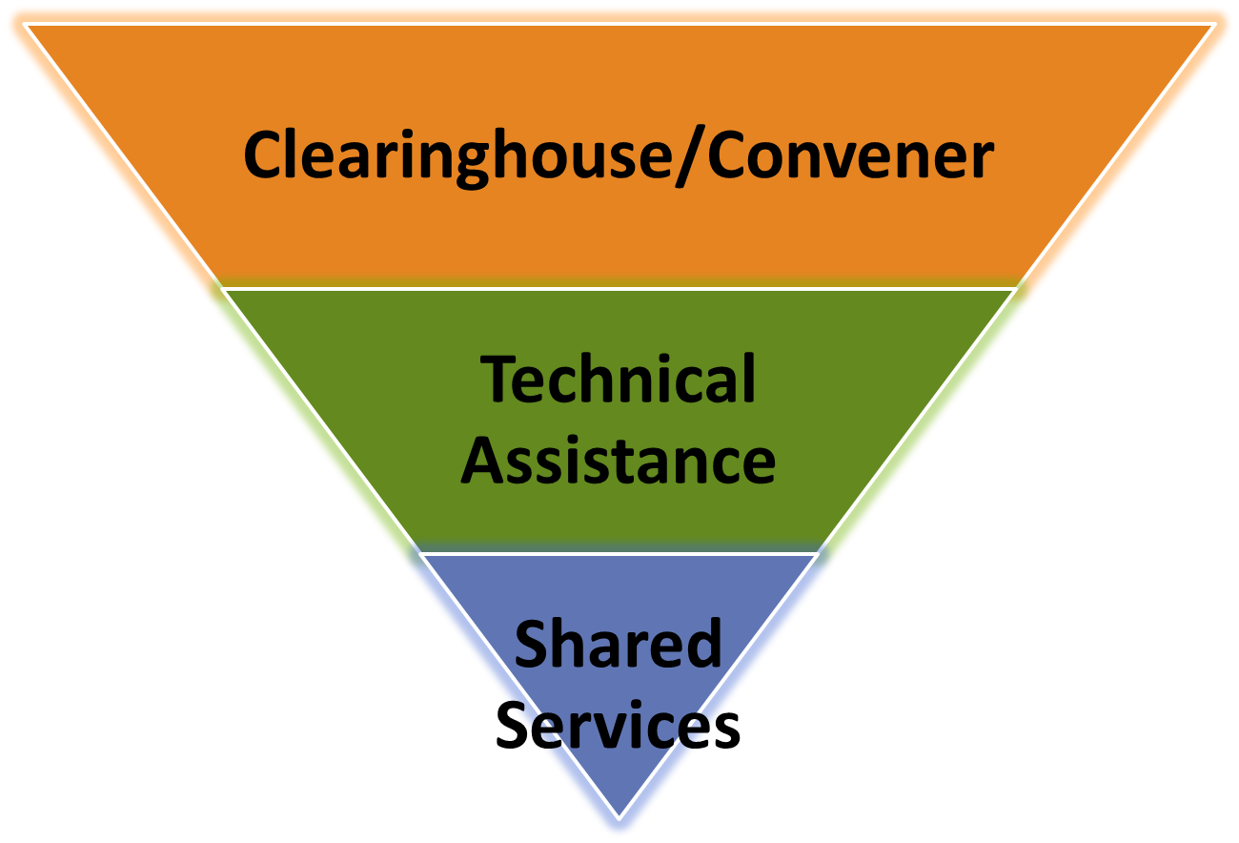
Developmental Model of PCEP
Roles the PCEP could serve in supporting primary care practice transformation (described on next slides).

Slide 42
Functional Levels of PCEP
Convener/Clearinghouse/“General Contractor”
  Facilitate alignment of resources in a state
  Align quality improvement activities and metrics
  Knowledge management and dissemination of best practices
  Education for practices, systems

Slide 43
Functional Levels of Extension
Technical Assistance
  Direct services to practices via:
    Data collection, monitoring, feedback, and benchmarking
    Academic detailing
    Practice facilitation
    Learning collaboratives

Slide 44
Functional Levels of Extension
Shared Services
  Offering personnel to practices to support transformed care, such as:
    Care managers or coordinators
    HIT support
    Community health workers
    Patient educators or navigators
    Behavioral health consultants
    Pharmacy consultants

Slide 45

Please contact us if you have any questions
For more detailed results on the PA SPREAD Collaborative, please reference the Final Report to the Agency for Healthcare Research and Quality.
Resources: www.PASPREAD.com
aadelman@hmc.psu.edu
robert.gabbay@joslin.harvard.edu

