Slide 1
National Healthcare Quality and Disparities Report
Chartbook on Health Care for Hispanics
October 2015
This presentation contains notes. Select View, then Notes page to read them.

Slide 2
Goals of the Chartbook on Health Care for Hispanics
Commemorates the 30th Anniversary of the Report of the Secretary’s Task Force on Black and Minority Health (Heckler Report)
Highlights progress for Hispanics on priorities of the Heckler Report
Summarizes trends in health care disparities by Hispanic ethnicity related to:
Access to health care.
Priorities of the National Quality Strategy (NQS).
Presents information on a unique, largely Hispanic population: residents of the U.S.-Mexico border

Slide 3
Organization of the Chartbook on Health Care for Hispanics
Part of a series related to the National Healthcare Quality and Disparities Report (QDR).
Organized into four parts:
Overviews of the QDR and the Hispanic population, one of AHRQ’s priority populations
Summary of trends in health care for Hispanic populations related to priorities of the Heckler Report
Summary of trends in health care for Hispanic populations related to access to health care and NQS priorities
Information on health care received by residents of the U.S.-Mexico border, a unique and largely Hispanic population

Slide 4
Key Findings of the Chartbook on Health Care for Hispanics
Data on access to and quality of health care received by Hispanics were available for almost all measures tracked in the QDR.
Among Heckler Report priorities, disparities in mental health care and diabetes care were big problems for Hispanics.
Hispanics have worse access to care although this is improving since the Affordable Care Act.
Hispanics receive poorer quality of care, especially as related to person centeredness.
Residents of the U.S.-Mexico border face unique health care challenges.

Slide 5
Part 1: Overviews of the Report and the Hispanic Population
National Healthcare Quality and Disparities Report
Chartbook on Health Care for Hispanics

Slide 6
National Healthcare Quality and Disparities Report
Annual report to Congress mandated in the Healthcare Research and Quality Act of 1999 (P.L. 106-129)
Provides a comprehensive overview of:
Quality of health care received by the general U.S. population
Disparities in care experienced by different racial, ethnic, and socioeconomic groups
Assesses the performance of our health system and identifies areas of strengths and weaknesses along three main themes:
Access to health care
Quality of health care
NQS priorities

Slide 7
National Healthcare Quality and Disparities Report
Based on more than 250 measures of quality and disparities covering a broad array of health care services and settings
Data generally available through 2012
Produced with the help of an Interagency Work Group led by the Agency for Healthcare Research and Quality and submitted on behalf of the Secretary of Health and Human Services

Slide 8
Key Findings of the 2014 QDR
The Nation has made clear progress in improving the health care delivery system to achieve the three aims of better care, smarter spending, and healthier people.
There is still more work to do, specifically to address disparities in care.
Access improved.
Quality improved for most National Quality Strategy priorities.
Few disparities were eliminated.
Many challenges in improving quality and reducing disparities remain.

Slide 9
Chartbook on Health Care for Hispanics
This chartbook includes summaries of trends in health care for Hispanic populations related to:
Priorities of the Heckler Report
Access to health care
Priorities of the National Quality Strategy
Introduction and Methods contains information about methods used in the chartbook.
Appendixes include information about measures and data.
A Data Query tool (http://nhqrnet.ahrq.gov/
inhqrdr/data/query) provides access to all data tables.

Slide 10
Key Metrics Used in Chartbooks
Trends: Assesses the rate of change over time (typically 2002-2012) for a population using regression for measures with 4+ time points
Disparities: Assesses whether measure estimates for two populations differ at the most recent time point
Change in Disparities: Assesses whether the rates of change over time for two populations differ using regression
Achievable Benchmarks: Defines a level of performance for a measure that has been attained by the best performing States
Notes:
In this chartbook Hispanics are usually contrasted with non-Hispanic Whites and non-Hispanic Blacks. To make text more concise, the labels White and Black are used to refer to populations that are non-Hispanic White and non-Hispanic Black, respectively. In addition, unless otherwise specified, Hispanics include all races.
Examples of successful interventions come from the AHRQ Health Care Innovations Exchange: https://innovations.ahrq.gov/.
See Introduction and Methods for more information about methods used in the chartbook.

Slide 11
HHS Data Collection Standards for Race and Ethnicity, 2011
Are you of Hispanic, Latino/a, or Spanish origin? (One or more categories may be marked)
____ No, not of Hispanic, Latino/a, or Spanish origin;
____ Yes, Mexican, Mexican-American, Chicano/a;
____ Yes, Puerto Rican;
____ Yes, Cuban;
____ Yes, another Hispanic, Latino/a, or Spanish origin
What is your race? (One or more categories may be selected)
____White
____Black or African American
____American Indian or Alaska Native
____Asian Indian
____Chinese
____Filipino
____Japanese
____Korean
____Vietnamese
____Other Asian
____Native Hawaiian
____Guamanian or Chamorro
____Samoan
____Other Pacific Islander
These categories roll up to the Hispanic or Latino category of the Office of Management and Budget (OMB) standard.
These categories are part of the current OMB standard.
These categories roll up to the Asian category of the OMB standard.
These categories roll up to the Native Hawaiian or Other Pacific Islander category of the OMB standard.
Notes:
The Affordable Care Act includes several provisions aimed at eliminating health disparities in America. Section 4302 (Understanding health disparities: data collection and analysis) focuses on the standardization, collection, analysis, and reporting of health disparities data. Section 4302 requires the Secretary of Health and Human Services (HHS) to establish data collection standards for race, ethnicity, sex, primary language, and disability status. Adopted October 31, 2011, these data collection standards are to be used, to the extent practicable, in HHS-sponsored population health surveys.
The new data standards improve the quality of HHS data collection by establishing a consistent, uniform way to capture, record, and report data on race and ethnicity with additional granularity (beyond the OMB minimum) for the Asian race category and Hispanic ethnicity, and for the first time, standardized collection of language and disability status data.
Because many of the data available to produce this chartbook were collected in 2012 and earlier, there was insufficient time to incorporate the new 2011 standards . Thus, much of the information presented here will show estimates for Hispanics in aggregate. For several data sources, information was collected for more granular Hispanic groups, and this is presented to illustrate the importance of collecting this more granular information.

Slide 12
Diversity of the Hispanic Population in the United States
Hispanics in the United States are a diverse population, including:
Mexicans (64%),
Puerto Ricans (9.4%),
Cubans (3.7%),
South Americans (5.9%),
Central Americans (9%), or
Other Spanish origin groups.
Although socioeconomically disadvantaged (except Cubans), Hispanics, particularly Mexican women, have better mortality rates than Whites.
Notes:
Source: http://minorityhealth.hhs.gov/; http://www.cdc.gov/nchs/data/nvsr/nvsr63/nvsr63_09.pdf.

Slide 13
Health of the Hispanic Population in the United States
Health of Hispanics is influenced by many factors, including language, lack of access to preventive care, lack of health insurance, and other cultural barriers.
Leading causes of morbidity and mortality include heart disease, cancer, unintentional injuries, stroke, and diabetes.
Compared with non-Hispanic Whites, Hispanics have a:
Higher prevalence of asthma, chronic obstructive pulmonary disease, HIV/AIDS, suicide, and liver disease.
Higher rate of obesity.
Notes:
Source: http://minorityhealth.hhs.gov/; http://www.nih.gov/news/health/feb2014/nhlbi-24.htm.

Slide 14
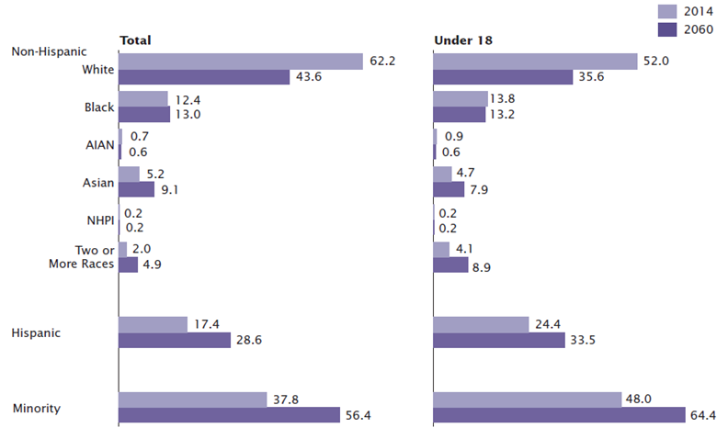
Projected Growth of the Hispanic Population Between 2014 and 2060
Distribution of Population by Race and Hispanic Origin
Key: AI/AN = American Indian or Alaska Native; NHPI = Native Hawaiian or Other Pacific Islander.
Source: U.S. Census Bureau, 2014 national projections.
Note: Unless noted, race categories represent race alone. Percentages of the population under 18 may not add to 100 due to rounding.
Notes:
In 2060, it is projected that 28.6% of the total U.S. population and 33.5% of U.S. children will be Hispanic.

Slide 15
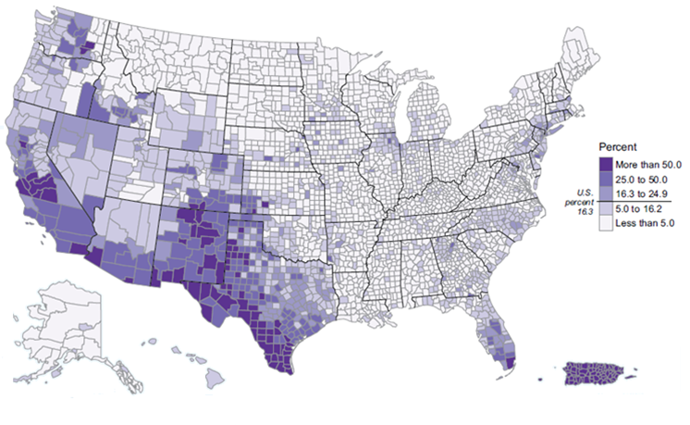
Distribution of the U.S. Hispanic Population, 2010
Hispanic or Latino Population as a Percentage of Total Population, by County, 2010
Source: U.S. Census Bureau. 2010 Census Summary File 1.
Note: For information on confidentiality protection, nonsampling error, and definitions, see www.census.gov/prod/cen2010/doc/sf1.pdf.
Notes:
Hispanics are concentrated in specific geographic locations. Three quarters of the U.S. Hispanic population live in eight States:
California (28% of Hispanics in the United States)
Texas (19%)
Florida (8%)
New York (7%)
Illinois (4%)
Arizona (4%)
New Jersey (3%)
Colorado (2%)
One-quarter of the U.S. Hispanic population live in eight counties:
4.7 million Hispanics in Los Angeles County, California
1.7 million in Harris County, Texas
1.6 million in Miami-Dade County, Florida
1.2 million in Cook County, Illinois
1.1 million in Maricopa County, Arizona
1.0 million in each of the following counties: Orange, California; Bexar, Texas; and San Bernardino, California

Slide 16
Hispanic Mothers and Children
About 84% of Hispanic mothers receive early prenatal care compared with 87% of White mothers.
Most Hispanic populations have lower infant mortality rates than Whites.
Infant mortality rates range from 3.0 for Cuban Americans to 5.9 for Puerto Ricans compared with 5.1 for non-Hispanic Whites.
Congenital malformation, low birthweight, and maternal complications are the leading causes of infant mortality among Hispanics.
Notes:
Source: https://www.acog.org; Markides & Coreil, 1986; http://minorityhealth.hhs.gov.

Slide 17
Older Hispanics in the United States
In 2012, there were:
3.1 million Hispanics age 65 and over (7% of older adults); by 2060, this is projected to increase to more than 19 million, accounting for 21% of older adults.
4,129 Hispanics age 100 and over (1,105 men, 3,024 women), or 7% of all centenarians.
Most (70%) older Hispanics lived in four States: California, Texas, Florida, and New York.
Notes:
Source: https://www.nlm.nih.gov/medlineplus/hispanicamericanhealth.html

Slide 18
Health of Older Hispanics in the United States
In 2012, the top five chronic conditions among older Hispanics were hypertension, arthritis, heart disease, diabetes, and cancer.
Nearly one-quarter (24%) of older Hispanics had Medicare and supplementary private health insurance compared with 50% of all older adults.
Nearly one-quarter (23%) of older Hispanics were covered by Medicare and Medicaid compared with 8% of all older adults.
Notes:
Source: https://www.nlm.nih.gov/medlineplus/hispanicamericanhealth.html

