Slide 1
Implementing TeamSTEPPS
Introduction

Slide 2
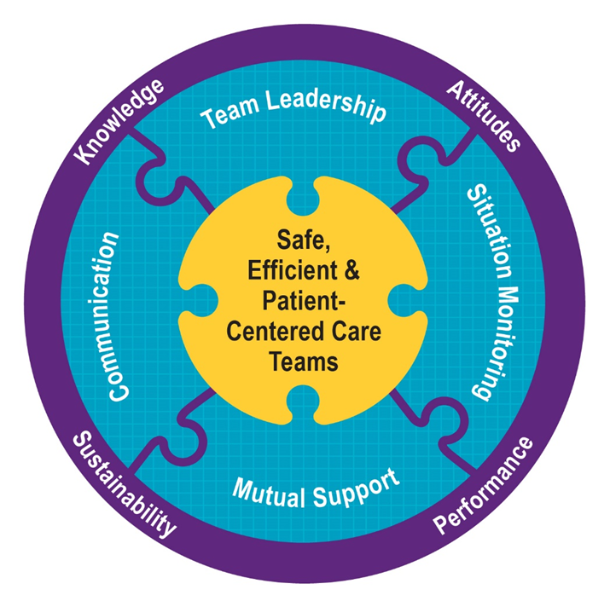
Reflecting on Day 1
Day 2 Preview
Patient safety is threatened by poor communication and teamwork.
TeamSTEPPS provides tools and a framework to improve both.
Questions or reflections on day 1.

Slide 3
Preparing for Day 2
Day 2 Preview
Day 1:
Introduction
Module 1—Communication
Module 2—Team Leadership
Module 3—Situation Monitoring
Module 4—Mutual Support
Putting It All Together
Day 2:
Should you implement TeamSTEPPS?
Are you ready?
Is there a measurable problem?
How to implement TeamSTEPPS
Implementation planning
Coaching
Change management
Refining implementation Skills
Coaching
Implementation
Practice teaching

Slide 4
Day 2 Objectives
Day 2 Preview
Learn to assess your readiness for TeamSTEPPS.
Explain measurement’s role in successful implementation.
Describe key principles of change management.
List key characteristics of successful coaching.
Practice creating an implementation plan.
Refine skills related to coaching, implementation planning, and teaching TeamSTEPPS.

Slide 5
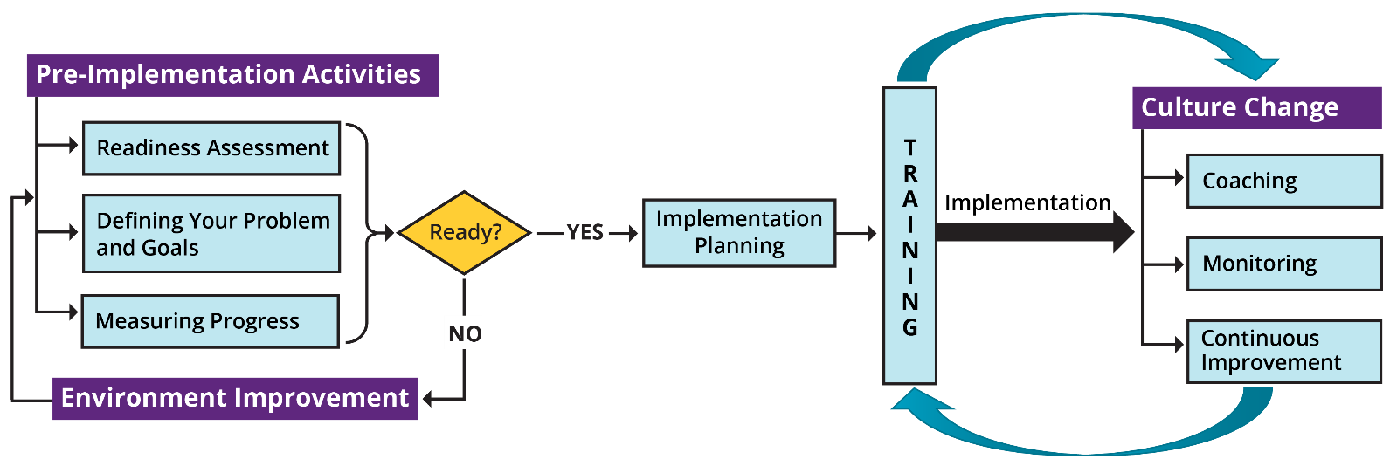
Implementation Activity Overview
Day 2 Preview

Slide 6
Implementing TeamSTEPPS:
Pre-implementation Activities
6

Slide 7
Section Objectives
Pre- Implementation
Explain how to assess your organization’s readiness for TeamSTEPPS.
List reasons defining your problem and goals is essential.
Describe options for measuring the extent of your problem and whether it is improving.

Slide 8
TeamSTEPPS is NOT a Solution for All Problems
Pre- Implementation
TeamSTEPPS will not:
Fix problems caused by acute financial or staffing shortages.
Succeed in a culture unconcerned about patient safety and focused exclusively on the bottom line.
Produce significant improvements right away or with minimal sustained effort.
Thrive in a culture that punishes individuals for systemic failures.
Many TeamSTEPPS training participants report negligible progress implementing TeamSTEPPS 6 months after their attendance.
WE DON’T WANT YOU TO BE ONE OF THESE!

Slide 9
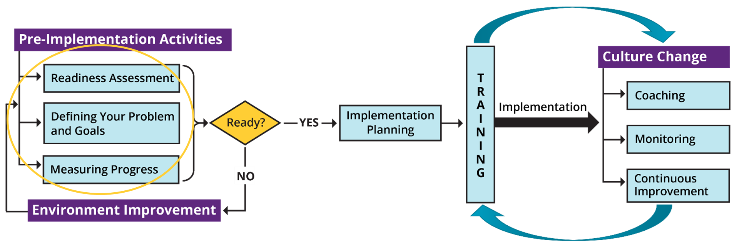
Successful Implementation Begins With Careful Pre-Implementation Planning
Pre- Implementation

Slide 10
Assessing Your Readiness
Pre- Implementation
Lack of organizational readiness is a major reason TeamSTEPPS implementations fail.
Readiness considers:
Whether there is a clearly defined need.
Whether organizational culture supports safety improvements.
Whether time, resources, and personnel are available to implement TeamSTEPPS.
Whether the organization is ready to make a SUSTAINED commitment.

Slide 11
Conducting a Readiness Assessment
Pre- Implementation
Who should participate:
Administrative sponsor
Implementation champion for the organization or unit
Key clinical influencers whose support will be essential
Representative staff who will be trained
A knowledgeable patient
How to assess readiness:
Use readiness assessment tool. (https://www.ahrq.gov/teamstepps-program/curriculum/implement/pre/ready.html)
Discuss results as a group.
Address obstacles identified in assessment results.
Examine safety culture survey results. (https://www.ahrq.gov/sops/surveys/index.html)

Slide 12
Measurement
12

Slide 13
Define a Measurable Goal or Problem You Plan To Address
Measurement
A clearly defined goal or problem will:
Help make the case to administration for investing in TeamSTEPPS.
Help staff understand the importance of TeamSTEPPS.
Enable accountability by setting clear expectations for outcomes you seek to change.
Keep the focus on patient safety.
Be measurable.
More guidance on defining your goal or aim is provided in the Action Planning discussion.

Slide 14
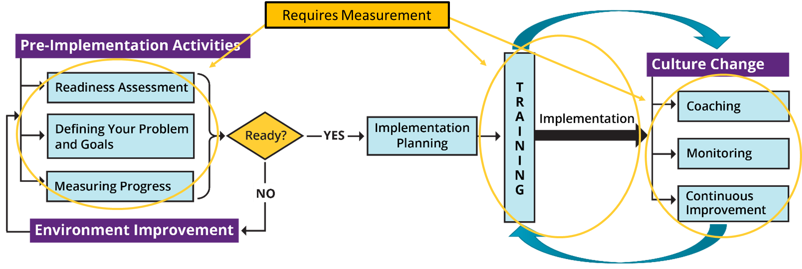
Measurement Is Foundational to Implementation
Measurement

Slide 15
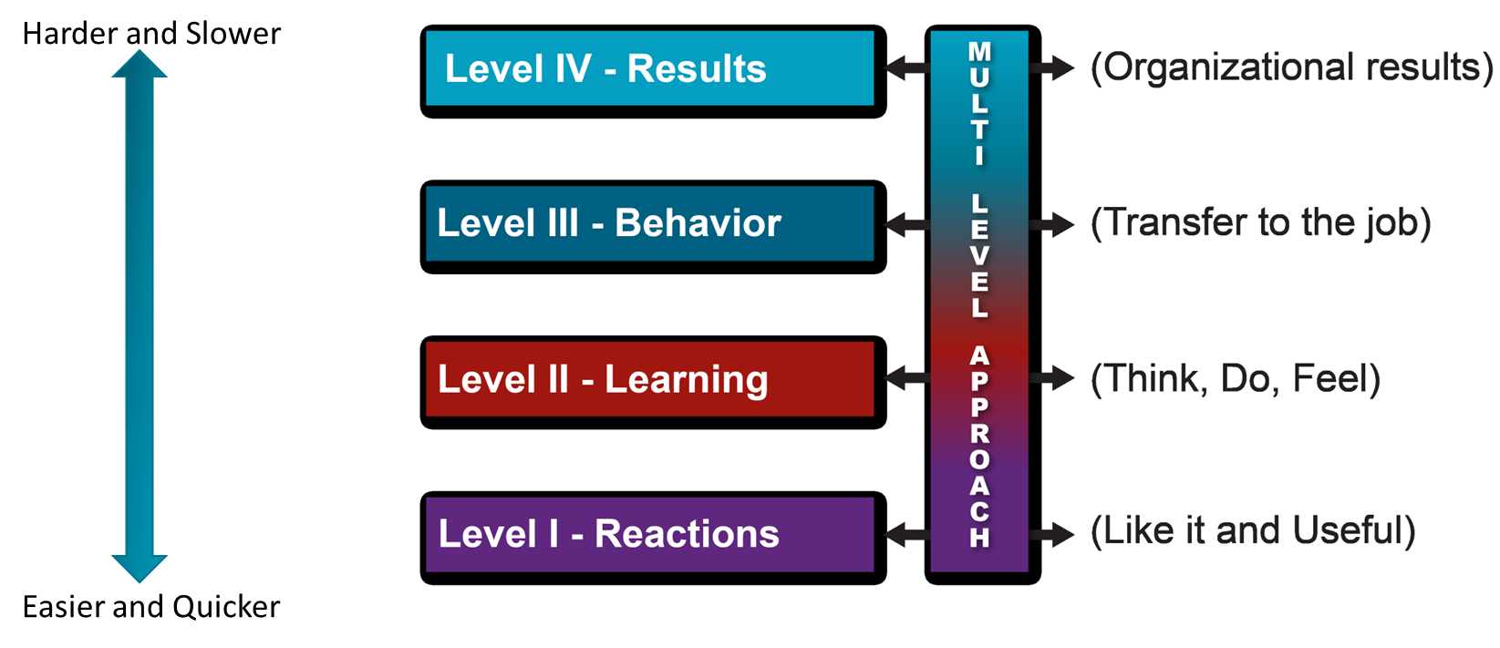
How To Measure—Different Levels
Measurement

Slide 16
TeamSTEPPS Measurement Option Overview
Measurement
Reactions
Course Evaluation Form
Open-ended feedback
Learning
Teamwork Attitudes Questionnaire (T-TAQ)
Learning Benchmarks
Team Performance Observation Tool
Teamwork Perceptions Questionnaire (T-TPQ)
Behavior
Team Performance Observation Tool
Teamwork Perceptions Questionnaire (T-TPQ)
AHRQ Surveys on Patient Safety Culture
Results
Patient outcome and clinical process measures
AHRQ Surveys on Patient Safety Culture
Patient Safety Indicators

Slide 17
Level III: Behavior Measures
Measurement
Team Performance Observation Tool.
Teamwork Perceptions Questionnaire (T-TPQ).
AHRQ Surveys on Patient Safety Culture.
CAHPS questions: can provide patient perceptions of some targeted behaviors.
Feedback from staff, patients, and supervisors: are targeted behaviors changing?

Slide 18
Level IV: Results
Measurement
Outcome changes are key to sustained organizational buy-in.
Staffing Measures:
Job satisfaction, employee turnover, and other staff measures can show if changes are positively impacting staff.
Patient Outcome Measures:
Examples: Complication rates, infection rates, measurable medication errors, and patient perceptions of care and satisfaction with their care.
Clinical Process Measures:
Examples: Length of patient wait time, time to intubate, medication administration delays, compliance with preventive screenings, number of misdiagnoses, number of structured handoffs used.

Slide 19
AHRQ Patient Safety Indicators
Measurement
Level IV Results From PSIs:
Provide information on potential in-hospital complications and adverse events.
Can help identify potential adverse events that might need further study.
Include indicators for in-hospital complications that may represent patient safety events.
Quality Indicators: PSI Measures

Slide 20
Accurately and Efficiently Measuring Outcomes
Measurement
Use preexisting measures, which are easier to monitor and more credible to the organization than new measures you have to begin collecting.
Make sure the measures you monitor are matched to the areas where you’ve implemented TeamSTEPPS. Changing one unit will only have a small effect on measures tracking the entire organization.
Match the time covered by the measure to the intervention period. Measure time lag can delay the availability of some measures substantially (especially if based on claims data or organizational or patient surveys).
Be realistic about how long process changes take to affect outcomes. Change is rarely immediate and sometimes outcomes get worse before they start getting better.

Slide 21
Evaluating TeamSTEPPS Exercise
Measurement
Three nurses and the infection control officer at a 16-bed postsurgical intensive care unit attend the 2-day TeamSTEPPS Training. During the implementation planning session, the team agrees that hand hygiene compliance is a major problem, especially physician compliance. Therefore, the unit has a relatively high surgical site infection rate.
The team decides to use CUS and the Two-Challenge Rule to address this issue. As part of their implementation, they train all the nurses and the employed physician staff on these two tools but struggle to get surgeons who are not employed by the hospital to participate. Once the training is complete, they decide to launch the implementation of CUS and the Two-Challenge Rule.

Slide 22
Implementation Planning
22

Slide 23
Objectives
Implementation
Describe the steps involved in implementing TeamSTEPPS.
Develop a TeamSTEPPS Implementation Plan.

Slide 24
Shift Toward a Culture of Safety
Implementation

Slide 25
Key Principles of Implementation
Implementation
The Implementation Guide is based on the principle of improving patient safety and quality of care by improving healthcare team processes.
Key activities include:
Identifying a recurring problem or opportunity for improvement.
Developing a flowchart or map of the process.
Studying the process to identify risk points.
Implementing interventions aimed at eliminating the risk points.
Testing the intervention.
Sustaining positive changes.

Slide 26
10 Steps of Implementation Planning
Implementation
Create a Change Team.
Define the problem, challenge, or opportunity for improvement.
Define the aims of your TeamSTEPPS intervention.
Design a TeamSTEPPS intervention.
Develop a plan for testing the effectiveness of your TeamSTEPPS intervention.
Develop an implementation plan.
Develop a plan for sustained continuous improvement.
Develop a communications plan.
Develop a TeamSTEPPS Implementation Plan timeline.
Review your TeamSTEPPS Implementation Plan with key stakeholders and modify according to input.

Slide 27
Describe the Targeted Unit/Work Area
Implementation
Key Actions:
Describe the targeted unit or work area:
Unit/Work area name
Size in terms of number of beds or admissions
Number of staff by profession:
Name of targeted unit/work area:
Size of unit/work area:
Number of staff within unit/work area:
Physicians:
Nurses:
Other:

Slide 28
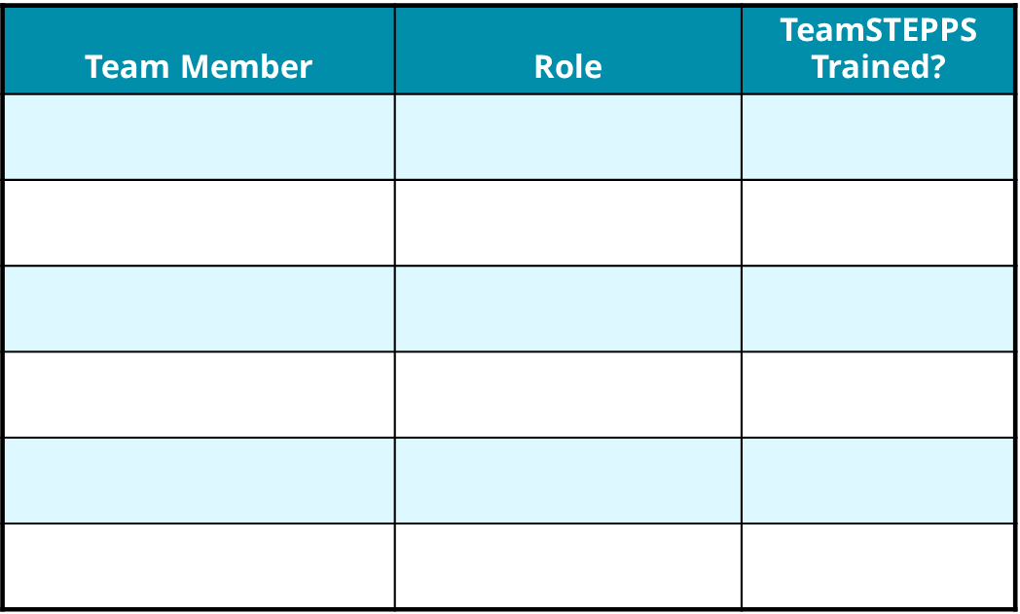
Step 1: Create a Change Team
Implementation
Key Actions:
Select a multidisciplinary Change Team.
Ensure representation from different leadership levels.
Ensure at least one member has substantial TeamSTEPPS training.
Ensure one member or advisor has experience in performance improvement.

Slide 29
Step 2: Define the Problem or Opportunity for Improvement
Implementation
Key Actions:
Review unit performance and safety data:
Incident reports
AHRQ Patient Safety Survey
Clinical process and outcome measures
Review RCAs and/or FMEAs.
Ask frontline staff.
Conduct the Magic Wand exercise.
Refer to the teamwork issue you identified on the TeamSTEPPS Implementation Worksheet as a starting point, if applicable.
What existing information will you review?
1.
2.
3.
What new information will you collect?
1.
2.
3.
What are the main problems and opportunities?
1.
2.
3.

Slide 30
Example: Problem Definition
Implementation
Problem:
Suboptimal communication among surgical team members
Team Process:
What: Communication of critical information about the patient and surgical procedure
Who: Surgeons, anesthesiologists, operating room nurses, and scrub technicians in the General Surgery Service
When: Just prior to first incision
Where: In the operating room

Slide 31
Step 3: Define the Aims of TeamSTEPPS Intervention
Implementation
Key Actions:
Develop one to three measurable aims.
What do you hope to achieve?
Who will be involved?
When and where will the improvements occur?
Consider including team process, team outcome, and clinical outcome aims.
Team Process Aims:
1.
2.
3.
Team Outcome Aims:
1.
2.
3.
Clinical Outcome Aims:
1.
2.
3.

Slide 32
Step 4: Design a TeamSTEPPS Intervention
Implementation
Key Actions:
Flowchart or map the process during which the target problem/challenge/opportunity occurs.
Identify risk points.
Determine which TeamSTEPPS tools or strategies would work best to eliminate the process risk points.
State what tools and strategies will be implemented, who will use them, when and where (Refer to your responses on the TeamSTEPPS Implementation Worksheet, if applicable).
Evaluate your TeamSTEPPS intervention for potential benefits and negative effects.
List the risk points you intend to address:
1.
2.
3.
List the TeamSTEPPS tools and strategies that will be implemented:
1.
2.
3.
List the order in which the tools and strategies will be implemented:
1.
2.
3.

Slide 33
Step 5: Develop a Plan for Testing Your TeamSTEPPS Interventions
Implementation
Key Actions:
Identify who on your Change Team will be responsible for data collection, analysis, and presentation (generation of graphs and charts).
Identify a measure and define target ranges for that measure.
Measure before and after you implement TeamSTEPPS.
Consider Kirkpatrick’s taxonomy when selecting measures.
Who is responsible?
At what level will you measure and what measures will you use?
1. Level I Reactions:
2. Level II Learning:
3. Level III Behavior:
4. Level IV Results:

Slide 34
Step 6. Develop an Implementation Plan
Implementation
Key Actions:
Determine who needs to be trained on what TeamSTEPPS skills and by when.
Develop a training plan for each audience.
Determine if refresher training is required.
Create training timelines.
Who will attend the training sessions?
What skills will you train?
When will the training sessions occur and for how long?
Where will the sessions occur?
How will you train (method of presentation, tools, supplies)?
What are the logistics to consider?

Slide 35
Determine How Coaches May Be Used
Implementation
Key Actions:
Determine whether coaches will be used to facilitate sustainment.
If coaches will be used, determine:
How many are needed?
When and how will they be trained
How will they be used?
What are the expectations for the role of coaches?
Will coaches be used?
If Yes:
Ho many are required?
When will coaches be trained?
How will coaches be trained?
How will coaches be used?
What are the expectations for the role of coaches?

Slide 36
Step 7: Develop a Sustainment Plan
Implementation
Key Actions:
For your monitoring plan, determine:
Measures and target outcomes.
Data source (e.g., existing QI database).
Resources required (money, time, equipment, personnel, expertise).
Person(s) responsible for implementation and oversight.
Determine how data from your monitoring plan will be used to continually improve processes and performance.
Identify Components of a Monitoring Plan:
1. Measures and Targeted Outcomes:
2. Data Sources:
3. Resource Requirements:
4. Individual Responsible:

Slide 37
Step 8: Develop a Communications Plan
Implementation
Key Actions:
Develop a communications plan.
Identify goals for communication with this group. What do you want to achieve?
Who will receive the information?
What information will you communicate?
When and how often will you communicate?
How will you communicate (e.g., reports, presentations, emails)?
Who are the stakeholders?
1.
2.
What do you want to achieve?
1.
2.
What information will you communicate?
1.
2.
When will you communicate?
1.
2.
How will you communicate?
1.
2.

Slide 38
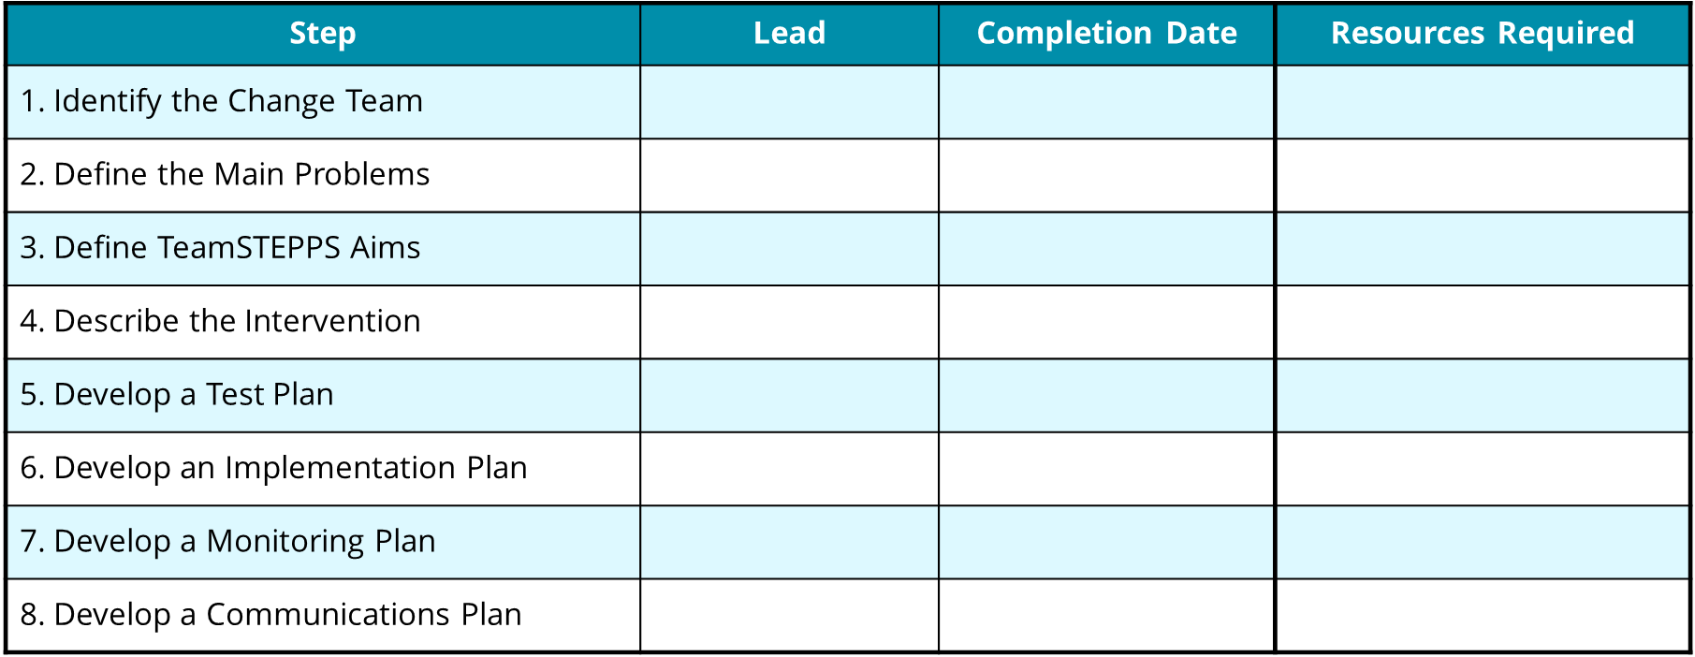
Step 9. Develop an Implementation Plan Timeline
Implementation

Slide 39
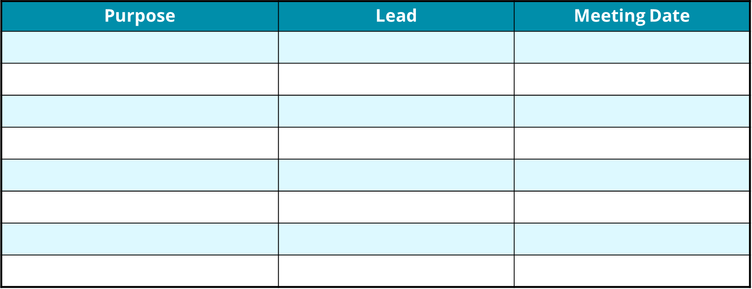
Change Team Meetings
Implementation

Slide 40
Step 10: Review Your Plan With Key Stakeholders
Implementation
Key Actions:
Identify stakeholders who could contribute significantly to the Implementation Plan.
Ask key stakeholders to review your Action Plan and to provide input.
Modify your Action Plan based on their input, if needed.
Which key stakeholders should review the plan?
1.
2.
3.
4.
5.

Slide 41
TeamSTEPPS Implementation Planning Exercise
Implementation
Break into working groups by unit or by best alignment of common issues.
Develop your Action Plan based on the 10-step process.
Be ready to present and discuss your Action Plan with the larger group.

Slide 42
Coaching for Culture Change
42

Slide 43
Objectives for Coaching
Coaching
Define coaching and its outcomes.
Describe the role of a TeamSTEPPS coach.
List competencies of an effective coach.
Describe how to implement coaching in TeamSTEPPS.

Slide 44
TeamSTEPPS Implementation Process
Coaching

Slide 45
Coaching
Coaching
Involves providing instruction, direction, and prompting
Includes demonstrating, reinforcing, motivating, and providing feedback
Requires monitoring and ongoing performance assessment
Continues even after skills are mastered to ensure sustainment

Slide 46
Why Is Coaching Important?
Coaching
Effective coaching can result in:
Clear and defined goals.
Aligned expectations between team leader and team members.
“Just-in-time” knowledge transfer.
Increased individual motivation and morale.
Increased ability to adapt and react.
Early identification of unforeseen performance barriers.
Commitment to ongoing learning and improvement.
Movement toward superior team performance.

Slide 47
Why Is Coaching Important in TeamSTEPPS?
Coaching
Effective coaching in TeamSTEPPS further aims to achieve:
Successful integration of teamwork behaviors into daily practice.
Increased understanding of teamwork concepts.
Increased teamwork competence among staff.
Sustainment of improved performance over time.
Improved team performance and safer patient care.

Slide 48
The Role of a TeamSTEPPS Coach
Coaching
Be a role model for desired behaviors.
Observe performance and provide feedback.
Motivate team members.
Provide opportunities to practice and improve.

Slide 49
The Coach as a Role Model
Coaching
Demonstrates effective use of teamwork behaviors, tools, or strategies
As a respected member of the team, reinforces acceptance of behavior through performance

Slide 50
Coaches Provide Feedback That Is…
Coaching
Timely.
Respectful.
Specific.
Directed toward improvement.
Two way.
Considerate.

Slide 51
The Coach as a Motivator
Coaching
Helps team members see the bridge between new behaviors and patient safety and outcomes
Encourages belief in team members’ abilities to succeed
Expresses enthusiasm and commitment
Validates current levels of accomplishment while advocating greater achievement
Recognizes successful performance
Identifies potential challenges, pitfalls, and unforeseen consequences
Offers support, assistance, and empathy
Communicates positive results and outcomes

Slide 52
Providing Opportunities To Practice
Coaching
Can be formal/structured or informal.
Examples include:
Ask team members how they might have approached a situation differently by using a TeamSTEPPS tool or strategy.
Use scenarios during staff or team meetings to discuss or simulate the effective use of a TeamSTEPPS tool or strategy.
Develop tools that facilitate use of a tool or strategy, such as notepads that outline the SBAR components.
Provide staff with a TeamSTEPPS “tip of the week.”

Slide 53
Exercise: Effective Coaches
Coaching
Think about coaches you’ve known or observed…
What characteristics did those coaches have that made them effective?
Are coaching characteristics innate or can they be learned?

Slide 54
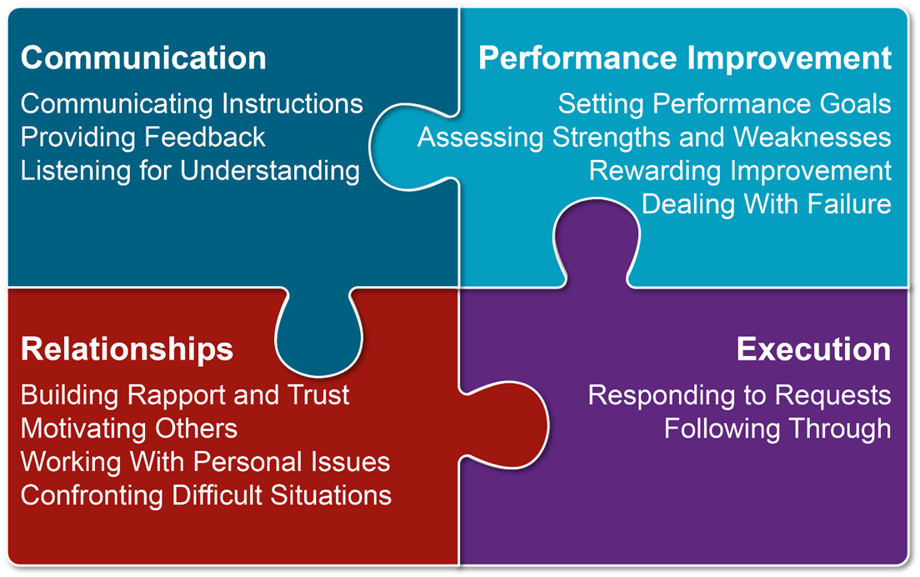
Coaching Competencies
Coaching

Slide 55
Exercise: Coaching Self-Assessment
Coaching
Complete a coaching self-assessment form to identify coaching strengths and areas for improvement.

Slide 56
Implementing Coaching in TeamSTEPPS
Coaching
Develop a coaching plan and gain buy-in.
Identify coaches.
Train and prepare coaches.
Prepare staff to receive coaching.
Ensure organizational support for coaches.

Slide 57
Develop a Coaching Plan
Coaching
As part of implementation planning, determine whether and how coaching will be used.
To obtain buy-in, present coaching plan to leadership, including:
Importance of coaching in TeamSTEPPS.
Specific plans and considerations for implementation (e.g., number of coaches required, time required, costs).
Anticipated performance improvements and results.

Slide 58
Identifying and Preparing TeamSTEPPS Coaches
Coaching
When identifying coaches, consider:
Where TeamSTEPPS will be implemented.
Individual characteristics and competencies.
Number of coaches needed.
Conduct a training session on coaching for the identified coaches.
Match coaches with team members, if appropriate.

Slide 59
Prepare Staff for TeamSTEPPS Coaching
Coaching
Identify who the coaches are to the staff.
Describe the goals and positive outcomes of coaching.
Explain the role and responsibilities of coaches.
Describe the expectations regarding staff interactions with coaches.

Slide 60
Organizational Support for Coaches
Coaching
Include coaches in efforts to integrate TeamSTEPPS performance into the organization:
Leverage coaches’ work with frontline staff and knowledge of barriers.
Formally recognize or reward coaches for contributions to the team’s success.
Provide opportunities for coaches to work together to plan, problem solve, and share feedback:
Promotes and reinforces accountability.

Slide 61
Coaching Tips
Coaching
Do…
Actively monitor and assess team performance.
Establish performance goals and expectations.
Acknowledge desired teamwork behaviors and skills through feedback.
Coach by example; be a good mentor.
Do not…
Coach from a distance when avoidable.
Coach only to problem solve.
Lecture instead of coach.

Slide 62
Exercise: Coaching Practice
Coaching
Use the coaching feedback form and a scenario you’ve selected to gain practice coaching and evaluating the coaching of others or yourself.

Slide 63
Change Management
Achieving a Culture of Safety
63

Slide 64
Objectives for Change Management
Change Management
List the Eight Steps of Change.
Identify errors common to organizational change.
Discuss what is involved in creating a new culture.
Begin planning your organizational change strategy.

Slide 65
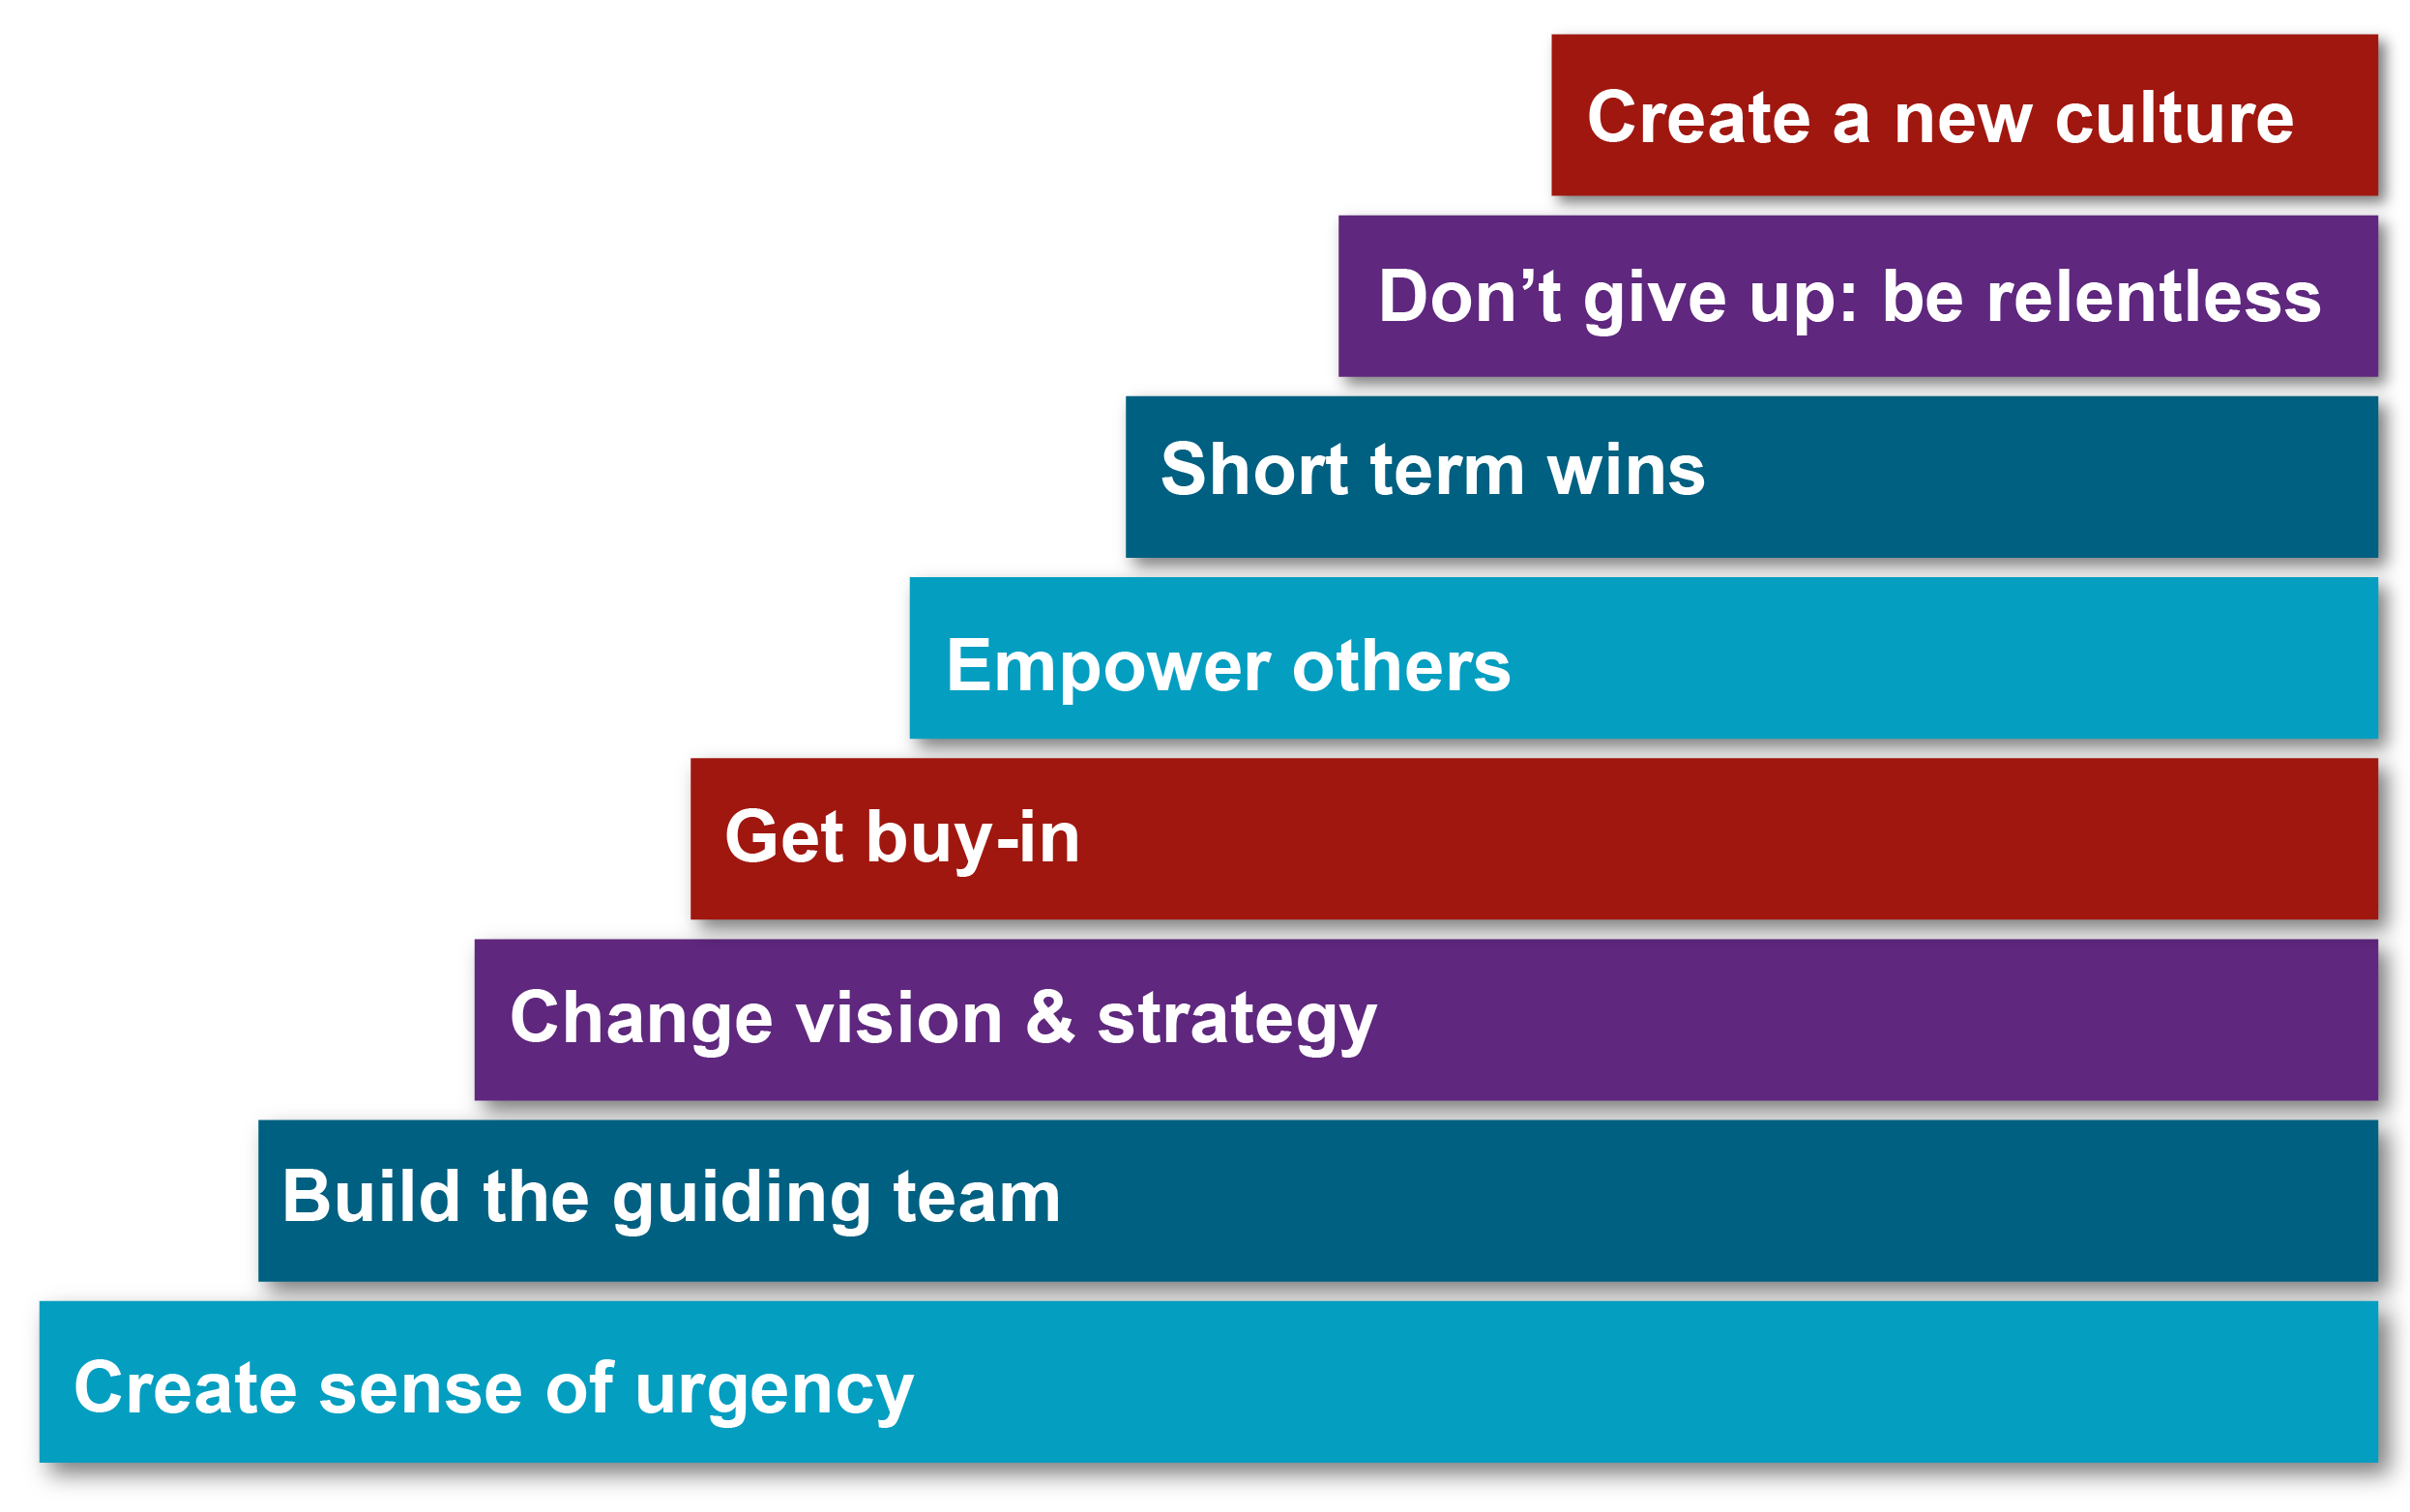
Eight Steps of Change
Change Management

Slide 66
Set the Stage and Create a Sense of Urgency
Change Management
Get people’s attention!
Sell the need for change…describe the consequences of not changing.
Immerse people in information about the change.
Discuss ways to solve the problems people identify with the change.
Empower people to solve the “problem.”

Slide 67
Pull Together the Guiding Team
Change Management
Choose key players, especially staff-level managers (don’t forget nights and weekends).
Identify a Guiding Team that is multidisciplinary.
Consider the credibility and integrity of change leaders.
Choose proven leaders who can drive the change process:
Strong position power, broad expertise, and high credibility.
Ensure the Guiding Team has both management and leadership skills:
Management skills control the process.
Leadership skills drive the change.

Slide 68
Develop the Change Vision and Strategy
Change Management
Senior leadership is responsible for:
Establishing the definition of a “culture of safety” aligned with expectations, core values, and shared beliefs.
Informing the organization of these values and evaluating the culture.
Leading the process of:
Translating values into expected behaviors.
Establishing trust and accountability.
Communicating a commitment to shaping the culture.

Slide 69
Communicate for Understanding and Buy-In
Change Management
Provide supportive actions for fear, anger, and resistance.
Encourage discussion, dissent, disagreement, debate—keep people talking.
Tell people what you know―and what you don’t know.
Acknowledge concerns, perceived losses, and anger.
Model the expected behaviors.
Value resisters.
They clarify the problem and identify other problems that need to be solved first.
Their tough questions can strengthen and improve the change.
They may be right―it is a dumb idea!

Slide 70
Empower Others To Act
Change Management
Provide direction.
Allow others to find their own team-driven solutions.
Encourage others to speak up and take risks.
Share the information you know.
Encourage teamwork and collaboration.
Encourage personal reflection and learning.
Train employees so they have the desired skills and attitudes.
Track activities and progress.
Set short-term goals.

Slide 71
Produce Short-Term Wins
Change Management
Show visible success, which is further impetus for change.
Provide positive feedback; recognize and reward contributions to wins.
Further builds morale and motivation.
Leverage lessons learned to help plan next goal.
Create greater difficulty for resisters to block further change.
Provide evidence of success to leaders.
Build momentum.
Helps draw in neutral or reluctant supporters.

Slide 72
Don’t Let Up
Change Management
Acknowledge hard work.
Celebrate successes and accomplishments.
Reaffirm the vision.
Bring people together toward the vision.
Acknowledge what people have left behind.
Develop long-term goals and plans.
Provide tools and training to reinforce new behaviors.
Reinforce and reward the new behaviors.
Create systems and structures that reinforce new behaviors.
Prepare people for the next change.

Slide 73
Create a New Culture
Change Management
Develop action steps for stabilizing, reinforcing, and sustaining the change:
Give people time to mourn their actual losses.
Provide skill and knowledge training.
Develop new reward systems.
Recognize and celebrate accomplishments.
Develop performance measures to continually monitor the results from the change and to identify opportunities for further improvements.
Make adjustments to the change vision and strategy to reflect new learning and insights.
Encourage people to be open to new challenges, forces, and pressures for the next change.

Slide 74
Organizational Change Exercise
Change Management
In your group answer the following questions:
Why do some of your organization’s initiatives fail?
Of these risks, which seem biggest for implementing TeamSTEPPS?
What can you do to avoid or manage these risks?
Report out on your major conclusions and recommendations.

Slide 75
Errors Common to Organizational Change
Change Management
Allowing for complacency
Failing to create a sufficiently powerful Guiding Coalition and Change Team
Not truly integrating the vision
Allowing obstacles to block change
Not celebrating short-term wins
Declaring victory too soon
Neglecting to anchor changes firmly in the culture

Slide 76
Culture Change Comes Last, Not First
Change Management
Most alterations in norms and shared values come at the end of the transformation process.
New approaches sink in after success is shown.
Feedback and reinforcement are crucial to buy-in.
Sometimes the only way to change culture is to change key people.
Individuals in leadership positions need to be on board, or the old culture will reassert itself.

Slide 77
TeamSTEPPS Change Model
Change Management

Slide 78
Other Change Models
Change Management
PDSA: Plan, Do (TeamSTEPPS), Study, Act
DMAIC: Define, Measure, Analyze, Improve (TeamSTEPPS), Control
IHI Model for Improvement: Forming the Team, Setting Aims, Establishing Measures, Selecting Changes, Testing Changes, Implementing Changes (TeamSTEPPS), Spreading Changes
CUSP: Assemble the Team, Engage the Senior Executive, Understand the Science of Safety, Identify Defects through Sensemaking, Implement Teamwork and Communication (TeamSTEPPS)
Six Sigma
Baldrige

Slide 79
Using Other Change Models
Change Management
All effective change models incorporate most of the same major elements.
Any change model can be effective, somewhat effective, or not effective, depending on the quality of implementation.
TeamSTEPPS can be implemented using any defined change model.
Using your organization’s language and processes for change is better than introducing a different approach.

Slide 80
Change Management Exercise
Change Management
Share stories.
Identify best practices.
Prioritize best practices.
Review Kotter’s Eight Steps of Change.
Discuss errors common to change efforts.

