Slide 1
Introducing TeamSTEPPS
Introduction

Slide 2
Faculty and Participant Introductions

Slide 3
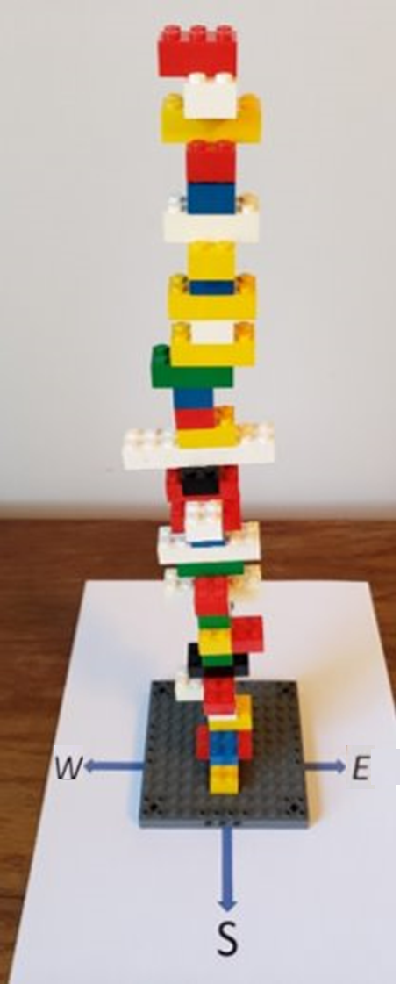
Teamwork Exercise: Build the Tallest Tower
Introduction
Rules:
Each block must be the right color, length (based on rows of knobs), and direction (N-S or E-W).
Each team member should have one role:
Assembler: Builds the tower based on instructions from three Guides.
Color, Length, and Direction Guides: Share information with the Assembler:
Each Guide can ONLY share one type of information—color, length, or direction.
Checker: Confirms correct color, length, and direction of each block before the next can be assembled:
Can ONLY say “correct” or “incorrect.”
Each group will have 1 minute to organize and 2 minutes to build their tower.

Slide 4
Teamwork Exercise: Discussing Rounds 1 and 2
Introduction
Discussion:
Which team had the highest tower in Rounds 1 and 2?
What allowed the winning teams to go fast?
What communication strategies helped groups get faster in Round 2?
What made doing the exercise as part of a virtual team more challenging?

Slide 5
Teamwork Exercise: Conclusions
Introduction
Conclusions:
All complex activities (especially patient care) depend on teams whose members have unique knowledge and skills.
Teamwork can be fun, improve with practice, and benefit from specific strategies covered in the TeamSTEPPS training.

Slide 6
Introduction Section: Learning Objectives
Introduction
Describe the TeamSTEPPS training course.
Describe the impact of errors and why they occur.
Describe the TeamSTEPPS framework.
State the outcomes of the TeamSTEPPS framework.

Slide 7
Course Agenda
Introduction
Day 1:
Introduction
Module 1—Communication
Module 2—Team Leadership
Module 3—Situation Monitoring
Module 4—Mutual Support
Putting It All Together
Day 2:
Should you implement TeamSTEPPS?
Are you ready?
Is there a measurable problem?
How to implement TeamSTEPPS
Change management
Coaching
Implementation planning
Workshops
Coaching
Implementation
Practice teaching

Slide 8
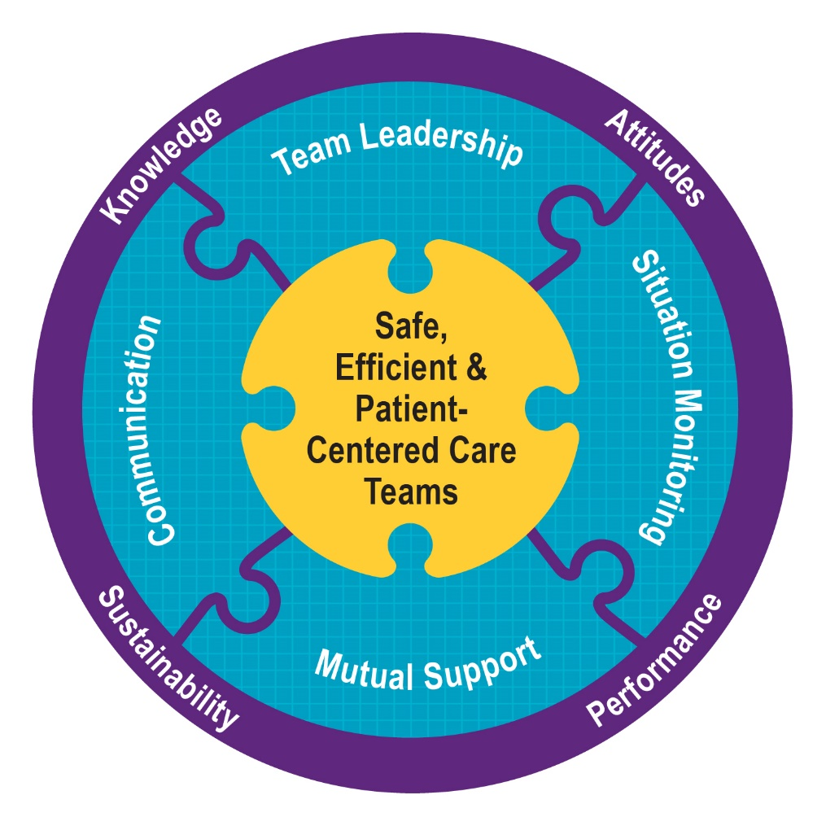
Day 1 – Core Teamwork Skills
Introduction

Slide 9
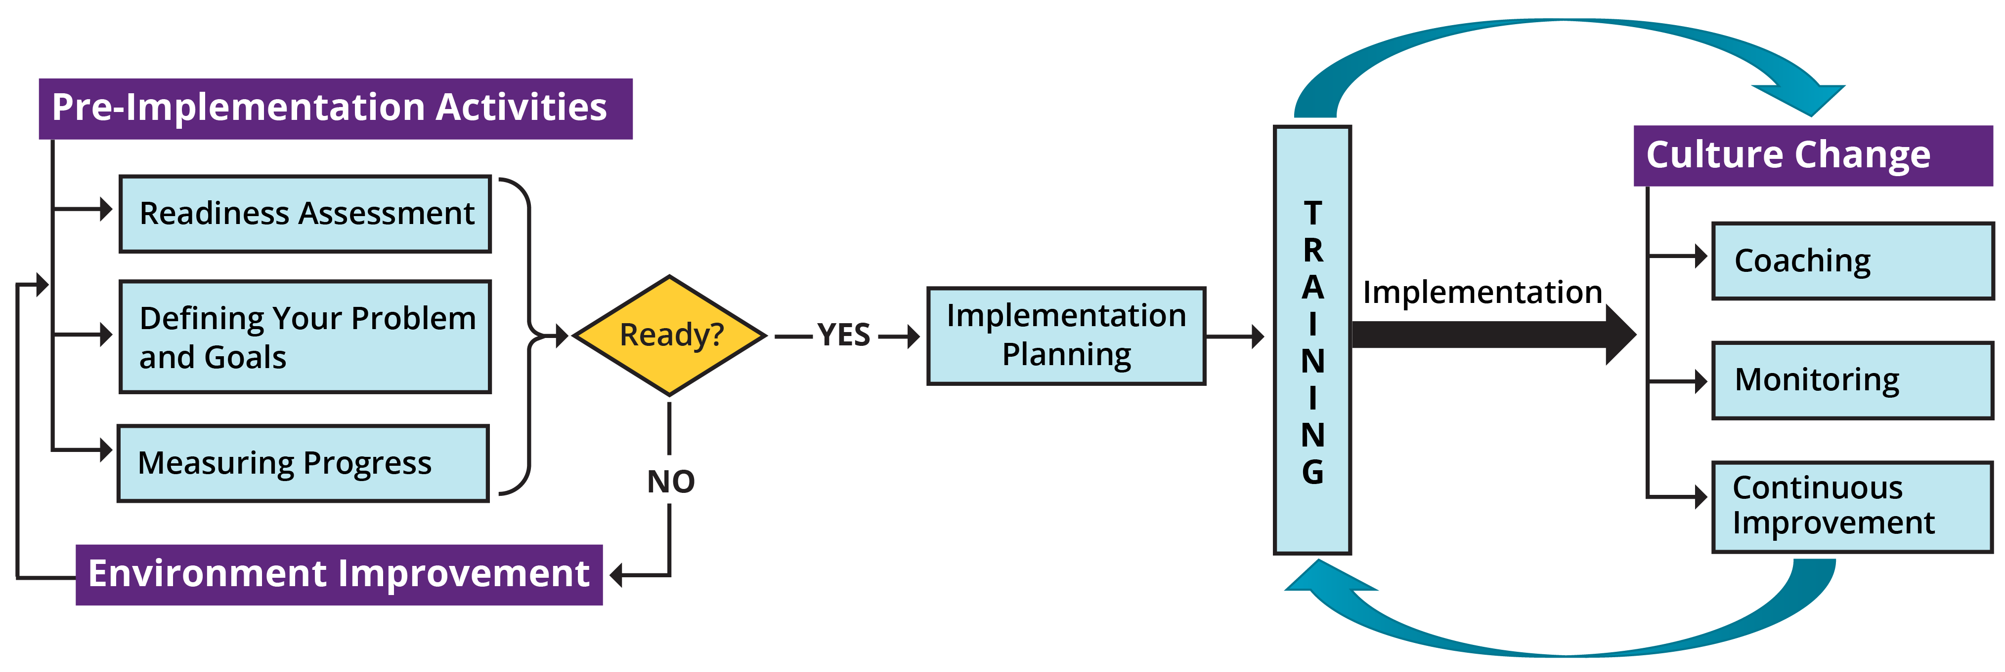
Day 2 – Plan, Implement, Sustain
Introduction

Slide 10
Trainer and Learner Resources
Introduction
Resources on the AHRQ TeamSTEPPS website:
A Pocket Guide and downloadable Pocket Guide app
Welcome Guides for TeamSTEPPS users (e.g., patients, frontline staff, trainers)
Resources for each module:
Section 1: A quick overview (what is contained in the Pocket Guide)
Section 2: Explanations of key concepts and tools
Section 3: Resources for people teaching TeamSTEPPS
Section 4: Implementation resources
Video examples and training units that are embedded into the four modules
Evidence related to TeamSTEPPS
PowerPoint slides for trainings
PDF versions of instructional and implementation resources frequently printed

Slide 11
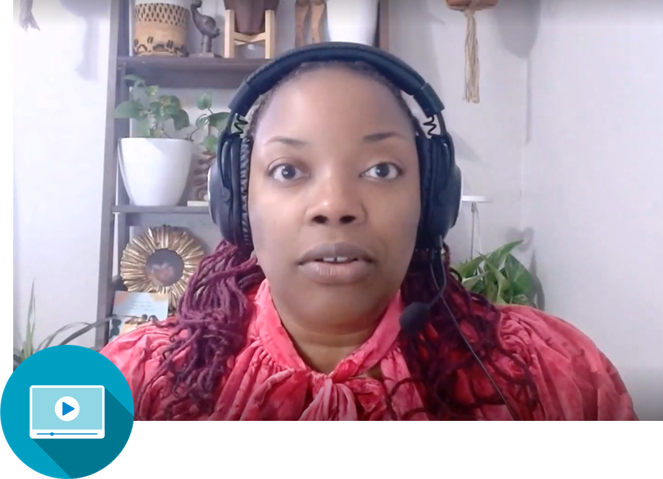
Patient Story Video
Introduction
What breakdowns in teamwork did you observe?
How could effective teamwork help protect and support patients and families?
How does being part of low- and high-performing teams impact your own well-being and job satisfaction?

Slide 12
Barriers to Team Performance
Introduction
Team membership that frequently changes
Lack of involvement of the patient and possibly their family or caregivers
Lack of time
Lack of information sharing
Hierarchy
Defensiveness
Conventional thinking
Varying communication styles
Conflict
Lack of coordination and followup
Distractions
Fatigue
Workload
Misinterpretation of cues
Lack of role clarity

Slide 13
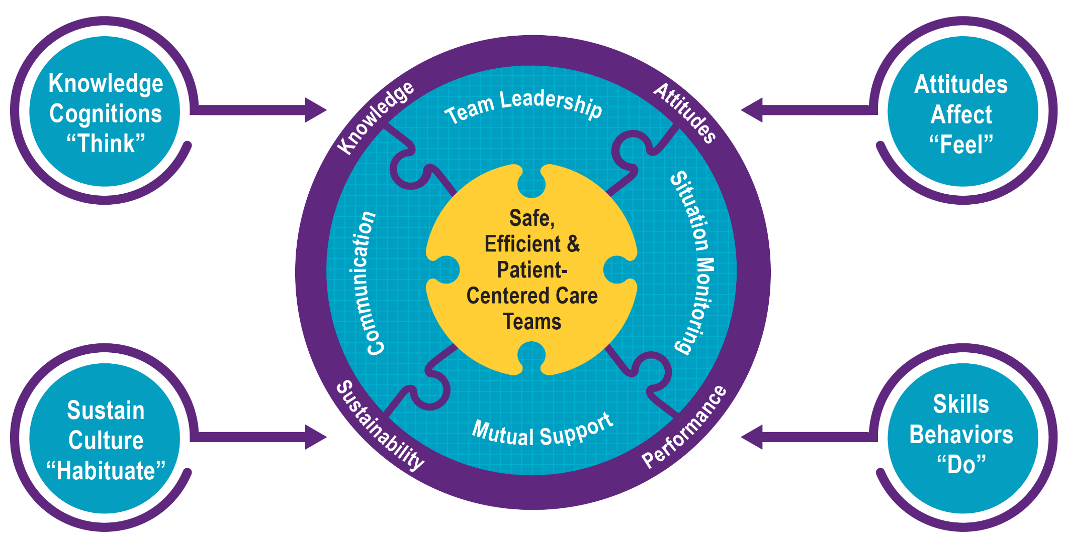
What Makes Up Team Performance?
Introduction

Slide 14
Outcomes of Team Competencies
Introduction
Knowledge
Shared Mental Model
Sustainability
Habits
Enduring Culture of Safety
Aligned Incentives
Attitudes
Mutual Trust
Team Orientation
Performance
Adaptability
Accuracy
Productivity
Efficiency
Safety
High Reliability

Slide 15
High-Performing Teams
Introduction
Teams that perform well:
Hold shared mental models.
Have clear roles and responsibilities.
Have a clear, valued, and shared vision.
Optimize resources.
Have strong team leadership.
Engage in a regular discipline of feedback.
Develop a strong sense of collective trust and confidence.
Create mechanisms to cooperate and coordinate.
Manage and optimize performance outcomes.
(Salas, et al., 2004)

Slide 16
Evidence That TeamSTEPPS Works
Introduction

Slide 17
Applying TeamSTEPPS Exercise
Introduction
What is the safety issue your organization is facing that is linked to a teamwork problem?
How is this problem affecting patient safety and the staff on teams caring for them?

