Slide 1
Situation Monitoring
Module 3

Slide 2
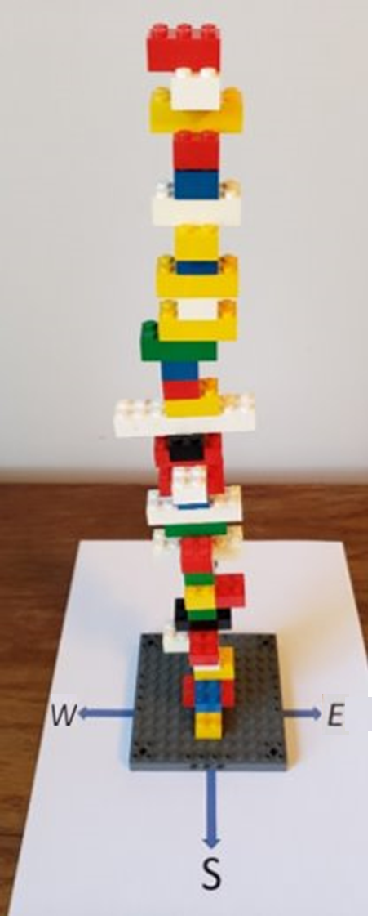
Situation Monitoring Exercise: Rebuild Your Tower
Situation Monitoring
Rules:
Same goals and rules as the earlier tower building exercise except one BIG change:
The Color Guide cannot speak or write the name of any color.
The Length Guide cannot speak or write any number.
The Direction Guide cannot speak or write “north,” “south,” “east,” or “west.”
Your group will have 1 minute to plan and 2 minutes to build your tower.

Slide 3
Situation Monitoring Exercise: Discuss Rebuilding Your Tower
Situation Monitoring
Discussion:
Why was this round harder?
What strategies did you use to communicate effectively as a group?
What challenges confronting people with limited English proficiency does this exercise highlight?
What situation monitoring concepts and tools does this exercise illustrate?

Slide 4
Objectives
Situation Monitoring
Understand how situation monitoring affects team processes and outcomes.
Explain situation awareness and identify approaches to maximize it.
Define a shared mental model and how it is cultivated within a team.
List components of STEP and other mnemonic tools.

Slide 5
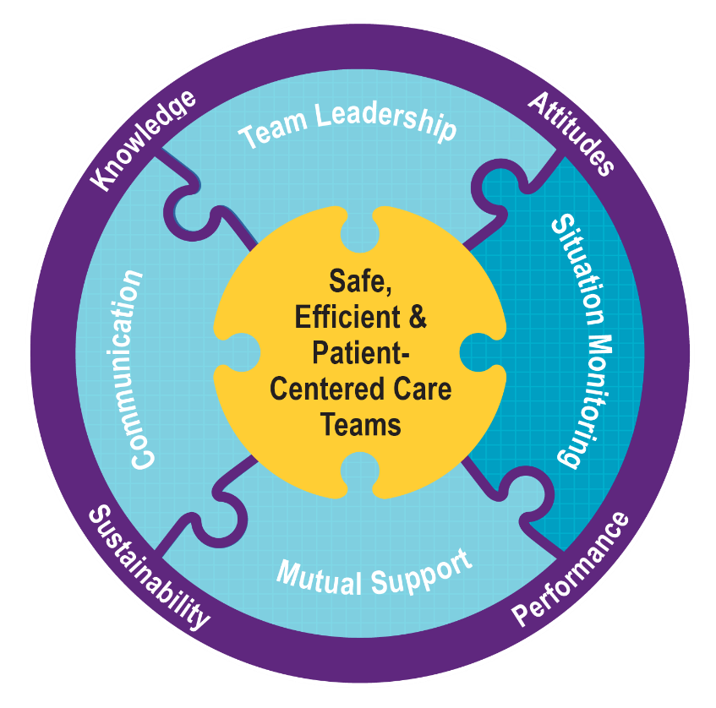
Situation Monitoring…
Situation Monitoring
Ensures new or changing information is identified for communication and decision making.
Leads to effective support of fellow team members.

Slide 6
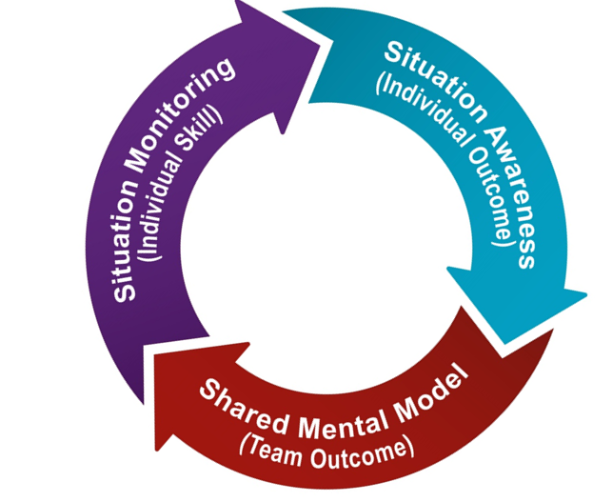
Situation Monitoring: A Continuous Process
Situation Monitoring

Slide 7
Situation Awareness Is…
Situation Monitoring
The state of knowing the current conditions affecting one’s work.
It includes knowing…
Status of the patient.
Status of other team members.
Environmental conditions.
Current progress towards goals.

Slide 8
Situation Awareness Small Group Discussion
Situation Monitoring
Goal:
Identify factors that promote and prevent situation awareness.
Process:
In your group, compile a list of factors that affect situation awareness in your team.
Create a list of ways other team members help or hurt your situation awareness.
Discuss what group members do to help get and share information with patients to foster situation awareness.

Slide 9
Conditions That Maximize Situation Awareness
Situation Monitoring
When team members:
Share information with the team
Request information from others
Direct information to specific team members
Include patient or family in communication
Use resources fully (e.g., status board, automation)
Maintain documentation
Know and understand where to focus attention
Know and understand the plan
Inform team members when the plan has changed

Slide 10
How Shared Mental Models Help Teams
Situation Monitoring
Lead to mutual understanding of situation
Lead to more effective communication
Enable backup behaviors
Help ensure understanding of each other’s roles and how they interplay
Enable better prediction and anticipation of team needs
Create commonality of effort and purpose

Slide 11
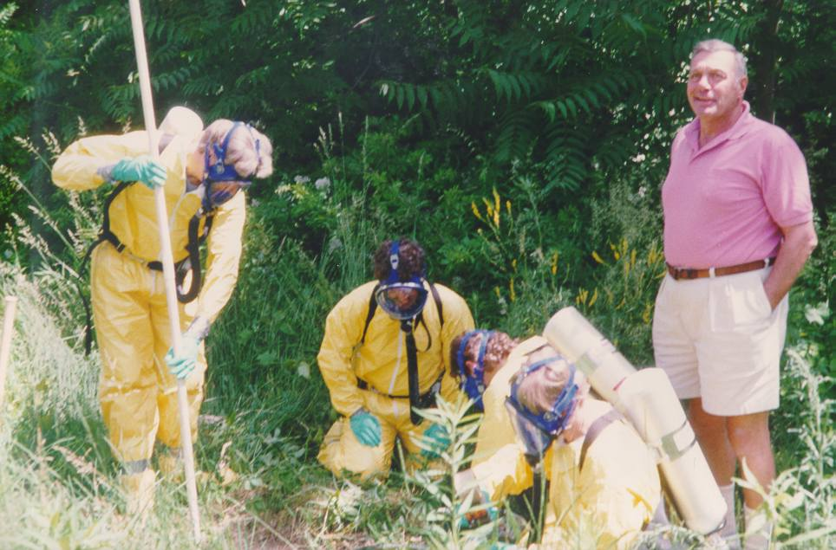
A Shared Mental Model Is…
Situation Monitoring
The perception of, understanding of, or knowledge about a situation or process that is shared among team members through communication.
Who Lacks the Shared Mental Model?

Slide 12
What Do You See?
Situation Monitoring

Slide 13
When and How To Share?
Situation Monitoring
When:
Briefs
Huddles
Debriefs
Transitions in care
How:
SBAR
Call-outs
Check-backs

Slide 14
Tools To Support Situation Monitoring
Situation Monitoring
Tool | Primary Use
STEP | Patient Status
I’M SAFE | Team Member Status
Cross-Monitoring | Status of Environment and Other Team Members
STAR | Status of Specific Activities or Tasks

Slide 15
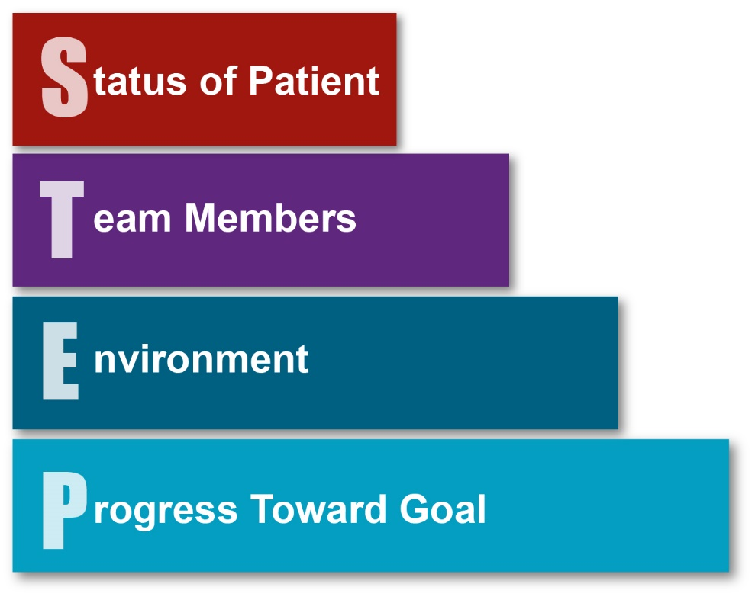
Status of Patient
Situation Monitoring
Patient History
Vital Signs
Medications
Physical Exam
Plan of Care
Psychosocial Condition
Patient Preferences or Concerns
If Patient Has Limited English Proficiency

Slide 16
Team Members
Situation Monitoring
Fatigue
Workload
Task Performance
Skill Level
Stress Level

Slide 17
Environment
Situation Monitoring
Facility information, including occupancy levels
Administrative information and available staff
Human resources
Triage acuity
Community or facility disease outbreaks
Equipment status

Slide 18
Progress Toward Goal
Situation Monitoring
Call a Huddle!
Status of Team’s Patients
Goal of Team
Tasks/Actions That Are or Need To Be Completed
Plan Still Appropriate

Slide 19
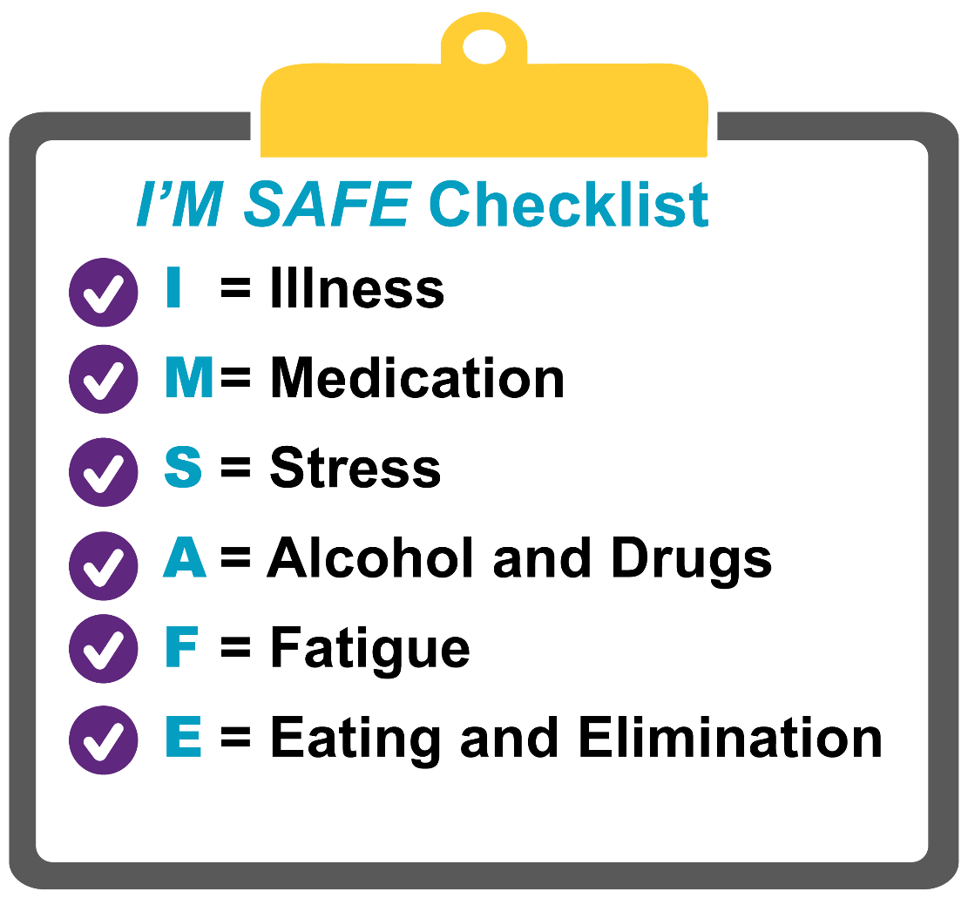
Tools for Situation Monitoring: I’M SAFE Checklist
Situation Monitoring

Slide 20
Tools for Situation Monitoring: Cross-Monitoring
Situation Monitoring
What it is:
“Watching each others’ back” to ensure team members’ actions are consistent with the plan and advocating for the patient as needed when risks arise and help is needed.
Why it matters:
The plan may be unclear or misunderstood.
The plan may be forgotten or changed.
When plans are unclear or not implemented, a shared mental model is lost and patients are at risk.
How to do it:
Make monitoring each other a group norm that’s expected and not a sign of mistrust.
Encourage asking questions to confirm that actions match the plan.
Express concerns when actions aren’t consistent with the plan.
Involve the patient whenever relevant.

Slide 21
Cross-Monitoring Example
Situation Monitoring
What actions by the nurse manager demonstrated cross-monitoring?
Would your teams respond positively to the use of cross-monitoring by its members?

Slide 22
Tools for Situation Monitoring: STAR
Situation Monitoring
What it is:
A four-step mnemonic tool that is used extensively to elicit and share key information about activities and their consequences.
Key elements include:
Stop: Pause to focus on the immediate task.
Think: Think methodically and identify the correct action.
Act: Perform the act.
Review: Confirm anticipated result has occurred or apply contingency if required.
Practice example:
Pick a task you were asked to perform by a family member or friend in the past month that didn’t quite go as planned. Use STAR to explain what you did and what you could have done differently to have achieved a better outcome.

Slide 23
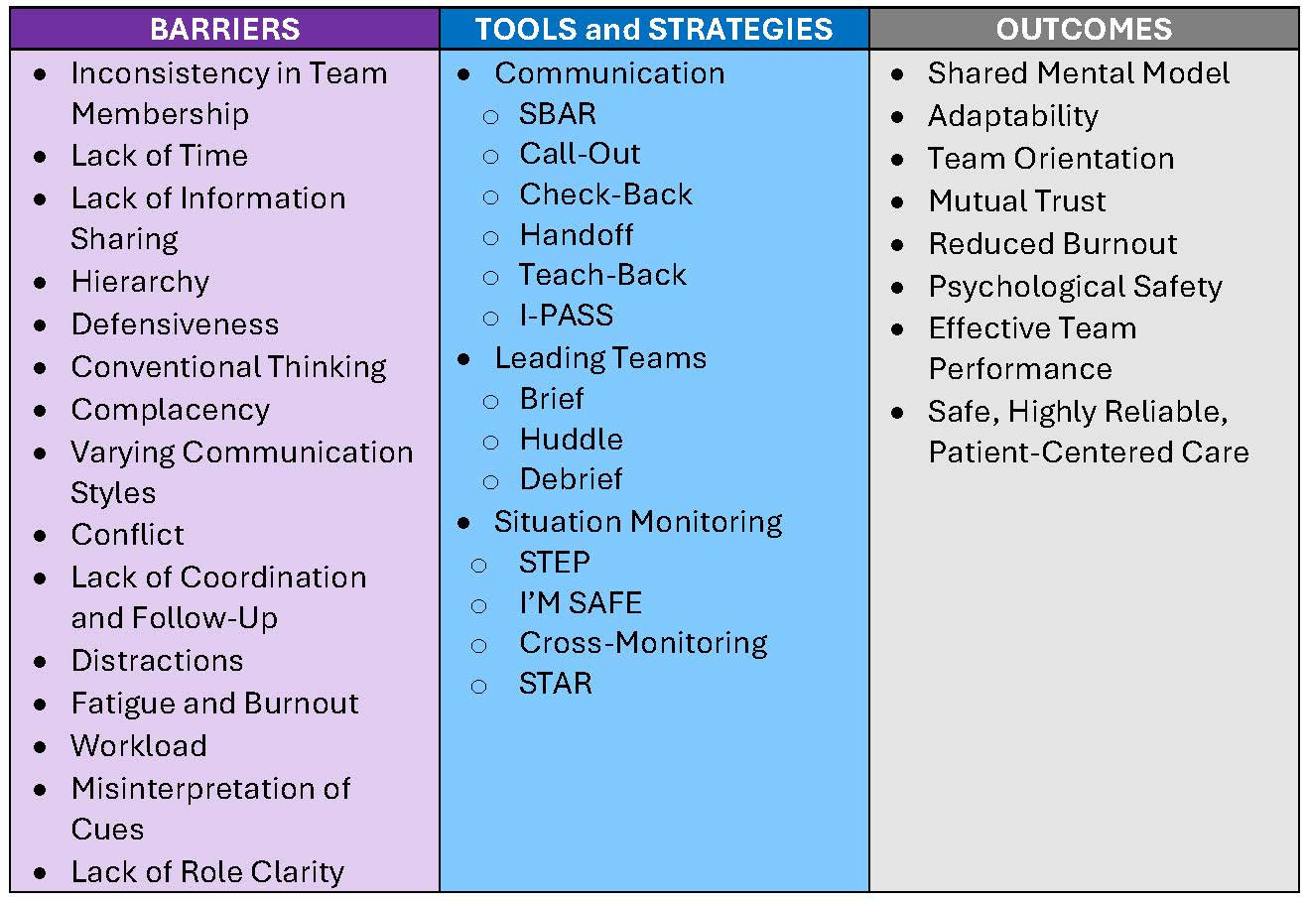
Tools and Strategies Summary
Situation Monitoring

Slide 24
Applying TeamSTEPPS Exercise
Situation Monitoring
Is your teamwork issue related to the team’s or individuals’ situation monitoring skills?
If yes, what is the situation monitoring issue?
Which situation monitoring tools or strategies might you consider implementing to address the issue?

